Slide 1
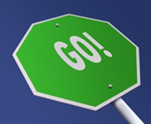
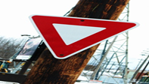
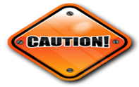
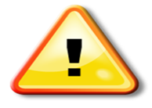
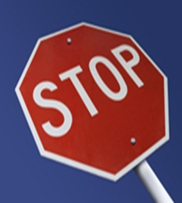
Potential Application of Wallet Card for Radiation Zones to Inspection Team Health and Safety Protection in Inspection Areas
[AL-SALHY SALWA ]
Radiation Protection Center (RPC) / Ministry Of Environment / Iraq
P4.5-786
Radiation Zones – wallet card
Zones | Notes | Radiation Field | Contamination | Controls
Background |  | <0.2 µSv/hr | none | none
Safe |  | <0.2 µSv/hr | none | none
Low |  | >2 x Bkg <10 µSv/hr | low | Pre-work planning; ALARA controls
Medium |  | >10 µSv/hr <1 mSv/hr | medium | Pre-work planning; ALARA controls; consult H&S team
High |  | >1<10 mSv/hr | high | Pre-work planning; ALARA controls, H&S team approval; written work plan
Very High |  | >10 mSv/hr | very high | Pre-work planning; ALARA controls; H&S team & IA TL approval: written work plan; DG authorization
The wallet card prepared and designed for inspection teams health and Safety to maintain the radiation doses of an inspection team on-site within ALARA principle to reduce the potential doses of radiation and radioactive Materials .
for more information about wallet card - Radiation Zones please visit my e- poster( P4.5-786 AL-SALHY ) at CTBTO:SnT2023

