Slide 1
On-Site Inspection: Inspected State Party Perspectives towards Successful Inspection
Nalin de Silva
Geological Survey and Mines Bureau, Sri Lanka
ISP is having an obligation to assist the OSI Inspectors as of the Treaty.
The behavior of the ISP in different scenarios, which an has not been thoroughly analyzed that may lead into successful inspection outcome
Analysis of possible behavioral patterns of the OSI as of the potential three Scenarios:
S1.Natural event that resembles a UNE
S2. Nuclear accident
S3. Nuclear test by violating the Treaty
The following is expected as results:
S1: Full co-operation
S2: Partial / full co-operation
S3: Lack of co-operation
Training of Inspectors to identify and analyze the behavioral patterns of the ISP, for different scenarios, would be an added advantage towards a success of the On-Site Inspection.
Please do not use this space, a QR code will be automatically overlayed
P4.5-627

Slide 2
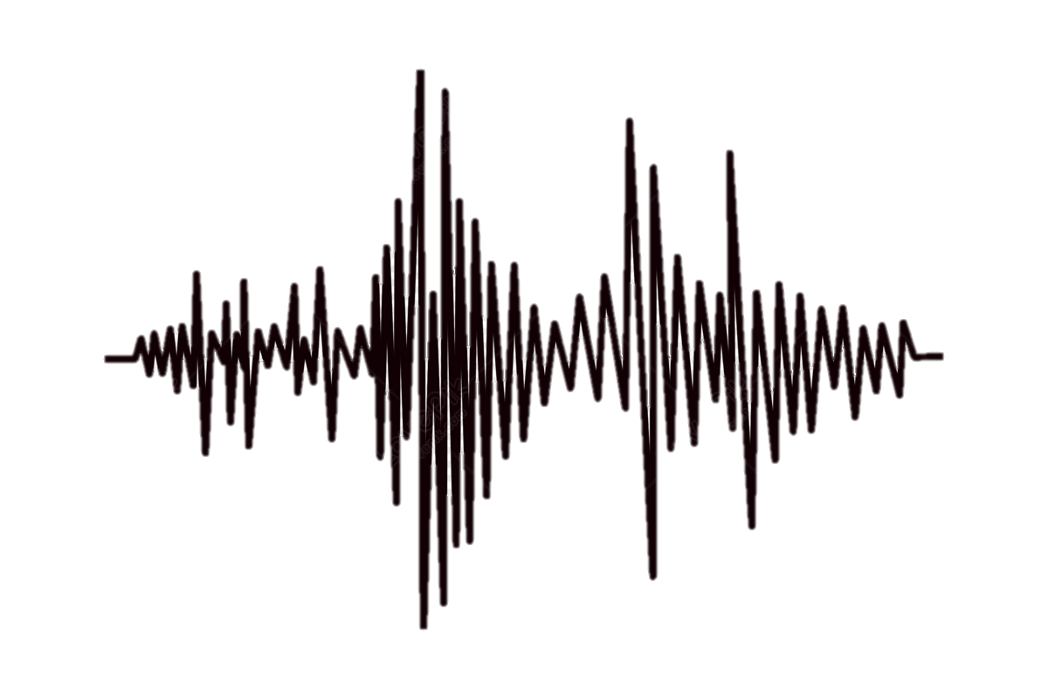
Introduction: ISP perspectives as of different scenarios
ISP shall have the right and obligation to make every reasonable effort to demonstrate its compliance with CTBT (Article IV, Para:57).
Considered the nature of the OSI, the ISP representatives engage thoroughly with the Inspection Team (IT) throughout the inspection activities.
As of the scenarios which the inspection is initiated, the behavior of the ISP expected to vary with different degree of co-operation.
Please do not use this space, a QR code will be automatically overlayed
P4.5-627

Slide 3
Objectives
To analyze the behavioral pattern of the ISP as of different scenarios to develop a method that enables to guide the Inspection Team towards the factual situation which the OSI is called for.
Please do not use this space, a QR code will be automatically overlayed
P4.5-627

Slide 4
Methods/data
Analysis of possible behavioral patterns of the OSI as of the potential three Scenarios:
S1. Natural event that resembles a Underground Nuclear Explosion (UNE).
S2. Nuclear accident with emission of particles to the environment
S3. Nuclear test by violating the Treaty
Analysing Criteria
Efficiency at POE
Degree of local facilities provided
Level of access granted
Responding time for requests
Level of allowed NTM assistance
Please do not use this space, a QR code will be automatically overlayed
P4.5-627

Slide 5
Results ( hypothetically expected)
SNERIO | Analysed Criterion | Level of Cooperation | Remarks
S1 | Efficiency at POE Degree of local facilities provided Level of access granted Responding time for requests Level of allowed NTM assistance | High | Both ISP and IT are driven by a single objective
S2 |  | Medium High | ISP may required to prevent leaking information on such accidents due to “national pride”
S3 |  | Low? | Violation of the treaty and concealment is expected
Please do not use this space, a QR code will be automatically overlayed
P4.5-627

Slide 6
Conclusion
Conclusion:
In violation of the Treaty, once Entry Into Force (EIF) the behavior of the ISP would be peculiar with a minimum degree of cooperation. In such a situation the ISP is destined to hinder the OSI while adhering to the minimum Treaty obligations.
Recommendation:
Training of Inspectors to identify and analyze the behavioral patterns of the ISP, for different scenarios, would be an added advantage towards a success of the On-Site Inspection.
Please do not use this space, a QR code will be automatically overlayed
P4.5-627

Slide 7
References
Comprehensive Nuclear-Test- Ban Treaty
Model Text for the Draft OSI Operational Manual , 2013
On-Site Inspection Test Manual , CTBT/WGB/TL-18/30, 2006
Commentary on National Implementation Measures for On-site Inspections under the Comprehensive Nuclear-Test-Ban Treaty (CTBT), Legal Service Section, Preparatory Commotion for the CTBT, 2013
Please do not use this space, a QR code will be automatically overlayed
P4.5-627

