Slide 1
EFFORTS, CHALENGES AND WAY FORWARD FOR THE CTBT ENTERING INTO FORCE
Ibrahim Abdulmajeed
Nigerian Nuclear Regulatory Authority
Place your institution logo here
(remove this text box)
An effective response to the threats & challenges of the 21st century can only be achieved through the coordinated efforts of the international community, through the UN and international law. The CTBT has important role, however this role has been hampered because inability of the Treaty to enter into force.
To ensure innovative & focused approach to advance the CTBTs ratification by the remaining Annex 2 States , some of the following efforts were made: Creation of Group of Eminent Persons, 2013, CTBTO Youth Group ,2016 , CTBTO Fellowship for youths & several diplomatic engagements by the CTBTO Secretariat were made.
I propose that a conference on the Entry into force of the CTBT be organized bi-annually in the affected Annex-2 States until the treaty enters into force , these will create more awareness and some pressure through direct engagement of all national & local stakeholders (Legislative and Executive)
If the treaty enters into force the role of CTBT can not be underestimated, because the current conflicts can jeopardize all historical gains, which may result into another nuclear weapon arms race, these will hamper Global Peace and Security.
Please do not use this space, a QR code will be automatically overlayed
P5.1-037

Slide 2
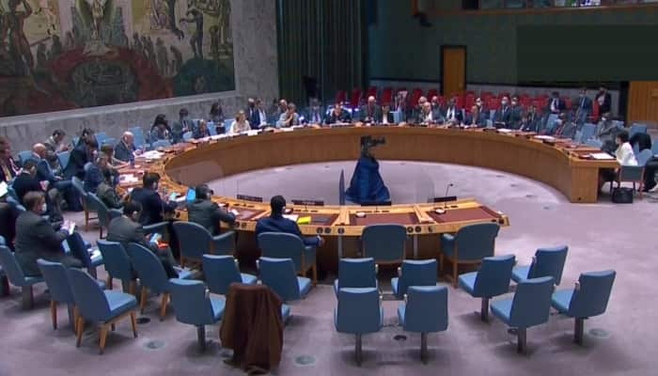
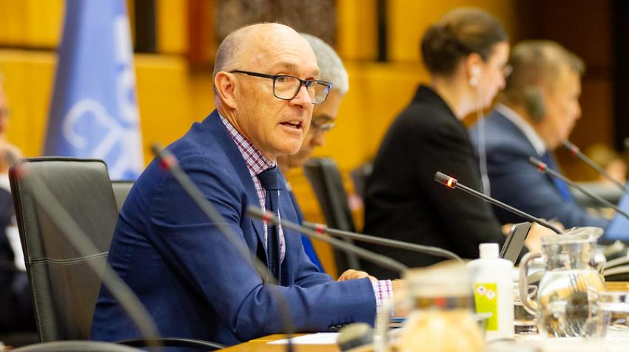
THREATS OF GLOBAL PEACE AND SECURITY
Place your institution logo here after removing this text box!
An effective response to the threats & challenges of the 21st century which include the proliferation of nuclear weapons amongst others can only be achieved through the coordinated efforts of the international community, through the UN and international law. The CTBT has important role, however this role has been hampered because of the inability of 8 Annex 2 States who are yet to sign and ratify the treaty
Please do not use this space, a QR code will be automatically overlayed
P5.1-037

Slide 3
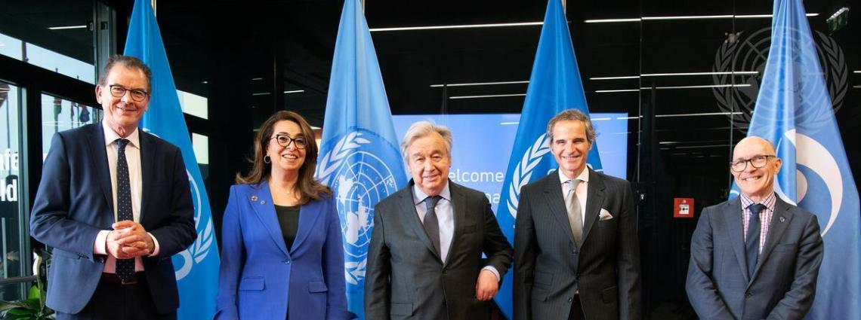
THE TREATY NOT ENTERING INTO FORCE
Place your institution logo here after removing this text box!
The objective of this paper is to highlight some of the efforts and challenges and propose more effective and efficient solution, through engagements of all stakeholders in the affected sates, stakeholders should include think tanks, International Organizations, NGO’s and Government Officials
Please do not use this space, a QR code will be automatically overlayed
P5.1-037

Slide 4
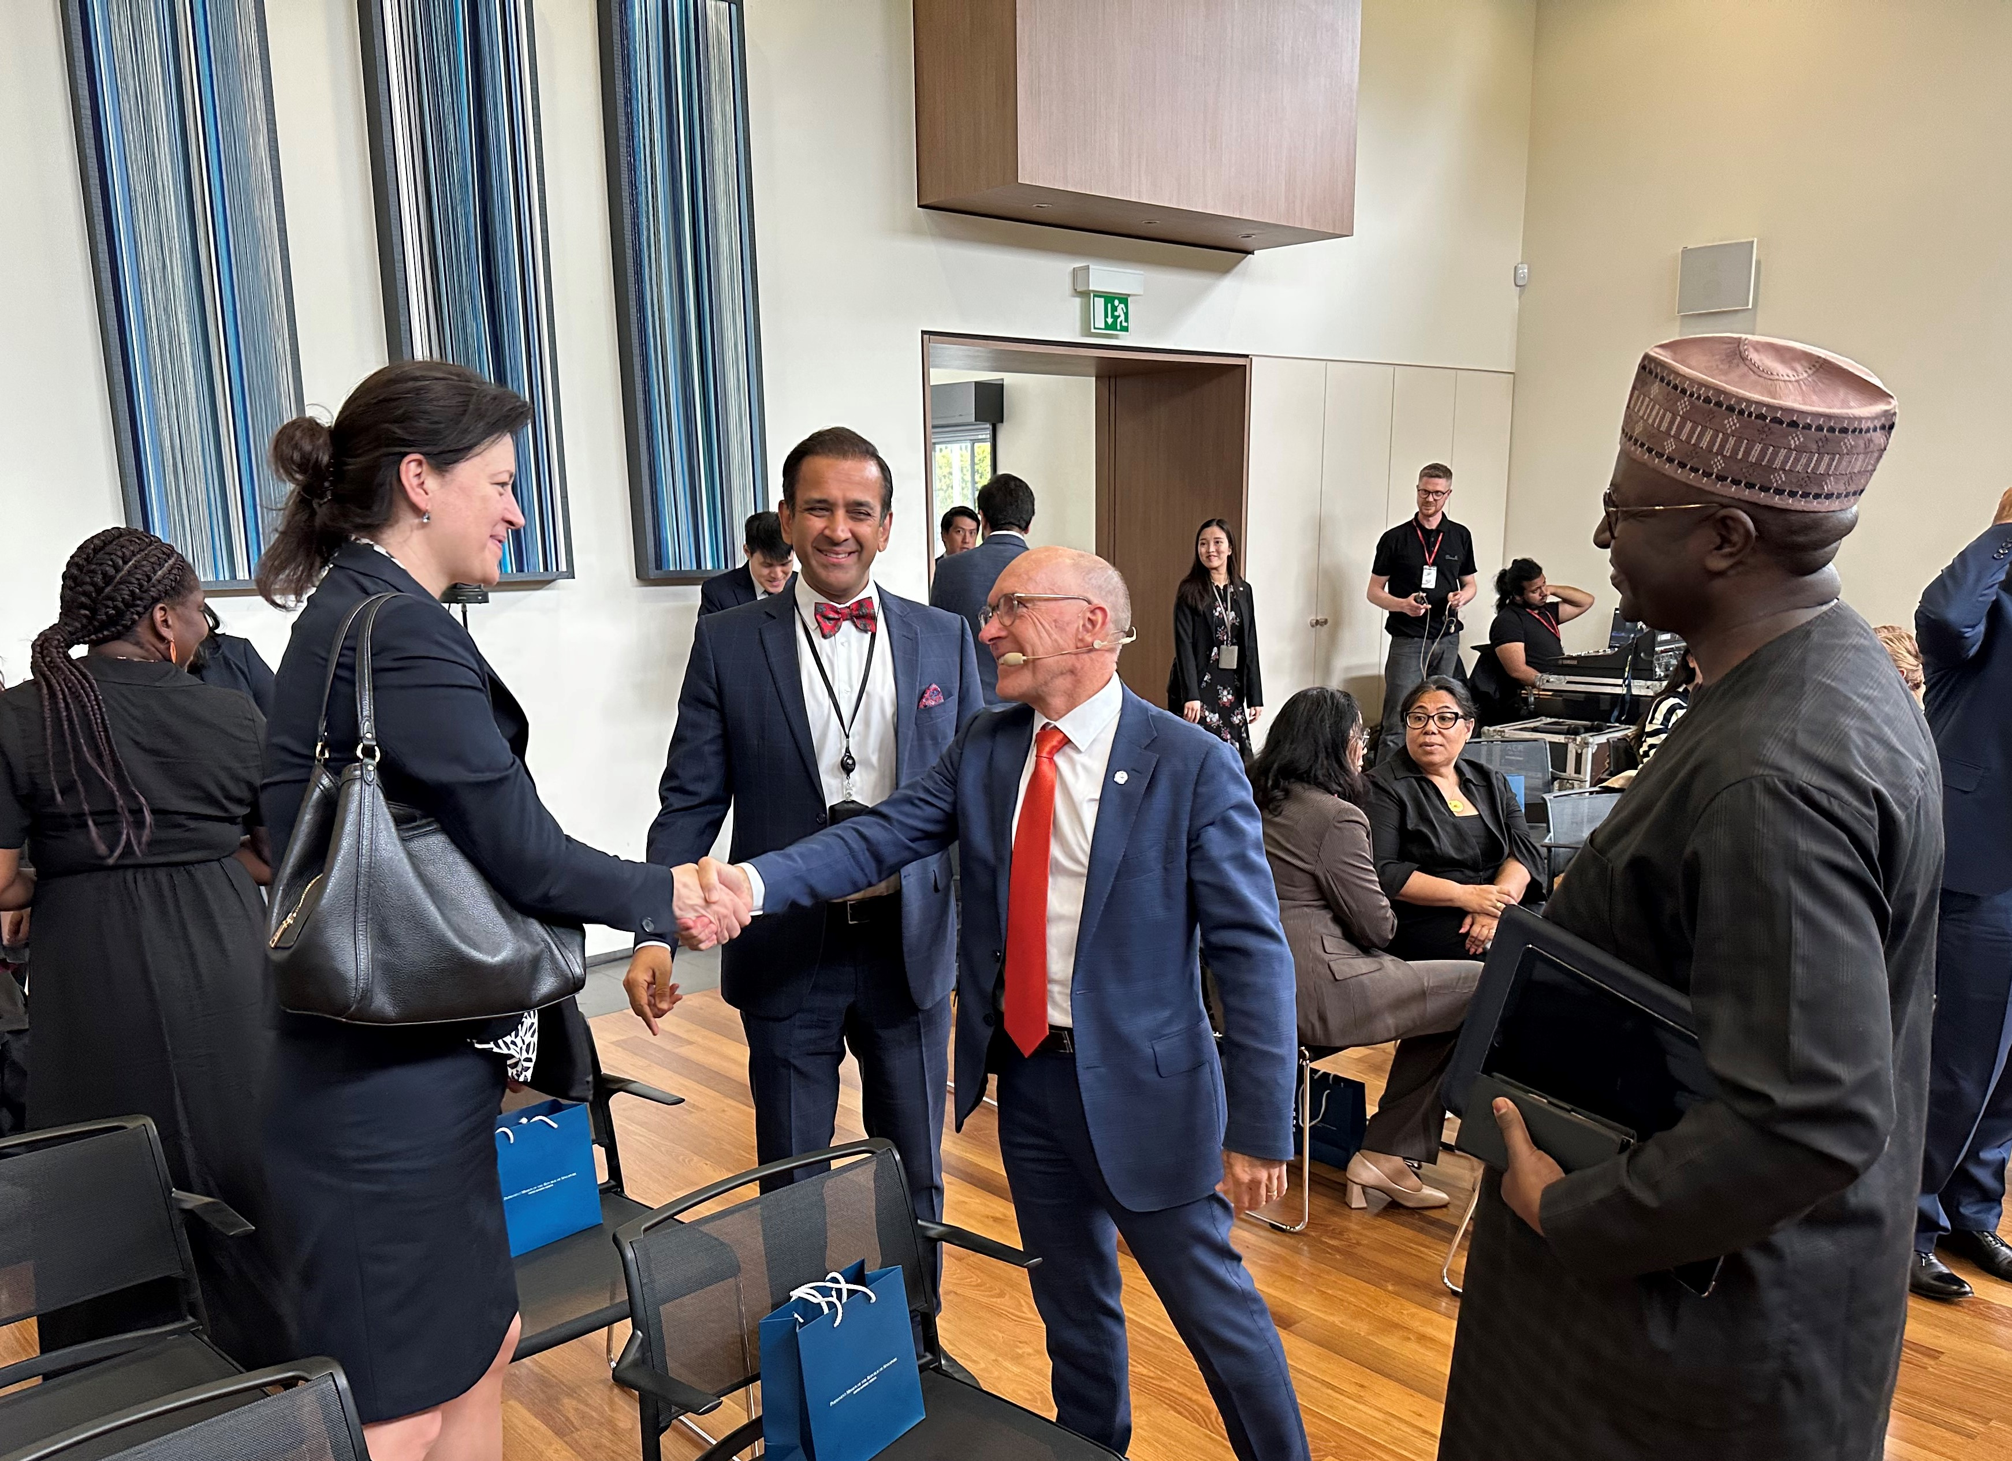
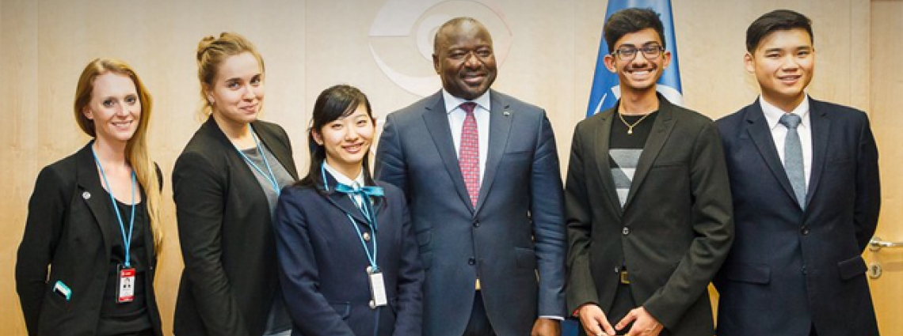
OVERVIEW OF EFFORTS OF THE PST
Place your institution logo here after removing this text box!
To ensure innovative & focused approach to advance the CTBTs ratification by the remaining Annex 2 States , some of the following efforts were made:
Creation of Group of Eminent Persons, New York 2013
Establishment CTBTO Youth Group , Vienna 2016
CTBTO Fellowship for youths
Diplomatic/ Intergovernmental engagements:
Engagement with Civil Society & Groups
Please do not use this space, a QR code will be automatically overlayed
P5.1-037

Slide 5
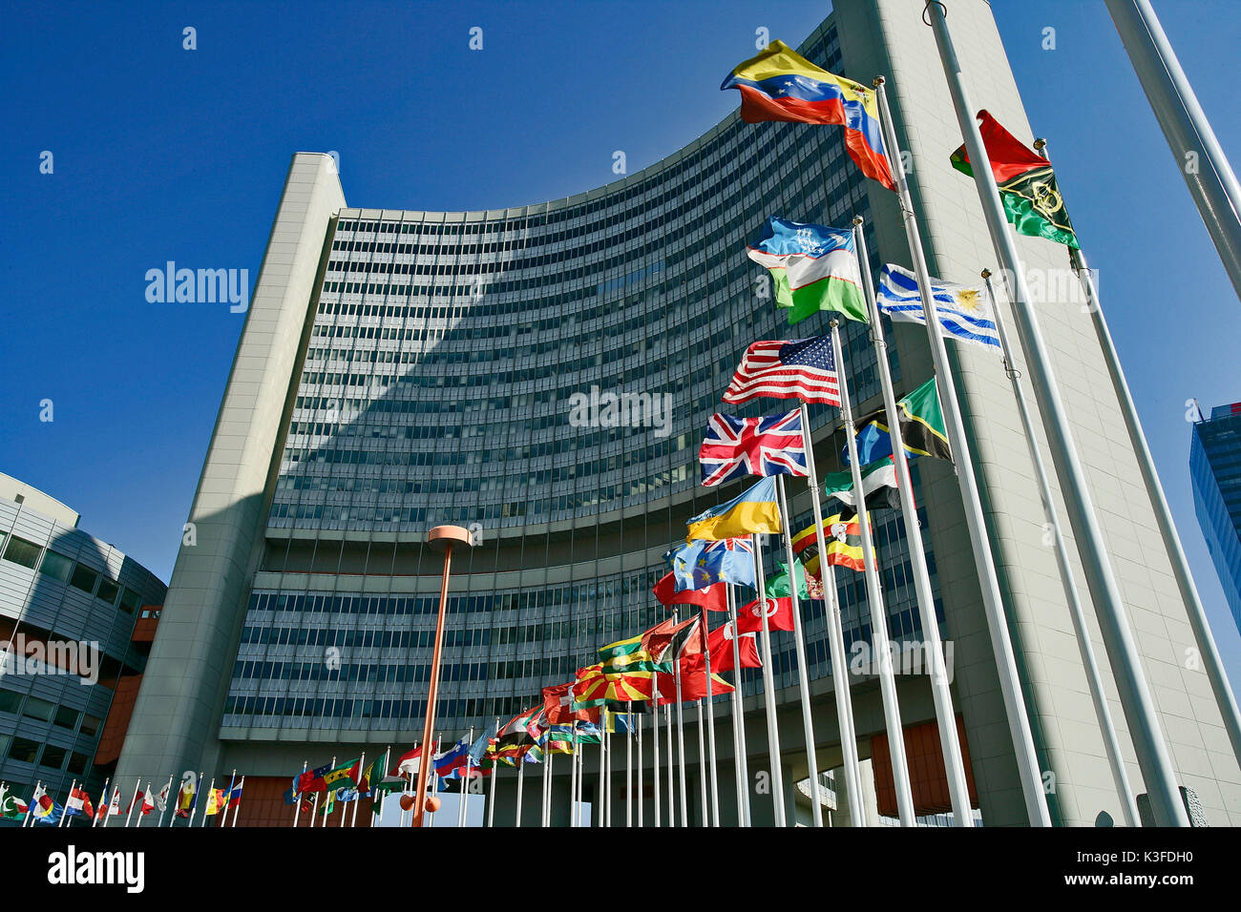
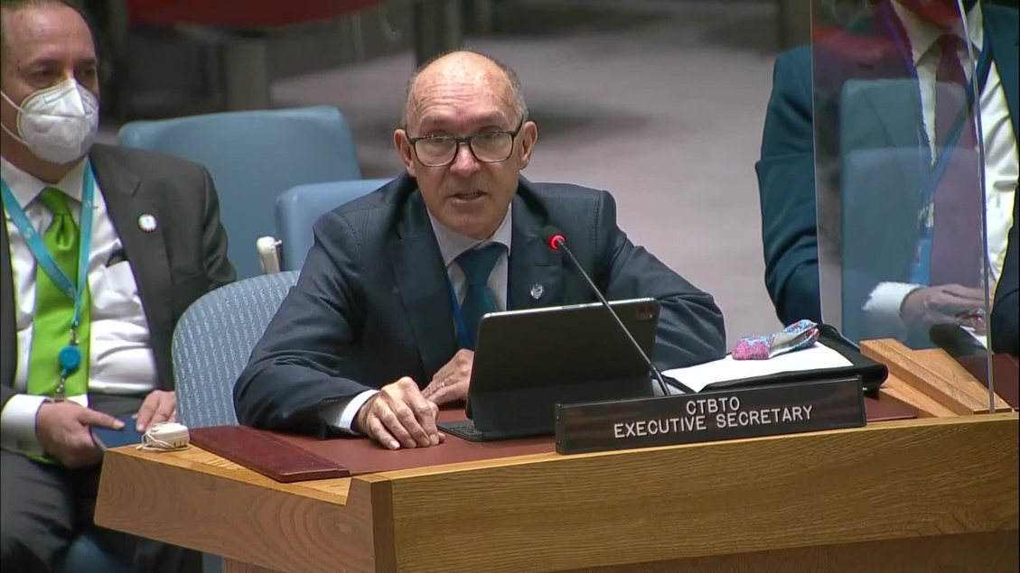
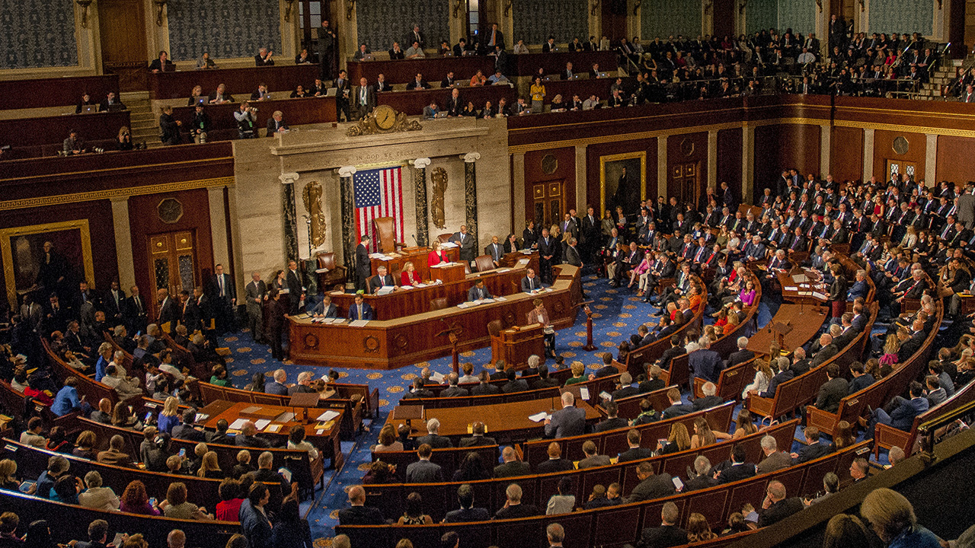
Place your institution logo here after removing this text box!
PROPOSED 4 POINT SOLUTION
I propose that a “Conference on the Entry into force of the CTBT” should be organized bi-annually until the CTBT enters into force.
The venue should be rotated between the remaining eight Annex 2 states, to raise awareness and engage all stakeholders directly at national level i.e. the legislative / parliament and executive arms of government
A desk office be set up at the PST of the CTBTO to propel this agenda
Sustain the momentum of the past & current efforts and initiatives
Please do not use this space, a QR code will be automatically overlayed
P5.1-037

Slide 6
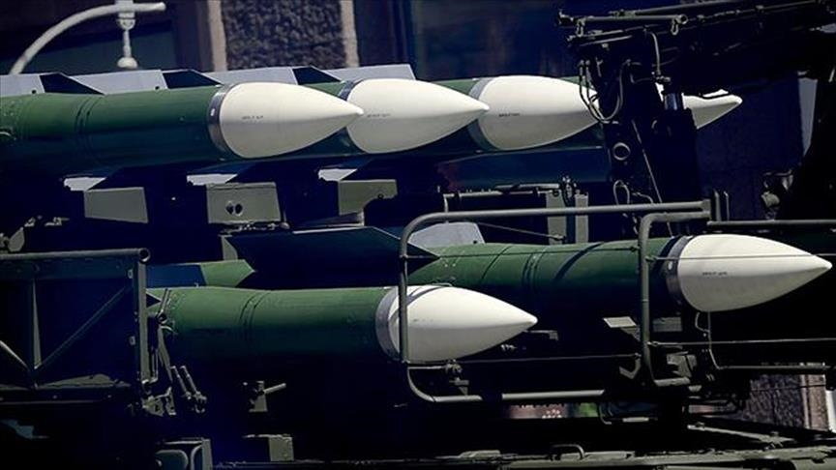
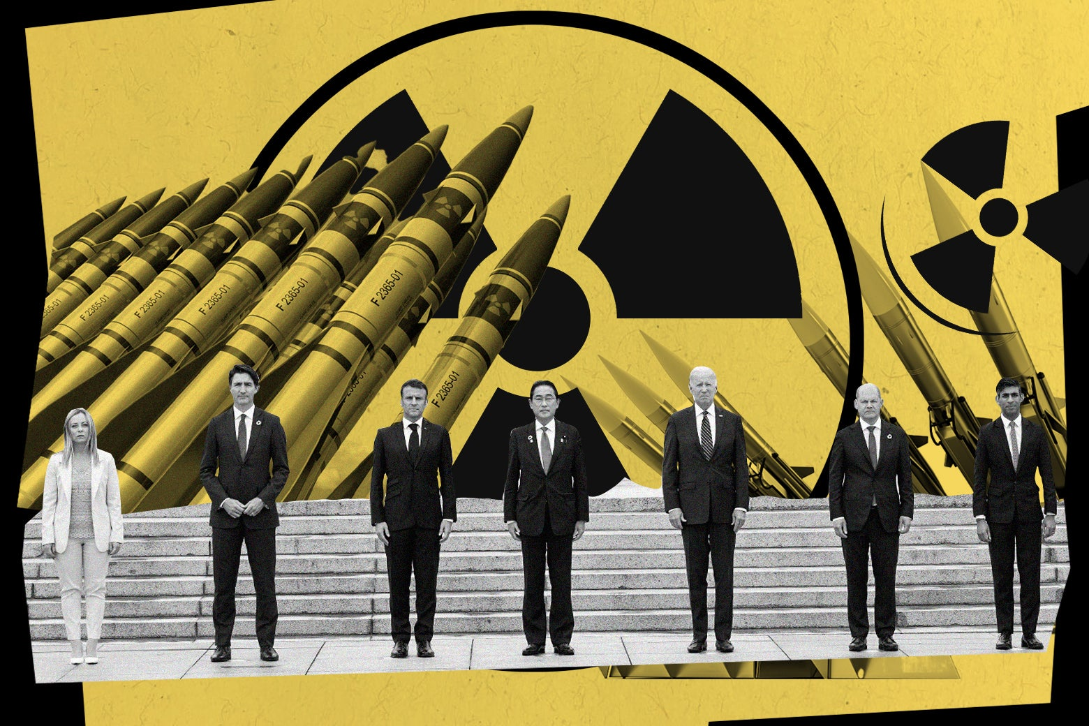
CONCLUSION
Place your institution logo here after removing this text box!
If the treaty enters into force the role of CTBT can not be underestimated, because the current conflicts can jeopardize all historical gains, which may result into another nuclear weapon arms race, this will definitely hamper Global Peace and Security.
Please do not use this space, a QR code will be automatically overlayed
P5.1-037

Slide 7
APPRECIATION
Place your institution logo here after removing this text box!
Please do not use this space, a QR code will be automatically overlayed
P5;1-037

