Slide 1
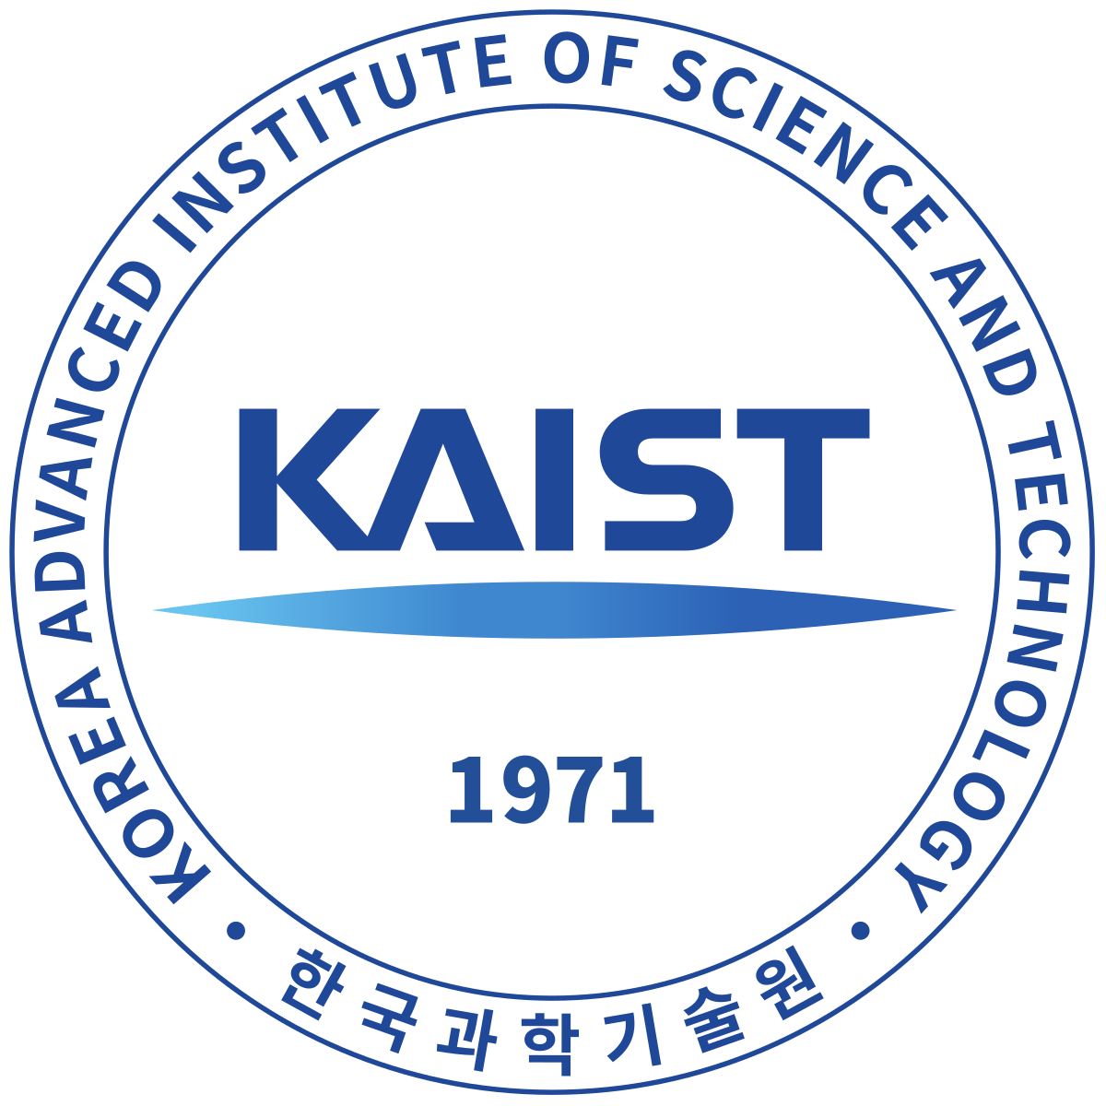
Nuclear Justice Mechanisms: Addressing Nuclear Legacies in Kazakhstan and the Marshall Islands
Kseniia Pirnavskaia
Graduate School of Science and Technology Policy, Korea Advanced Institute of Science and Technology
Communities affected by nuclear testing continue to face a multitude of challenges that have not been adequately addressed, resulting in ongoing injustices.
Mechanisms of justice should be revisited due to the potential resumption of nuclear testing.
A qualitative comparative case study incorporated a diverse dataset, incl. testimonies, hearings, reports, news, and oral history.
The data was analysed using content analysis with a qualitative blended coding approach.
Mechanisms of justice:
acknowledgment, declassification, capacity-building, research, media, liability, compensation, healthcare, environmental remediation, reintegration, international support, grassroots initiatives, international norm, education & empowerment, historical commemoration & arts
Justice mechanisms should be survivor-friendly, survivor-oriented & survivor-inclusive.
Non-traditional approaches like capacity-building, research, arts, education, etc., contribute to addressing the varied social, cultural, emotional, and spiritual needs of survivors.
Please do not use this space, a QR code will be automatically overlayed
P5.1-113

Slide 2
Introduction
Environmental
Gender & Reproductive
Injustices Resulting From Nuclear Testing
Racial
Generational
Information-related
Communities affected by nuclear weapons testing still suffer;
Human costs of nuclear testing:
physical & mental health damage
birth defects
forced displacement
damage to socioeconomic development & social order
social stigma & discrimination
unsafe long-term conditions for habitation
Injustices - not adequately addressed;
Existing security challenges a resumption of nuclear testing;
Please do not use this space, a QR code will be automatically overlayed
P5.1-113

Slide 3
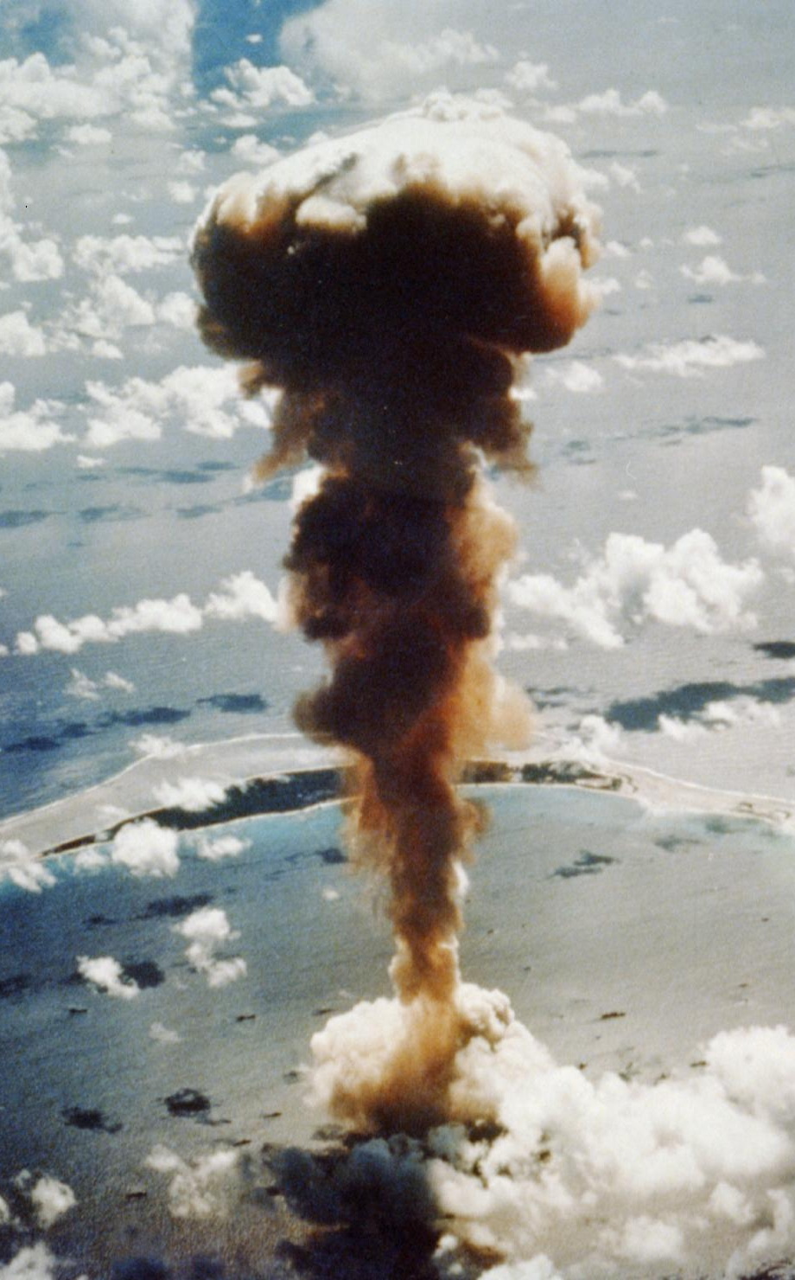
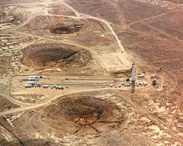
Objectives
Research Questions
Justification for Case Studies
Which instruments are used to address injustices in the context of nuclear weapons testing?
How have they been applied in the US and Soviet Union nuclear testing programs in the Marshall Islands and Kazakhstan?
What are the possible gaps in their applications?
Availability of data
Access to survivors & their testimonies
The largest nuclear testing programmes
Research Design & Theoretical Framework
Theory of transitional justice (TJ) (truth-seeking, prosecution, reparations, & guarantee for non-recurrence through reform)
An additional pillar - memory & commemoration
Feminist approach to TJ
Please do not use this space, a QR code will be automatically overlayed
P5.1-113

Slide 4
Methodology
Data Collection
Data Analysis
testimonies
hearings
government & IO’s reports
scholarship & news articles
conferences field work – notetaking
Nuclear Pep Talk recording
content analysis
qualitative blended coding approach (deductive & inductive)
Qualitative Comparative Case Study
Please do not use this space, a QR code will be automatically overlayed
P5.1-113

Slide 5
Results
Please do not use this space, a QR code will be automatically overlayed
P5.1-113

Slide 6
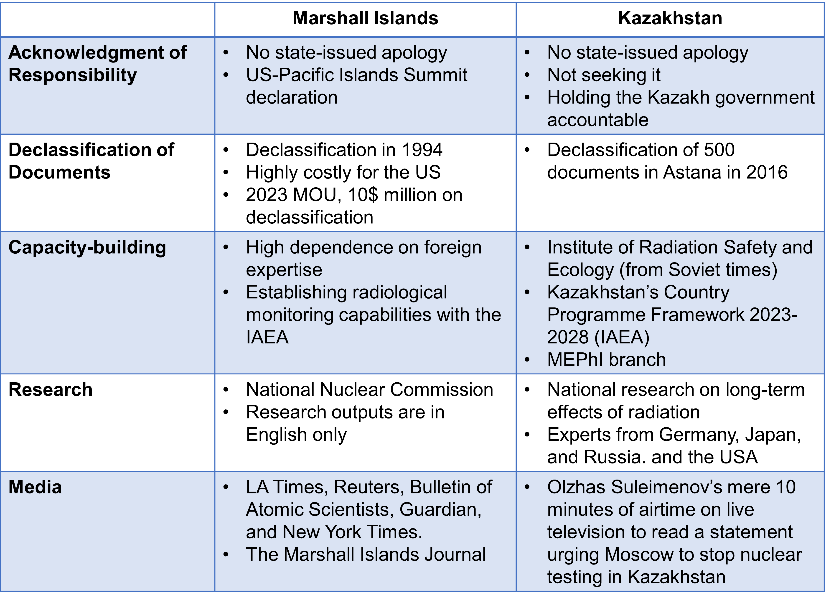
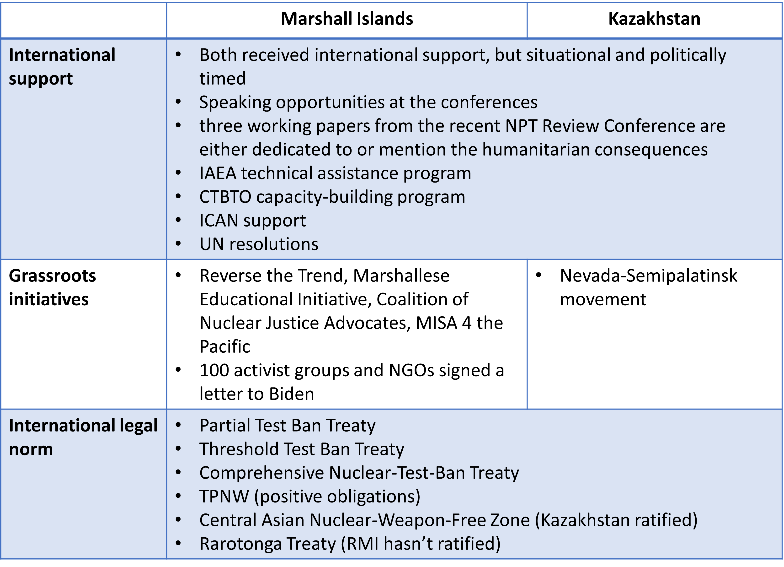
Results (1/2)
Please do not use this space, a QR code will be automatically overlayed
P5.1-113

Slide 7
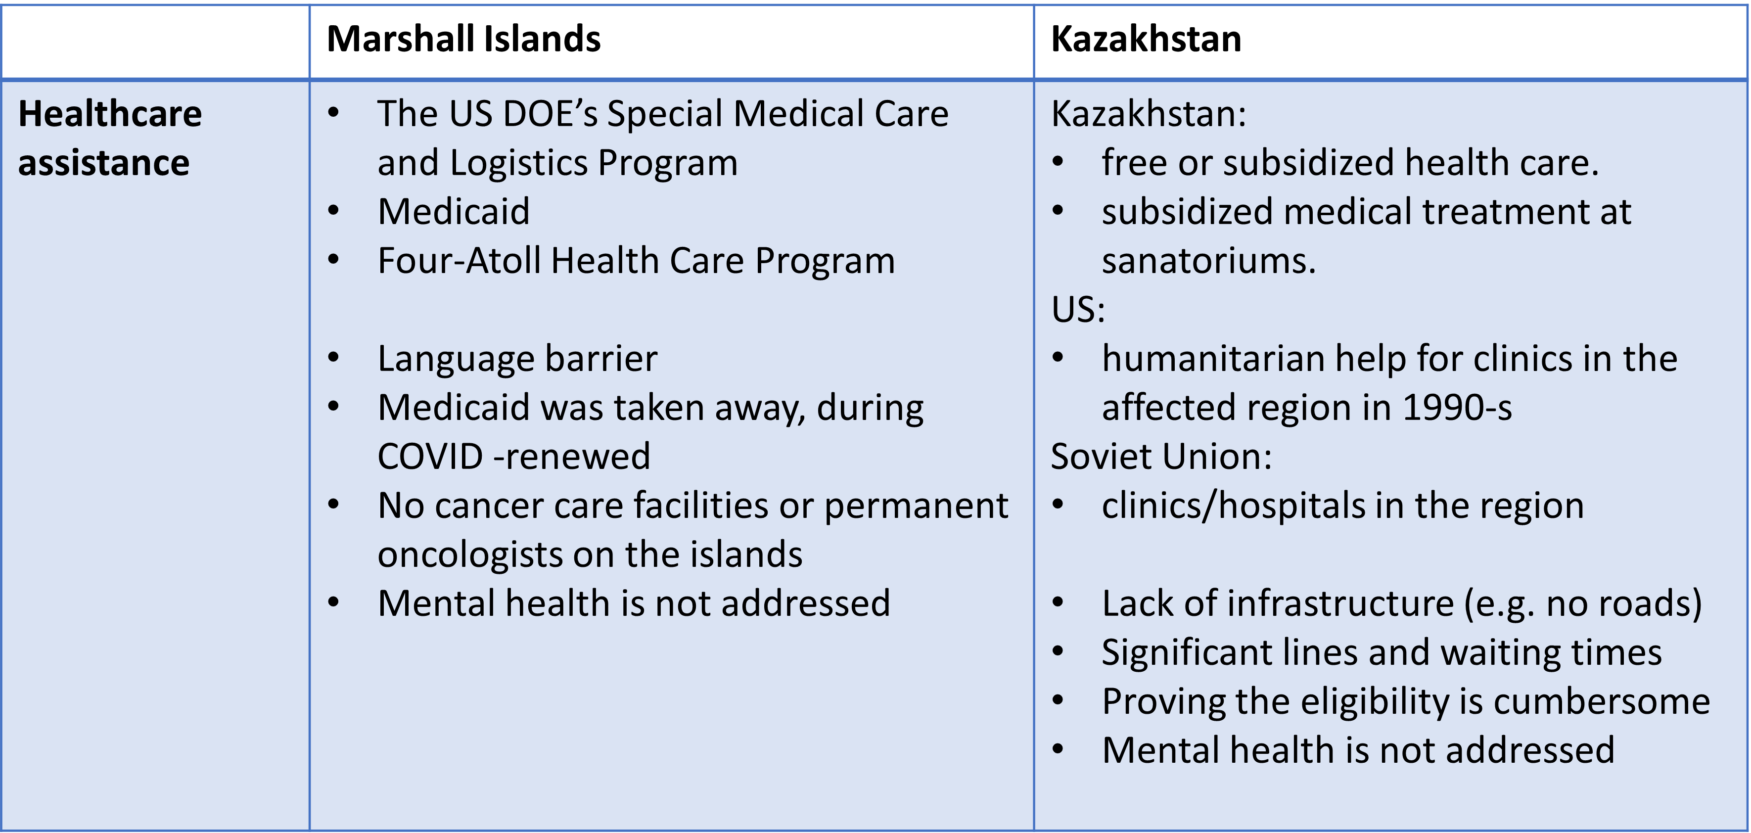
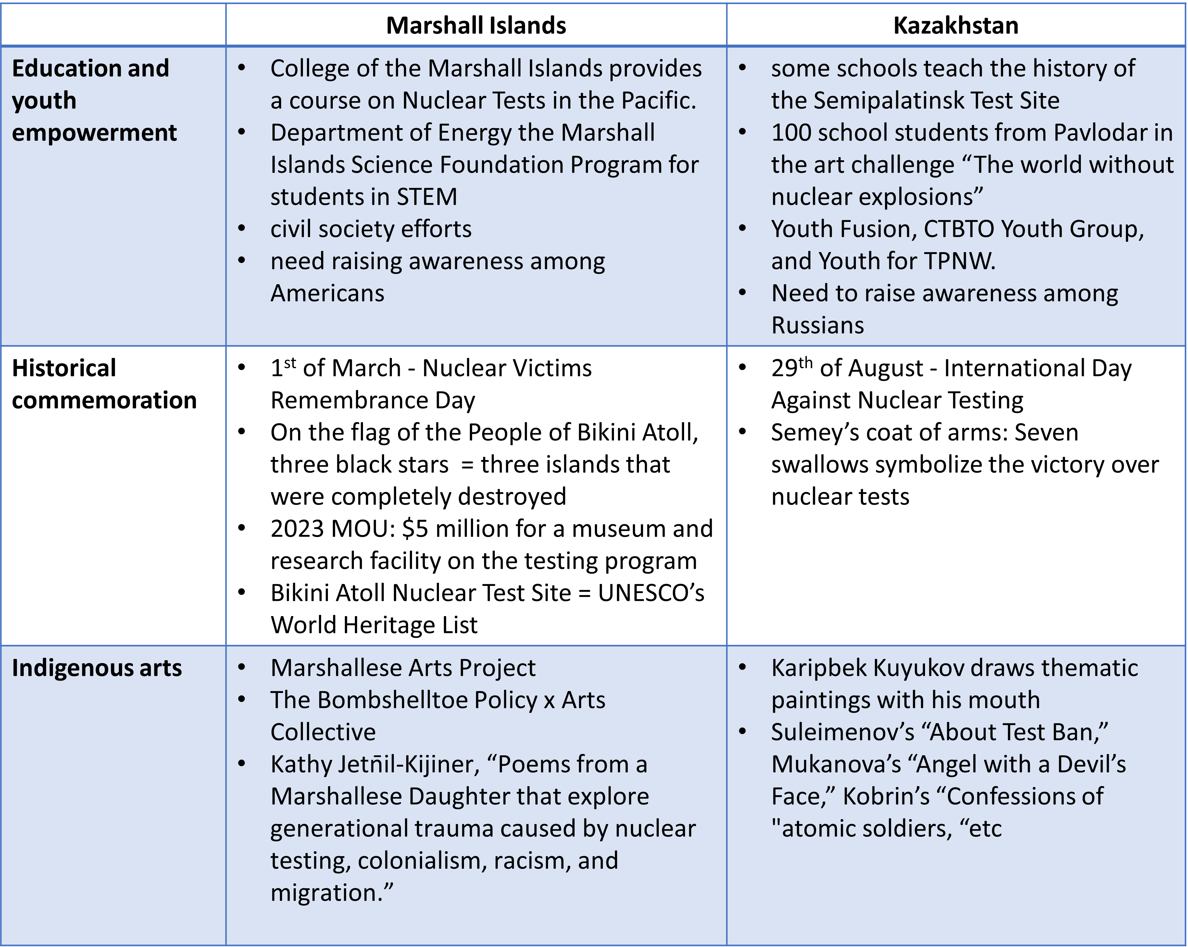
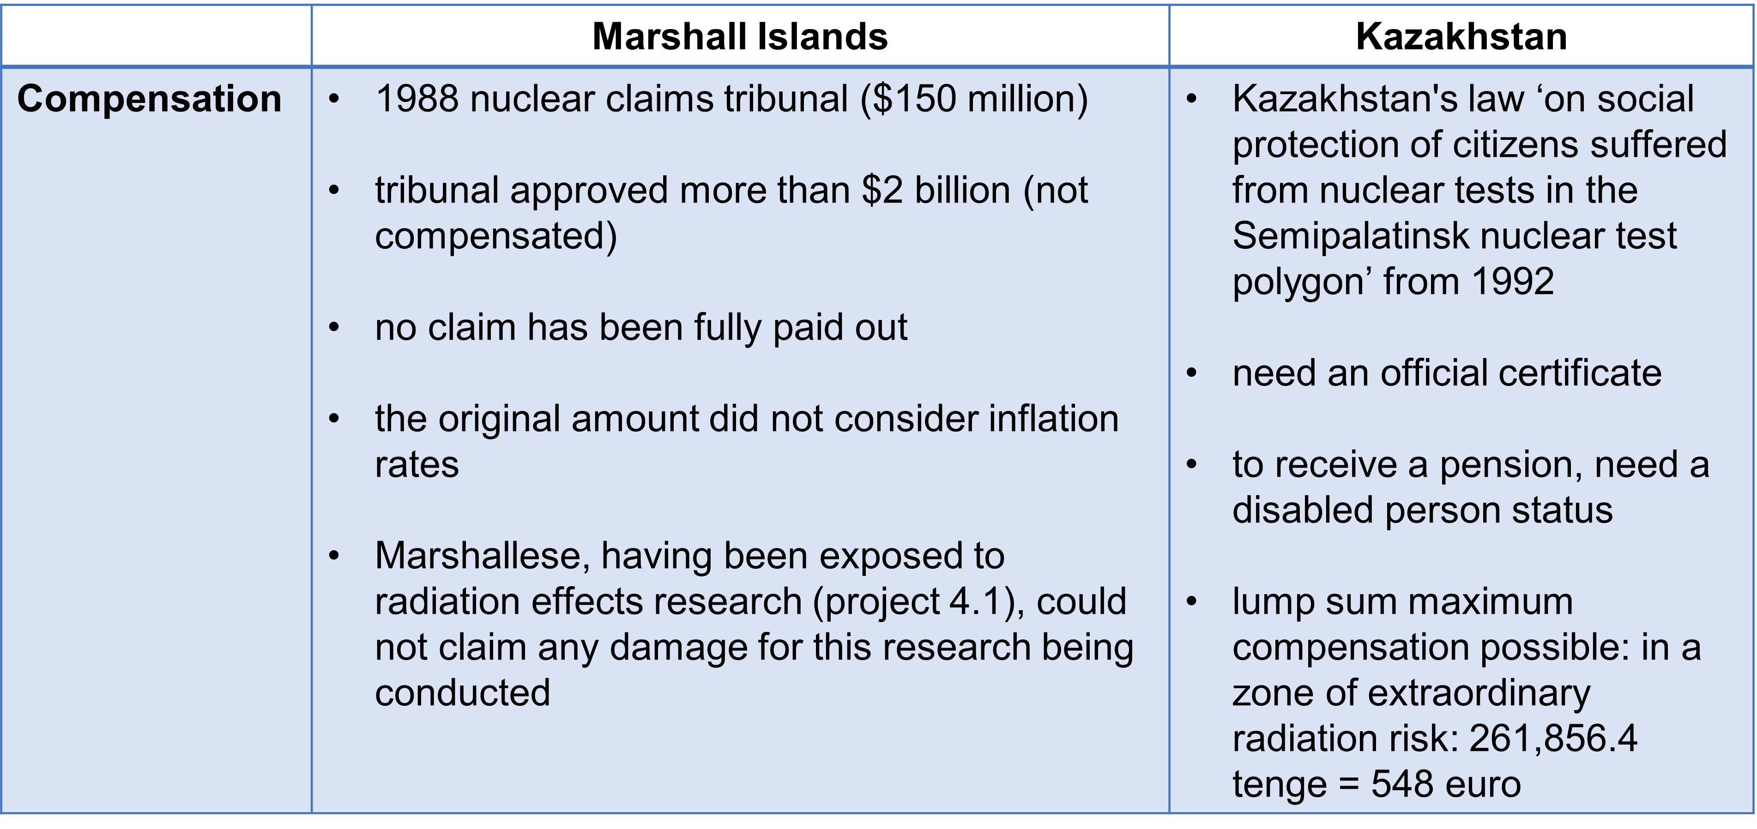
Results (2/2)
Please do not use this space, a QR code will be automatically overlayed
P5.1-113

Slide 8
Conclusions (1/2)
Policy Implications
Justice mechanisms: survivor-friendly, survivor-oriented, survivor-inclusive;
Reintegration of survivors;
Comprehensive environmental remediation;
Non-conventional nuclear justice mechanisms for sustainability;
Long-term norm against nuclear injustices involving the younger generation;
Use of international instruments like TPNW as a standard approach;
Positive obligations as legally binding international norms;
Advancing humanitarian consequences discussion through global platforms.
Limitations
Nuclear injustice cases are unique and contextual, complicating the classification of justice mechanisms;
Nuclear justice is trans-generational and cross-border, extending beyond individual cases;
No universal perception of nuclear justice or universally applicable mechanisms;
Effectiveness of policy choices depends on the political will and interests of states;
Accountability requires the active involvement of diverse stakeholders.
Please do not use this space, a QR code will be automatically overlayed
P5.1-113

Slide 9
Conclusions (2/2)
CTBTO Potential Contribution
Capacity-building:
help develop national relevant expertise in the affected states/communities;
prioritising the recruitment of individuals from states affected by nuclear testing;
cooperate with national institutions and research centres;
International Support:
include mentions of humanitarian consequences of nuclear testing and challenges the survivors face during the bilateral meetings, international addresses, and other available platforms;
include voices of survivors in the CTBTO’s conferences;
Research: conduct actionable research on past/future nuclear testing and share it with the affected states
Education & Empowerment:
Include modules on nuclear testing legacy in CTBTO’s educational initiatives such as mentorship, fellowship, and other CYG activities;
invite youth from survivors’ communities to join CYG and establish projects for and with them.
Please do not use this space, a QR code will be automatically overlayed
P5.1-113

