Slide 1
Daring in Dilemma: Raison d’Etre of Indonesian Legal Contribution
to Comprehensive Nuclear-Test-Ban Treaty and Its Challenges
Wahyu Yun Santoso
Faculty of Law, Centre for Environmental Studies (PSLH) Universitas Gadjah Mada, Indonesia
Government of Indonesia (GoI) has shown it firm political position and proactive support for “atoms for peace” since the active pioneering of IAEA in 1957.
However, does the daring legal contribution to global nuclear agenda (including CTBT) positively contributes the nuclear development in Indonesia? What are the present challenges?
Legal rationale of GoI contribution to CTBT traced by historical statutory analysis.
A descriptive analysis is presented to criticize how the daring policy has created a dilemma for national nuclear development.
GoI active contribution for global nuclear agenda is affected by “idee das rechtstaat” mandated in constitution;
Existing nuclear laws in Indonesia haven’t firmly regulated the four pillars of Safety, Security, Safeguard, and Liabilty, which affects the development of nuclear potential.
Indonesia’s strategic geo-position is significant in supporting the full enactment of CTBT.
Active support of GoI should be balanced with the advanced development of nuclear potential, i.e legal, economic, political, environment, and social framework.
Leave empty – QR code will be overlayed on touchscreen
P5.1-526

Slide 2
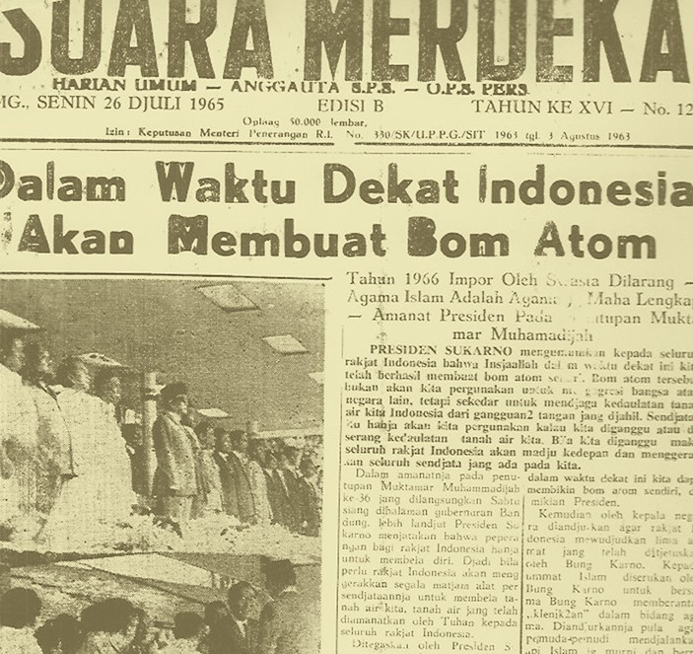
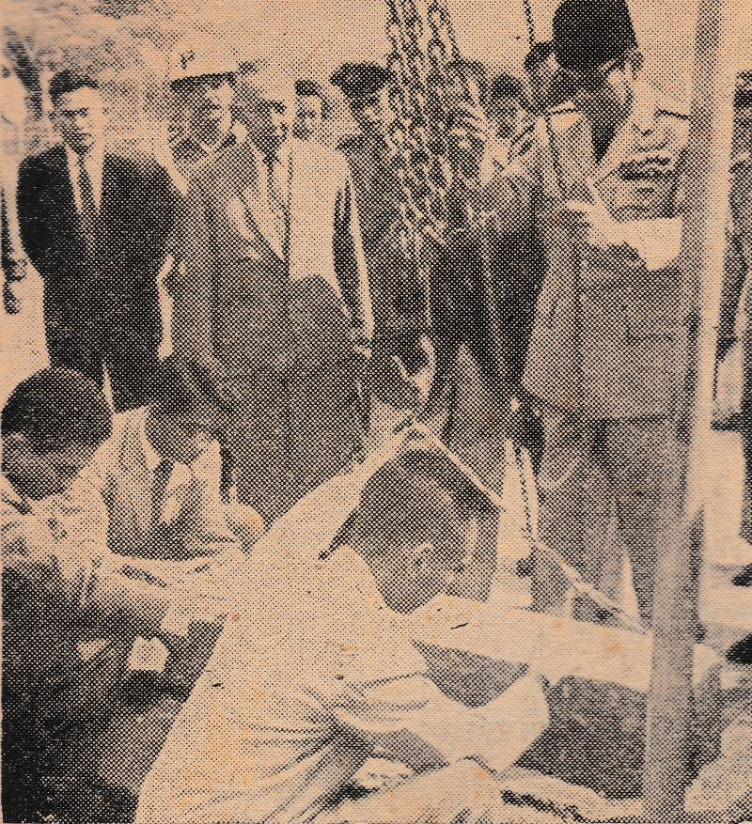
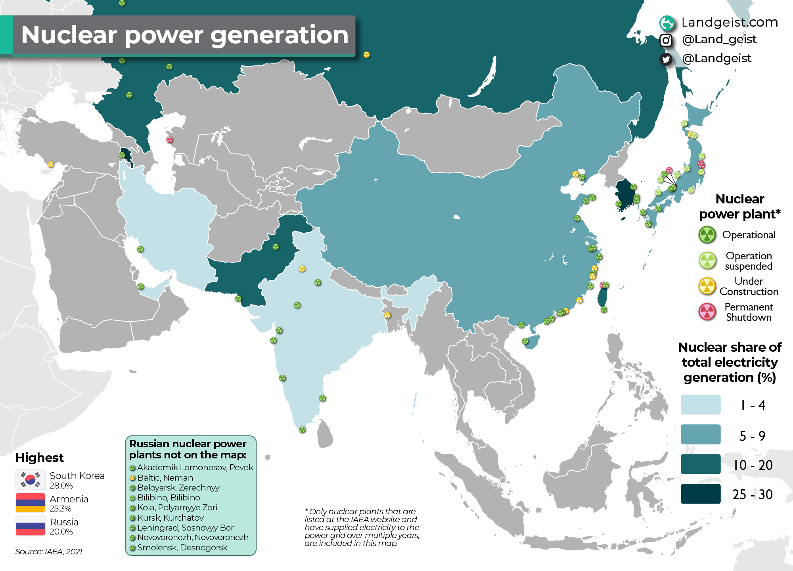
Introduction
Since early “Atomic Age”, the Government of Indonesia (GoI) has shown it firm political position and proactive support for “atoms for peace” (as proven by the active involvement of pioneering IAEA and many political statements of GoI). However, does the daring legal contribution to the global nuclear agenda (including CTBT despite incomplete support from the remaining eight Annex 2 countries), positively contribute to the development of nuclear power potency?
In the recent update, adapting to global commitment of energy transition, GoI oppressed with the international mandate and national low “energy mix target”. As in 2020, the shares of renewables, natural gas, oil, and coal were 11.20 percent%, 19.16 percent%, 31.60 percent%, and 38.04 percent % respectively. In the last five years, the development of renewable energy (in which nuclear power is legally defined as part of it) has only reached 11.5 percent%. Yet, under National Energy Policy, support from nuclear power plant will only be started in 2035.
P5.1-526
Leave empty – QR code will be overlayed on touchscreen

Slide 3
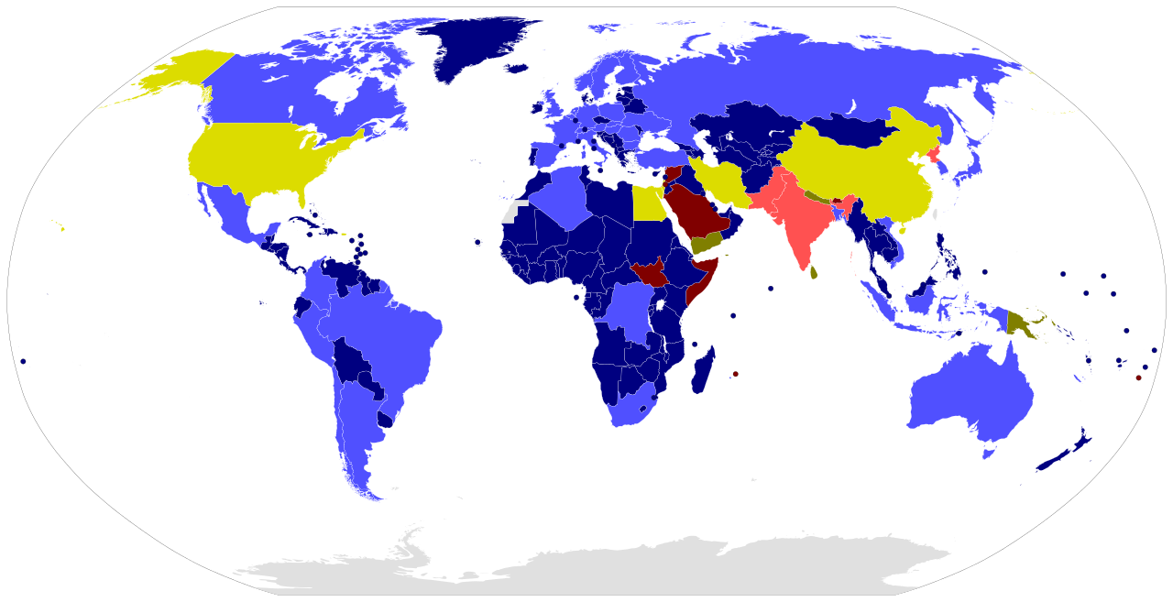
Objectives of the Research
This study aims to:
examining the legal rationale behind Indonesia’s ratification of CTBT and the socioeconomic challenges affected;
reframing geopolitical perspective of Indonesia’s commitment to CTBT and the best available strategy should be imposed to harmonize this commitment with expediency.
As of January 2023, 186 states have signed and 177 states have ratified the treaty. Still, 8 annex 2 states have not signed or ratified the CTBT
P5.1-526
Leave empty – QR code will be overlayed on touchscreen
Source: CTBTO, 2023

Slide 4
Methods and Data
Using historical-statutory analysis, this study examines the “legal rationale” for Indonesia’s active involvement in nuclear politics, which can be traced back to the preparation committee for the establishment of the IAEA, and becoming a member notwithstanding the high-cost effect of the membership.
A qualitative-descriptive analysis is presented to criticize how the daring policy has created a dilemma when the need for “noncarbon-emission” energy is imminent while the tardiness of nuclear power plant utilization is under question for energy resilience and sustainability in Indonesia.
Historical milestones:
in the mid of atomic age (‘50s), US-Atomic Energy Commission continuously performed the atomic-bomb test in Pacific Ocean. GoI under Sukarno worried about the extent of radioactive impacts, which resulted in Presidential Decree 230/1954 for the establishment of the National Committee for Radioactive Investigation.
Statutory milestones:
Agreement for IAEA statute (Law 25/1957); Ratification of NPT (Law 8/1978); Ratification of CPPNM (Presidential Decree 49/1986); Ratification of Early Notification Convention (Presidential Decree 81/1993); Ratification of Convention on Assistance (Presidential Decree 81/1993); Ratification of Treaty on the SEA Nuclear Weapon Free Zone (Law 9/1997); Law 10/1997 on Nuclear Power; and Ratification of CTBT (Law 1/2012);
P5.1-526
Leave empty – QR code will be overlayed on touchscreen

Slide 5
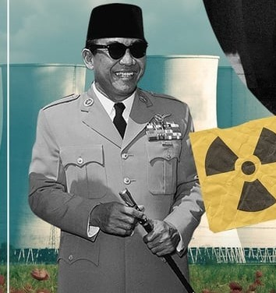
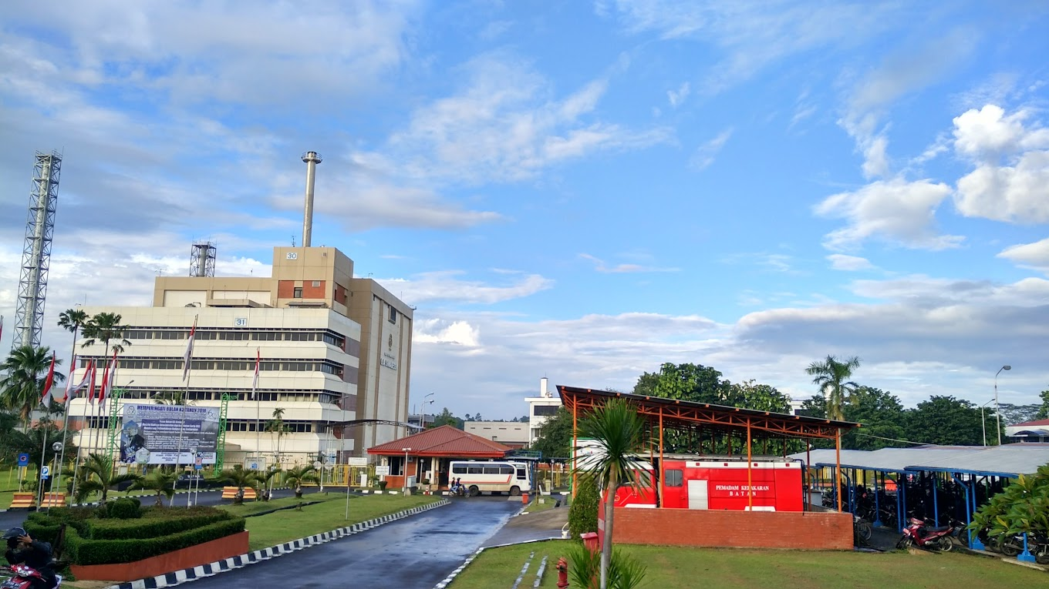
Ration d’Etre of Indonesia’s Ratification of CTBT
First initial commitment of President Sukarno: ATOM for PEACE, not for WEAPON, and no more of WEAPON production (Nations Address 12 June 1958);
Indonesia’s international politics: NON-BLOCK and ACTIVE in WORLD PEACEKEEPING (as mandated by the constitution), as one pillar of Idee das Rechtstaats;
The philosophical rational of ratify CTBT shown in the consideration of the Law 1/2012 as ratification is needed since GoI has signed the CTBT in first place (24 September 1996)
GoI argued that the most effective guarantee of any nuclear weapon threats is the active support for the non-proliferation of nuclear weapons, unconditionally, non-discriminative; and fair treatment, which is supported by legally binding instruments.
Comprehensive Nuclear Test Ban, therefore, is the most significant plane.
Kartini Research
Reactor, Yogya
Legal precautionary approaches taken, however, are critically argued as one of the obstacles in developing nuclear in higher level (as power reactor). i.e Indonesia only have 3 small reactors for research use.
Existing “nuclear law” is also lacking in comprehensive aspect on safety, security, safeguard, and liability.
P5.1-526
Leave empty – QR code will be overlayed on touchscreen
GA Siwabessy Research
Reactor, Tangerang

Slide 6
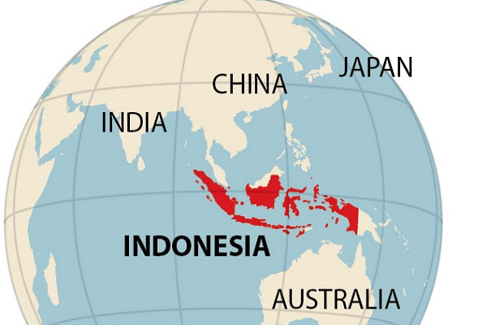
Geopolitical Perspective of Indonesia’s Commitment to CTBT
and the Harmonization Strategies
Indonesia’s geopolitics position is strategic to support the full commitment and enactment of CTBT;
As a member of G20 (with its 2022 presidency) as well as pioneer for SEANWFZ (Southeast Asia Nuclear Weapon Free Zone) provides more advantages;
Should GoI also take a (ambitious) lead in the safe, secure, and advanced use of nuclear power plant?? Moreover as if NO NUCLEAR POWER = NO NET ZERO EMISSION??
Recent Problems:
Bureaucratic issue: the “diminish” of formal “scientific authority” for nuclear agenda (since 2021). This issue started when BATAN (National Atomic Agency) is “dwarfed” as RESEARCH ORGANIZATION (OR) under BRIN (National Research and Innovation Agency), which is functioned as a technical research unit only;
Capacity issue: integration of the Nuclear Inspection Body (Bapeten) under the Ministry of Environment and Forestry opens the advancement of environmental safety and safeguard standards to be regulated, yet its “huge” responsibility makes other challenges;
Energy policy issue: a revision of national energy policy that clearly defines nuclear power optimization, as well as counter policy for coal-powered politics in Indonesia is urgently needed.
P5.1-526
Leave empty – QR code will be overlayed on touchscreen

Slide 7
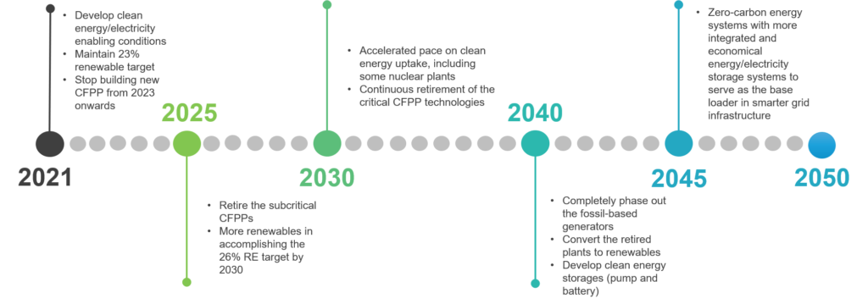
Conclusion: Commitment and Strategies
Source: MEMR’s Power and Utility Strategies to Achieve Indonesia’s Carbon Neutral by 2050 (draft 16 April 2021)
Commitment and Strategies:
Revised the National Energy Policy (currently based on Government Regulation 79/2014), in which harmonized with the Carbon Neutral Policy and accommodated the nuclear power optimization;
Developing a comprehensive legal framework to maintain pillars of safety, security, safeguard, and liability in national nuclear law;
Strengthening environmental safeguard aspects and standards on nuclear power;
Strong support from the national leader for nuclear power utilization (political year of 2024 is critical as well as crucial);
Participative public engagement on developing understanding of the nuclear power, potential, risks; and safety aspects; and
Clear and firm bureaucracy (norms, standards, procedures, and criteria) for nuclear governance.
P5.1-526
Leave empty – QR code will be overlayed on touchscreen

