Slide 1
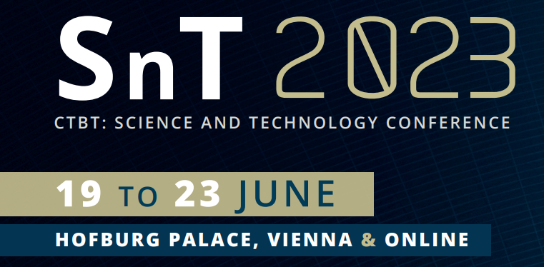
Daring in Dilemma: Raison d’Etre of Indonesian Legal Contribution
to Comprehensive Nuclear-Test-Ban Treaty and Its Challenges
Wahyu Yun Santoso
Centre for Environmental Studies Universitas Gadjah Mada, Indonesia
International Data Centre, Comprehensive Nuclear-Test-Ban Treaty Organization
P5.1-526
This study aims at:
examining the legal rationale behind Indonesia’s ratification of CTBT and the socioeconomic challenges affected;
reframing geopolitical perspective of Indonesia’s commitment to CTBT and the best available strategy should be imposed to harmonize this commitment with expediency.
Using historical-statutory analysis, this study examines the “legal rationale” for Indonesia’s active involvement in nuclear politics, which can be traced back to the preparation committee for the establishment of the IAEA, and becoming a member notwithstanding high-cost effect of the membership. A qualitative analysis presented to criticize how the dare policy has created a dilemma when the need of “noncarbon-emission” energy is imminent while tardiness of nuclear power plant utilization is under question for energy resilience and sustainability in Indonesia.
If you want to learn more about this, come see my e-poster during session P5.1-526 on 22 June 2023 or access it online on the SnT2023 Conference platform!

