Slide 1
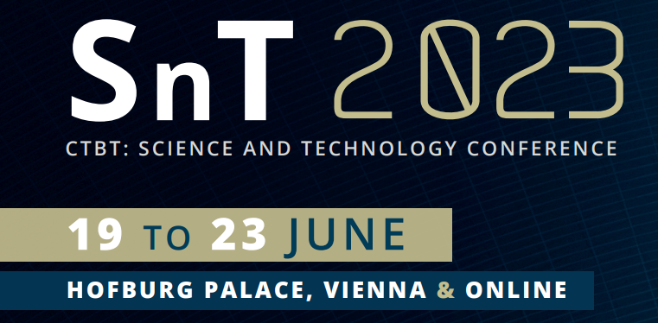
Towards Transformative Science: Advancing Knowledge Co-Production on the Comprehensive Nuclear test-Ban Treaty Universalization
Maharani Hapsari
International Data Centre, Comprehensive Nuclear-Test-Ban Treaty Organization
P2.4-123
This study aims at: (1) mapping knowledge production relationship involving CTBTO affiliated epistemic communities and other domestic constituents (wider people, groups and organizations) in ratifying countries (2) examining the context in which such relationships foster social learning and strengthen interests in ratification by the Annex II governments. Bringing knowledge co-production as an analytical framework, this study examines how epistemic communities in selected states-parties condition the wider cognitive and social bases of policy knowledge conducive to treaty ratification. A qualitative analysis of knowledge co-production identifies epistemic community’s roles in knowledge framing, practice, accumulation, dissemination, as well as policy and public engagement. As CTBT becomes a global knowledge undertaking, the role of epistemic community has extended from merely providing techno-scientific bases of policy certainty to navigating the broader sociological interactions through science-policy-public interfaces.
If you want to learn more about this, come see my e-poster during session P5.1.373 on 22 June 2023 or access it online on the SnT2023 Conference platform!

