Slide 1
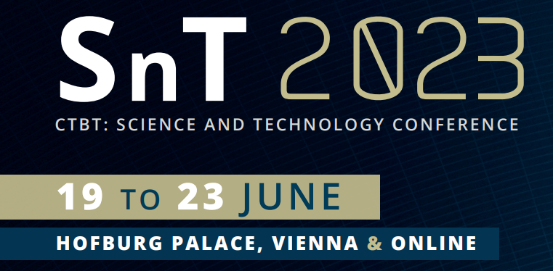
Preventing the Effects of Natural Disasters and Nuclear Test with the CTBT Verification Technologies for Myanmar
Aye Aye Thin
Department of Atomic Energy, Ministry of Science and Technology, Myanmar
P5.2-330
This paper has 2 main objectives:
This paper is aimed to be familiar with the CTBT verifications techniques, benefits, how CTBT work to contribute towards a peaceful world without nuclear weapons and to serve as a nuclear arm controlling measure to prevent proliferation and to apply for preventing the effects of natural disasters and nuclear test in Myanmar
Next is to share how Myanmar efforts to differentiate nuclear tests from other human made or natural events because Myanmar has neighboring huge countries occupied nuclear arms and Myanmar’s challenges in use of civil and scientific applications, capacity building and training related to CTBT techniques and data.
If you want to learn more about this, come see my e-poster during session 5.2 on this date or access it online on the SnT2023 Conference platform!

