Slide 1
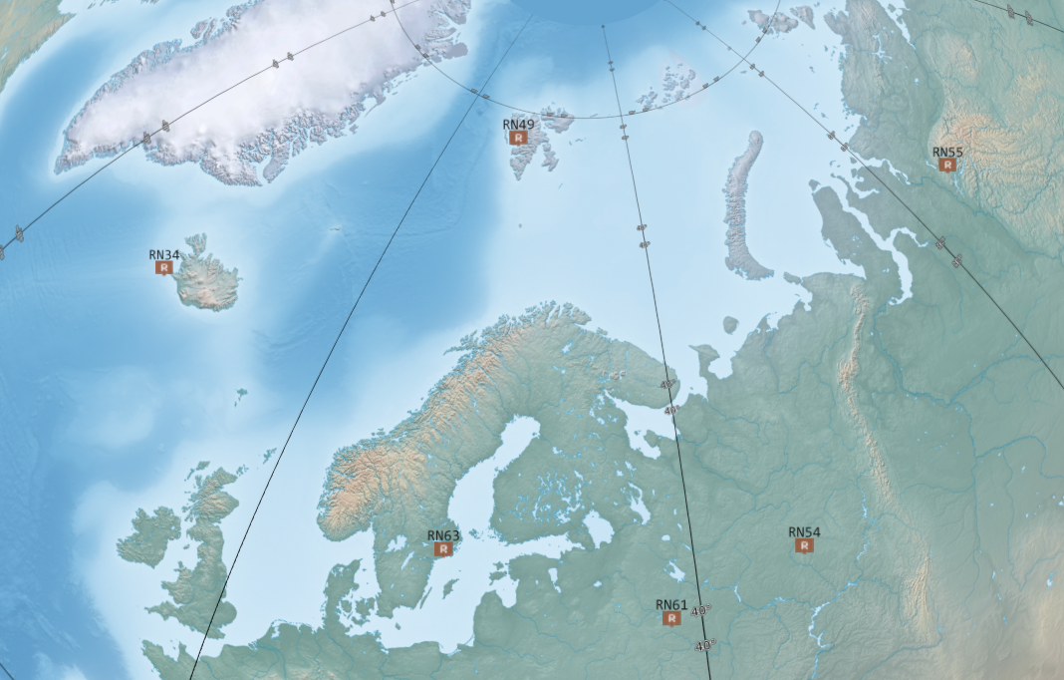
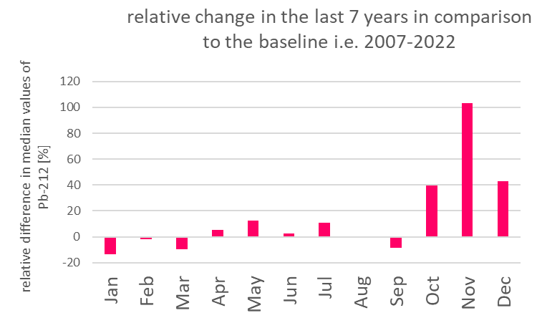
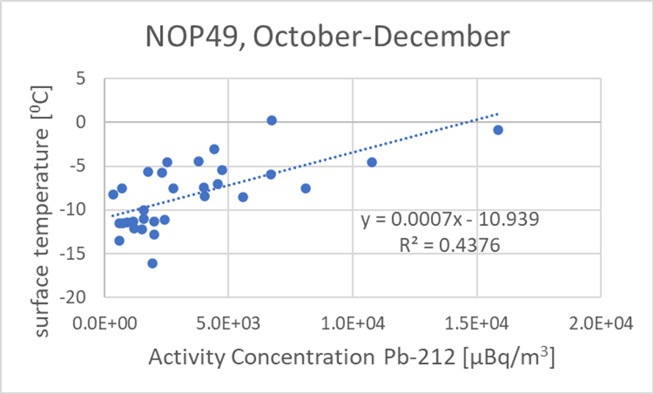
Climate change as observed by the CTBTO radionuclide IMS stations:
the case of Spitzbergen
Jolanta Kuśmierczyk-Michulec and Jonathan Baré
CTBTO
P5.2-296
Could environmental measurements from
the IMS network of the CTBTO Case study of the Spitzbergen station RN49
be used to evidence climate change?
Relative change in monthly median values of Pb-212 as observed during the last 7 years (2015-2022), in comparison to the baseline calculated for the period: 2007-2022.
One of the IMS radionuclide stations, RN49, is located in Spitzbergen, a place where, based on many lines of evidence, the signs of climate change are noticeable.
Median monthly values of surface temperature vs median monthly values of Pb212 activity concentration for months October, November and December.

