Slide 1
Climate change as observed by the CTBTO radionuclide IMS stations: the case of Spitzbergen
Jolanta Kuśmierczyk-Michulec and Jonathan Baré
CTBTO
One of the IMS radionuclide stations is located in Spitzbergen, a place where, based on many lines of evidence, the signs of climate change are noticeable.
Data used for this study include the natural radionuclides like Pb-212, and the Atmospheric Transport Modelling results.
The amount of Pb-212 increases exponentially with the surface temperature. The largest monthly changes during the last years (2007-2022) are noted for months between October and December.
This study demonstrates that environmental measurements from the IMS network of the CTBTO can be used to evidence climate change in the case of Spitzbergen.
Please do not use this space, a QR code will be automatically overlayed
P5.2-296

Slide 2
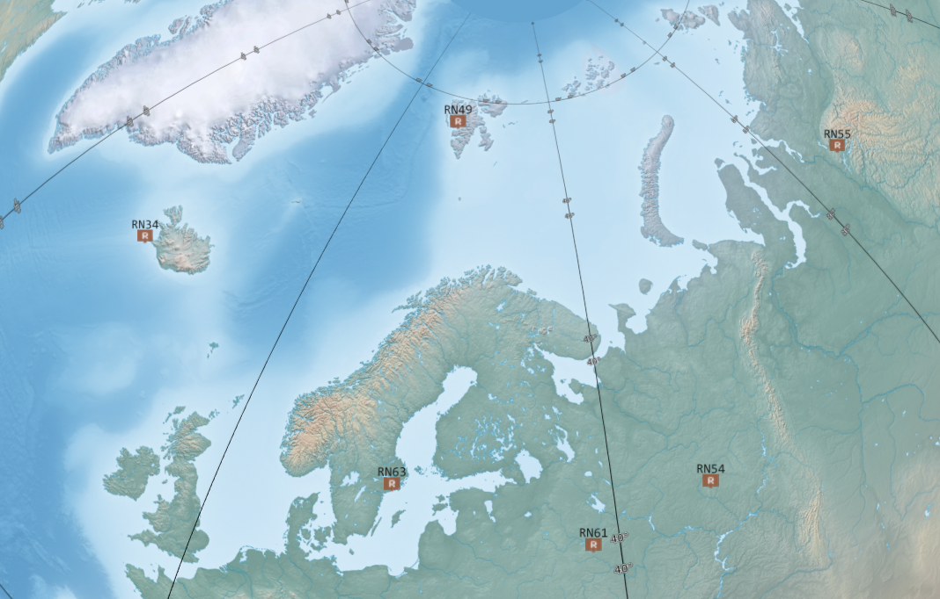
Introduction
The International Monitoring System (IMS), installed and maintained by the Comprehensive Nuclear-Test-Ban Treaty Organization (CTBTO) with the support of States Signatories, is a global system of monitoring stations composed of four complementary technologies: seismic, hydroacoustic, infrasound and radionuclide.
One of the IMS radionuclide stations, RN49, is located in Spitzbergen, a place where, based on many lines of evidence, the signs of climate change are noticeable.
Spitzbergen is the largest island of the Norwegian Svalbard archipelago, in the Arctic Ocean.
P5.2-296
Please do not use this space, a QR code will be automatically overlayed

Slide 3
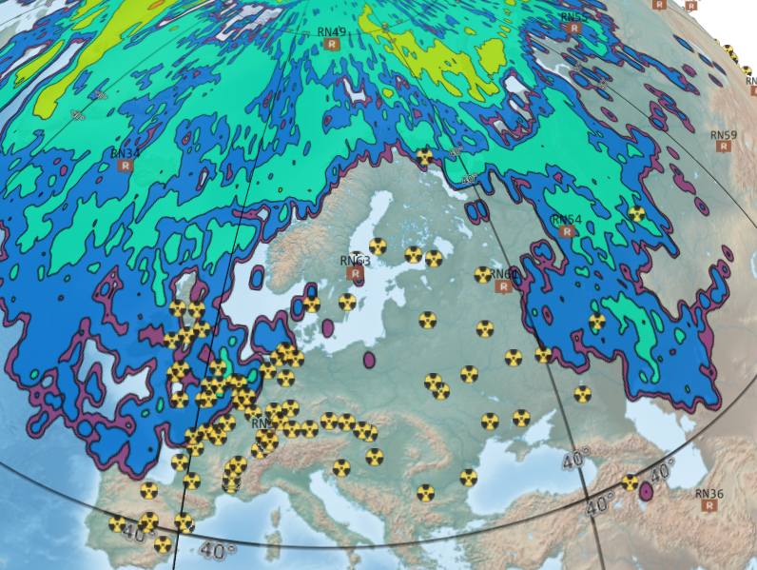
Objectives
This study based on almost twenty years of measurements (2003-2022) by the CTBTO demonstrates that variations of Pb-212 activity concentrations may be connected to climate variations.
Atmospheric Transport Modelling (ATM) calculations provide the link between IMS RN detections and potential sources of emissions. As all anthropogenic activities, they contribute to the climate change process and have impact on the air quality.
Snapshot showing where air masses were 14 days prior to the arrival at the station RN49 on 1st May 2023, as an example. As illustrated, RN49 collect air masses from the whole Northern Hemisphere.
The yellow-black dots indicate the location of Nuclear Power Plants
P5.2-296
Please do not use this space, a QR code will be automatically overlayed

Slide 4
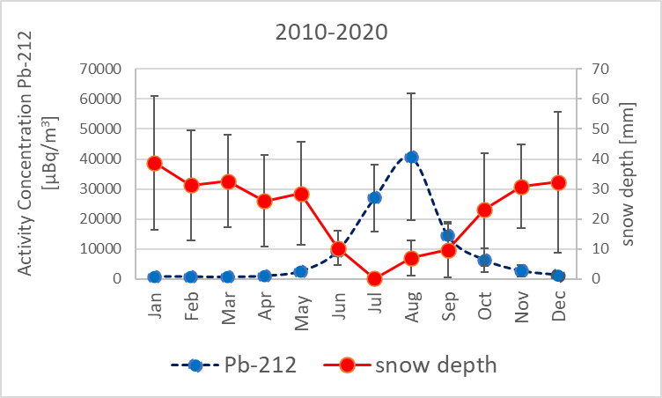
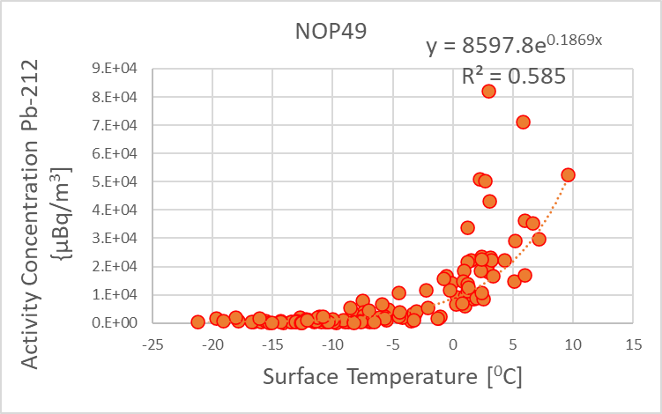
Methods/Data
Among other natural radionuclides, Pb-212 is always observed at IMS stations, in varying quantities. It concerns also the Spitzbergen station RN49. The increase of surface temperature has an influence on the amount of Pb-212 emitted from the ground surface (see Left & Right Panel). The relation between the amount of Pb-212 and the snow depth is inversely proportional (see Middle Panel).
Middle Panel: Variations in the monthly average amount of Pb-212 and the snow depth.
P5.2-296
Please do not use this space, a QR code will be automatically overlayed
Right Panel: Exponential increase in the amount of lead Pb-212 with the surface temperature
Left Panel: Activity concentration of Pb-212 versus surface temperature

Slide 5
Results
Right Panel: Relative change in monthly median values of Pb-212 as observed during the last 7 years (2015-2022), in comparison to the baseline calculated for the period: 2007-2022.
P5.2-296
Left Panels: Changes in the monthly values of Pb-212 as observed between 2007-2022 (or 2003-2022). The caps at the end of each box indicate the extreme values (minimum and maximum), the box is defined by the lower (first) and upper (third) quartiles, and the line in the centre of the box is the median. The dots represent outliers.
Please do not use this space, a QR code will be automatically overlayed

Slide 6
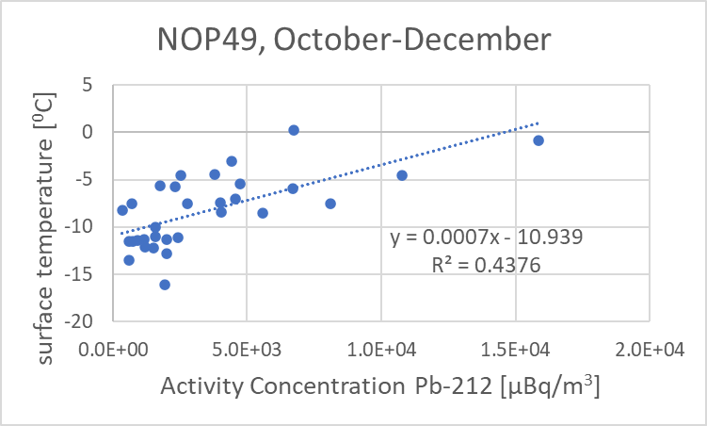
Results
P5.2-296
Left Panel: Monthly surface temperature. The caps at the end of each box indicate the extreme values (minimum and maximum), the box is defined by the lower (first) and upper (third) quartiles, and the line in the centre of the box is the median. The dots represent outliers.
Right Panel: Median monthly values of surface temperature vs median monthly values of Pb212 activity concentration for months October, November and December.
Please do not use this space, a QR code will be automatically overlayed

Slide 7
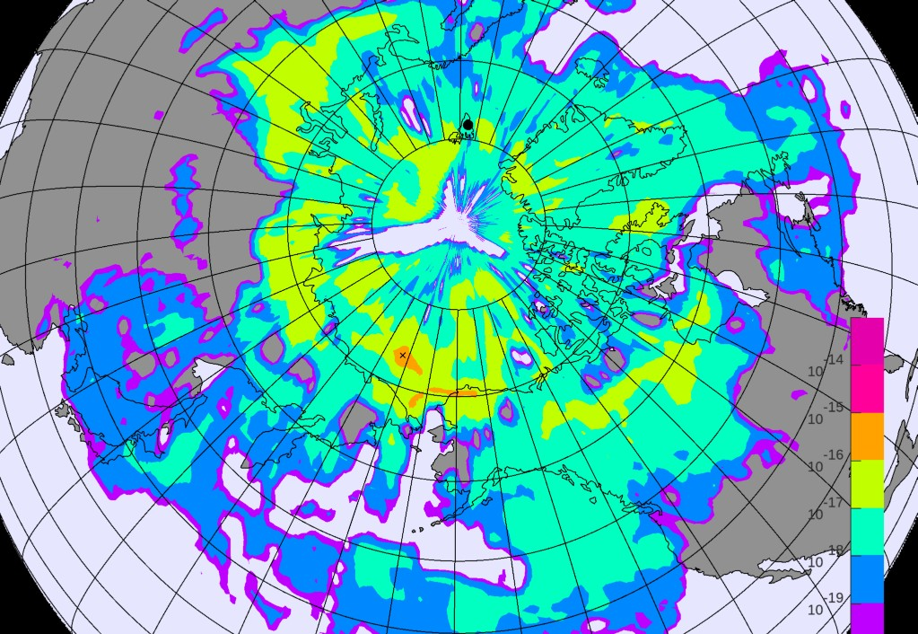
Results
Atmospheric Transport Modelling (ATM) calculations provide the link between IMS RN detections and potential sources of emissions, like in case of the Fukushima accident (see Left Panel). Due to the scale of this incident, anomalous anthropogenic detections (e.g. Caesium (Cs-137)) were frequently observed by the IMS RN network, including the station in Spitzbergen (Preparatory Commission for the CTBTO, 2011).
P5.2-296
Right Panel: Cs-137 measurements at the IMS station RN49 in the aftermath of the Fukushima accident
Please do not use this space, a QR code will be automatically overlayed
Left Panel: Screenshot taken on 26 March 2011, i.e. 14 days after
the Fukushima accident, showing the plume dispersion. The IMS
station in Spitzbergen is indicated by the back dot.

Slide 8
Conclusions
It is demonstrated that on an annual basis, the amount of lead Pb-212 increases exponentially with the surface temperature increase. As expected, the higher the snow depth, the lower the amount of measured Pb-212.
Comparison of monthly median values of Pb-212 for the last 7 years (2015-2022) with the baseline values calculated for the period: 2007-2022, indicates for a relative increase of Pb-212 values, for months October-December.
It is demonstrated that on a shorter time scale (i.e. three months, from October to December), a linear relationship between monthly median values of surface temperature and Pb-212 is observed. As noted above, compared to the previous 15 years, Pb-212 values have increased. This suggests a relative seasonal increase also in the surface temperature values.
The quality of air is influenced by various emissions. The effect of Fukushima accident is illustrated.
This study demonstrates that environmental measurements from the IMS network of the CTBTO can be used to evidence climate change in the case of Spitzbergen.
This study is to be further continued.
P5.2-296
Please do not use this space, a QR code will be automatically overlayed

Slide 9
References
Preparatory Commission for the CTBTO (2011). Fukushima related measurements by the CTBTO. https://www.ctbto.org/news-and-events/news/fukushima-related-measurements-ctbto
The Royal Society &the US National Academy of Sciences,(2020), Climate Change: Evidence and Causes, https://royalsociety.org/~/media/royal_society_content/policy/projects/climate-evidence-causes/climate-change-evidence-causes.pdf
P5.2-296
Please do not use this space, a QR code will be automatically overlayed

