Slide 1
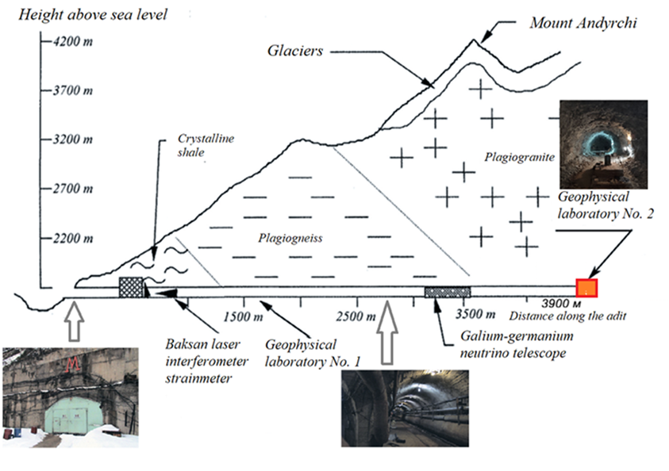
Observed Tidal Effects in the Fine Temperature Variations Measured in a Deep Underground Tunnel of the Northern Caucasus Geophysical Observatory of IPE RAS
Valentin Gravirov¹, Dmitry Likhodeev¹, Konstantin Kislov²
1. IPE RAS. 2 IEPT RAS.
P5.2-162
Layout of the Geophysical laboratory in the Baksan Neutrino Observatory. The red rectangle shows the place of installation of temperature sensors

