Slide 1


Observed Tidal Effects in the Fine Temperature Variations Measured in a Deep Underground Tunnel of the Northern Caucasus Geophysical Observatory of IPE RAS
Valentin Gravirov¹, Dmitry Likhodeev¹, Konstantin Kislov²
1.The Schmidt Institute of Physics of the Earth of the Russian Academy of Sciences 2.Institute of Earthquake Prediction Theory and Mathematical Geophysics the Russian Academy of Sciences
The location of the Northern Caucasus Geophysical Observatory of the IPE RAS in the immediate vicinity of the magma chamber of the Elbrus volcano makes it possible to obtain unique data on the structure and dynamics of the thermal field in its vicinity
The data used for this research were the results of real-scale observations carried out at the North Caucasus Geophysical Observatory located at a depth of 3.9 km from the adit entrance
Qualitative comparison between the normalized precise temperature variations in the deep adit and the normalized theoretical estimate of local values of the vertical component of the gravitational potential
The observed temperature variations may be caused, among other reasons, by the convective component of the heat and mass transfer as a result of the periodic effect of solar–lunar forces (tides) on the geophysical medium
Please do not use this space, a QR code will be automatically overlayed
P5.2-162

Slide 2

Introduction
The importance of the research
The fundamental research into deep layered inhomogeneous media within the lithosphere, which are responsible for the formation and evolution of fluid–magmatic systems in the region of the North Caucasus at the modern stage, are inseparably connected with the necessity to obtain novel and the most reliable information about the entire set of geological–geophysical processes that are manifested in regular changes in various geophysical fields.
As applied to geophysical and tectonic problems, fluids should be considered as a liquid or gaseous–liquid substances that differ from the mineral composition of the lithosphere in a lower density and viscosity, and also in high migration ability. The fluid phase and its characteristics in different parts of the Earth’s crust change within a broad range. For example, within horizons occurring at small depths, fluids are represented by water with more or less significant contents of dissolved salts and gases [1]. The area of the Elbrus volcanic center [2, 3] is characterized by the predominance of acidulous mineral water springs.
Certain difficulties related to the lack of data on the physical–mechanical properties of the main elements in the magmatic feeding system impose limitations on possible simulation of geodynamic processes; however, these problems can be resolved by the use of data from precise quartz tiltmeters [4]. Due to their design, these tiltmeters are affected by weak thermal noise, and this point has determined the necessity to organize a system for strict temperature control in the underground laboratory (Fig.1).
Please do not use this space, a QR code will be automatically overlayed
P5.2-162

Slide 3
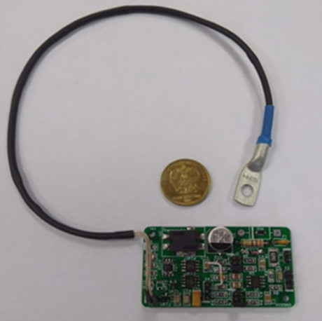
Objectives of the research
The main goal of the study was to try to find a possible correlation between lunisolar tides recorded by tiltmeters and rock temperature microvariations recorded by a multichannel precision temperature monitoring system.
We want to find that the diurnal and semidiurnal harmonics observed in microvariations of the underground temperature may be associated with the convective component of heat and mass transfer, which is largely determined by the corresponding changes in the regime of regular fluid migration due to the periodic influence of the combined solar–lunar tide effects on the geophysical medium in the deep underground tunnel.
Fig.1. General view of developed precise electronic thermosensor
(one channel)
Please do not use this space, a QR code will be automatically overlayed
P5.2-162

Slide 4
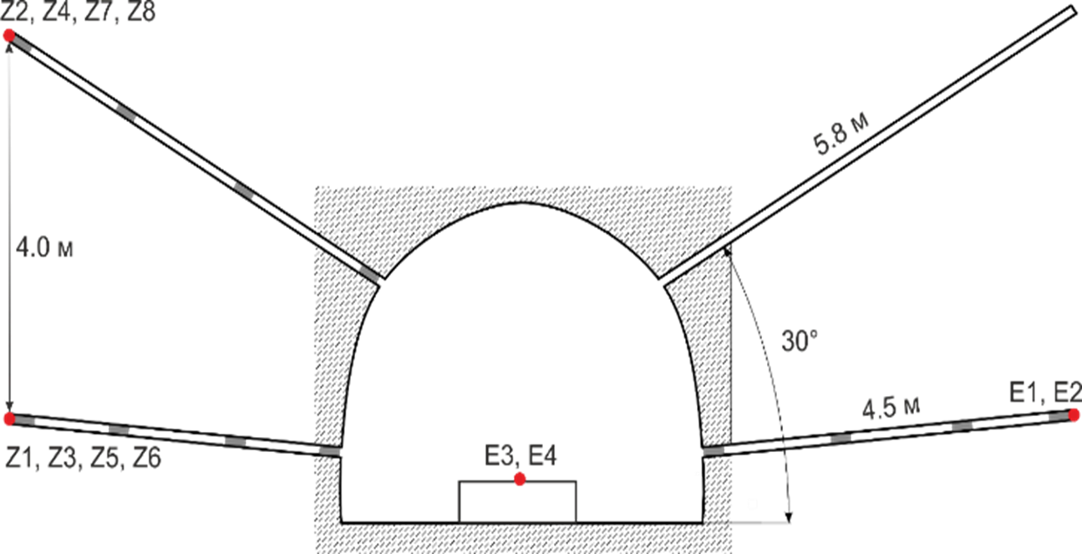
Methods and data acquisition
The initial data used were the results of real-scale observations carried out at the North Caucasus Geophysical Observatory, affiliated with the Schmidt Institute of Physics of the Earth, Russian Academy of Sciences (IPE RAS). The observatory is located at a depth of 3.9 km from the adit entrance, in a side roadway that is not affected by the forced ventilation system; the observatory is therefore an almost ideal test site for studying fine variations in the terrestrial thermal field [2, 5]. In order to install a precise temperature-measuring system, two pairs of holes were drilled in the opposite walls of the laboratory room. The holes are 10 cm in diameter and 4.5 to 5.8 m deep, the upper holes are arranged at an angle of 30º relative to the horizon, while the lower ones are inclined at 5º to it (Fig. 2). Such a design allowed the primary transducers to be spanned by 4 m along the vertical and also to exclude the concentration of water at their direct contact with the surrounding rocks. Multistage thermal insulation was designed for all holes to reduce the influence from temperature regime of the operational part of the laboratory room.
Fig. 2. Schematic vertical cross section of the underground laboratory in the plane along which the measuring holes are drilled (the main elements of the temperature data measuring system are installed in the holes). Z1 to Z8 and the units of precise electron thermometers attached to multichannel recorders. Gray triangles denote the passive plug made of heat-insulating material to minimize the atmospheric convection. Tiltmeters were installed on the pedestal shown in the center of the adit in the area of points E3 and E4.
Please do not use this space, a QR code will be automatically overlayed
P5.2-162

Slide 5
Results
Fig. 3. Qualitative comparison between the normalized temperature variations in the deep adit (measuring the Z1 (blue line) and Z4 (red line) sensors) and the normalized theoretical estimate of local values of the vertical component of the gravitational potential (yellow line) .
Please do not use this space, a QR code will be automatically overlayed
P5.2-162

Slide 6
Conclusion
Taking into consideration the topography in the Baksan gorge area and the altitude of Mt. Andyrchi, the thickness of the granitoid massif immediately over the chambers of the underground laboratory is about a kilometer and a half; in this respect, the conductive mechanism of heat transfer from the Earth’s surface, characteristic of shallow natural caves [6], can be completely excluded, up until variations in the hundredths.
The temperature at every single point of the geomedium depends not only on the thermal flow produced by various heat sources, but also on the thermal conductivity of rocks; the latter parameter, in turn, depends on the fluid saturation and can vary. Another important factor is heat transfer through fluid convection (this convection considerably contributes to the heat and mass transfer in the regions of active volcanism) [7].
Thus, the observed temperature variations may be caused, among other reasons, by the convective component of the heat and mass transfer as a result of the periodic effect of solar–lunar forces (tides) on the geophysical medium.
This suggestion is supported by the more intensive fluid release at the upper measuring hole (Fig. 2), which is partially confirmed by the corrosion signatures at the fittings of the Z2 and Z4 sensors (found during last calibration). We emphasize that corrosion is virtually absent in the analogous fittings of the Z1 and Z3 sensors in the lower measuring hole. In addition, application of the lidar air sounding in the air of the laboratory has allowed us to establish the relationship between the concentrations of aerosols and variations in the temperature of the environment [5]. Further research requires, in particular, the installation of a quartz microbarometer to carry out sequential interpretation of the geophysical data and to establish the real nature of the observed periodicities in microvariations of the underground temperatures.
Please do not use this space, a QR code will be automatically overlayed
P5.2-162

Slide 7
References and Funding
This work is implemented in the framework of a State Assignment for the Schmidt Institute of Physics of the Earth, Russian Academy of Sciences.
Full text of research is available at: Doklady Earth Sciences, 2022, Vol. 503, Part 2, pp. 238–242. © Pleiades Publishing, Ltd., 2022. DOI: 10.1134/S1028334X22040092
REFERENCES
G. Kissin, Fluids in the Earth’s Crust: Geophysical and Tectonic Aspects (Nauka, Moscow, 2015) [in Russian].
A.L. Sobisevich, Selected Problems on Mathematical Geophysics, Volcanology and Geoecology, Vol. 2: Northern Caucasus Geophysical Observatory. Creation and Analysis of Observation Results (Schmidt Institute of Physics of the Earth, Moscow, 2013) [in Russian].
D.V. Likhodeev, Z.I. Dudarov, R.A. Zhostkov, D.A. Presnov, S.M. Dolov, and K.B. Danilov, J. Volcanol. Seismol. 11 (6), 413–419 (2017).
S.M. Molodenskii, M.S. Molodenskaya, and A.L. Sobisevich, in Seismic Processes and Catastrophes (Schmidt Institute of Physics of the Earth, Moscow, 2008), pp. 255–261 [in Russian].
S.M. Pershin, A.L. Sobisevich, M.Y. Grishin, V.V. Gravirov, V.A. Zavozin, V.V. Kuzminov, V.N. Lednev, D.V. Likhodeev, V.S. Makarov, A.V. Myasnikov, and A.N. Fedorov, Laser Phys. Lett. 17 (11), 115607–115613 (2020).
D. Dominguez-Villar, S. Lojen, K. Krklec, A. Baker, and I.J. Fairchild, Clim. Dyn. 45, 569–581 (2015).
V.I. Mal’kovskii and A.A. Pek, Faulting Effect onto Fluid Heat Mass Transfer in the Earth’s Crust (Schmidt Institute of Physics of the Earth, Moscow, 2014) [in Russian].
Please do not use this space, a QR code will be automatically overlayed
P5.2-162

