Slide 1
Dating Paleo Tsunamis with Strontium
Pedro Miguel Paulino
National Seismological Center / Universidad Autónoma de Santo Domingo
The main object of this project is to be able of identifying Paleo tsunamis and climate change using heavy metals deposits and calcium ratio, more specifics strontium, reviewing the appearance of this elements as climates changes.
Dating with using radiometric XRF to analyses solid samples, we will determinate the droughts periods and the appearances of extraordinary climates events likes tsunamis, verifying the geological composition and the amount of specific elements like strontium let us to stablish the exact age.
Using ²¹⁰$Pb$as a primary technique, we have identified diverse sediment deposits that could serve as indicators of climate events such as tsunamis and droughts. These sediment deposits provide valuable insights into past environmental conditions and help us understand the occurrence of these significant climate phenomena.
This technique serves as an exceptional method to generate a historical record of climate events occurring within a specific time period. It allows us to establish intervals of climate event occurrences.
Please do not use this space, a QR code will be automatically overlayed
P5.2-762

Slide 2
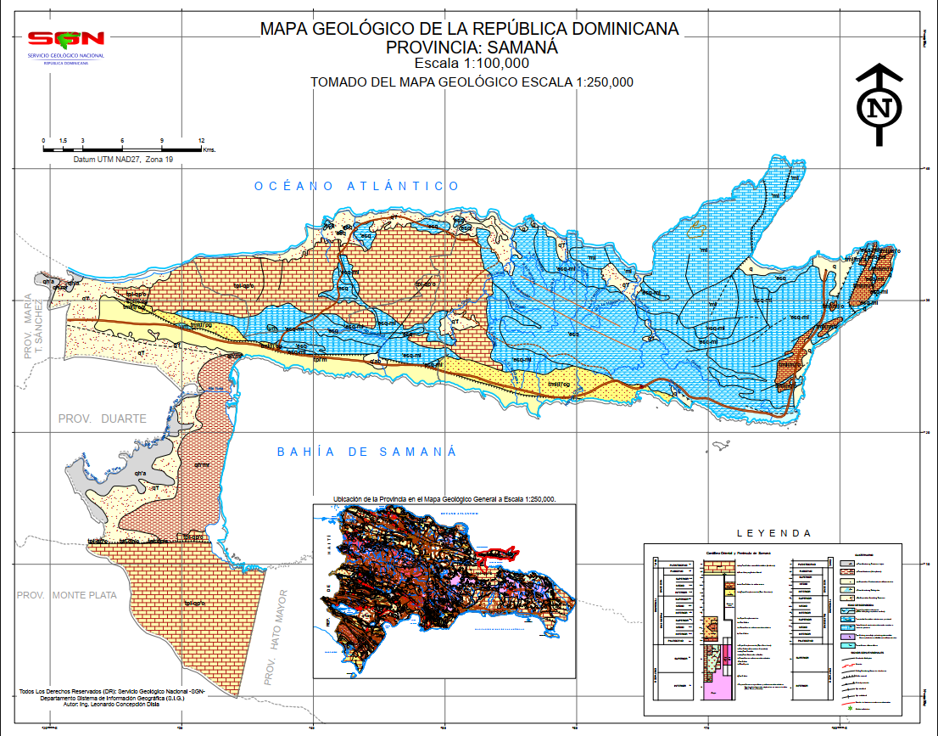
Geological settings
In 1946, this area experienced the impact of a tsunami, and we can observe an extraordinary SAR (sedimentary accumulation rate) as a result of this event.
In this zone, there are certain anomalies in the normalization ratio compared to the typical values for this area.
Please do not use this space, a QR code will be automatically overlayed
P5.2-762

Slide 3
Objectives
Reconstruct the temporal history of climate changes due to the impact of geological events on the Hispaniola island.
Analyze sediment samples from areas affected by extreme events such as tsunamis and droughts using XRF.
Determine the elemental composition of sediment samples using XRF and assess the concentration of strontium in relation to other elements for dating purposes.
Please do not use this space, a QR code will be automatically overlayed
P5.2-762

Slide 4
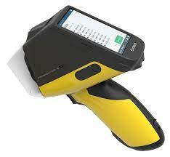
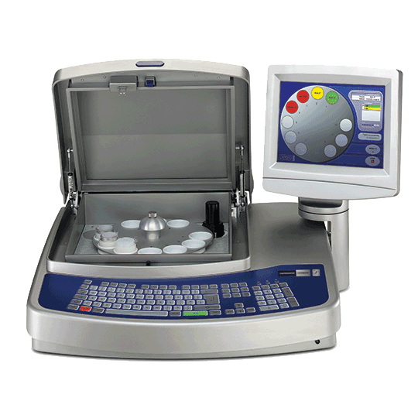
Methods
XRF is an analytical method that utilizes X-rays to examine the elemental makeup of materials by detecting and quantifying the emitted fluorescent X-rays. It is a non-destructive technique applicable to a wide range of substances. In the field of geological dating, XRF enables the determination of element concentrations, such as strontium, aiding in the estimation of sample age through the assessment of radioactive isotope ratios.
Please do not use this space, a QR code will be automatically overlayed
P5.2-762

Slide 5
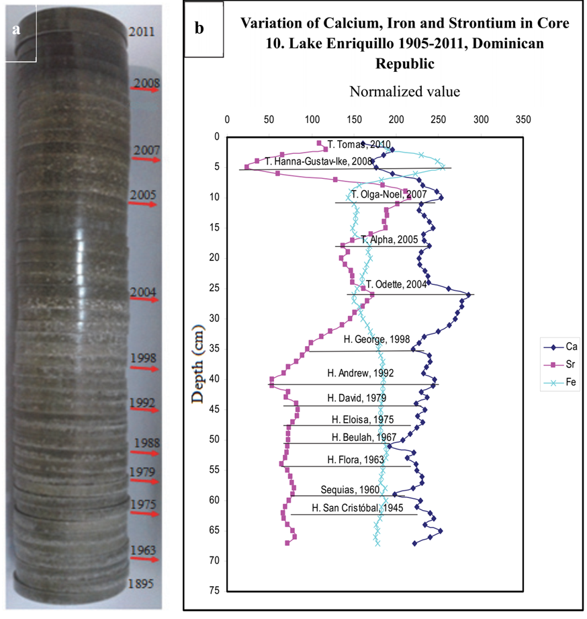
Results
The method combines sediment analysis and radiometric dating to reconstruct historical records of climate events, providing insights into their occurrence and frequency over a specific time period, and contributing to a better understanding of past climatic variations and patterns. We can figure by de proportions of strontium de droughts
Please do not use this space, a QR code will be automatically overlayed
P5.2-762

Slide 6
Conclusion
Using radiometric dating to study paleo tsunami not only provides us with a deeper understanding of climate changes and phenomena, the immense time scale captured by strontium allows us to unlock invaluable knowledge.
Radiometric dating techniques will play a crucial role in understanding climate variations. Reconstructing historical climate events and comprehending their frequencies of occurrence using XRF analysis to determine sediment composition will not only help us understand tsunamis but also droughts and their impacts on the environment.
Please do not use this space, a QR code will be automatically overlayed
P5.2-762

Slide 7
References
Mendez-Tejeda, R., Delanoy, R. (2017). Influence of Climatic Phenomena on Sedimentation and Increase of Lake Enriquillo in Dominican Republic, 1900-2014. Journal of Geography and Geology, 9(4), 19. https://doi.org/10.5539/jgg.v9n4p19
Delanoy, R., Diaz Asencio, M., & Rodriguez, D. (2021). Geochemistry and Heavy Metal Levels in the Sediments of the Port of Santa Bárbara de Samana, Dominican Republic. Journal of Geoscience and Environment Protection, 9(ISSN Online: 2327-4344), 195-205. https://doi.org/10.4236/gep.2021.94012
Compston, W., & Pidgeon, R. T. (1962). Rubidium-Strontium Dating of Shales by the Total-Rock Method. Journal of Geophysical Research Atmospheres, 67(9), 3493-3502. https://doi.org/10.1029/JZ067i009p03493
Argentino, C., Reghizzi, M., Conti, S., Salocchi, A. C., Casadio, S., Fontana, D., & Gennari, R. (2017). Strontium Isotope Stratigraphy as a contribution for dating Miocene shelf carbonates (S. Marino Fm., northern Apennines). Rivista Italiana di Paleontologia e Stratigrafia, 123(1), 39-50. https://doi.org/10.13130/2039-4942/8017
SGN. (n.d.). Geología y Temáticos. Retrieved from https://www.sgn.gob.do/index.php/geologia-y-tematicos/info-geologia
HyperPhysics. (n.d.). Meteorite Impact Craters and Earth's History. Retrieved from http://hyperphysics.phy-astr.gsu.edu/hbase/Nuclear/meteorrbsr.html
Please do not use this space, a QR code will be automatically overlayed
P5.2-762

