Slide 1
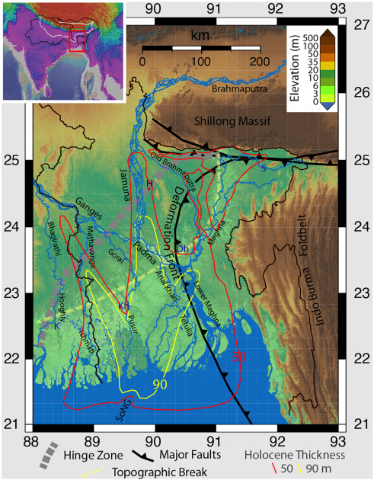
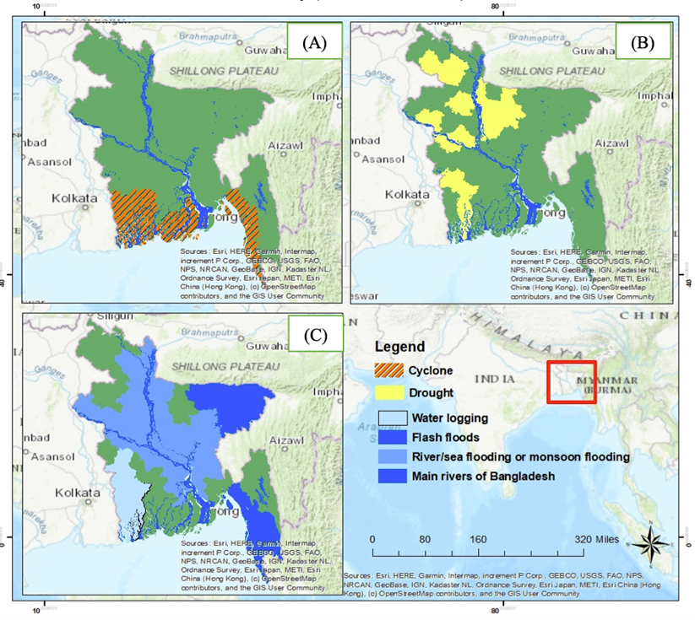
Integrating CTBTO data in academic research of Environmental Science and Disaster Management in Bangladesh
Mahfuza Parveenª*, Rajib Mohammad ^{b}, A.B.M. Kamal Pashaª
ªDepartment of Environmental Science and Disaster Management, Daffodil International University, Bangladesh.
^{b} Institute of Nuclear Minerals, AERE, Bangladesh Atomic Energy Commission and National Data Center Bangladesh (NDC-BD), CTBTO
P5.2-142
Bangladesh, a major part of the Bengal Basin, is an Earthquake prone country due to its location at the junction of two major tectonic plates.
Researcher suggested that the country might cause 7.5 to 8-9 Magnitude.
The data obtained from National Data Centre of Bangladesh (NDC-BD) through International Data Center (IDC) can contribute to improve the disaster preparedness systems of the country as part of their R&D activities.
The Department of Environmental Science and Disaster Management (ESDM) of Daffodil International University (DIU) has the scope of initiating a wide range of academic research covering geological, environmental and disaster related courses in collaboration with National Data Centre of Bangladesh under CTBTO.
In future the researcher of ESDM can also use CTBT’s International Monitoring System (IMS) selected data and resources to better understand the natural world and increase youth involvement from the university as well as Bangladesh.
If you want to learn more about the work, come see my e-poster during session 5.2 on 20 June from or access it online on the SnT2023 Conference platform!

