Slide 1
Integrating CTBTO data in academic research of Environmental Science and Disaster Management in Bangladesh
Mahfuza Parveenª*, Rajib Mohammad ^{b}, A.B.M. Kamal Pashaª
ªDepartment of Environmental Science and Disaster Management, Daffodil International University, Bangladesh.
^{b} Institute of Nuclear Minerals, AERE, Bangladesh Atomic Energy Commission and National Data Center Bangladesh (NDC-BD), CTBTO
*Presenting author
Bangladesh, a major part of the Bengal Basin, is an Earthquake prone country due to its location at the junction of two major tectonic plates. The consequence of the earthquake and other natural disasters would be devastating for the country for it’s over population, faulty and unplanned infrastructures.
The Department of Environmental Science and Disaster Management of Daffodil International University has the scope of initiating a wide range of academic research covering geological, environmental and disaster related courses in collaboration with National Data Centre of Bangladesh under CTBTO.
Can contribute to improve the disaster preparedness systems of the country.
Increase youth involvement from the university as well as Bangladesh
In future the researcher of Bangladesh can also use CTBT’s International Monitoring System (IMS) selected data and resources to better understand the natural world.
Please do not use this space, a QR code will be automatically overlayed
P5.2-142

Slide 2
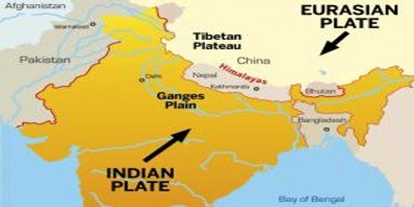
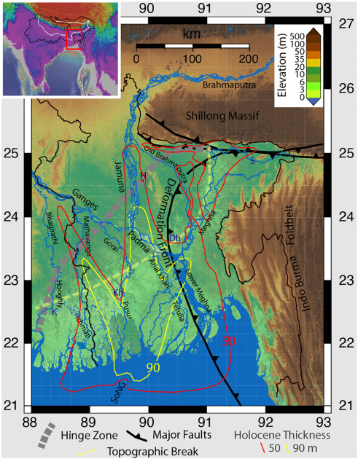
Introduction
The complicated geology of this basin is responsible for occurring several major and minor earthquakes in Bangladesh and it’s adjacent areas.
Figure: Tectonic map of Bengal Basin¹
Bangladesh, a major part of the Bengal Basin, is an Earthquake prone country due to its location at the junction of two major tectonic plates.
Because of its unique geographical location the country become one of the most vulnerable countries in the world to natural disasters.
Please do not use this space, a QR code will be automatically overlayed
Figure: Location map of Bangladesh and the Ganges Brahmaputra Delta showing major tectonic and sedimentary boundaries, and significant rivers
(Steckler et al., 2022).
P5.2-142

Slide 3
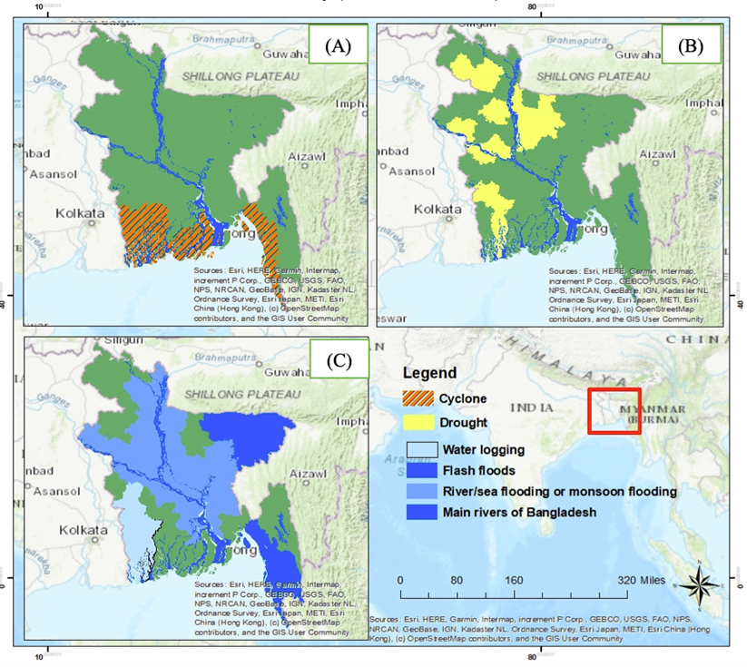
Disasters in Bangladesh
Major Disasters in Bangladesh
Cyclone
Flooding
Erosion
Salinization
Landslide and
Earthquake
Over the last two decades, the Global Climate Risk Index rates Bangladesh as the seventh most affected country in the world from extreme weather events.
Please do not use this space, a QR code will be automatically overlayed
Figure: Map of Disaster prone areas in Bangladesh Cyclone (A), Drought (B) and Flood (C) (Cardoso & Parveen et al., 2023).
P5.2-142

Slide 4
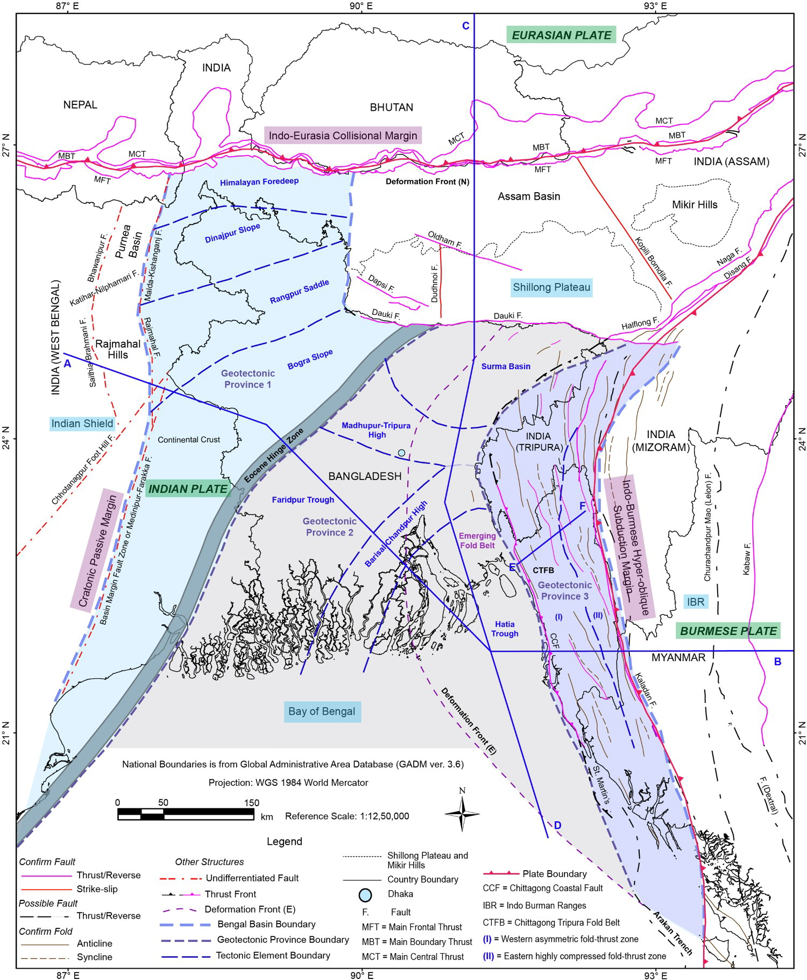
Earthquake in Bangladesh
Examples of earthquakes:
1885 Bengal earthquake (rev. Mw 6.8) close to the Hinge Zone,
1918 Srimangal earthquake (rev. Mw 7.1) on the Sylhet (trough) fault and
1923 Mymensingh earthquake (rev. Mw 7.0) at the northern end of the Hinge Zone where it intersects the Dauki Fault.
Shillong Plateau earthquakes like Great Assam Earthquake (1897, rev. Mw 8.1) and moderately active Indo-Burma subduction zone in the east.
Recent theories of Earthquake
The presence of a locked megathrust plate boundary generated enough tectonic stress in Bengal basin which might cause megathrust induced earthquakes (Mw 8-9) in Bangladesh (Steckler et al., 2016).
Not capable of earthquakes greater than Magnitude 7.5 in the Bengal Basin System (Karim et al., 2021).
Please do not use this space, a QR code will be automatically overlayed
Figure: Schematic Tectonic map of the Bengal Basin and its surroundings (Hossain et al., 2020)
P5.2-142

Slide 5
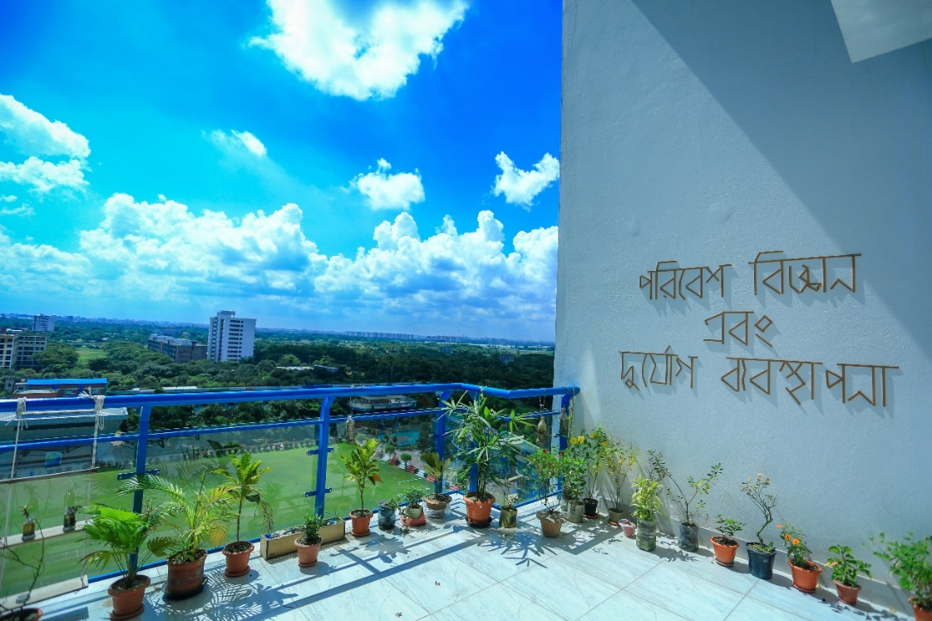
ESDM Overview
Daffodil International University (DIU) is one of the leading private universities in Bangladesh, established on 24 January, 2002 DIU provides higher education in 23 academic departments.
The Department of Environmental Science and Disaster Management (ESDM) of DIU covers
Earth Science
Environmental Science
Climatic Disaster
Disaster Risk Reduction
Climatic Hazard etc.
ESDM has published their collaboration work with United States of America, Portugal, Australia, Thailand, Srilanka, Japan.
DIU topped among private universities and 2nd among all public and private universities as per Scopus indexed quality research publications in 2022.
ESDM, DIU has the scope of initiating a wide range of academic research covering such geological, environmental and disaster related courses in collaboration with National Data Centre of Bangladesh under CTBTO.
Please do not use this space, a QR code will be automatically overlayed
P5.2-142

Slide 6
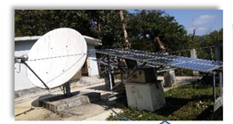
Concluding Remarks
The data obtained from National Data Centre of Bangladesh (NDC-BD) through International Data Center (IDC) can contribute to improve the disaster preparedness systems of the country.
The Department of Environmental Science and Disaster Management (ESDM) can utilize and make collaboration with the National Data Centre of Bangladesh under CTBTO through academic activities.
The collaboration work will be able to increase youth involvement from the university as well as Bangladesh.
In future the researcher of ESDM can also use CTBT’s International Monitoring System (IMS) selected data and resources to better understand the natural world, including the Earth’s core, marine life, climate change.
IMS and IDC products for geoscience researches
Ø Seismic Technology
Ø Hydroacoustic Technology
Ø Infrasound Technology
Ø Radionuclide Technology
Ø ATM (Atmospheric Transport Models)
Figure: Auxiliary Seismic Station
(BRDH) in Bangladesh under CTBTO established in 2011.
Further possible applications include backtracking of greenhouse gases such as carbon dioxide or methane to better assess their emissions in order to localize, and possibly monitor, their sources.
Please do not use this space, a QR code will be automatically overlayed
P5.2-142

Slide 7
References
https://en.banglapedia.org/index.php/Tectonic_Framework.
Cardoso, J.C. et al. (2023) ‘Climate Change and Humanitarian Responses: A Proposal of Education for Health Hazards Preparedness’, in Climate Change and Health Hazards: Addressing Hazards to Human and Environmental Health from a Changing Climate. Springer, pp. 407–425.
Hossain, M.S. et al. (2020) ‘Geodynamic model and tectono-structural framework of the Bengal Basin and its surroundings’, Journal of Maps, 16(2), pp. 445–458.
Karim, M.F. et al. (2021) ‘TECTONIC AND GEOTECHNICAL REVIEW OF BENGAL BASIN FOR SEISMIC RISK ASSESSMENT IN BANGLADESH’.
Steckler, M.S. et al. (2016) ‘Locked and loading megathrust linked to active subduction beneath the Indo-Burman Ranges’, Nature Geoscience, 9(8), pp. 615–618.
Steckler, M.S. et al. (2022) ‘Synthesis of the distribution of subsidence of the lower Ganges-Brahmaputra Delta, Bangladesh’, Earth-Science Reviews, 224, p. 103887. Available at: https://doi.org/https://doi.org/10.1016/j.earscirev.2021.103887.
https://www.daffodilvarsity.edu.bd/
Please do not use this space, a QR code will be automatically overlayed
P5.2-142

