Slide 1
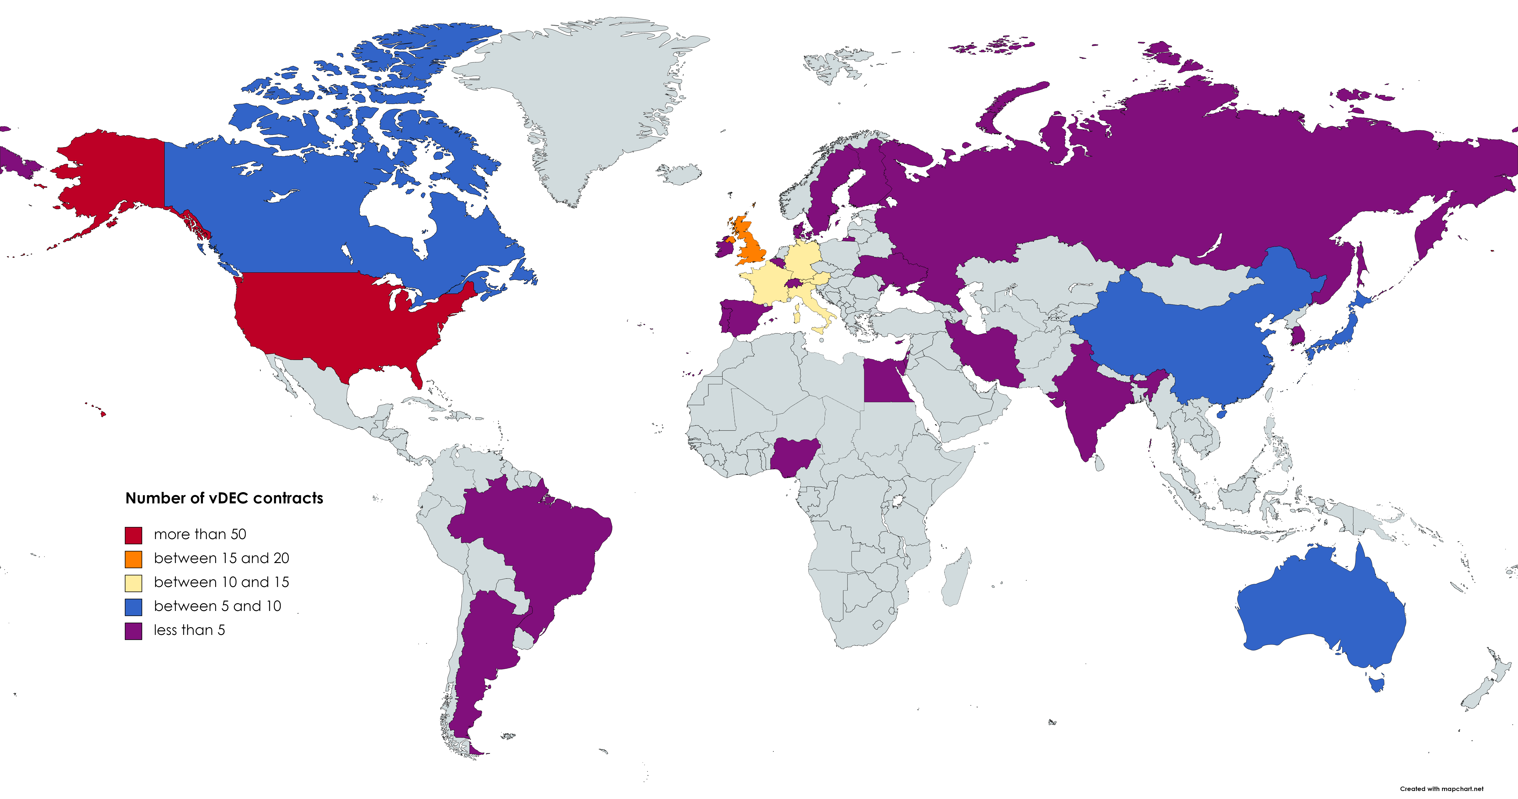
CTBTO Virtual Data Exploitation Centre (VDEC) as a Way to Access Data Collected
by the International Monitoring System
J. Kuśmierczyk-Michulec, R. Phiri, C. Saragiotis, M. Slinkard, P. Mialle, M.B. Kalinowski, T. Oliveira, R. Laput CTBTO
P5.2-288
How to get access to the IMS data for scientific purposes?
VDEC
Since 2011, vDEC contracts have been concluded with institutions representing 29 countries, including 3 International Organizations
As of today, 117 scientific papers were published using IMS data available via vDEC
Researchers use data representing one technology but more and more often they try to take advantage of availability of data from other technologies. Mixed technologies refer to the following combination of technologies: seismic and infrasound, hydroacoustic and seismic, seismic and radionuclide, hydroacoustic, seismic and infrasound.

