Slide 1
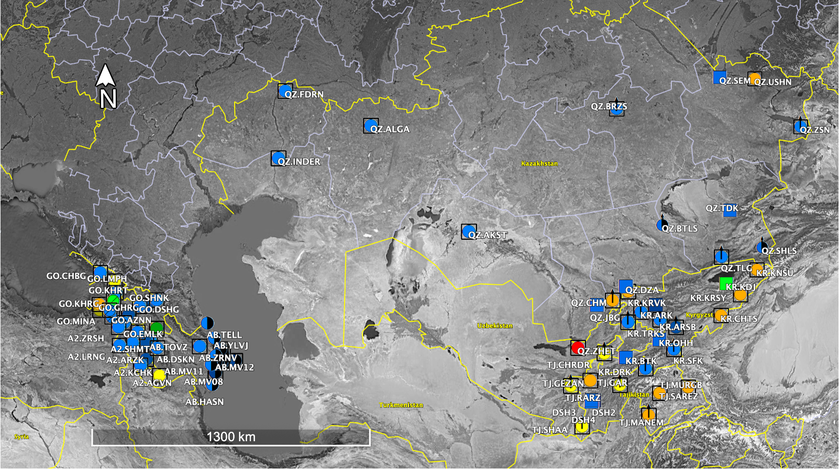
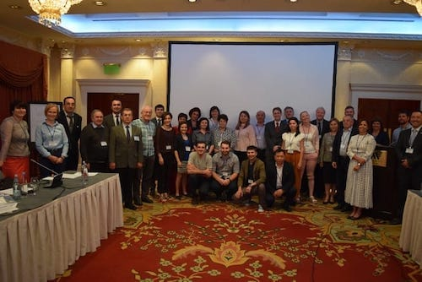
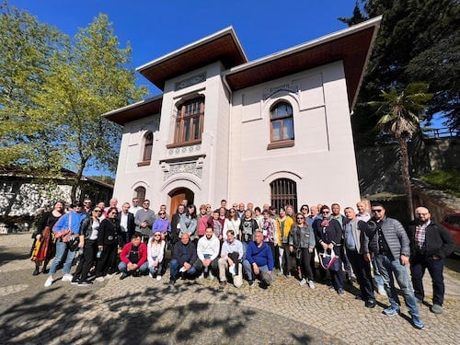
Seismic Network Expansion in the Caucasus and Central Asia (SNECCA)
Andrea Chiang, R. Gök, T. Godoladze, A. Berezina, A. Aguiar, K. Aderhold, K. Hafner, R. Woodward, K. Mackey, J. Stachnik, H. Babayan, G. Yetirmishli, N. Mikhailova, B. Ashirov, S. Negmatullaev
P5.2-464
Coordinated effort involving multiple institutions and countries
Strengthen national seismic monitoring and earthquake response in Caucasus and Central Asia
Training in best practices on station design, site selection, construction and installation, data management and sustainable network operation
Facilitate data exchange and open data
SNECCA Project
Map and legend show current status of stations
This work was performed under the auspices of the U.S. Department of Energy by Lawrence Livermore National Laboratory under Contract DE-AC52-07NA27344.

