Slide 1
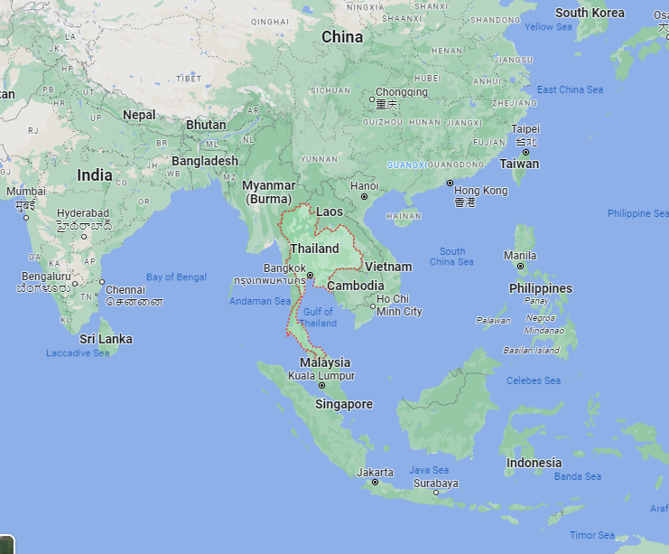
Effect of the monsoon on radioactivity concentrations of ^{212F}Pb and ⁷Be in particular matter at the THP65
Thawatchai Itthipoonthanakorn
Office of Atoms for Peace Thailand as Thai National Data Center
P5.2-143
Seasons
Rainy (mid May – mid October)
Winter (mid October – mid February)
Summer (mid February - mid May)
Monsoons
South West (mid May – mid October)
North East (mid October – mid February )
THP65
PHP52
Analysis
MYP42
IDC/IMS Data of THP65
Local Climate Data

