Slide 1
Review on the use of IMS radionuclide observations for scientific studies related to the Fukushima Daiichi nuclear power plant accident
Martin Kalinowski
International Data Centre (IDC), Comprehensive Nuclear-Test-Ban Treaty Organization (CTBTO), Vienna, Austria
The objective of this presentation is to explore what kind of scientific applications were made with the IMS observations of atmospheric radioactivity following the Fukushima Daiichi nuclear power plant accident.
In total 43 papers are included in this study.
The most frequent application is the reconstruction of the source term for ¹³⁷Cs, ¹³¹I, and ¹³³Xe.
Optimization of wet deposition schemes is another application highlighted here.
Benefits from scientific applications of IMS data include:
Enhancing radionuclide analysis and related atmospheric transport modelling (ATM) for CTBTO monitoring of atmospheric radioactivity
Please do not use this space, a QR code will be automatically overlayed
P5.2-321

Slide 2
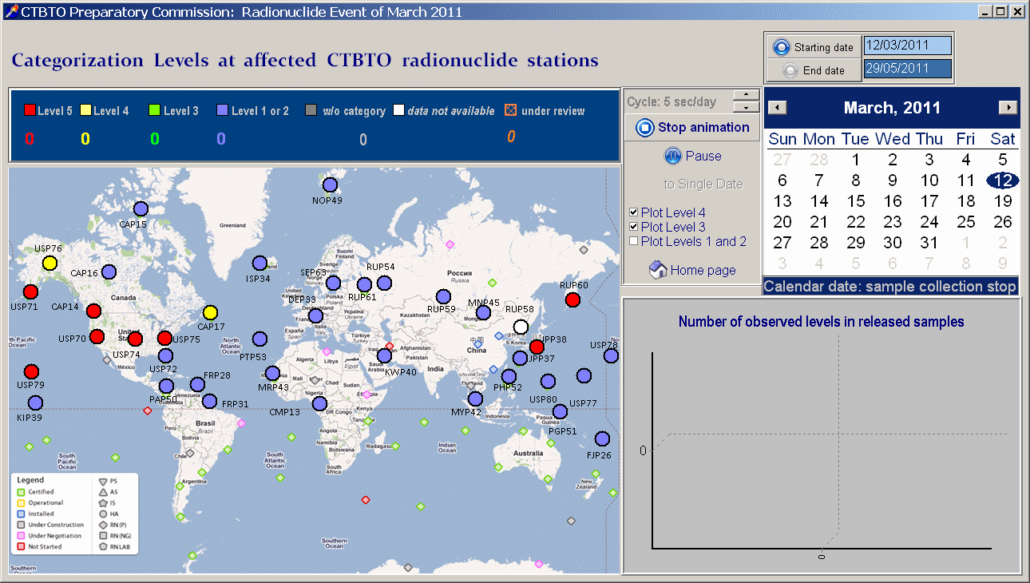
Introduction
In the months following the Fukushima Daiichi nuclear power plant accident, the IMS radionuclide stations observed elevated concentrations of anthropogenic radionuclides throughout the northern hemisphere. These data are unique in terms of the global coverage and the broader range of radionuclides than reported elsewhere, including four radioxenon isotopes.
The animation shows IMS sample categories in the time between 12 March and 30 May 2011.
P5.2-321
Please do not use this space, a QR code will be automatically overlayed

Slide 3
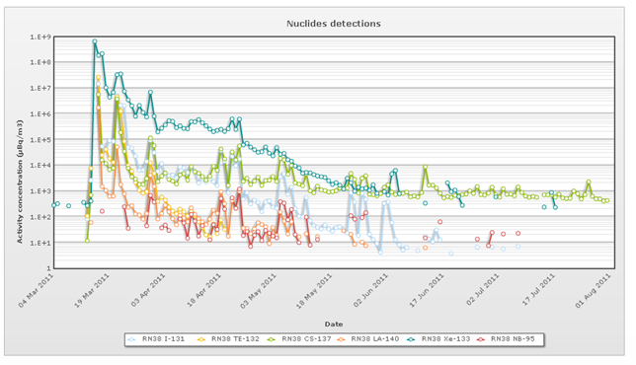
Objectives
The objective of this presentation is to explore what kind of scientific applications were made with the IMS observations of atmospheric radioactivity following the Fukushima Daiichi nuclear power plant accident.
P5.2-321
Please do not use this space, a QR code will be automatically overlayed

Slide 4
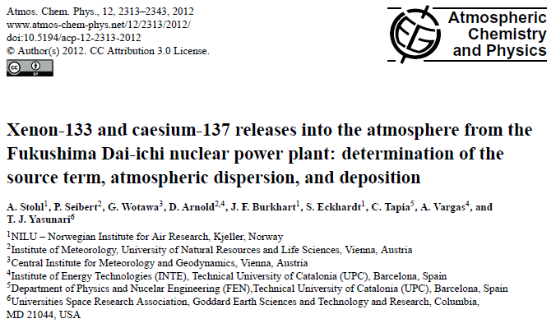
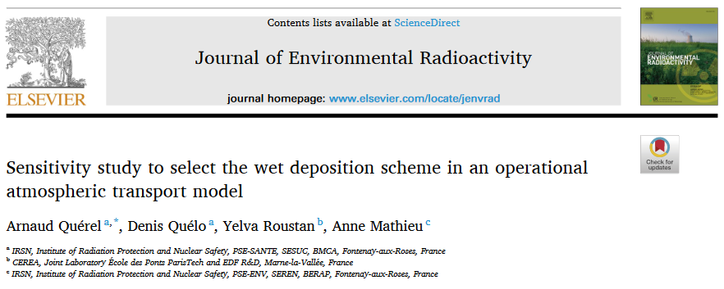
Methods
This presentation reviews the use of IMS radionuclide observations following the Fukushima Daiichi NPP accident in peer-reviewed scientific papers.
In total 43 papers are included in this study. There are different ways of using IMS data (multiple counts of the same publication possible)
29 make use of IMS data directly for own data analysis
9 make use of IMS data directly as background information
9 make use of IMS data indirectly by referring to other publications that use IMS data
P5.2-321
Please do not use this space, a QR code will be automatically overlayed

Slide 5
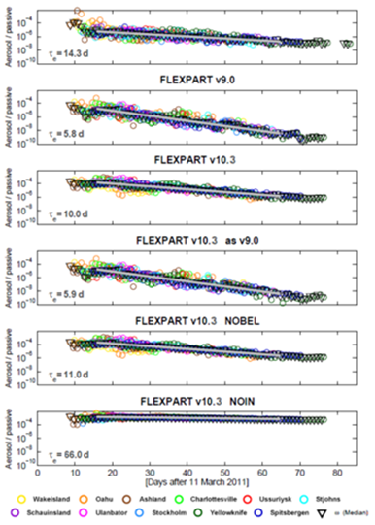
Results (1/4)
The IMS radionuclide observations were used and quoted in dozens of peer-reviewed scientific papers.
The most frequent application is the reconstruction of the source term for ¹³⁷Cs, ¹³¹I, and ¹³³Xe. Further applications include studies of wet deposition rates, enhancements for atmospheric transport modelling methods, reconstruction of release patterns, assessment of reactor damage, and environmental impact.
The following application are published in peer-reviewed papers (number of papers in second column):
Source term for ¹³⁷Cs, ¹³¹I, or ¹³³Xe | 9
Enhancements for atmospheric transport modelling methods | 8
Regional analysis including on environmental impact | 14
Global impact assessment | 9
Evaluation of procedures | 1
Assessment of reactor damage | 1
Sum | 42
P5.2-321
Please do not use this space, a QR code will be automatically overlayed
Thanks to Rosie Watt for supporting the information collection as intern at the CTBTO.
¹³⁷Cs and ¹³³Xe from Fukushima for aerosol lifetime estimation

Slide 6
Results (2/4)
Examples for publications that use IMS radionuclide observations for reconstructing the source term.
Isotope | Researchers | Activity release estimate (Bq)
Xe-133 | Stohl et al, 2011 | 16.7 * 10^18
 | Stohl et al, 2012 | 15.3 * 10^18
 | Eslinger et al, 2013 | 11.4 * 10^15
Cs-137 | Stohl et al, 2011 | 35.8 * 10^15
 | Ten Hoeve and Jacobson, 2012 | 17 * 10^15
 | Winiarerk et al 2012 | 100-190 * 10^15
 | Katata et al, 2015 | 14.5 * 10^15
I-131 | Winiarerk et al 2012 | 190-700 * 10^15
 | Ten Hoeve and Jacobson, 2012 | 65.3 * 10^15
 | Katata et al, 2015 | 151 * 10^15
P5.2-321
Please do not use this space, a QR code will be automatically overlayed
Thanks to Rosie Watt for supporting the information collection as intern at the CTBTO.

Slide 7
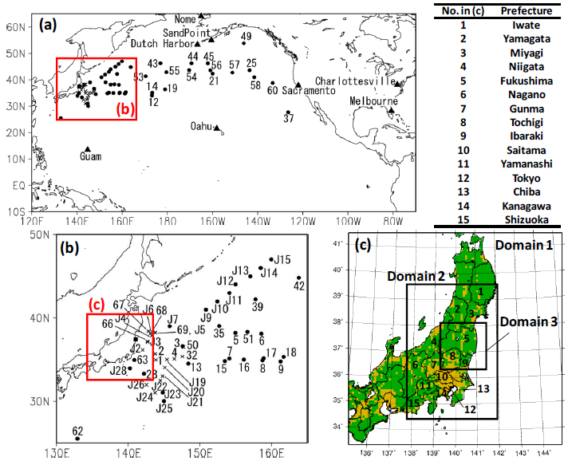
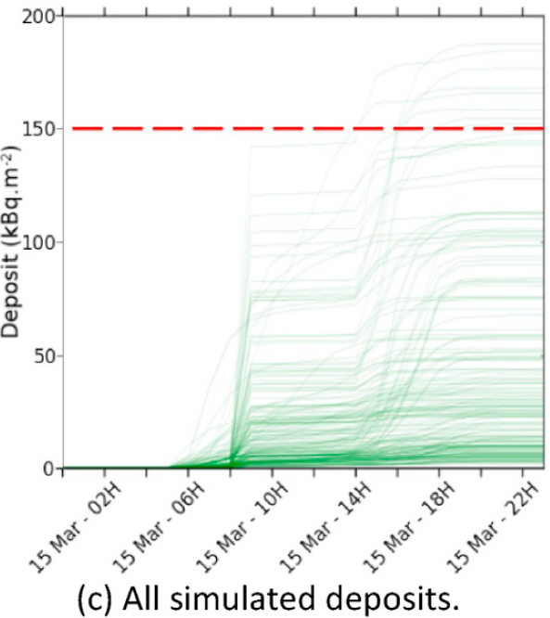
IMS data
Radioactive noble gas
Particle-born radioactivity
Katata et al. (2015)
Cs-137 source term
Acknowledged as good estimate
Querel et al. (2021)
Select wet deposition scheme
For operational ATM
Results (3/4)
Examples: From IMS data, through source term estimates to wet deposition schemes.
Benefits to international organizations and society from scientific results:
Enhance ATM for CTBTO monitoring of atmospheric radioactivity
Optimize modelling of ground deposition for emergency response
P5.2-321
Please do not use this space, a QR code will be automatically overlayed

Slide 8
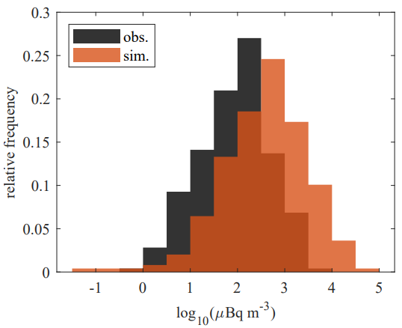
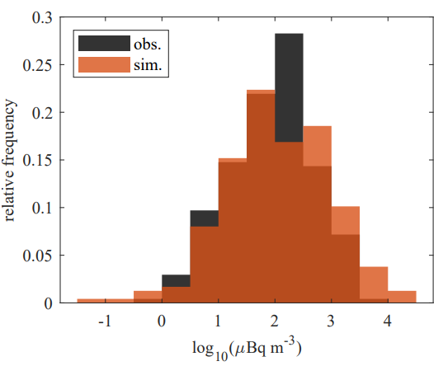
IMS data
Radioxenon: Xe-133
Van Leuven et al. (2023)
Optimized scheme for wet scavenging rate
For operational ATM
Particulate radioactivity: Cs-137
Results (4/4)
Examples: From IMS data, directly to wet deposition schemes.
Benefits to international organizations and society from scientific results:
Enhance ATM for CTBTO monitoring of atmospheric radioactivity
Optimize modelling of ground deposition for emergency response
P5.2-321
Please do not use this space, a QR code will be automatically overlayed
Cs-137 concentrations: reference (left plot) and optimised (right plot) vs. IMS observations.

Slide 9
Conclusions
This presentation reviews the use of IMS radionuclide observations following the Fukushima Daiichi NPP accident in dozens of peer-reviewed scientific papers. The most frequent application is the reconstruction of the source term for 137Cs, 131I, and 133Xe. Further applications include studies of wet deposition rates, enhancements for atmospheric transport modelling methods, reconstruction of release patterns, assessment of reactor damage, and environmental impact.
Benefits resulting from scientific applications of IMS radionuclide data:
Advance fundamental understanding of physical process in the atmosphere like wet deposition.
Enhance radionuclide analysis and related atmospheric transport modelling (ATM) for CTBTO monitoring of atmospheric radioactivity
Assessment of accident processes and optimize environmental impact like ground deposition for emergency response
P5.2-321
Please do not use this space, a QR code will be automatically overlayed

Slide 10
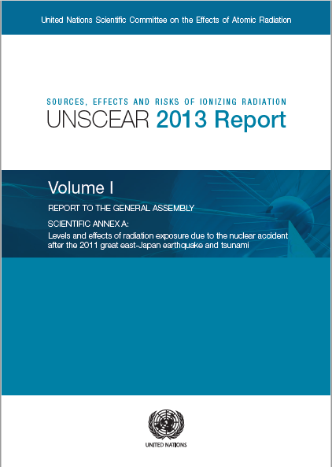
References
The IMS radionuclide observations following the Fukushima Daiichi nuclear power plant accident are available for scientific research through the virtual Data Exploitation Centre (vDEC) after signing a cost-free confidentiality agreement with the CTBTO.
Part of these radionuclide concentrations were given to UNSCEAR for inclusion in their 2013 report. These data are highlighted in its scientific Annex on “Levels and effects of radiation exposure due to the nuclear accident after the 2011 great east-Japan earthquake and tsunami” as being unique in terms of the global coverage and the broader range of radionuclides than reported elsewhere, including four radioxenon isotopes.
Van Leuven, S., De Meutter, P., Camps, J., Termonia, P., & Delcloo, A. (2023). An optimisation method to improve modelling of wet deposition in atmospheric transport models: applied to FLEXPART v10. 4. EGUsphere, 2023, 1-27. https://doi.org/10.5194/egusphere-2023-357
Querel, A., Quelo, D., Roustan, Y., and Mathieu, A. (2021). Sensitivity study to select the wet deposition scheme in an operational atmospheric transport model, Journal of Environmental Radioactivity, 237, https://doi.org/10.1016/j.jenvrad.2021.106712
Stohl et al, 2011
Stohl et al, 2012
Eslinger et al, 2013
Stohl et al, 2011
Ten Hoeve and Jacobson, 2012
Winiarerk et al 2012
Katata et al, 2015
Winiarerk et al 2012
Ten Hoeve and Jacobson, 2012
Katata et al, 2015
P5.2-321
Please do not use this space, a QR code will be automatically overlayed

