Slide 1
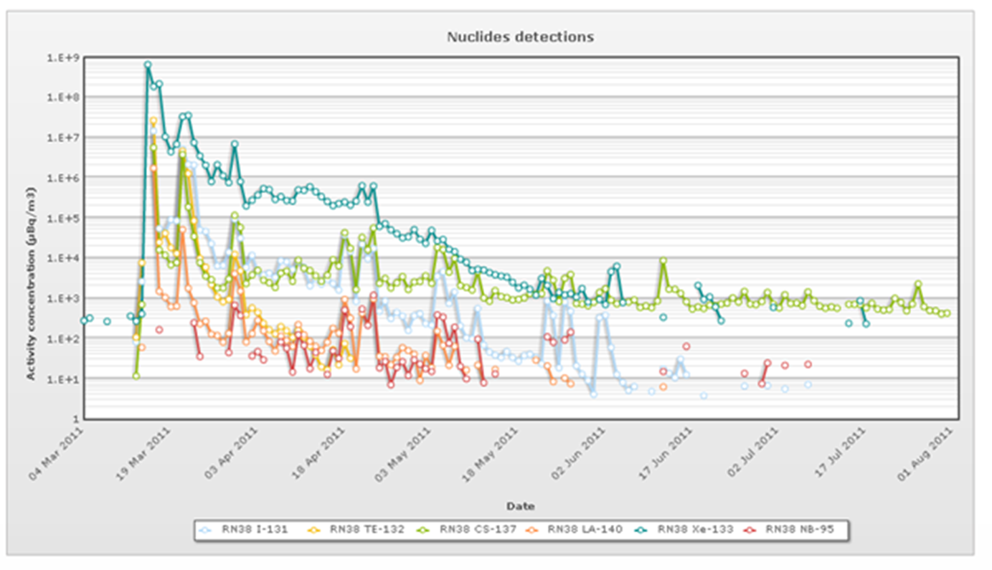
Review on the use of IMS radionuclide observations for scientific studies related to the Fukushima Daiichi nuclear power plant accident
Martin Kalinowski
Comprehensive Nuclear-Test-Ban Treaty Organization
P5.2-321
This presentation reviews the use of IMS radionuclide observations following the Fukushima Daiichi NPP accident.
43 peer-reviewed scientific papers were found that use these IMS data.
.
The most frequent application is the reconstruction of the source term for key radionuclides.
Special focus is given on studies of wet deposition schemes to enhance atmospheric transport modelling (ATM).
Benefit for the CTBT: Radionuclide analysis and related ATM of atmospheric radioactivity can be enhanced.

