Slide 1
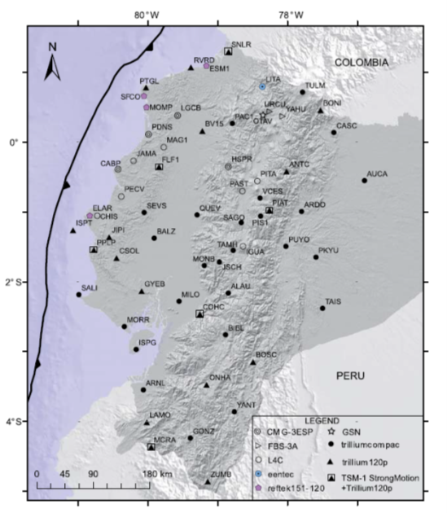
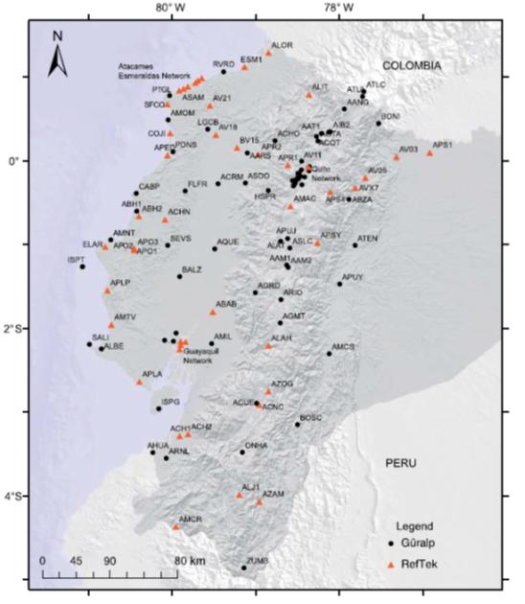
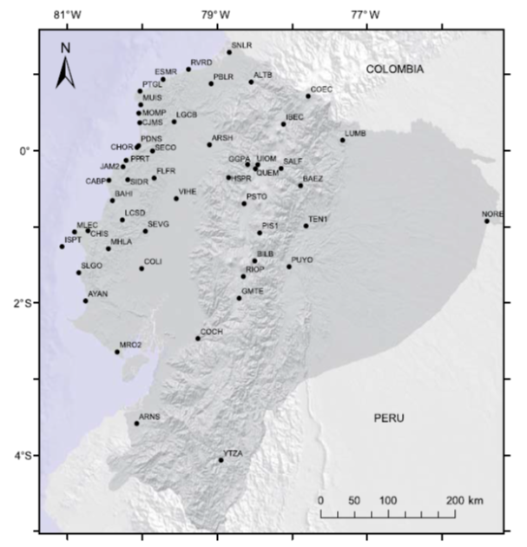
Seismic and Volcanic Networks in real time of Instituto Geofísico in Ecuador: performance, evaluation and optimization
Cristina Ramos, Cristina González, Ana Peralvo
Instituto Geofísico de la Escuela Politécnica Nacional
P5.2-58
This e-poster shows 4 main features of seismic and volcanic networks in real time:
- Coverage
Availability
Evaluation
Optimization
Seismic network Strong motion network Geodetic network
90% monitoring instrumentation installed in Ecuador has real time transmission.
If you want to learn more about this, come see my e-poster during session P5.2-58 on Tuesday 20th, or access it online on the SnT2023 Conference platform!

