Slide 1
Community Preparedness for Tsunami Disaster: A Case Study for Tsunami Ready Community in Glagah Village, Kulon Progo, Yogyakarta - Indonesia
Prayoedhie S., A. K. Ekarsti, D. Ngadmanto, B. Yudhiastuti, Y. D. Trisnowati
Meteorology, Climatology, and Geophysics Agency of Indonesia
Glagah Village has a high tsunami vulnerability, thus it is necessary to prepare its community for a tsunami that can occur at any time. The community of Glagah Village and many stakeholders in building a tsunami preparedness community have received national recognition from Indonesia's National Tsunami Ready Board and international recognition by IOC-UNESCO.
This study adopts a qualitative method and desk study. The qualitative approach was conducted through participatory observation and focus group discussions. The fulfillment of the IOC-UNESCO Tsunami Ready Indicator requires data collected in the field.
Glagah Village has fulfilled all the Tsunami Ready Indicators. The people of Glagah have taken preparedness steps collaboratively, covering all elements of assessment, preparedness, and response.
Glagah Village has recognized as Tsunami Ready by NTRB in January 2022 and as a Tsunami Ready by IOC-UNESCO in November 2022.
Please do not use this space, a QR code will be automatically overlayed
P5.2-048

Slide 2
Why Glagah Village Should be Tsunami Ready?
Glagah is one of the cultural village in Kulon Progo, Yogyakarta, Indonesia which has several tourist objects, such as the beach, the Sidorejo Stupa site, the Puro Pakualam Pesanggrahan, and the Buk Abang bridge heritage. The village is also famous for cultural activities including the Arak-Arak Gunungan festival, wayang kulit, traditional dancing, Adus Gongso festival, and Labuhan festival. As well the existence of Yogyakarta International Airport in Glagah as a gateway to Yogyakarta.
The activity of the subduction zone in southern of Java island has been generating severe earthquakes and tsunami events in the past. This natural disaster made the southern region of Java, including Yogyakarta, prone to tsunami. Glagah is one of 1.013 villages in Indonesia that has a high tsunami vulnerability.
Therefore, it is necessary to carry out reasonable mitigation efforts by setting up a system that can ensure the preparation of disaster-prone areas so that more lives can be saved. Preparations that need to be made include better planning, education, awareness, and emergency managers strengthening their local operations.
Please do not use this space, a QR code will be automatically overlayed
P5.2-048

Slide 3
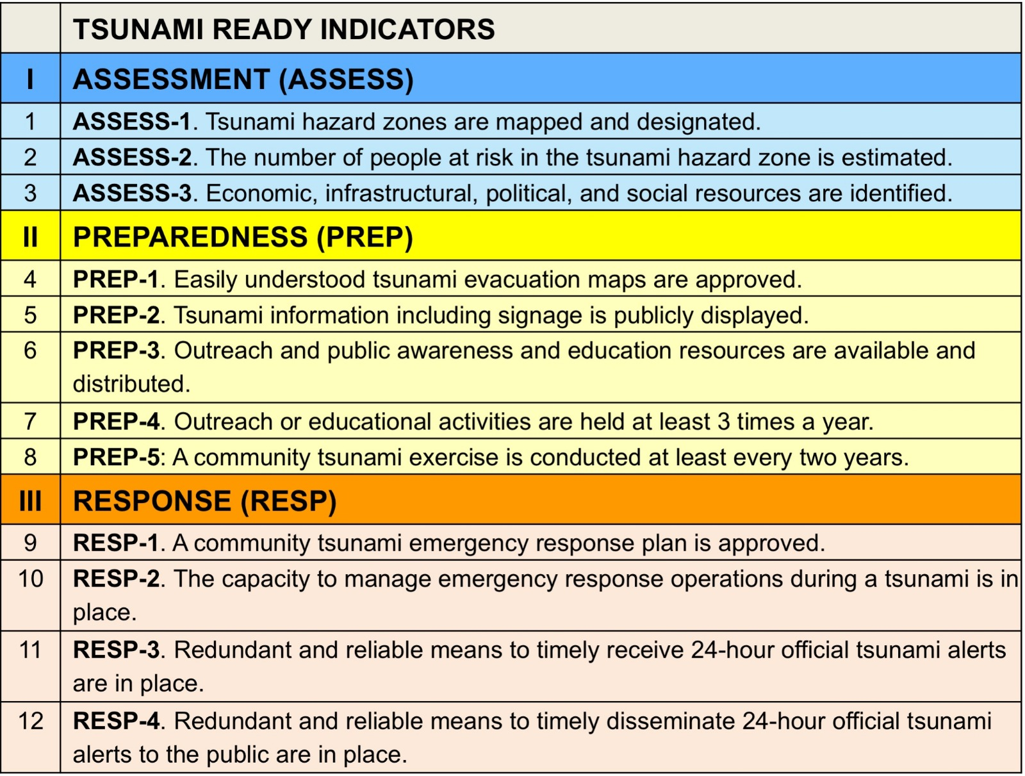
The Goals of Tsunami Ready Programme
The goals of the Tsunami Ready Programs:
Improve coastal community preparedness for tsunami and to minimize the loss of life, livelihoods and property.
Identification and fulfillment of tsunami ready indicators, including assessment, preparedness, and response
National and International Tsunami Ready Recognition
Please do not use this space, a QR code will be automatically overlayed
P5.2-048

Slide 4
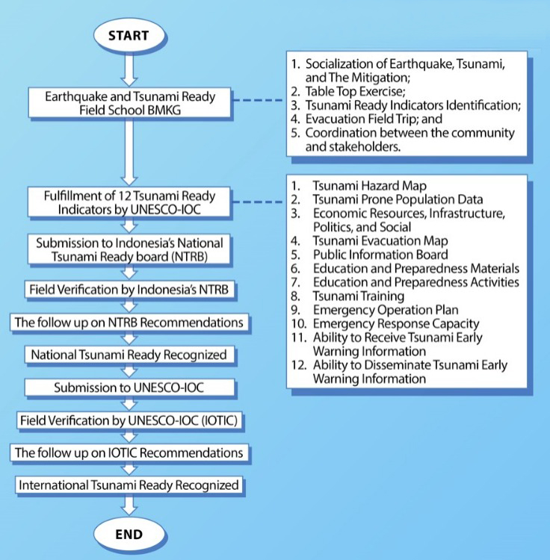
Data and Methods
Data
The fulfillment of the IOC-UNESCO Tsunami Ready Indicator requires data collected in the field. Data collection to meet the tsunami ready indicator is carried out by collecting data in the Glagah Village government, Glagah Regional Disaster Management Agency (BPBD), and community organizations such as Glagah Village Community Preparedness Forum (FPRB Glagah Village).
Methods
The method used in this study was to conduct interviews with the Glagah Village government, BPBD Kulonprogo Regency, Glagah Village Community Preparedness Forum (FPRB), and the Glagah Regency Tourism Office. As well, a field survey was conducted to determine the distribution of evacuation signs and tsunami disaster information boards and tsunami shelters in Glagah Village. This survey aims Tsunami Ready mapping was carried out using the standards set by IOC- UNESCO. The field survey was carried out on 2021-2022 by visiting the institutions mentioned above to collect data, conduct interviews, and conduct field visits to obtain data.
Please do not use this space, a QR code will be automatically overlayed
P5.2-048

Slide 5
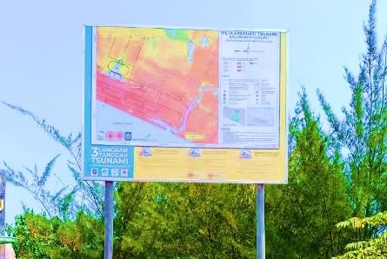
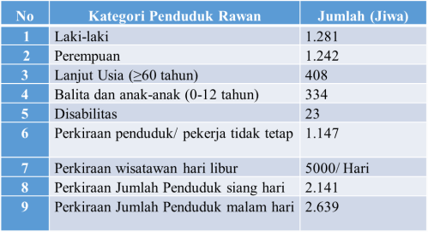
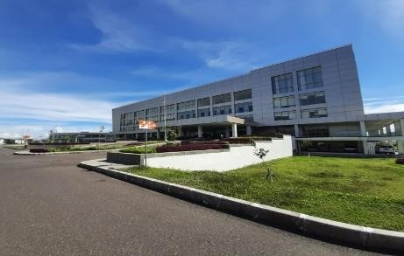
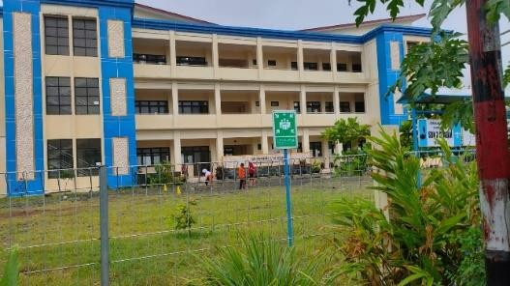
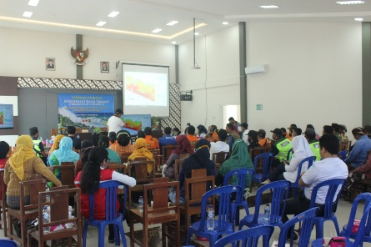
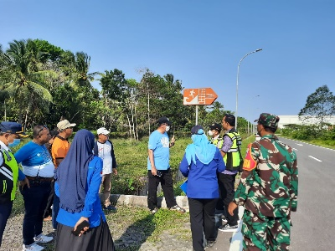
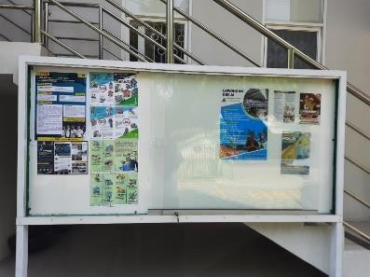
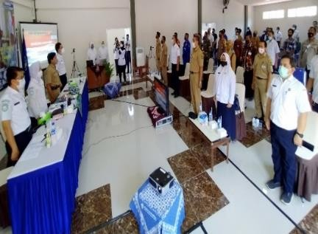
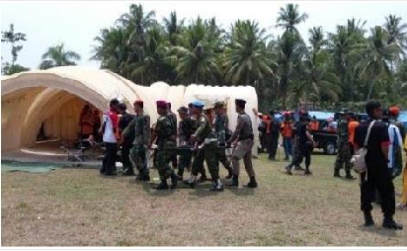
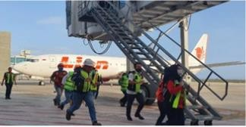
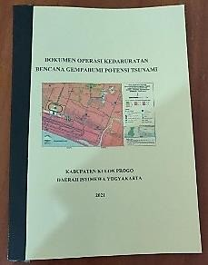
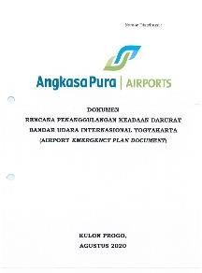
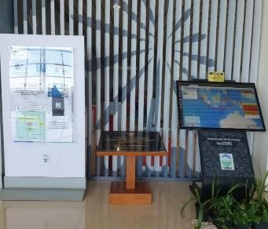
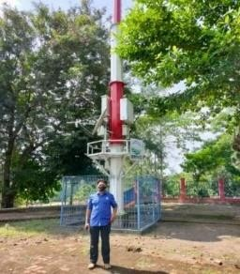
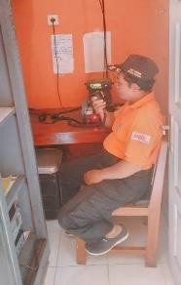
Tsunami Ready Indicators Fulfillment
The collaboration between community of Glagah Village and their stakeholder have taken covering all Tsunami Ready Indicators, including assessment, preparedness, and response.
From left: Tsunami Hazard Map in Glagah beach area; Tsunami prone Population Data; YIA as Vertical evacuation building; SDN 3 Glagah as a temporary evacuation building
From left: Sozialitation of Tsunami Hazard Map to the community; Tsunami Evacuation Route Assessment; Public Information Board within tsunami mitigation materials;
Earthquake and tsunami ready field school; tsunami drill in Glagah Village
Please do not use this space, a QR code will be automatically overlayed
From left: tsunami drill in YIA; emergency operation plan in Glagah Village and YIA; Warning Receiver System (WRS) New Gen in YIA, Tsunami Early Warning Sirens in Glagah Beach; HT Radio; Kentongan as local wisdom for disseminating emergency situation.
P5.2-048

Slide 6
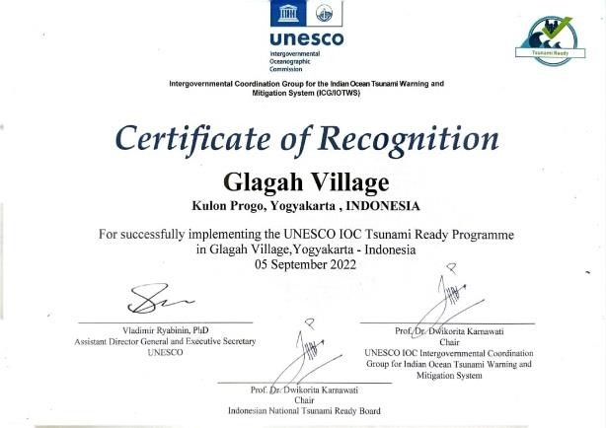
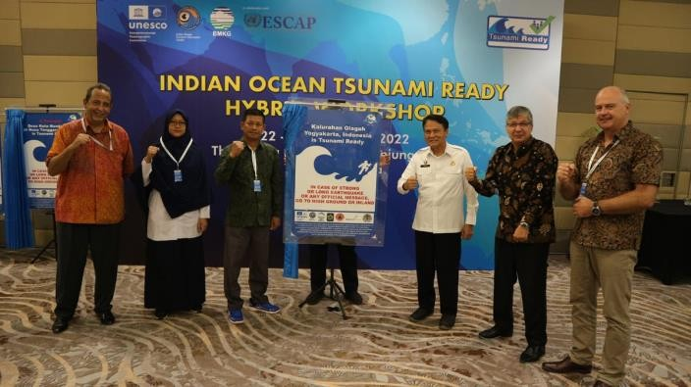
Conclusion
The Glagah community have preparedness for tsunami and capacity through Identification and fulfillment of tsunami ready indicators, including assessment, preparedness, and response to minimize the loss of life, livelihoods and property.
Glagah has recognized as National Tsunami Ready by National Tsunami Ready Board (NTRB) Indonesia in January 2022 and as International Tsunami Ready by IOC-UNESCO in November 2022.
Please do not use this space, a QR code will be automatically overlayed
P5.2-048

Slide 7
References
[1] A.E. Sakya dkk., Sow the seeds of tsunami ready community in Indonesia: Lesson learned from Tanjung Benoa, International Journal of Disaster Risk Reduction 87 (2023), https://doi.org/10.1016/j.ijdrr.2023.103567.
[2] C. A. D. S. Nusantara dkk., Mapping of IOC-UNESCO Tsunami Ready Indicators in the Pangandaran Village, Indonesia, IOP Conf. Series: Earth and Environmental Science 925 (2021), doi:10.1088/1755-1315/925/1/.
[3] BMKG Stageof Sleman, Peta Bahaya Tsunami Daerah Istimewa Yogyakarta, 2022.
[4] BMKG, Katalog Tsunami Indonesia 416 – 2018, BMKG, 2019, 978-602-52407-0-6.
[5] http://itic.ioc-unesco.org/index.php?option=com_content&view=category&id=2234&Itemid=2758.
[6] BNPB, Katalog Desa/Keluarahan Rawan Tsunami, 2019
[7] D. Karnawati, Tsunami Ready Community, Focus Group Discussion on Science Policy Interface on UNESCO IOC Tsunami Ready Recognition (UITR) Program, BRIN, Jakarta, 26 April 2022
[8] https://glagah-kulonprogo.desa.id/
Please do not use this space, a QR code will be automatically overlayed
P5.2-048

