Slide 1
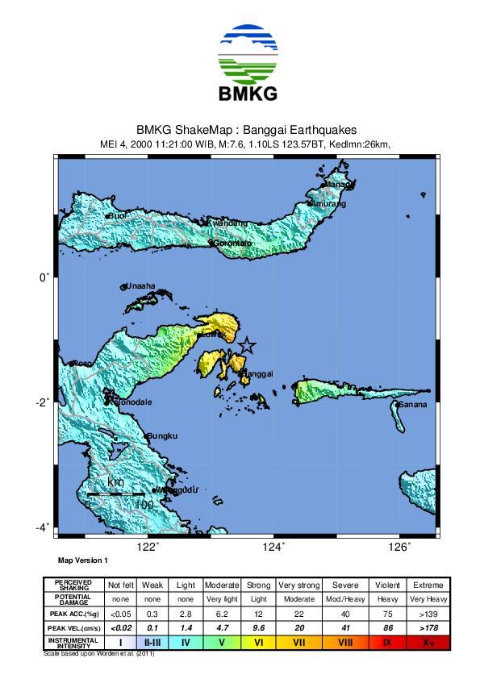
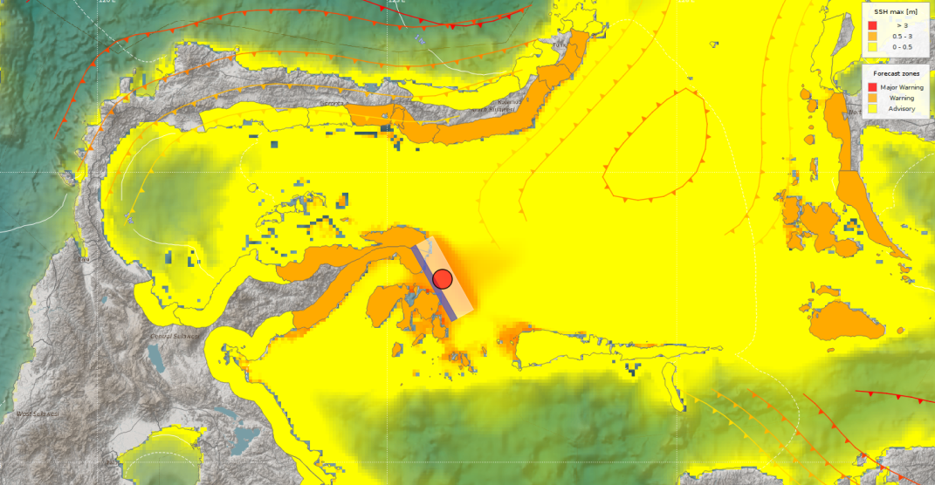
Preserving Past Tsunami Banggai 2000
[Litanya Octonovrilna¹, Ardito M. Kodijat², Alfath Abubakar¹, Admiral Musa Julius¹, Januar Arifin¹]
Indonesian Meteorology, Climatology and Geophysics Agency¹, UNESCO²
P5.2.130
Past earthquakes in the Banggai area were not widely reported. Lack information of the source mechanism and the tsunami making it difficult to obtain a complete picture of the disaster events. The earthquake and tsunami on May 4, 2000 is one example. The tsunami earthquake that occurred, although very local in nature, had quite impact on damage in some locations. However, generating mechanism correlated with earthquake sources, propagation and affected areas is not satisfied enough and raises a number of questions.
If you want to learn more about this, come see my e-poster during session P5.2 on this date or access it online on the SnT2023 Conference platform!

