Slide 1
The Interconnection between the Comprehensive Nuclear Test Ban Treaty (CTBT) and the Nuclear Non-proliferation Treaty (NPT)
¹Engr. Awwal Bisallah,¹Mr. Chad C. Anyaegbu, ¹Mr. Modibbo Ibrahim, ¹Dr. Uchenna O. Madu
1 - Nigeria Atomic Energy Commission (NAEC)
This gives a snapshot of the interconnection that exist between two key Treaties – the Comprehensive Nuclear Test Ban Treaty and the Nuclear Non-Proliferation Treaty (NPT)
This widespread benefits of peaceful uses of nuclear lends credence to the enormous success of the NPT regime as well as the Civil applications of the CTBT within the scope of the IMS data and IDC products Textbox
The outcome of our work indicates that both the CTBT and the NPT have significant complementarity in supporting the total elimination of nuclear weapons
Both CTBT & NPT have proven to be essential for the promotion of global peace and security through their contributions to the reduction of global nuclear weapons.
Please do not use this space, a QR code will be automatically overlayed
P5.2-807

Slide 2
INTRODUCTION
While the focus of the Comprehensive Nuclear-Test-Ban Treaty (CTBT) is to ban nuclear explosions by everyone, everywhere: above ground, under water and underground, the NPT plays a key role in preventing the spread of nuclear weapons and nuclear weapons technology with the objective of fostering the peaceful uses of nuclear science and technology and furthering the goal of disarmament.
This widespread benefits of peaceful uses of science are an enormous success of the NPT regime as well as the Civil applications of the CTBT within the scope of the IMS data and IDC products. This work looks at how the CTBT and the NPT are interconnected and complementary to one another while still being different.
Please do not use this space, a QR code will be automatically overlayed
P5.2-807

Slide 3
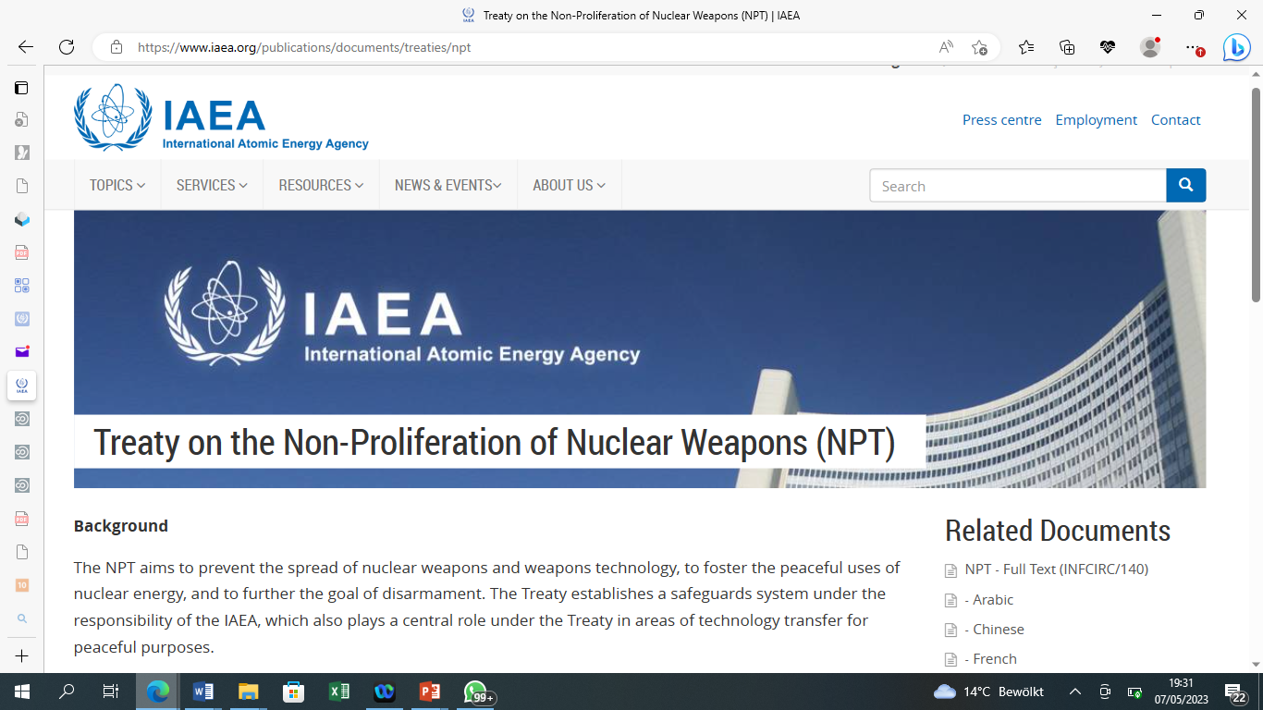
THE NPT
The NPT was opened for signature in 1968. Under the NPT, which is the most widely adhered to treaty in the field of nuclear non-proliferation, peaceful uses of nuclear energy and nuclear disarmament, non-nuclear-weapon States parties have committed themselves not to manufacture or otherwise acquire nuclear weapons or other nuclear explosive devices while nuclear-weapon States parties have committed not to in any way assist, encourage or induce any non-nuclear-weapon State party to manufacture or otherwise acquire nuclear weapons or other nuclear explosive devices
Please do not use this space, a QR code will be automatically overlayed
P5.2-807

Slide 4
COMPREHENSIVE NUCLEAR TEST BAN TREATY (CTBT)
The CTBT, on the other part, is a multilateral Treaty established to ban nuclear weapons test explosions and any other nuclear explosions in all environments. It was adopted by the United Nations General Assembly on 10 September 1996, but has not entered into force, as eight nations of the 44 Annex II States have not ratified the treaty
Please do not use this space, a QR code will be automatically overlayed
P5.2-807

Slide 5
INTERCONNECTION
While the NPT entered into force since 1970, the CTBT is yet to as it requires the ratification of the remaining 8 annex II States. but both the CTBT and the NPT are considered essential global instruments for the enhancement of international peace and security through the banning of nuclear weapons tests and constraining further development of existing nuclear weapons
The two treaties are interconnected in that they both offer a foundation for eliminating the spread of nuclear weapons and providing the necessary tools for the promotion of global stability. Even before its entry into force, the CTBT is already contributing to global peace and security like the NPT.
Please do not use this space, a QR code will be automatically overlayed
P5.2-807

Slide 6
INTERCONNECTION (2)
As can be seen while NPT seeks to reduce nuclear weapons through ensuring that the parties that have no nuclear weapons are not supported to have, the CTBT seeks to reduce nuclear weapons through the ban on nuclear weapons tests which is prerequisite for nuclear weapons production. In this wise, both instruments are essential for the promotion of global peace and security through their contributions, directly and indirectly, to the reduction of global nuclear weapons which are currently in thousands across the globe.
Because of this strong interconnection, the CTBT took the center stage during the NPT Review Conference which took place in August 2022 in New York, USA. This Conference provided a benchmark to support the entry into force of the CTBT, which is considered the cornerstone of non-proliferation. At that Conference, the CTBT is considered critical in the attainment of the goals and objectives of the NPT globally and the need to support its entry into force.
Please do not use this space, a QR code will be automatically overlayed
P5.2-807

Slide 7
CONCLUSION
Since the opening of the CTBT for signatures, all signatory states including US, Russia and China, France etc stopped nuclear weapons tests. Only 3 non signatory states have carried out tastes thereafter. This gives credence to the strong role of the CTBT in stopping nuclear weapons tests and its complementary stance with the NPT and the need for Member States to promote the speedy entry into force of the CTBT as it will further strengthen the NPT’s work.
Please do not use this space, a QR code will be automatically overlayed
P5.2-807

Slide 8
REFERENCES
https://www.ctbto.org
“Unfinished Business: The Negotiation of the CTBT and the End of Nuclear Testing.” - Rebecca Johnson
www.iaea.org/publications/documents/treaties/npt
www.nti.org
https://www.armscontrol.org/factsheets
UN General Assembly Resolution - A/RES/72/70
https://www.nti.org/education-center/treaties-and-regimes
“Strengthening the CTBT and Its Verification Regime” – www.vcdnp.org
Please do not use this space, a QR code will be automatically overlayed
P5.2-807

