Slide 1
California and Nevada Short Term Seismic Risk Detection
Farzad Azima
Earling Ltd.
Revolutionary technology in earthquake early warning systems provides advanced risk acknowledgment of unusual earthquakes, days in advance, compared to mere seconds. California and Nevada are leading regions already benefiting from these models.
Using big data analysis, seismographs, and IoT devices enables early detection and prediction of earthquakes, enhancing risk management.
Big data analysis reveals precursory indicators for early earthquake detection, empowering timely response plans and risk mitigation. Open Quake provides accurate seismic risk information by zip code, revolutionizing risk management practices for various sectors.
Revolutionary earthquake early warning systems based on big data analysis offer advanced risk detection and potential to transform risk management practices. California and Nevada are already experiencing the benefits of these models.
Please do not use this space, a QR code will be automatically overlayed
P5.2-765

Slide 2
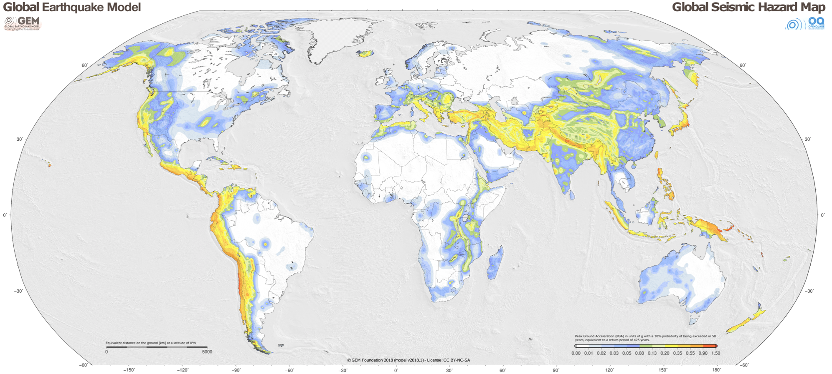
Introduction
The predictability of unusual earthquakes in California and Nevada has become a topic of great interest and importance for authorities and risk managers particularly after the M7.8 Turkiye earthquake. This scientific e-post aims to shed light on the potential of big data analysis in improving earthquake predictability, specifically focusing on the seismic activity in these regions. Leveraging a vast amount of data from various sources, including seismographs and IoT devices, this study explores the application of innovative and cutting-edge technology to analyze over 200+ billion data records per day. By harnessing this wealth of data and utilizing advanced analytics, the objective is to enhance our understanding of earthquake occurrences and provide valuable insights for improved preparedness and response.
Please do not use this space, a QR code will be automatically overlayed
P5.2-765

Slide 3
Objectives
The primary objective of this study is to demonstrate the predictability of unusual earthquakes in California and Nevada using big data analysis. By leveraging nine years of comprehensive data analysis and utilizing innovative technology, the aim is to identify patterns, trends, and anomalies in seismic activity. The goal is to provide authorities and risk managers with actionable insights that can help improve their preparedness strategies and decision-making processes. Through the integration of diverse data sources and cutting-edge analytical techniques, this study aims to showcase the effectiveness of big data analysis in earthquake predictability and support evidence-based risk management.
Please do not use this space, a QR code will be automatically overlayed
P5.2-765

Slide 4
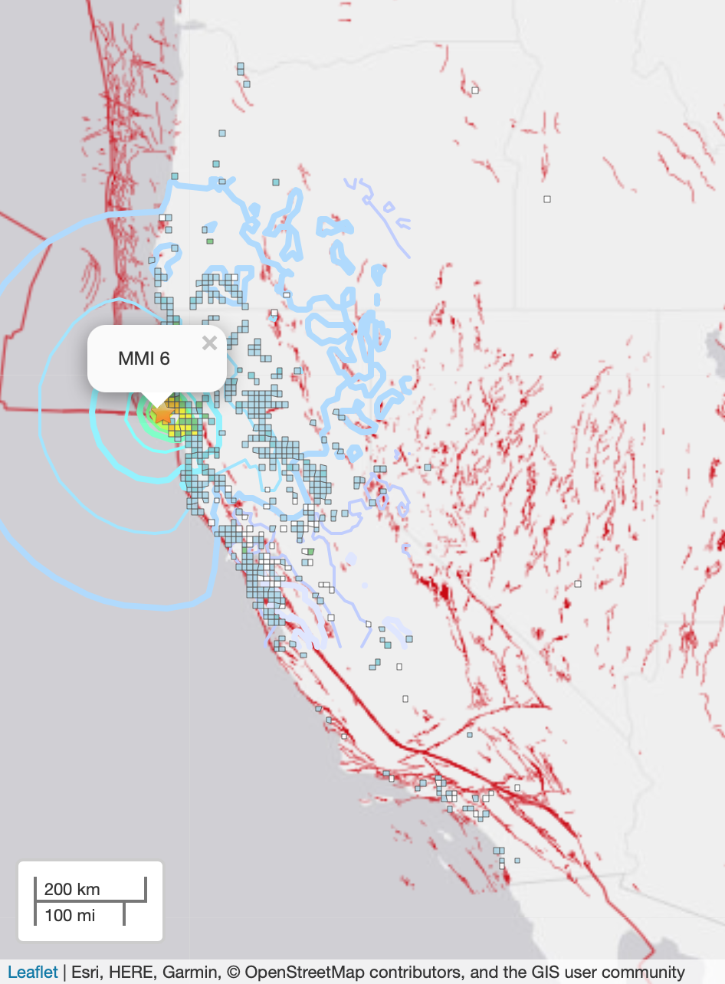
Methods/data
The methodology employed in this study involves the collection and analysis of vast amounts of data from multiple sources. Seismic data from seismographs and data generated by IoT devices are aggregated and processed using advanced algorithms. These algorithms leverage machine learning and statistical modeling techniques to detect patterns and correlations within the data. The analysis spans a period of nine years, capturing a comprehensive understanding of seismic activity. The results are stored in trustworthy and reliable repositories, ensuring the integrity and accessibility of the findings. By applying innovative technology and utilizing cutting-edge data analysis methods, this study aims to provide accurate and reliable predictions of unusual earthquakes.
Please do not use this space, a QR code will be automatically overlayed
P5.2-765

Slide 5
Result
The results of the study demonstrate the remarkable predictability of unusual earthquakes in California and Nevada through the utilization of big data analysis. By analyzing the vast amount of data collected from seismographs, IoT devices, and other sources, significant patterns and anomalies associated with seismic activity are identified. The analysis reveals precursory indicators that allow for early detection and prediction of these earthquakes, enabling authorities and risk managers to initiate timely response plans and implement necessary measures to mitigate risks. The results, available through Open Quake in the form of earthquake risk by zip code, represent the accuracy of seismic risk on a weekly basis for the public sector. They confirm the efficacy of big data analysis in earthquake forecasting, highlighting its potential to revolutionize current risk management practices for government, enterprises, SMEs, and the public sector.
A real-world example representing the San Francisco earthquake risk level was low at the time.
Please do not use this space, a QR code will be automatically overlayed
P5.2-765

Slide 6
Conclusion
In conclusion, the utilization of big data analysis in earthquake prediction has shown promising results in the predictability of unusual earthquakes in California and Nevada. The integration of diverse data sources, including seismographs and IoT devices, coupled with innovative technology and cutting-edge analytical techniques, has significantly enhanced our understanding of seismic activity. By analyzing vast amounts of data and identifying patterns and trends, this study demonstrates the potential for improved earthquake predictability. The findings provide valuable insights for authorities and risk managers, enabling them to make informed decisions and implement proactive measures to enhance preparedness and response. As the field of big data analysis continues to advance, further improvements in earthquake predictability can be expected, leading to enhanced safety and resilience in earthquake-prone regions.
Hours
Days (5)
Days (10)
Days (20)
Please do not use this space, a QR code will be automatically overlayed
P5.2-765

Slide 7
References
Please do not use this space, a QR code will be automatically overlayed
P5.2-765

