Slide 1
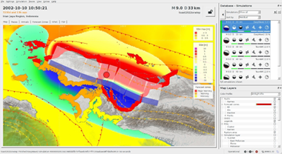
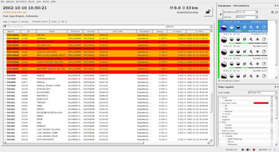
ANALYSIS OF POTENTIAL IMPACT OF TSUNAMI
IN WEST PAPUA DUE TO NORTH WEST PAPUA EARTHQUAKE USING TOAST MODELING
[Lestari Naomi Lydia]
SnT2023 Organizing Team
International Data Centre, Comprehensive Nuclear-Test-Ban Treaty Organization
P5.2-045
One area in Indonesia that has relatively high seismic activity, namely in West Papua, is related to plate subduction activity and active faults. Where this area is affected by thrust faults. This condition causes the West Papua region to have very intensive seismic activity. TOAST is software for tsunami modeling simulation that can provide results very quickly and can assist in making tsunami early warning decisions. When a tsunami occurs, TOAST can quickly process tsunami modeling in real time and provide immediate results.
If you want to learn more about this, come see my e-poster during session P5.2-045 on this date or access it online on the SnT2023 Conference platform!

