Slide 1
Paraguay NDC Evolution
Ayala H., Caballero A., Figueres V.,Fugarazzo R., Gadea M.
Facultad de Ciencias Exactas y Naturales – Universidad Nacional de Asunción
In 2012 Paraguay with the help of CTBTO installed the National Data Center (NDC), installing the Capacity Buildng System Server, then in 2016 a Project with the University of Sao Paulo (Institute of Astronomy and Geophysics) of Brazil, was they installed sensors in the Paraguayan territory that transmitted data in real time to the server, and finally in 2019 with CTBTO Techncians there was an update of the NDC (National Date center) software.
Observation of a before NDC; Installation and NDC Update.
A favorable work environment is achieved; Quality and precision in data analysis and configuration of the automatic detection system.
From the installation and updating of the server, it was possible to improve and expand the quality and precision of the analysis of regional seismic data and telesisms.
Please do not use this space, a QR code will be automatically overlayed
P5.3-827

Slide 2
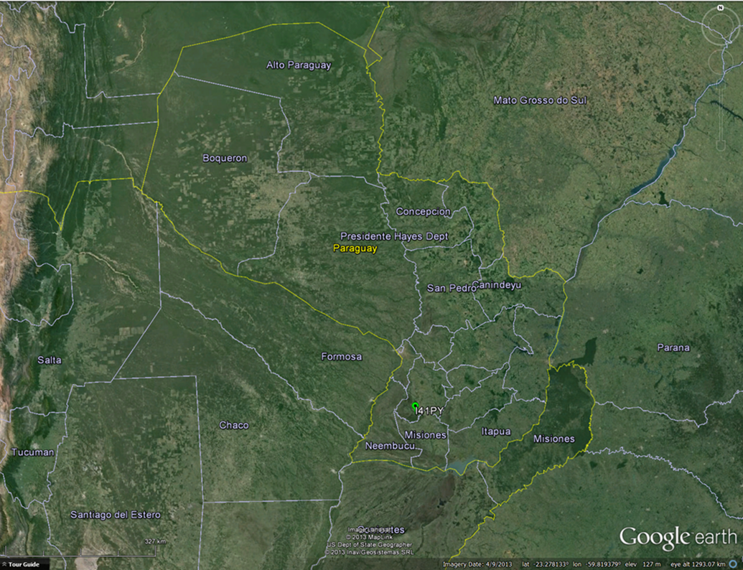
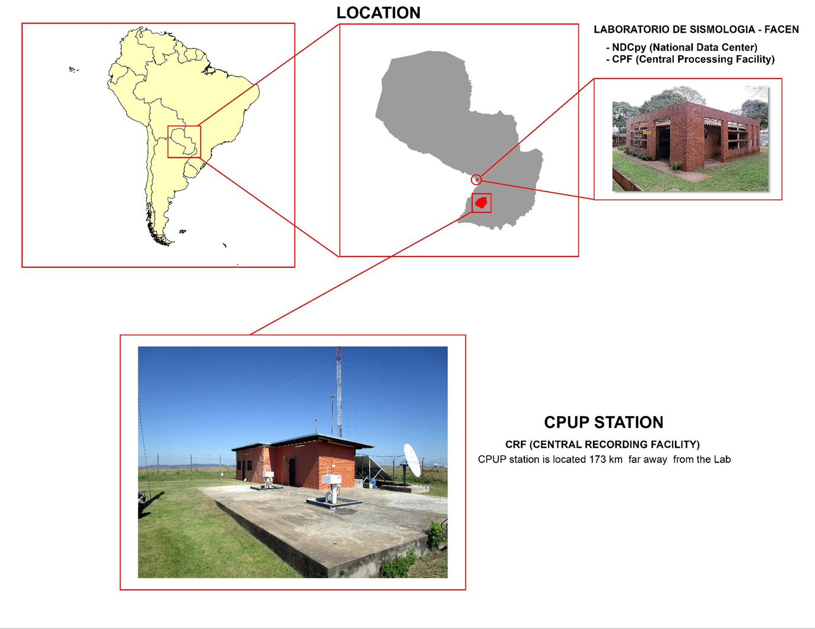
Introduction
With the synchronized work between the CTBTO and the FACEN – UNA (Faculty of Exact and Natural Sciences) in 2012 the National Data Center (NDC) was installed and inaugurated in the Seismology Laboratory of the FACEN – UNA it had a server and a PC. In 2016, through a Project called “Three basins”, with the University of Sao Paulo (Institute of Astronomy and Geophysics) of Brazil, sensors were installed in the Paraguayan territory that transmitted data in real time to the server. In 2019, With an update, two PCs were added for further analysis and new software was updated. These improvements cover regional seismic monitoring and the location of local events.
Please do not use this space, a QR code will be automatically overlayed
P5.3-827

Slide 3
Objectives
Objectives
Present the improvement of the regional seismic monitoring capacity.
Keep updating to improve the software.
Create international collaborations and access a greater amount of seismic data in real time.
Please do not use this space, a QR code will be automatically overlayed
P5.3-827

Slide 4
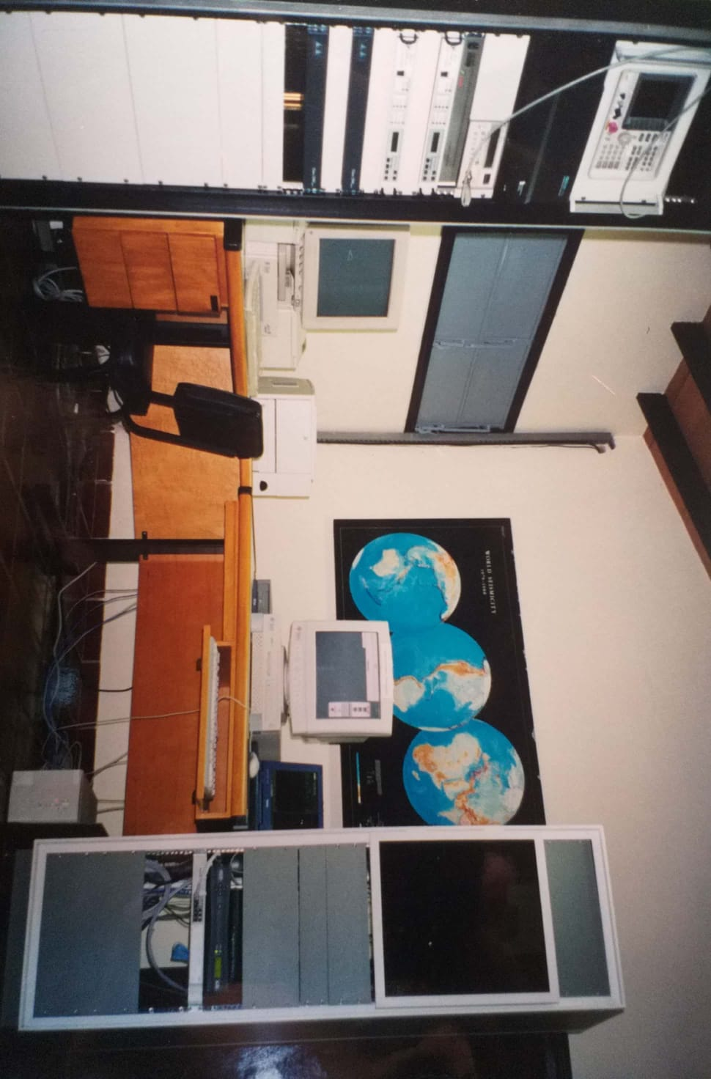
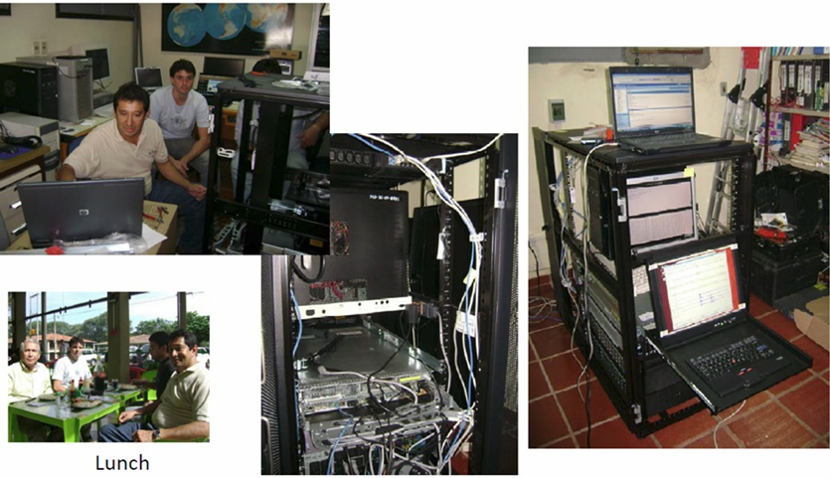
Before and after of NDC installation
Before the NDC
Event analysis was performed with Seatools software and using data from a single Station.
2012 – Installation the NDC
An IBM server with a Workstation was installed.
Prepare a PC that Works with NDC-in-a-Box.
Configuration of reception in real time data of the South American seismic stationes of the IMS network.
Data from the I41PY Station is received in real time
IDC supplementary data is accesed via AutoDRM and the secure-web-portal.
Please do not use this space, a QR code will be automatically overlayed
P5.3-827

Slide 5
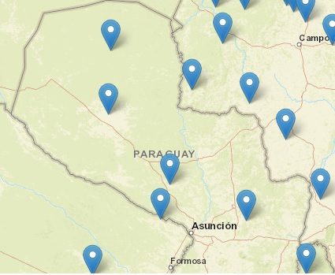
2016 “Three basins” project
Three basins
XC code stations are installed in the región within the framework of the Project called “Three basins” by the University of Sao Paulo, and said data is received in real time.
Please do not use this space, a QR code will be automatically overlayed
P5.3-827

Slide 6
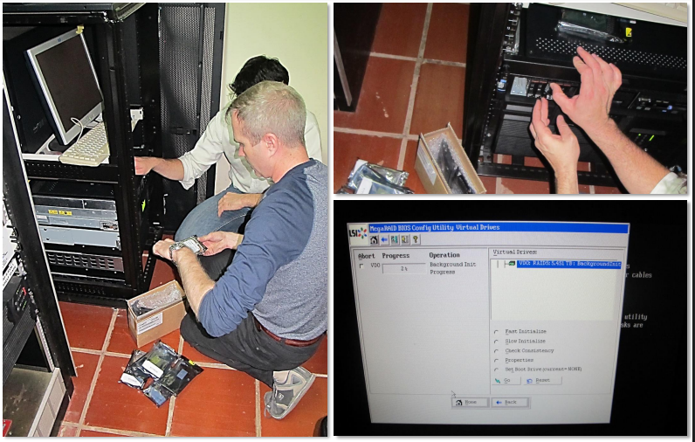
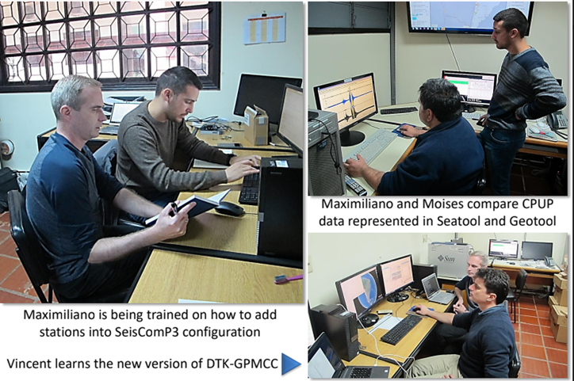
2019 – NDC Update
Works done:
Server maintenance.
Added 3 PCs for data analysis using server access and NDC-in-a-Box.
Geotool was updated, Seiscomp3, GPMCC, AutoNMS_client sortware were installed.
The reception of data from local and regional Stations belonging to other networks was added to the server.
Training of new analysts.

Slide 7
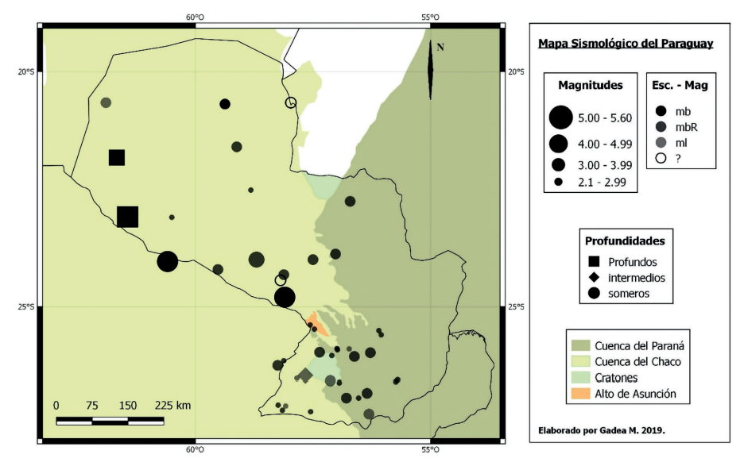
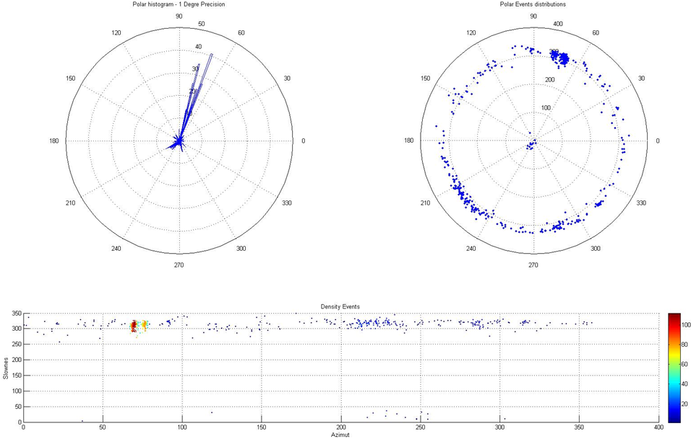
Results and Improvement
Facility Improvement
Our quality and accuracy of the analysis of regional seismic data and teleseismic was improved
We conducted studies on regular infrasound sources picked up by the IS41 station using IDC products.
We study the South American noise sources using the South American infrasound stations.
Improves with update
Infrasound data analysis began by creating bulletins from the IS41 station.
The creation of Bulletins from South American stations is extended.
The automatic detection system of seismic events was configured using the seiscomp Software.
Please do not use this space, a QR code will be automatically overlayed
P5.3-827

Slide 8
Conclusion
Conclusion
The installation and updating of the NDC in Paraguay has significantly improved the analysis of seismic data, including the study of infrasound and South American noise. The creation of bulletins and the implementation of an automatic detection system of seismic events have increased the precision and quality of the analysis carried out. These advances have strengthened the seismic monitoring capacity and contributed to the knowledge of seismic activity in the South American region.
Please do not use this space, a QR code will be automatically overlayed
P5.3-827

