Slide 1
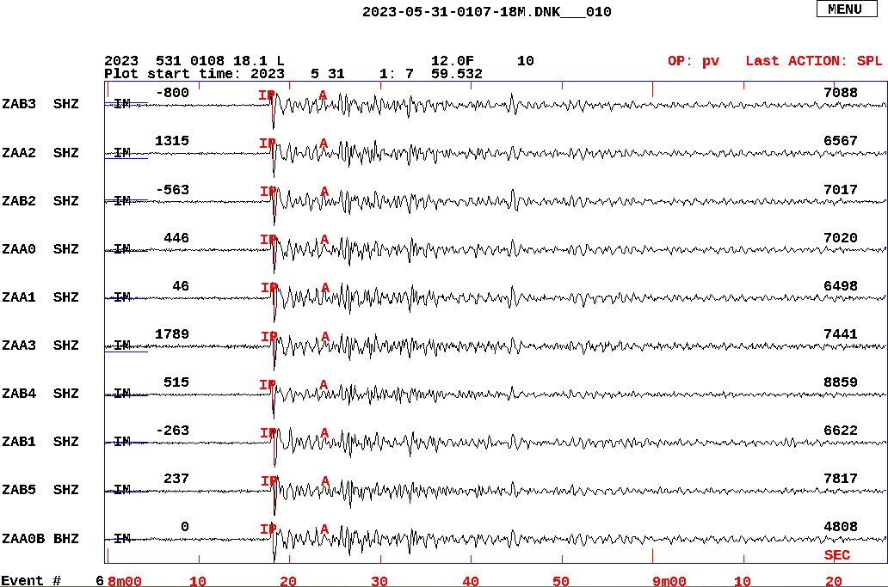
Automatic seismic event detection using real time data from the IMS
Peter Voss(1), Gonzalo Antonio Fernandez Marañon(2) & Jens Havskov(3)
(1)Geological Survey of Denmark and Greenland, Denmark (2) Observatorio San Calixto, Bolivia
(3) University of Bergen, Norway
P5.3-866
IMS
We present a new method for NDCs to use CTBTO seismic realtime data in the local events detection, which will enable NDCs to improve nuclear test monitoring and / or scientific and civil applications, using the SeedLink service available on the GCI.
We use NETDET is a newly developed tool for SEISAN (Earthquake Analysing Software) that enables event detection and location in near real time or offline.
Automation of streaming data for local storage and event detection often include very complex computer programs, here we show that it can be done using a few simple commands.
GCI
Data archive
The seismograms above show one of the automatic detections from the NETDET program. Signals are from an IMS array and the event is also reported in the IDC SEL3 event list located in Southern Sumatra, Indonesia. IDC_SEL3 reported a magnitude of ML 4.8 / mb 4.7.
Bulletin

