Slide 1
Automatic seismic event detection using real time data from the IMS
Peter Voss(1), Gonzalo Antonio Fernandez Marañon(2)
& Jens Havskov(3)
Geological Survey of Denmark and Greenland, Denmark
(2) Observatorio San Calixto, Bolivia
(3) University of Bergen, Norway
We present a new method for NDCs to use CTBTO seismic realtime data in the local events detection, which will enable NDCs to improve nuclear test monitoring and / or scientific and civil applications, using the SeedLink service available on the GCI.
Data is stored locally using the SLARCHIVE program and processed in near realtime or from historical data using the SEISAN program
netdet
NETDET produced 101 events for further analysis, in comparison the SLSD automatic had 87 P phase detection on the same day, 27 of the events was detected on both systems.
We show that NDC’s can using a GCI connection stream data from IMS in realtime and store the data locally and process the data in near realtime or at a later stage in order to extract seismic events for further analyses, using a few computer programs with very simple configurations.
P5.3-866

Slide 2
Introduction
This presentation gives examples on how an NDC can automatically detect seismic events data obtained in near real time from the IMS through the SeedLink service available on the Global Communications Infrastructure (GCI), using the seismic analysis software NETDET that is part of the SEISAN package. We also show how to integrate the GCI data with locally collected data and how to analyse the data to obtain event locations and magnitudes. SEISAN (see http://seisan.info) is used in more than 30 countries mainly at smaller seismic networks or by students or researchers, for processing data from permanent or temporary seismic networks and at a number of NDCs. NETDET is a newly developed tool for SEISAN that enables event detection and location in near real time or offline. At a NDC the data flow from the GCI is send with SeedLink to a SDS or BUD miniseed archive structure from where NETDET loads the data and preform data processing and event analysis automatically. Dependent on the parameterization of NETDET location and magnitude estimations will be performed. The configuration of the data flow and the possible parameterization of NETDET will be presented.
In short: We present a new method for NDCs to use CTBTO seismic realtime data in the local events detection, which will enable NDCs to improve nuclear test monitoring and / or scientific and civil applications, using the SeedLink service available on the GCI.
IMS
GCI
Data archive
Bulletin
P5.3-866

Slide 3
Objectives
To show that realtime IMS data can be accessed and stored locally via GCI using simple commands
To show that detections can be automated and stored for analyses using the SEISAN software
P5.3-866

Slide 4
Methods/data
Using a GCI connection at the NDC one can stream data from IMS in realtime from:
Hostname: seedlink.gci.ctbto.org IP address: 172.22.242.244 Port: 18000 Network: IM
Available stations can be listed using SLINKTOOL program found in the SeisComP package in NDC-in-a-Box
slinktool -Q seedlink.gci.ctbto.org:18000
... IM ROSC BHE D 2023/03/07 15:11:28.2250 - 2023/03/09 13:02:53.2250 IM ROSC BHN D 2023/03/07 15:11:37.6500 - 2023/03/09 13:02:59.4500 IM ROSC BHZ D 2023/03/07 15:11:30.9750 - 2023/03/09 13:02:59.5750 IM SCHQ BHE D 2023/03/07 16:59:59.3250 - 2023/03/09 11:56:41.7250
…
Data is stored locally using the SLARCHIVE program and this simple command
slarchive -k 600 -l IMS.streams -SDS HOME/SDS 172.22.242.245:18000
Data is processed in near realtime or from historical data using the SEISAN program
netdet
P5.3-866

Slide 5
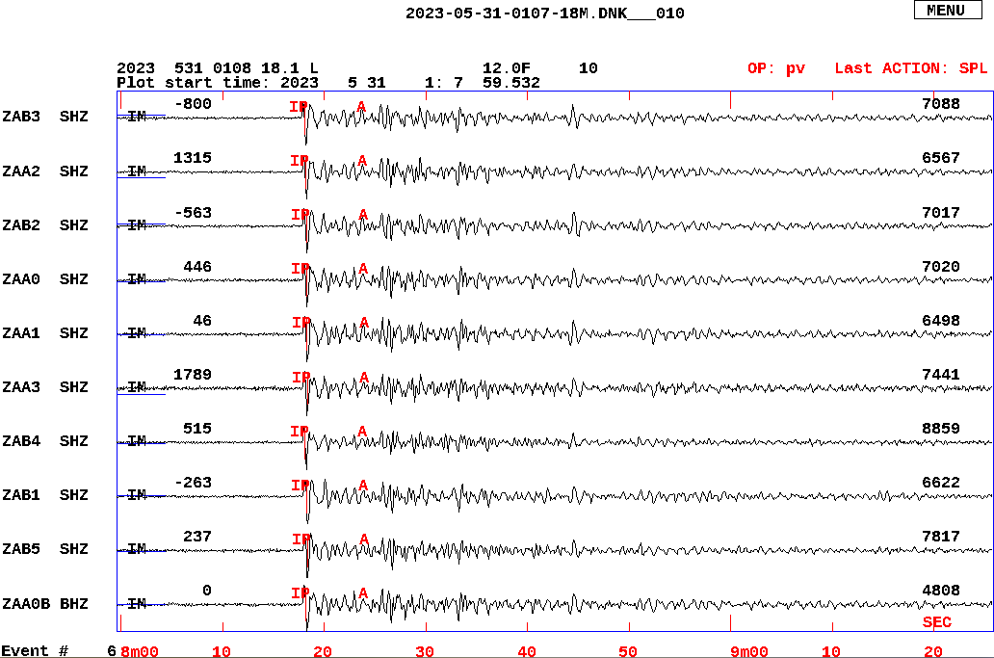
Results
In order to examine the detections from the NETDET program we compared the output from processing May 31st 2023, with the IDC SLSD:automatic detections. NETDET was configurated to apply a STA/LTA detector on the Zalesovo array channels and from the SLSD the array beam note ZELV was examined.
The duration of the STA and LTA was 3 and 300 s, respectively, using a triger level at 3. Data was band pass filtered at 2-7 Hz. All default parameters.
Applied on a single days of data it took NETDET app. 6,5 minuted to process the 24 hours of data from the array on a laptop computer with linux OS.
NETDET produced 101 events for further analysis, in comparison the SLSD:automatic had 87 P phase detection on the same day, 27 of the events was detected on both systems.
The seismograms above show one of the automatic detections from the NETDET program. Signals are from the Zalesovo array and the event is also reported in the SEL3 on the array beam node ZELV. The SEL3 event id is: EVENT 24091686 Southern Sumatra, Indonesia. ML 4.8, mb 4.7 IDC_SEL3. Data is unfiltered. The ”IP A” marks the time of the automatic detection. SEISAN is used for plotting and analysing data.
P5.3-866

Slide 6
Conclusion
The purpose of this presentation is to show that NDC’s can using a GCI connection stream data from IMS in realtime from the server seedlink.gci.ctbto.org and store the data locally and process the data in near realtime or at a later stage in order to extract seismic events for further analyses, using a few computer programs with very simple configurations.
To show that this is possible we have tested on a setup including 24 hour data from a IMS seismic array using default detection parameters and was able to identify several events also detected by the SLSD automatic system.
NDC’s can by using a similar setup integrate locally collected data with IMS data setup a realtime automated detection system with just a few commands.
Processing of 24 hours of data can be done within a few minutes, this enables the NDC’s to experiment with different detection parameters in order to find the most optimal for their network.
Automation of streaming data for local storage and event detection often include very complex computer programs, here we have shown that it can be done using a few simple commands.
P5.3-866

Slide 7
References
See the ”SEISAN End User Tutorials” at the NDC Forum: https://ndc-forum.ctbto.org/tag/seisan
Ottemöller, L., Voss, P.H. and Havskov J. (2021). SEISAN Earthquake Analysis Software for Windows, Solaris, Linux and Macosx, Version 12.0. 607 pp. University of Bergen. ISBN 978-82-8088-501-2.
http://seisan.info/
Havskov, J., Voss, P.H. and Ottemöller, L. (2020). Seismological Observatory Software: 30 Yr of SEISAN. Seismological Research Letters, 91 (3): 1846-1852. DOI: https://doi.org/10.1785/0220190313
P5.3-866

