Slide 1

“REVITALIZATION OF THE NDC TEAM IN MALI”
Mr. Adama COULIBALY
Head of Environmental Monitoring Service
Département Contrôle et Surveillance du Territoire (DCST)
Agence Malienne de Radioprotection (AMARAP)
There is two (02) National Data Centers (NDCs) in Mali (one in DNGM and one in AMARAP). Both are under leardership of Mines, Energy and water Ministry.
The main objective is to redynamize the CTBTO activities in Mali in order to to participate regularly to the nuclear test ban.
After the event in Toledo (Spain) in 2022, the AMARAP decided to create a NDC for radionuclide monitoring. In December 2022 through the official channel a Designation Form has been submitted to the PTS of CTBTO. In March 2023, AMARAP’s NDC has been created.
The AMARAP’s NDC has 4 nominated principal and 5 nominated regular users. It isn’t in operation due to the lack of equipments and trainings. Neverthless, AMARAP has a gamma spectrometry chain “(GeHP)” with Genie 2000 software for analysis of samples.
Considering the availability of a GeHP, we need:
Providing 1 or 2 aerosol sampler pumps and accessories;
Providing computer for data treatment and transmission ;
Providing adequat trainings for AMARAP’s NDC staff, etc.
Place your QR Code here after removing this text box!
P5.3-107

Slide 2
INTRODUCTION
Mali has participated (one participant from AMARAP) to the 2022 National Data Centers Workshop of CTBTO in Toledo (Spain) from 03rd to 07thoctober 2022. During this workshop, it was revealed the CTBTO activities in Mali aren’t working as well and need to be redynamized in order to participate regularly to the nuclear test ban according the main objective of CTBT.
Mali signed the CTBTO treaty in february 18th, 1997 and ratified it in august 04th, 1999. Now, there is two (02) National Data Centers (NDCs) in Mali:
One is created in 2005 to the « Direction Nationale de la Géologie et des Mines (DNGM) » for the seismic monitoring,
One is created in 2023 to the « Agence Malienne de Radioprotection (AMARAP) » for the radionuclide monitoring.
Place your QR Code here after removing this text box!
P5.3-107

Slide 3
OBJECTIVES
The objectives of this redynamization will be based on:
Creation of one NDC in AMARAP for radionuclide monitoring in aerosol ;
Pathways to find in order to equip to the AMARAP’s NDC (pump, filter, computer, UPS, software, etc.) ;
Collaboration between Malian NDCs for national and international purposes ;
Collaboration between Mali’s NDCs and the NDCs of others countries for knowledge exchanges or intercomparison exercises, etc.
One of the missions of AMARAP is the radiological monitoring of environment, this work will permit it to ensure a part of that mission.
Place your QR Code here after removing this text box!
P5.3-107

Slide 4
METHODS/DATA
One of the missions of AMARAP is “to represent the Government Malian as regards international cooperation, in the fields of the regulation of the protection against radiation and the management of radioactive waste”.
Based on that mission and the event in Toledo, the AMARAP Direction decided to create a NDC for radionuclide monitoring. In collaboration with Mines, Energy and water Ministry (under trusteeship Ministry), AMARAP submitted on December 13rd, 2022 through the official channel its Designation Form-NDC to the PTS of CTBTO.
A collaboration agreement between AMARAP NDC and DNGM NDC is on going to be established
Place your QR Code here after removing this text box!
P5.3-107

Slide 5
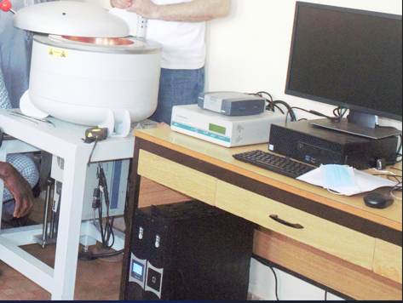
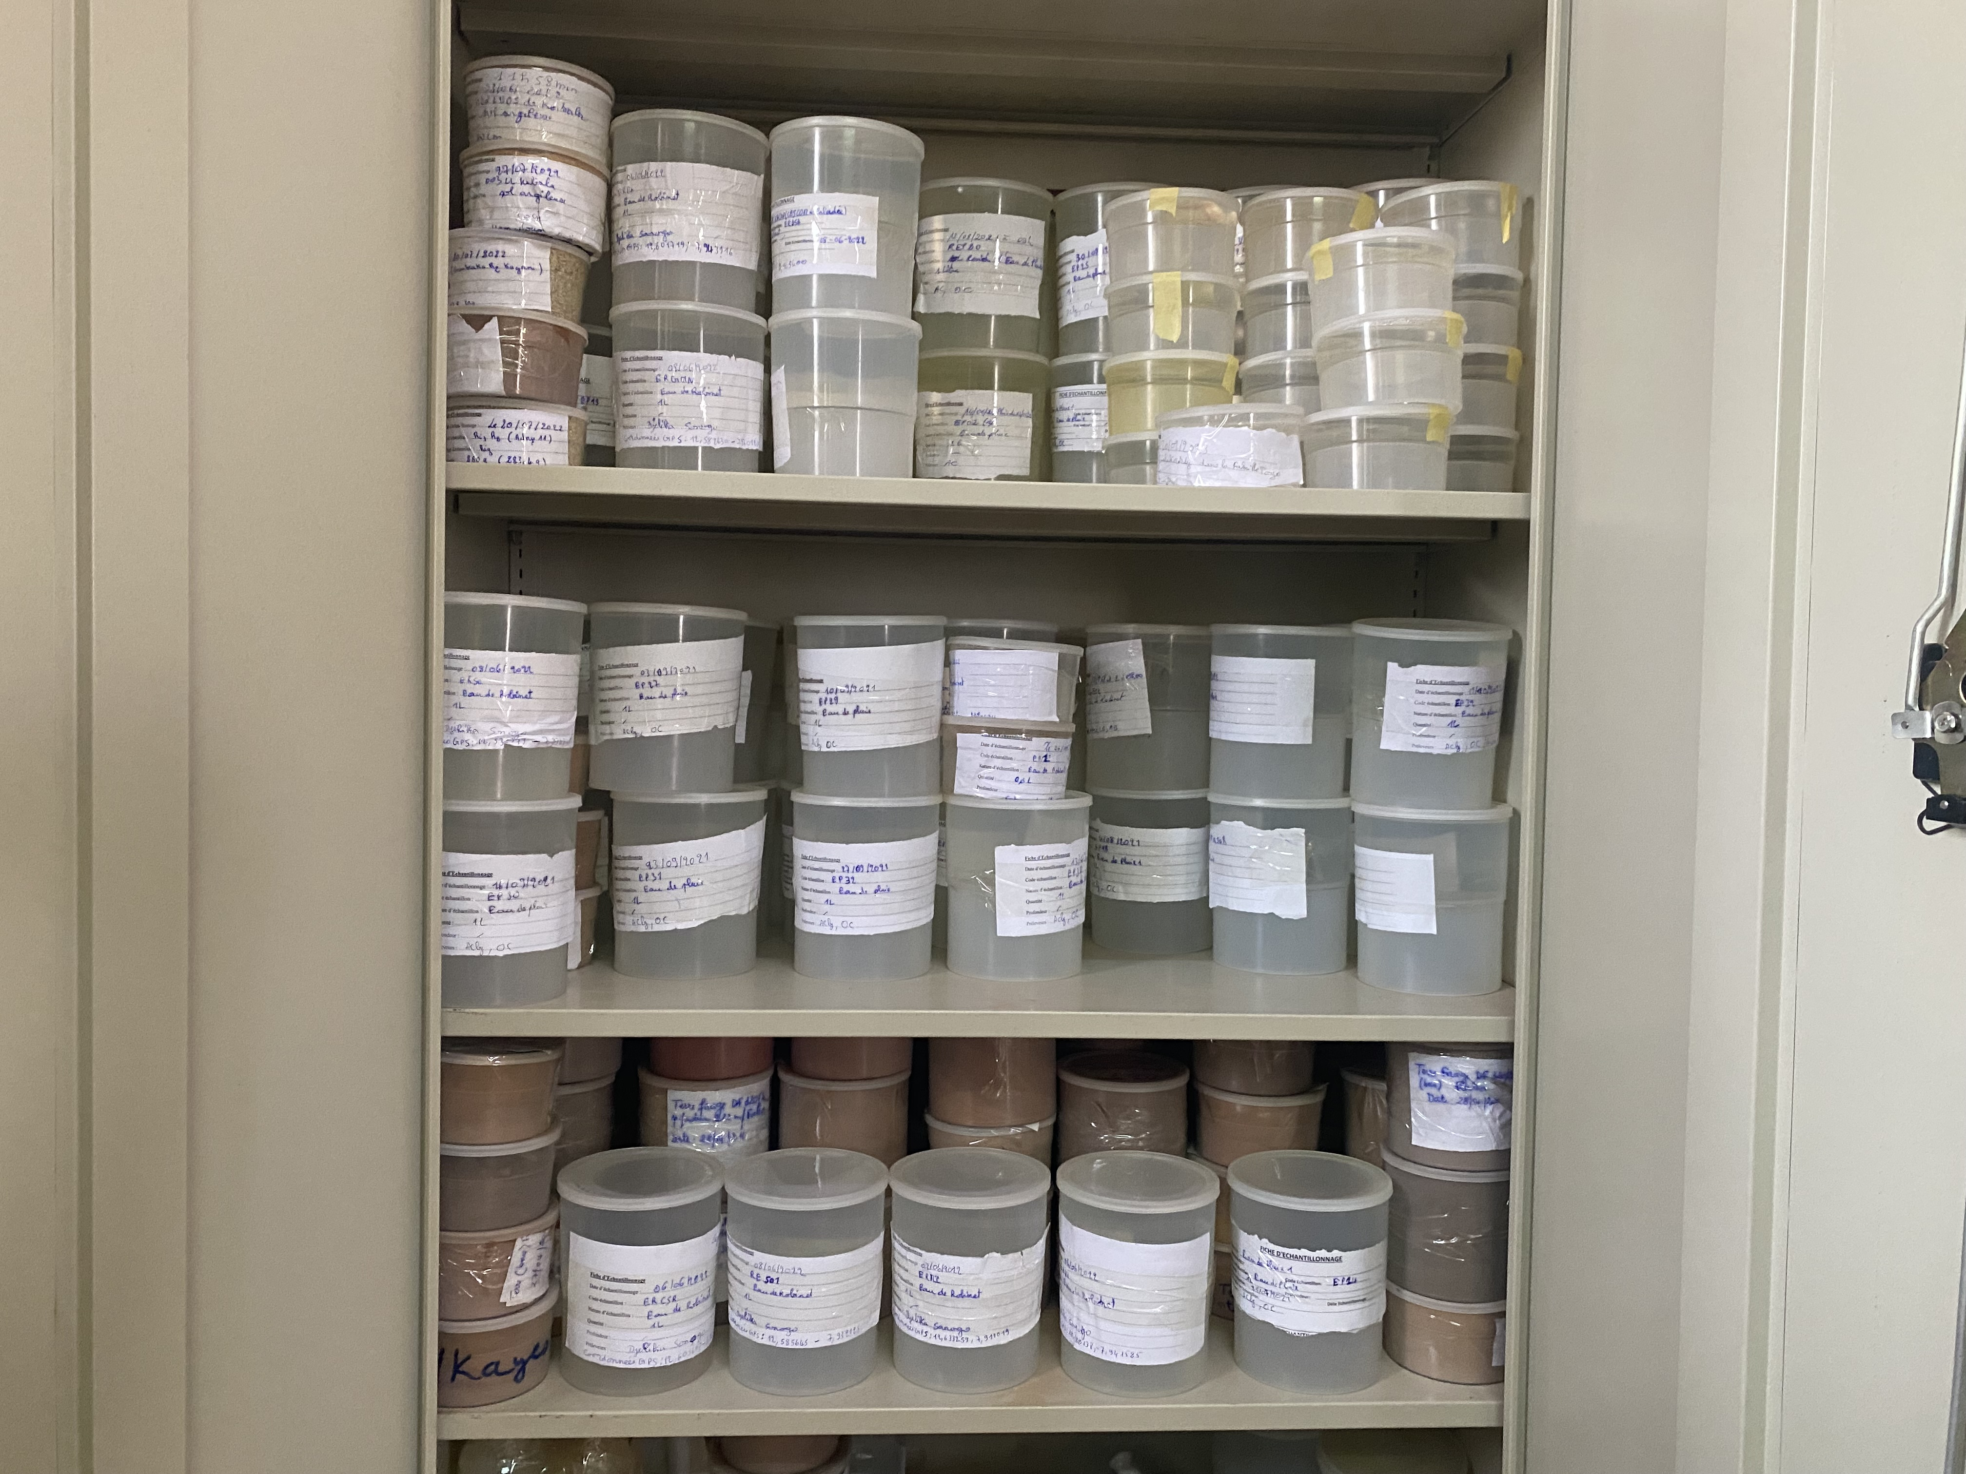
OBTAINED RESULTS
The AMARAP’s NDC is created in 2023 and located in the DCST with 4 nominated principal and 5 nominated regular users. The main mission of DCST is the radiological monitoring of environment and foodstuff in Mali. Radiological monitoring of aerosols is included into this national programme.
This NDC is not yet in operation due to the lack of equipments and training of users.
Neverthless, the DCST has a regulatory analysis laboratory with a gamma spectrometry chain “germanium high purity detector (GeHP)” coupled to the software called “Genie 2000” for analysis of environmental and foodstuff samples.
Place your QR Code here after removing this text box!
P5.3-107

Slide 6
CONCLUSION
Considering the availability of a GeHP detector and as part of the implementation of air radiological monitoring activities, AMARAP needs logistical support in equipment such as:
Providing 1 or 2 aerosol sampler pumps with appropriate filters (activated carbon filters to trap radionuclides in the air) ;
Providing computer for data treatment and transmission of data between AMARAP's NDC and CTBTO's IDC ;
Providing training of the AMARAP’s NDC on data processing and transmission ;
Implementing a collaboration between our NDCs for national and CTBTO purposes ;
To create a good relationship between NDCs from others countries for research purposes, etc.
Place your QR Code here after removing this text box!
P5.3-107

Slide 7
REFERENCES
Ordinance n°02-059/P-RM of 05 June 2002, set up the base of radiation protection and safety of radiation sources ;
Ordinance n°02-060/P-RM of 05 June 2002, created the National Radiation Protection Agency called « Agence Malienne de Radioprotection (AMARAP) » ;
Decree n°02-333/P-RM of 06 June 2002, set up the organisation and functioning modalities of the AMARAP, modified by Decree n°10-045/P-RM of 29 Jan. 2010 ;
Decree n°2014-0931/P-RM of 31 December 2014, set up the rules of protection against ionising radiations (it’s the new version of the Decree n°06-488/P-RM of 23 November 2006).
Place your QR Code here after removing this text box!
P5.3-107

