Slide 1
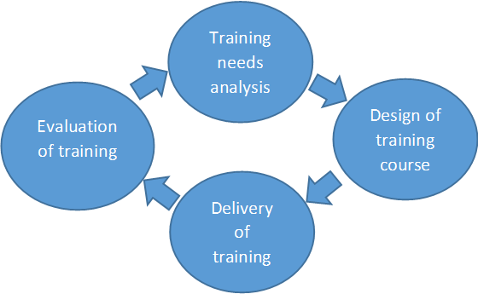
National Data Centre Capacity Building Training Cycle on the Access and Analysis of IMS Both Particulate and Noble Gas Radionuclide Data
Waseem Allan
International Data Centre, Comprehensive Nuclear-Test-Ban Treaty Organization
P5.3-492
Objectives of the new training cycle:
To meet the high demand and expectations of State Signatories;
To provide a chance to all NDCs with different levels and interests to apply and benefit from the capacity building opportunities;
To address specific needs of NDCs.
If you want to learn more about this, come see my e-poster during session 5.3 on 23 June 2023 or access it online on the SnT2023 Conference platform!

