Slide 1
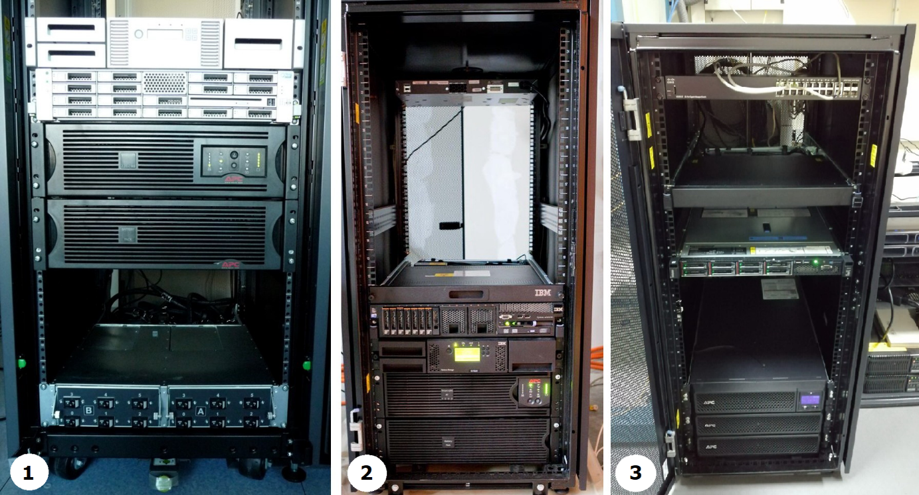
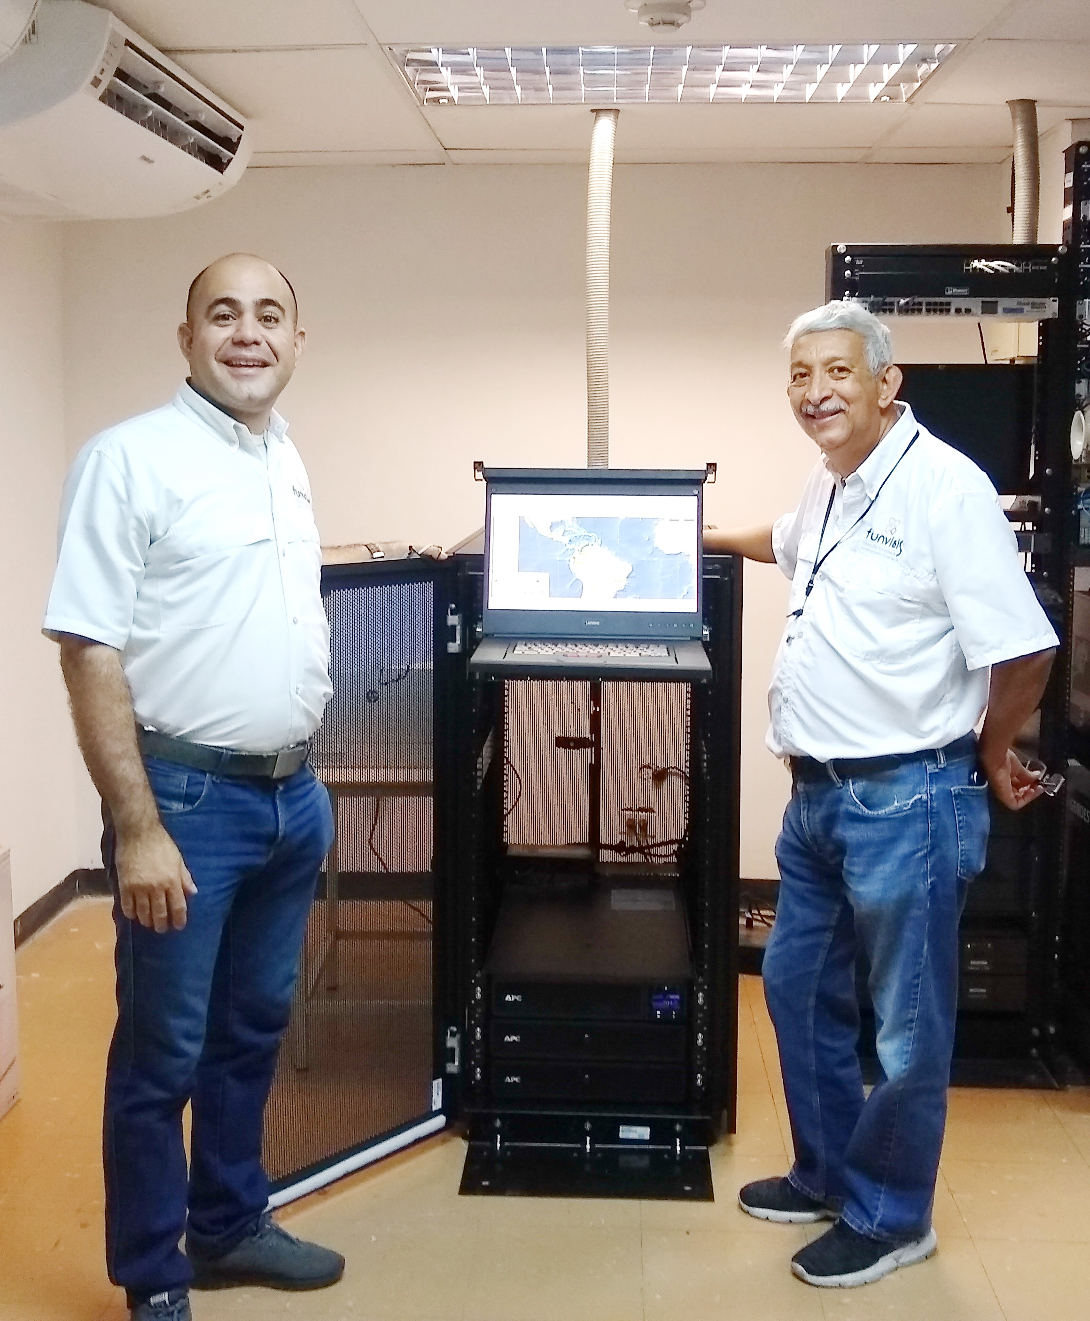
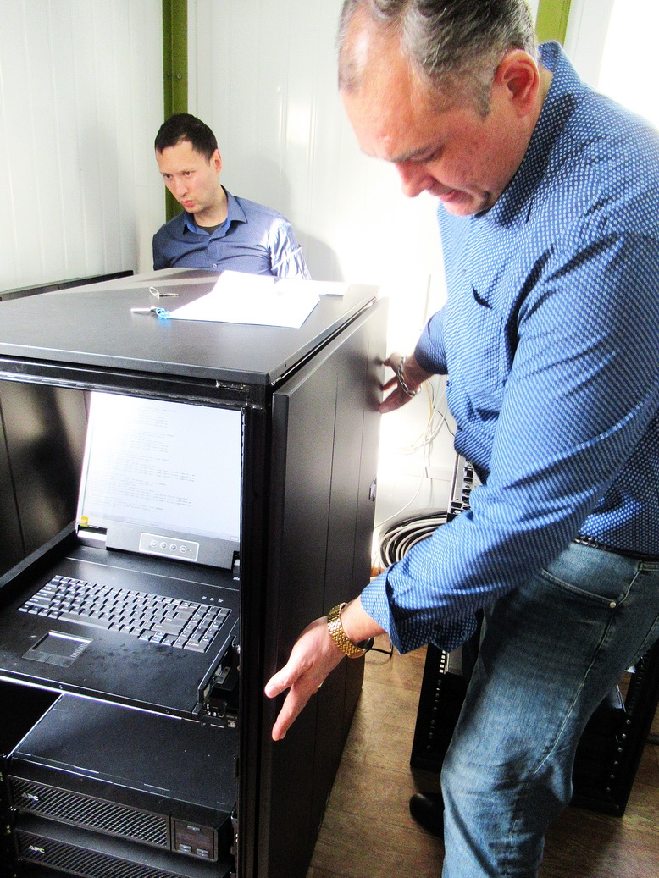
Development and Achievements of the NDC Capacity Building Project
Alexander Poplavskiy, Misrak Fisseha, Waseem Allan
CTBTO Preparatory Commission
P5.3-263
The National Data Centres (NDC) are organizations with technical expertise in the monitoring and verification technologies of the Treaty. Capacity building of NDCs is the ongoing process that NDCs follow to enhance their capability to provide technical advice to their National Authorities with the aim of becoming self-sufficient in the establishment of a credible verification regime.
The donation and installation of IT equipment, the so-called Capacity Building System (CBS), at National Data Centres (NDC) of States Signatories serves as a baseline example of the equipment required to establish an NDC.
The poster describes the current status, achievements and historical development of the project, which is funded by the European Union and the Provisional Technical Secretariat.

