Slide 1
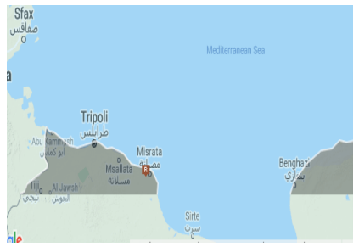
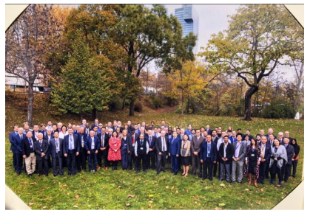
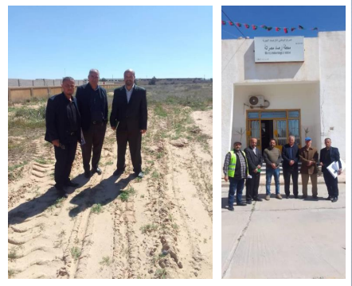
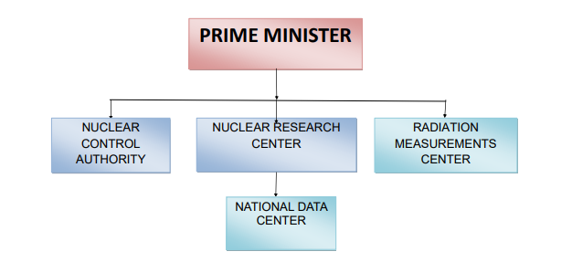
The participation of Libya in the CTBT verification regime
Abdurahim Sasi
NDC Manager / Nuclear Research Center / National Data Center
P5.3-359
The objective of my presentation
Enhancing Libya's Contribution to CTBTO Verification Regime
Collaboration on IMS radionuclide station RN041
Improving National Data Centre capabilities
The capacity building in Libya NDC
Cooperation and activities with the CTBTO and National Authorities
If you want to learn more about this, come see my e-poster during e-poster session in board 16

