Slide 1
Technical Modernization of Kazakhstan National Data Center (KNDC) to Implement the Tasks in Support of the CTBTO
Igor Komarov, Dmitriy Gordiyenko
Kazakhstan National Data Center, Almaty, Kazakhstan
In 2020-2022, under the financial support of Norwegian Center NORSAR there was technical modernization of Kazakhstan National Data Center of the NNC RK to implement the tasks in support of the CTBTO.
KNDC acquires and stores seismic and acoustic data from the NNC RK seismic monitoring network stations, and from stations of other countries. For data acquisition and storage, PostgreSQL and MySQL databases are used.
New equipment allowed for the creation of a fail-secure cluster from three virtualization servers under Proxmox hypervisor system. To ensure the fail-secure operation of the system, the cluster uses a remote file system CEPH.
This allowed supporting KNDC operation on a proper level and implement the tasks in support of the CTBTO
Please do not use this space, a QR code will be automatically overlayed
P5.3-204

Slide 2
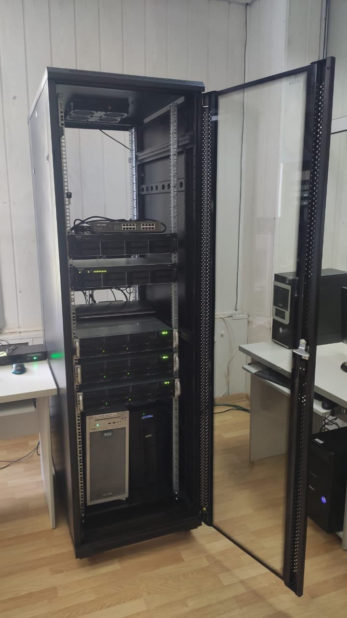
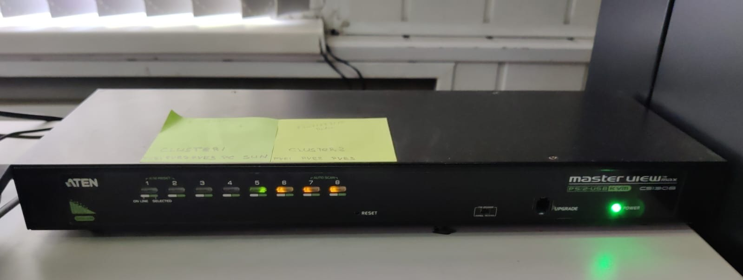
The equipment was installed in a server room of the Data Center
New equipment allowed for the creation of a cluster from virtualization servers consisting of three high-end servers under Proxmox virtualization system
Please do not use this space, a QR code will be automatically overlayed
P5.3-204

Slide 3
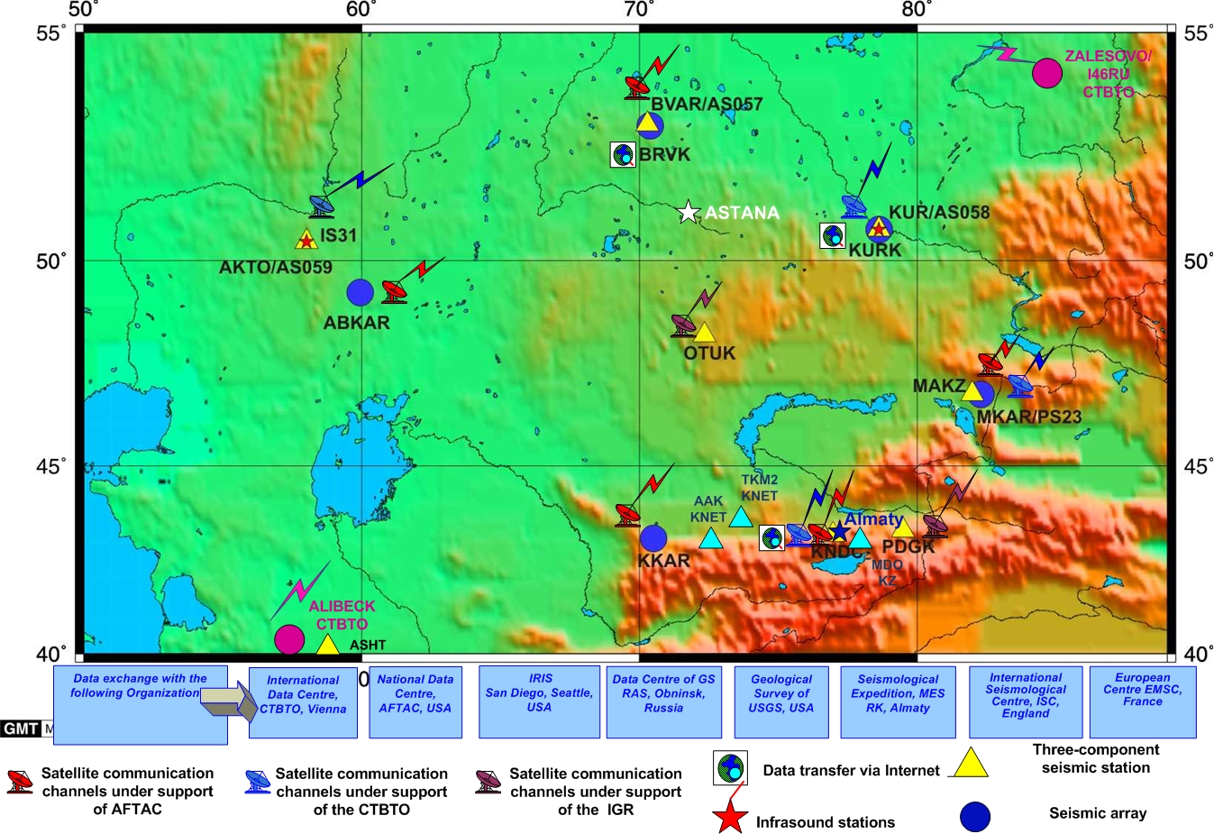
National Nuclear Center stations network which
data arrive to the Data Center.
Please do not use this space, a QR code will be automatically overlayed
P5.3-204

Slide 4
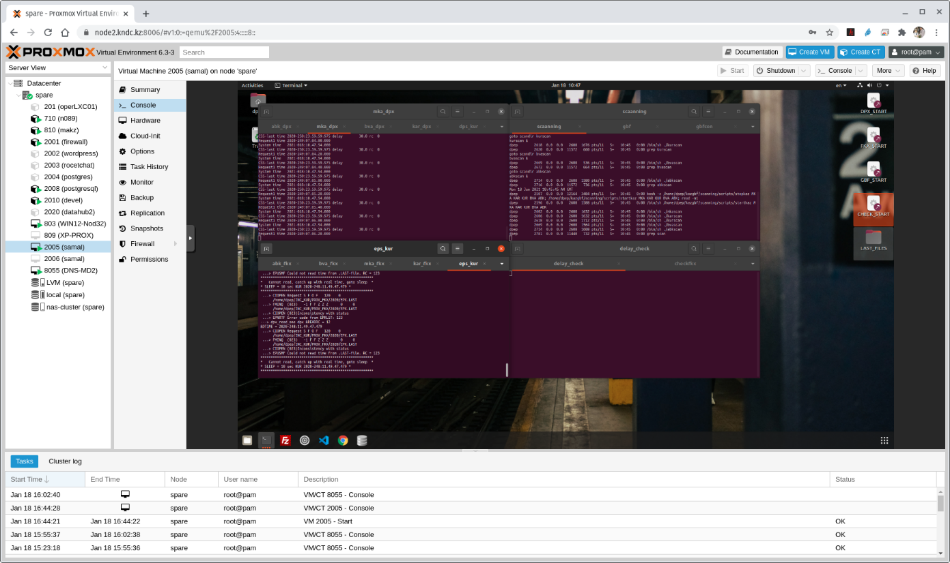
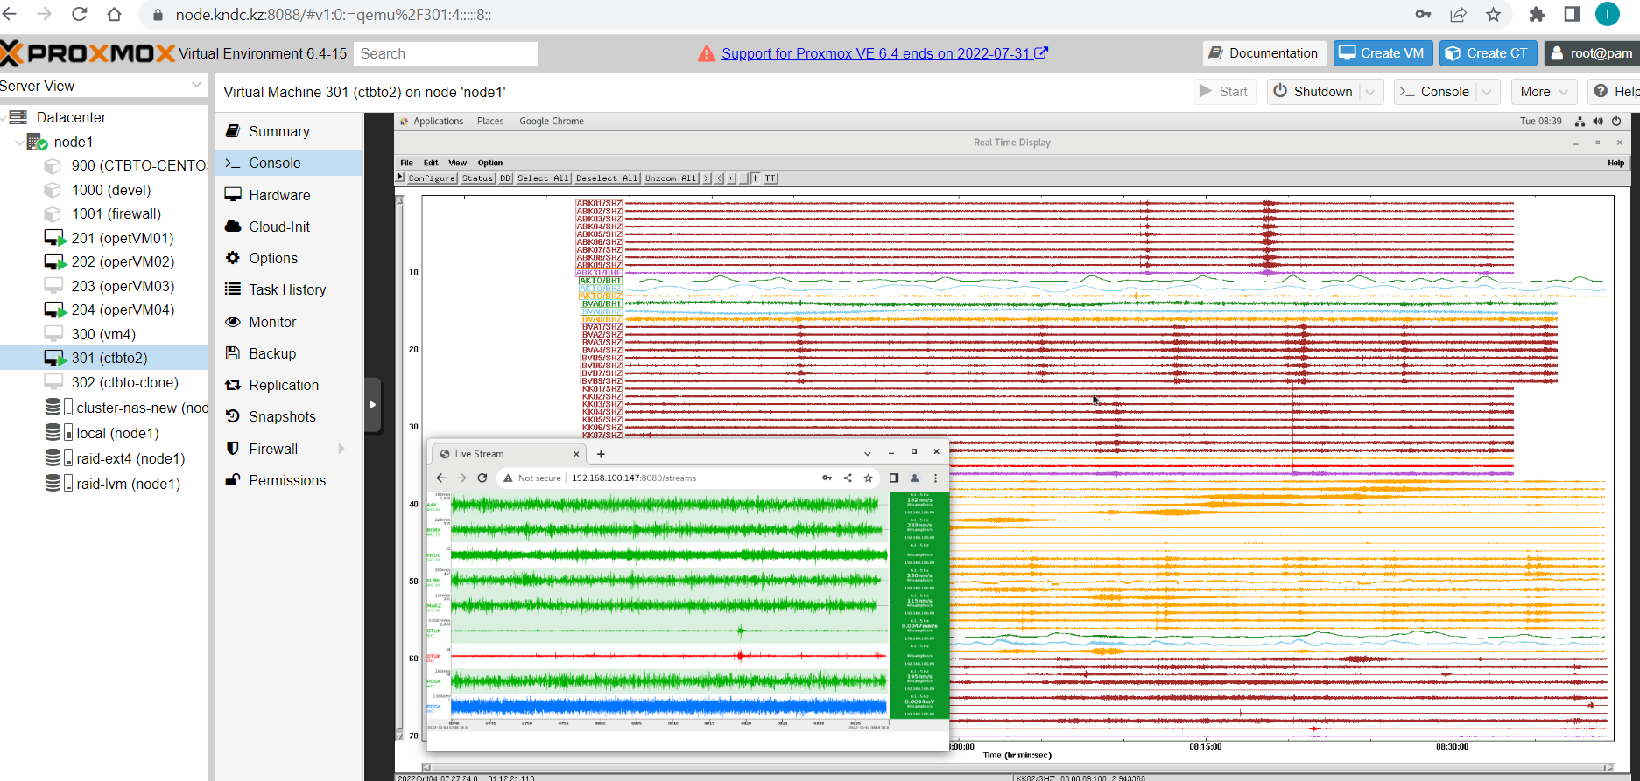
Virtual servers running on PROXMOX virtualization server
Software for data acquisition from different stations and its storage in the databases PostgreSQL and MySQL, functioning of Seedlink server
Please do not use this space, a QR code will be automatically overlayed
P5.3-204

Slide 5
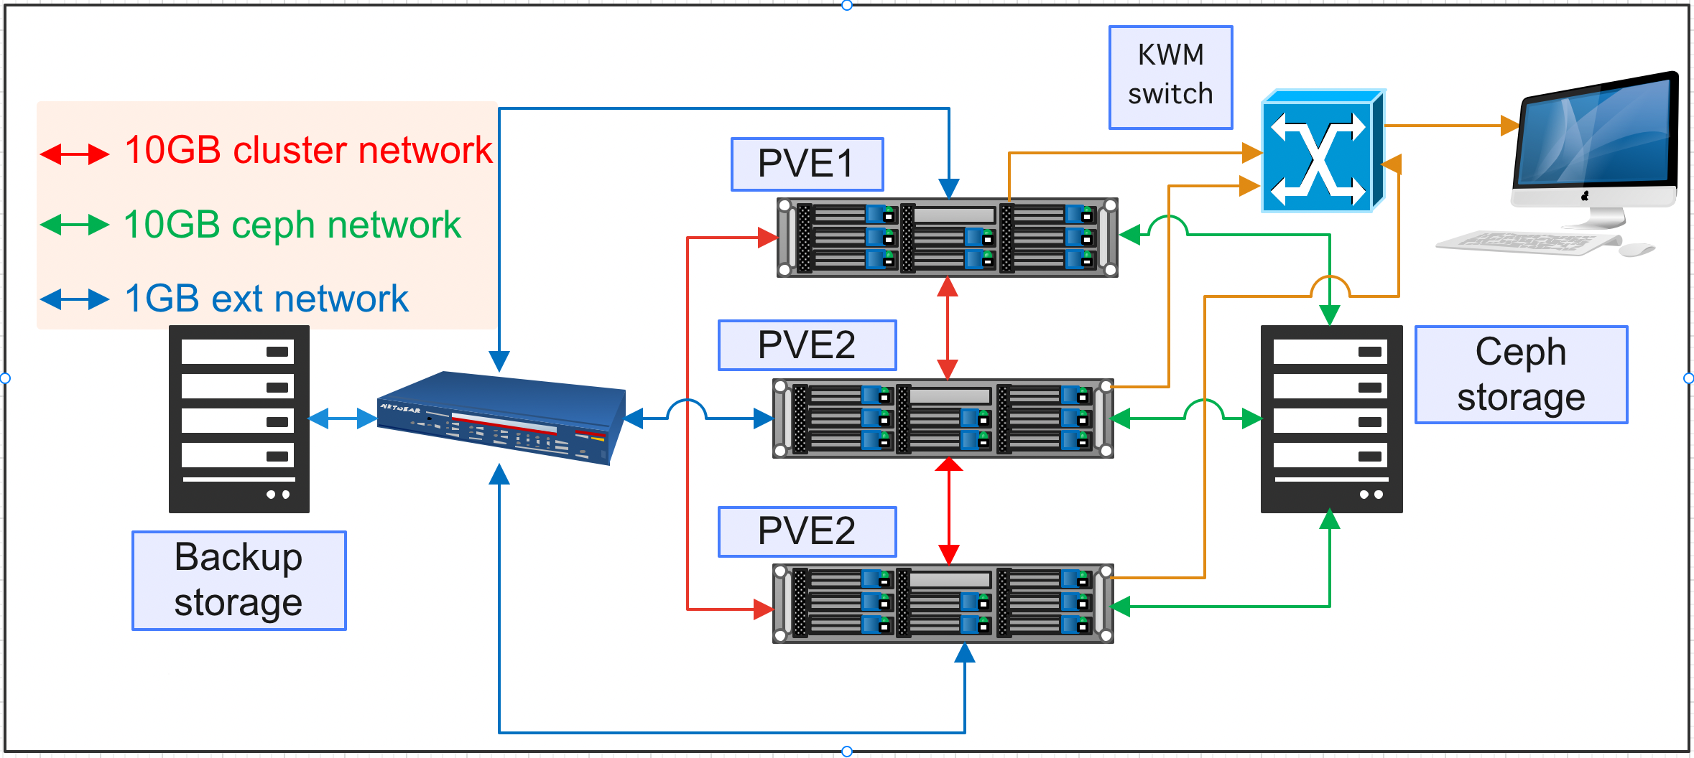
Structural scheme of virtualization cluster built on Proxmox platform
Please do not use this space, a QR code will be automatically overlayed
To ensure the fail-secure operation of the system, a cluster with remote file system CEPH was created as well as data storage systems built on RAID technologies.
P5.3-204

Slide 6
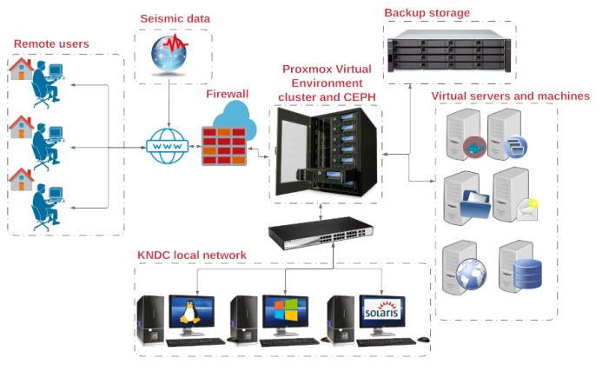
Arrangement of remote work during the lockdown (COVID-19)
New equipment purchased under financial support of NORSAR allowed for significant modernization of the existing information system of the Data Center and to support reliable and fail-secure operation of the whole system on acquisition, automated and interactive processing of arriving data. It was especially crucial during the pandemic period when Data Center staff worked from home.
Please do not use this space, a QR code will be automatically overlayed
P5.3-204

