Slide 1
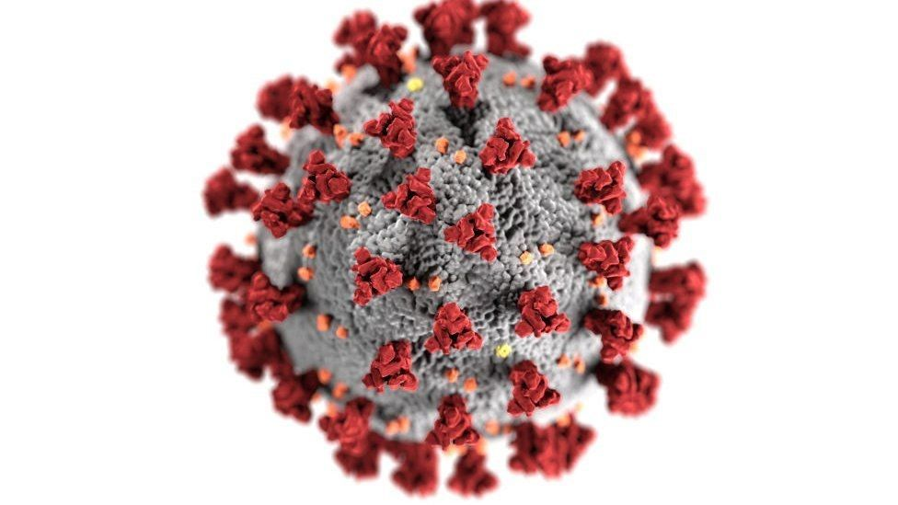
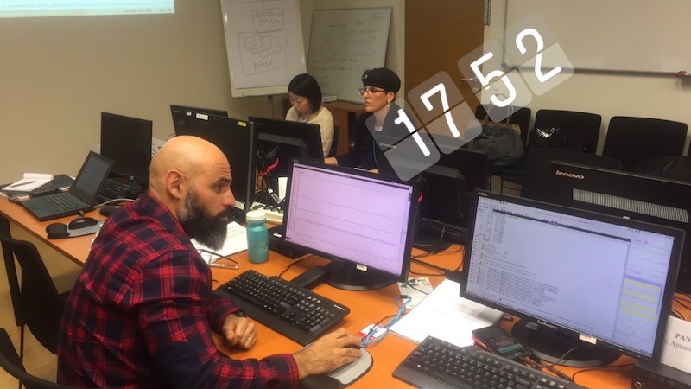
Seiscomp on OVSICORI-UNA after CTBTO course
Christian Garita Hidalgo
OVSICORI-UNA
P3.2-238
Since 2010 we have been using Antelope as our main acquisition system and processing system.
We got better and faster automatic earthquake solutions in Seiscomp.
We found more available data analysis tools with Seiscomp.
In 2018 we had our first contact with Seiscomp in a CTBTO training.

