Slide 1
Seiscomp on OVSICORI-UNA after CTBTO course
Christian Garita Hidalgo
OVSICORI-UNA
Since 2010 we have been using Antelope as our main acquisition system and processing system. In 2018 we had our first contact with Seiscomp in a CTBTO training. As we become more involved with Seiscomp every day, we are planning our transition.
We moved data acquisition to Seiscomp.
We move the automatic earthquake processing to Seiscomp.
We keep Antelope for manual locations and as a database system.
After several simulations, we got better and faster automatic earthquake solutions in Seiscomp.
We found more available data analysis tools with Seiscomp.
We found easier ways on making our own software to analyze data.
After 13 years running Antelope we are planning our last move to Seiscomp. Both systems are great but we don’t have enough resources to keep Antelope licenses for a longer time.
Please do not use this space, a QR code will be automatically overlayed
P3.2-238

Slide 2
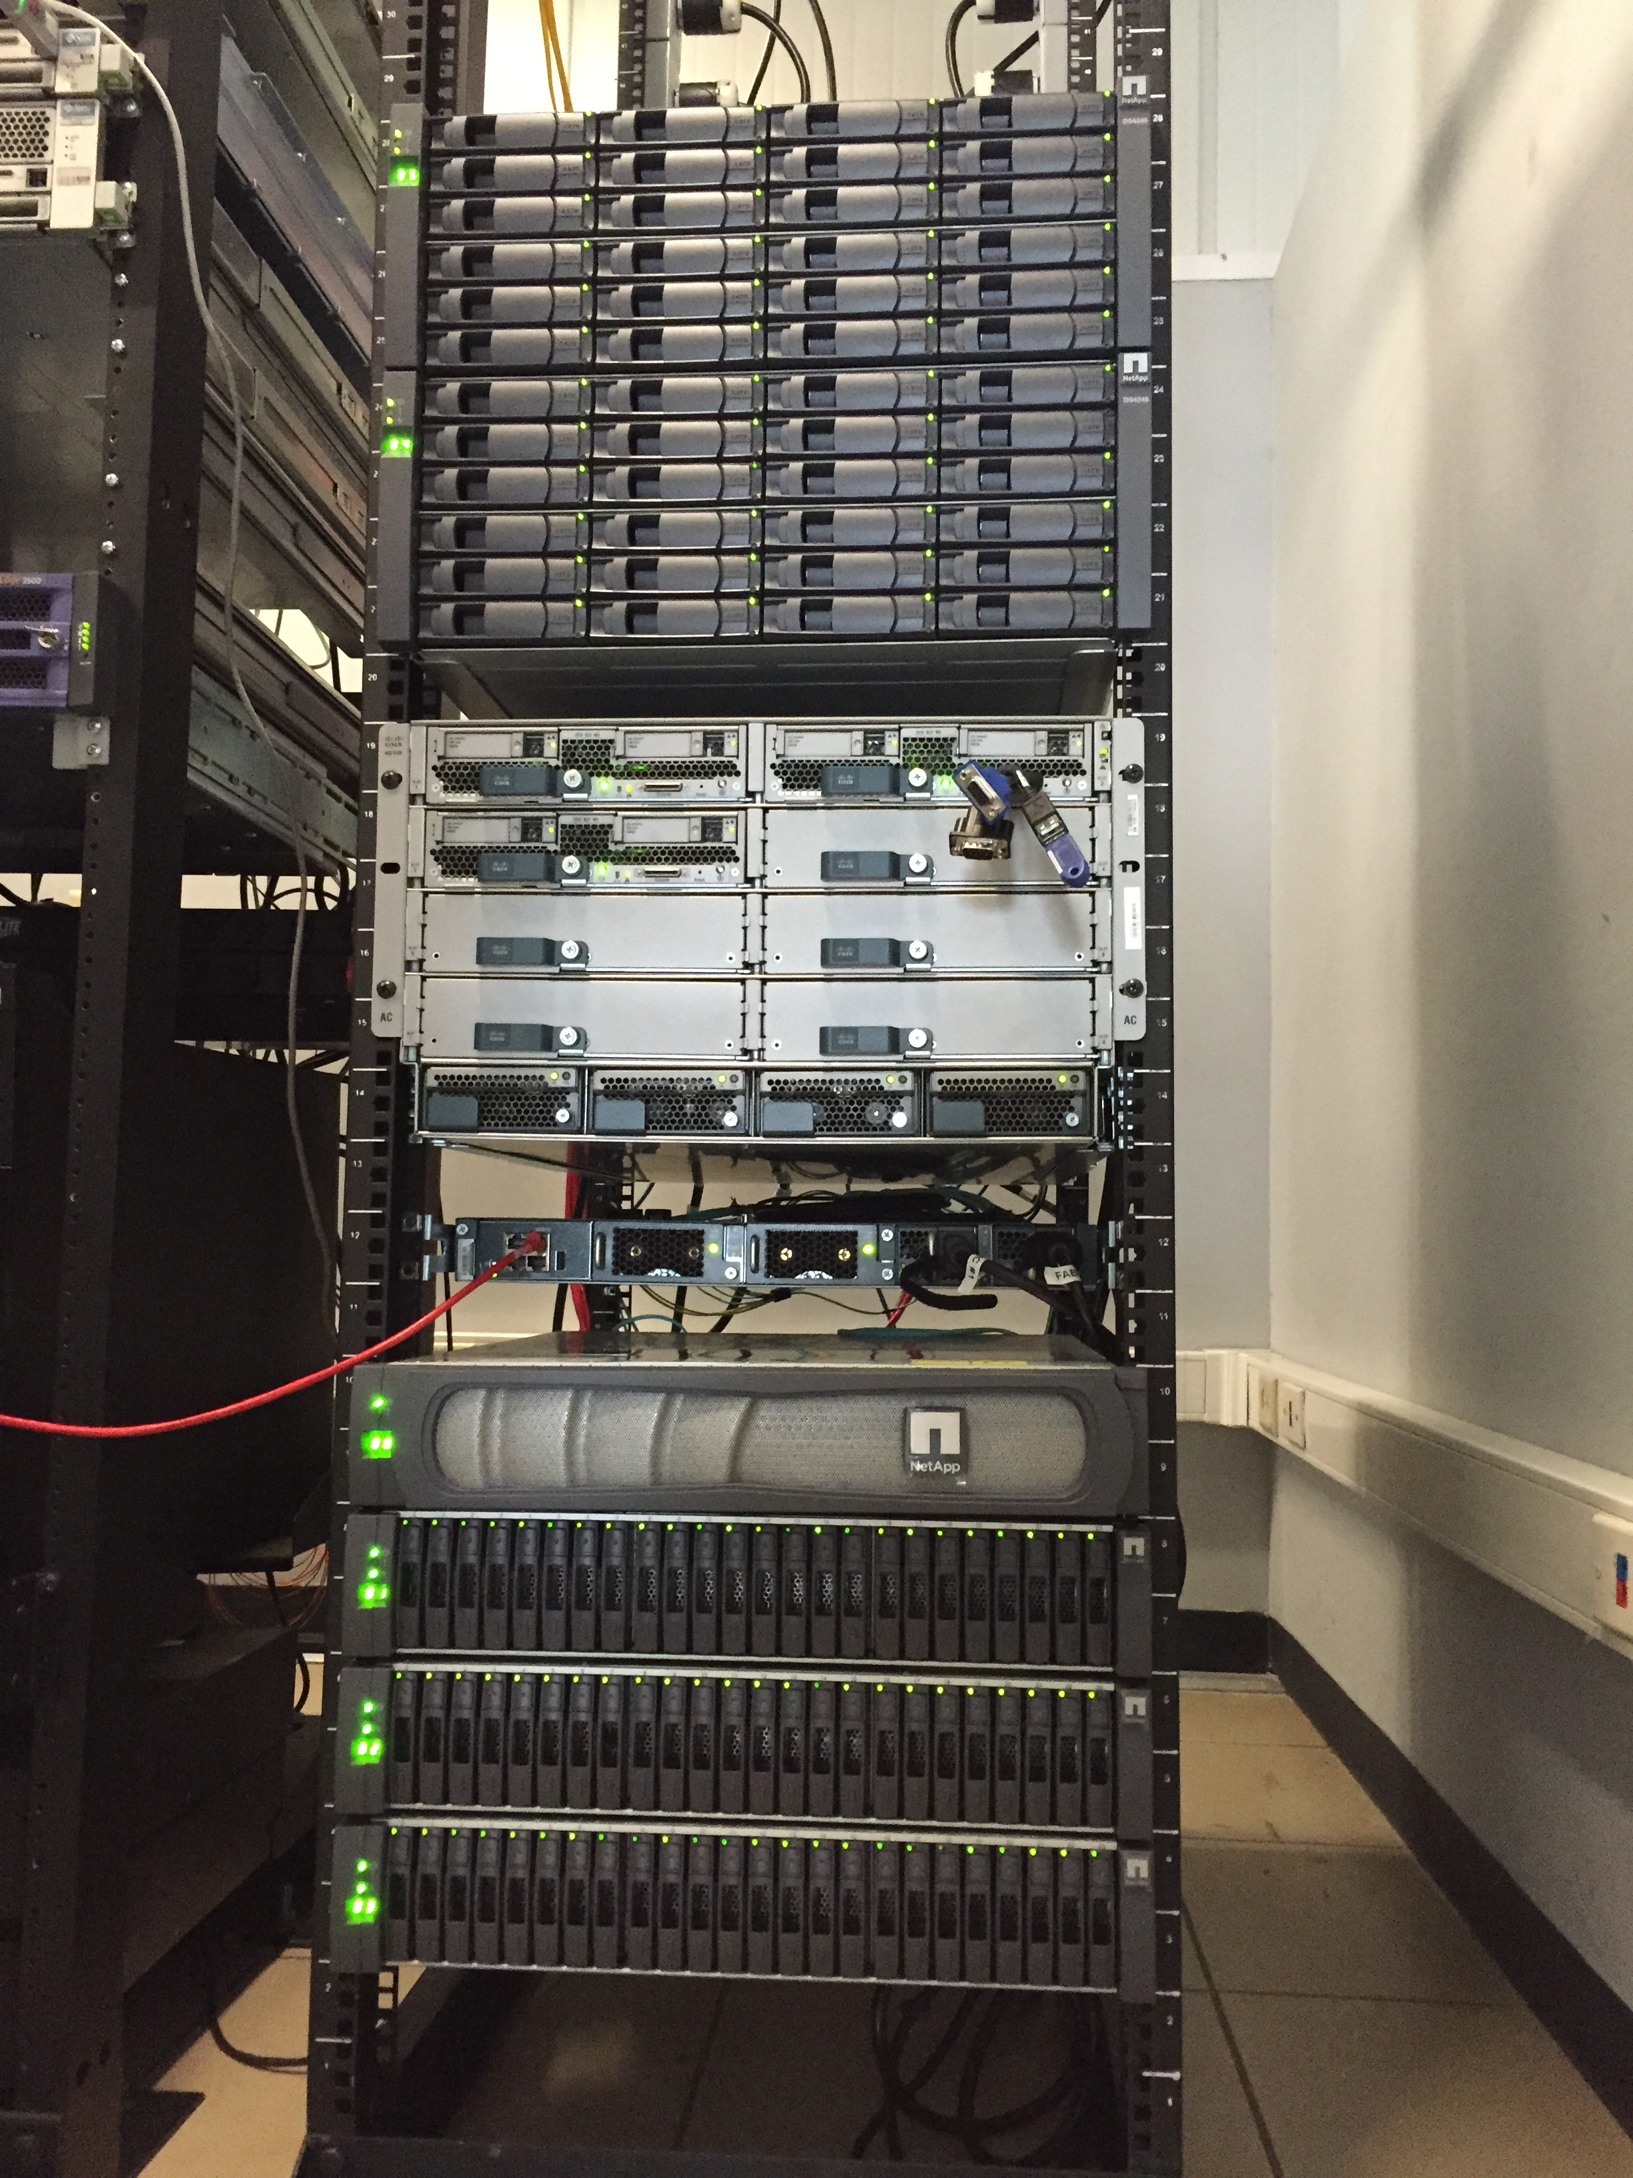
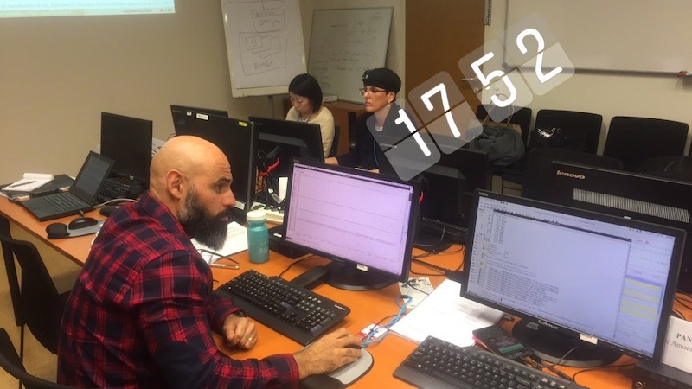
Seiscomp on OVSICORI-UNA after CTBTO course
Introduction
OVSICORI is in charge of earthquake and volcanoes monitoring in Costa Rica
2007 budget injection
Since 2010 we have been using Antelope as our main acquisition and processing system.
In 2018 we had our first contact with Seiscomp in a CTBTO training.
COVID-19
Government cuts our budget.
2010 Acquisition and
Processing system
2007-Technology Investment
Please do not use this space, a QR code will be automatically overlayed
2018 CTBTO - Seiscomp Training
P3.2-238

Slide 3
Seiscomp on OVSICORI-UNA after CTBTO course
Objectives
To find a system that fit to our budget.
Improve our automatic locations efficiency.
Use everything we learn about Seiscomp since 2018.
Keep our Seiscomp knowledge updated.
Please do not use this space, a QR code will be automatically overlayed
P3.2-238

Slide 4
Seiscomp on OVSICORI-UNA after CTBTO course
Methods
Database (catalogs)
Manual locations
Researching and training on Seiscomp since 2018 CTBTO course.
We moved data acquisition to Seiscomp.
We move the automatic earthquake processing to Seiscomp.
We keep Antelope for manual locations and as a database system.
Next steps, analysts training and move Antelope catalogs to Seiscomp.
Automatic locations
Main Acquisition System
Please do not use this space, a QR code will be automatically overlayed
P3.2-238

Slide 5
Seiscomp on OVSICORI-UNA after CTBTO course
Results
After several simulations, we got better and faster automatic earthquake solutions in Seiscomp.
We found more available data analysis tools with Seiscomp.
We found easier ways on making our own software to analyze data.
Please do not use this space, a QR code will be automatically overlayed
P3.2-238

Slide 6
Seiscomp on OVSICORI-UNA after CTBTO course
Conclusion
After 13 years running Antelope we are planning our last move to Seiscomp. Both systems are great but we don’t have enough resources to keep Antelope licenses for a longer time.
Seiscomp have proved to us that is a wonderful system which works for our needs.
Please do not use this space, a QR code will be automatically overlayed
P3.2-238

