Slide 1
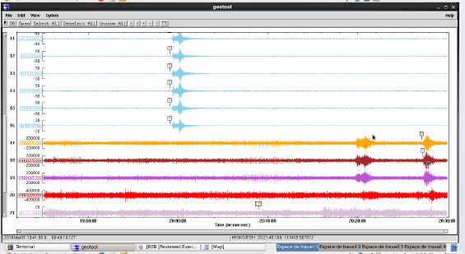
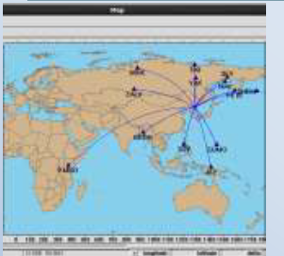
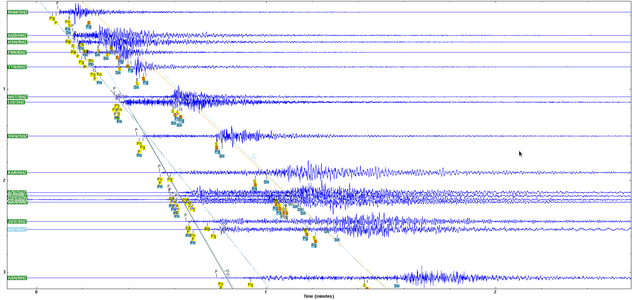
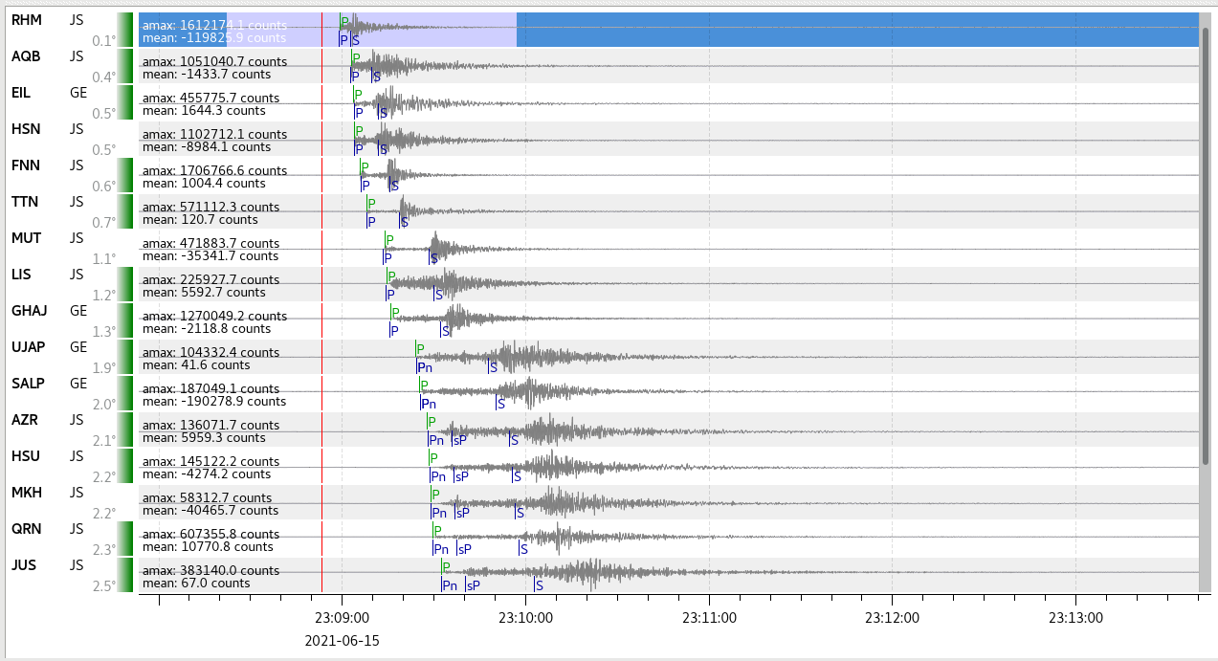
Capacity Building and Technical Assistance Cooperation in Jordan National Data Centre
Murad Alhomaimat
Jordanian Seismological Observatory/Jordan National Data Center
P5.3-422
Main Points:
Highlight the establishment of the Jordan National Data Centre (NDC) and the importance of capacity-building systems (CBSs)
the utilization of International Monitoring System (IMS) data and International Data Centre (IDC) products, emphasizing their role in accessing and analyzing seismic data.
Showcase the effective utilization of the NDC in a box package software, demonstrating its capabilities in seismic data analysis and its specific contribution to enhancing event relocation capabilities.
If you want to learn more about this, come see my e-poster during e-poster session in board 18

