Slide 1
Capacity Building and Technical Assistance Cooperation in Jordan National Data Centre
Murad Alhomaimat
Jordanian Seismological Observatory/Jordan National Data Center
The Jordan National Data Centre (NDC), established in 2004, has been utilizing the NDC in a box package, along with IMS data and IDC products, to analyze seismic events.
Local Earthquakes Events
Local Explosion Events
NDC-In-A-Box Package Software
The establishment of the Jordan National Data Centre (NDC) and utilization of the NDC in a box package software have enhanced event relocation capabilities and strengthened.
The establishment of the Jordan National Data Centre (NDC) and utilization of the NDC in a box package software have enhanced event relocation capabilities and strengthened seismic data analysis
Please do not use this space, a QR code will be automatically overlayed
P5.3-422

Slide 2
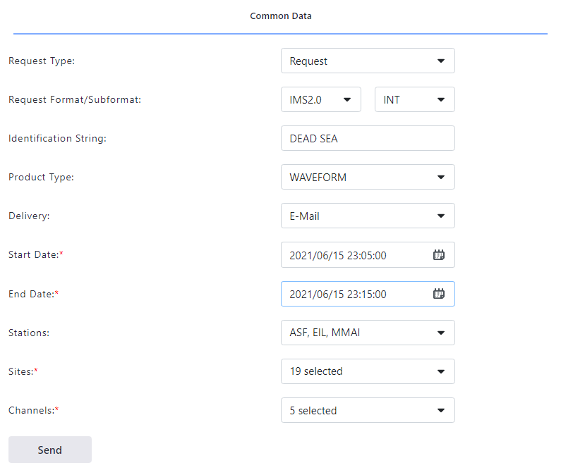
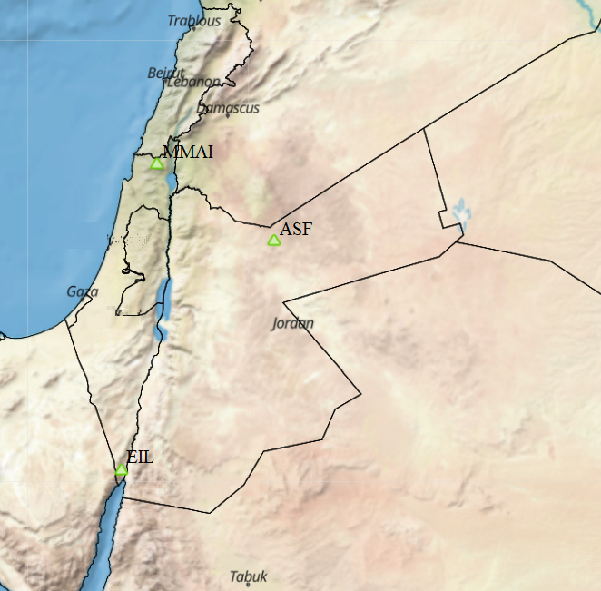
Capacity Building and Technical Assistance Cooperation in Jordan National Data Centre
Introduction
In 1999, Jordan signed the Facility Agreement to establish and upgrade the seismic auxiliary monitoring station hosted in Jordan to implement the Comprehensive Nuclear-Test-Ban Treaty (CTBT). Jordan signed the treaty on 26 September 1996 and ratified it on 25 August 1998. Since the Jordan National Data Centre (NDC) was established in 2004 and started receiving data from International Monitoring System (IMS) data from International Data Centre (IDC) products, the NDC utilized the NDC in a box package, IMS data, and IDC products for analysis of the seismic events by requesting data from IDC products and using it to relocate the events by using different software. As a result of the application of IMS data and IDC products, the NDC can strengthen its in-house capability, particularly in data analysis, and participate in any NDC-related exercises organized by the CTBTO.
Please do not use this space, a QR code will be automatically overlayed
P5.3-422

Slide 3
Capacity Building and Technical Assistance Cooperation in Jordan National Data Centre
Objectives
Highlight the establishment of the Jordan National Data Centre (NDC) and the significance of its capacity-building systems (CBSs) in the context of the Comprehensive Nuclear-Test-Ban Treaty (CTBT) implementation.
Explore the utilization of International Monitoring System (IMS) data and International Data Centre (IDC) products, emphasizing their role in accessing and analyzing seismic data for comprehensive evaluation.
Showcase the effective utilization of the NDC in a box package software, demonstrating its capabilities in seismic data analysis and its specific contribution to enhancing event relocation capabilities.
Discuss the vital role of the AS056 Tal-Alasfar Station in terms of continuous monitoring, operation, and maintenance of seismic waveform data, thus actively supporting the successful implementation of the CTBT.
Through this presentation, we aim to provide a comprehensive understanding of the establishment of the Jordan NDC, the utilization of IMS data and IDC products, and the successful implementation of capacity-building systems. By showcasing the practical application of the NDC in seismic data analysis, we will highlight its valuable contribution to enhancing event relocation capabilities and reinforcing the objectives of the CTBT.
Please do not use this space, a QR code will be automatically overlayed
P5.3-422

Slide 4
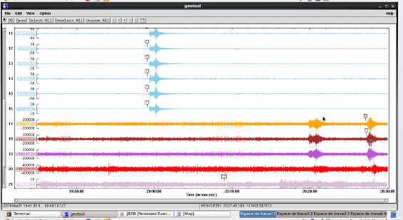
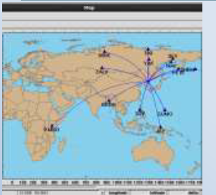
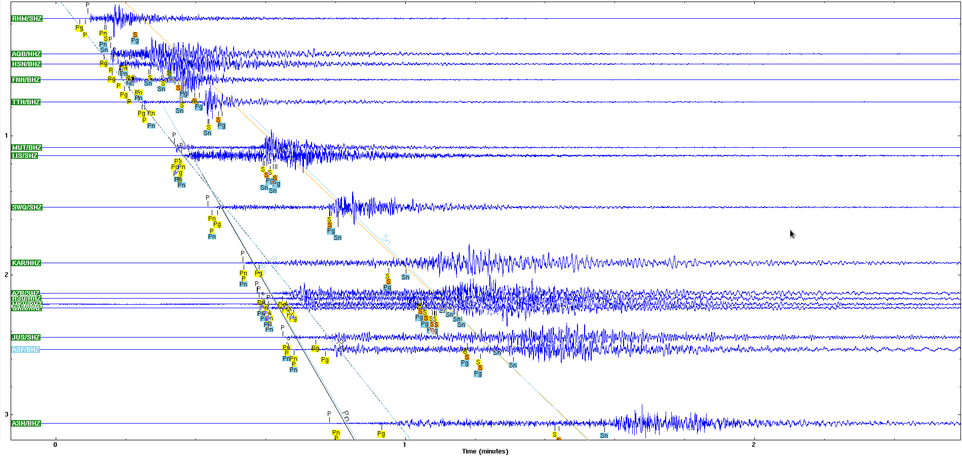
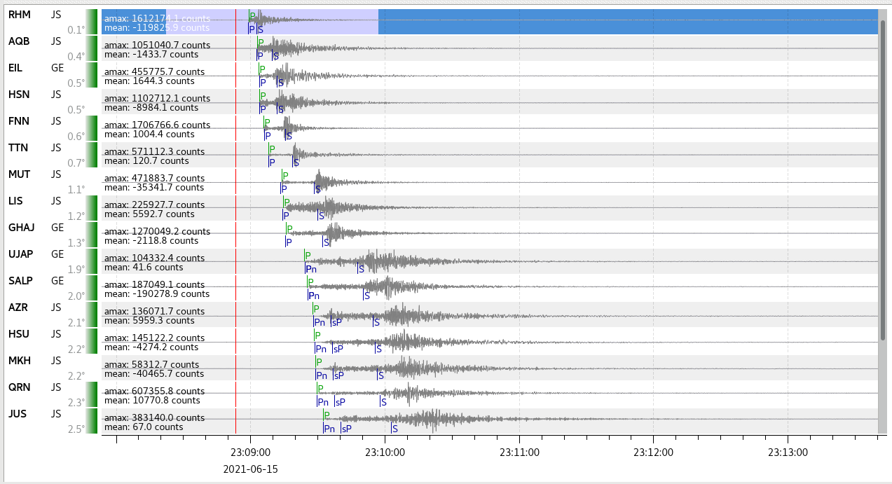
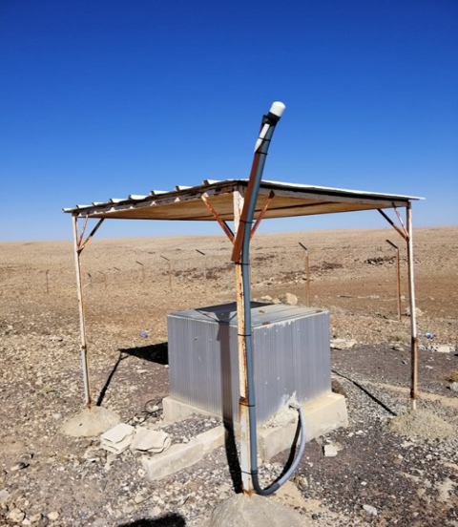
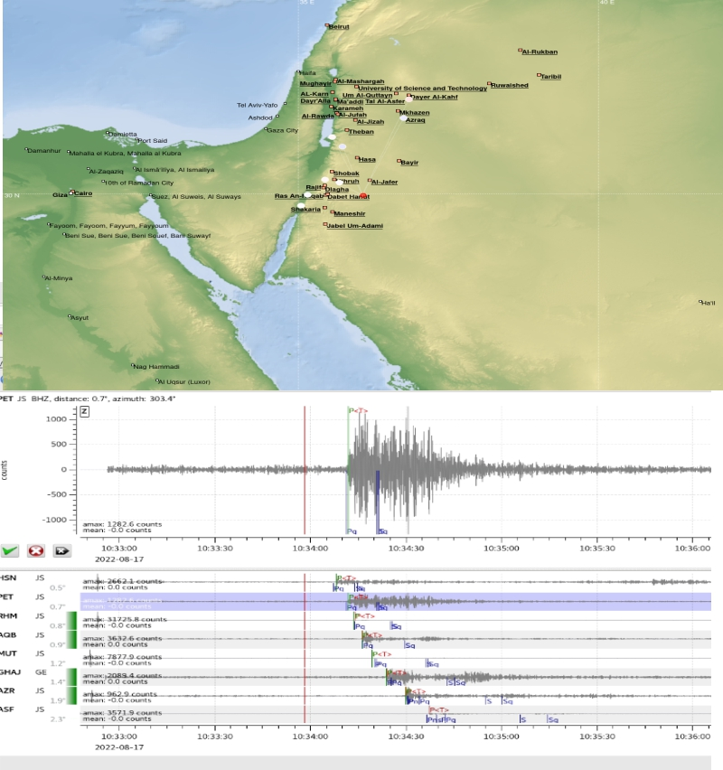
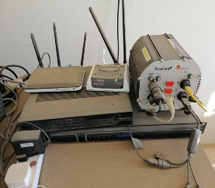
Capacity Building and Technical Assistance Cooperation in Jordan National Data Centre
Place your institution logo here after removing this text box!
Methods and data:
Tal Alasfer Station AS056
Jordan's commitment to nuclear non-proliferation is exemplified by its signed and ratified Comprehensive Nuclear-Test-Ban Treaty (CTBT) and the host of the Tel-ALASFAR Auxiliary Seismic Station (AS056)
Local Earthquakes Events
Al- shadiyah phosphate explosion detected by Jordan Seismological Observatory, 17-08-2022 at 10:33:55 am
.Building stone quarry explosion detected by Jordan Seismological Observatory, 24-08-2022 at 07:07:46 am
NDC-In-A-Box Package Software
Date | Time | Local
 |  | Latitude | Longitude
2021/4/11 | 01:55:45 | 29.2683 | 34.8392
2021/5/11 | 12:50:45 | 30.8453 | 35.4827
2021/6/15 | 23:08:53 | 30.0732 | 35.2028
Please do not use this space, a QR code will be automatically overlayed
P5.3-422

Slide 5
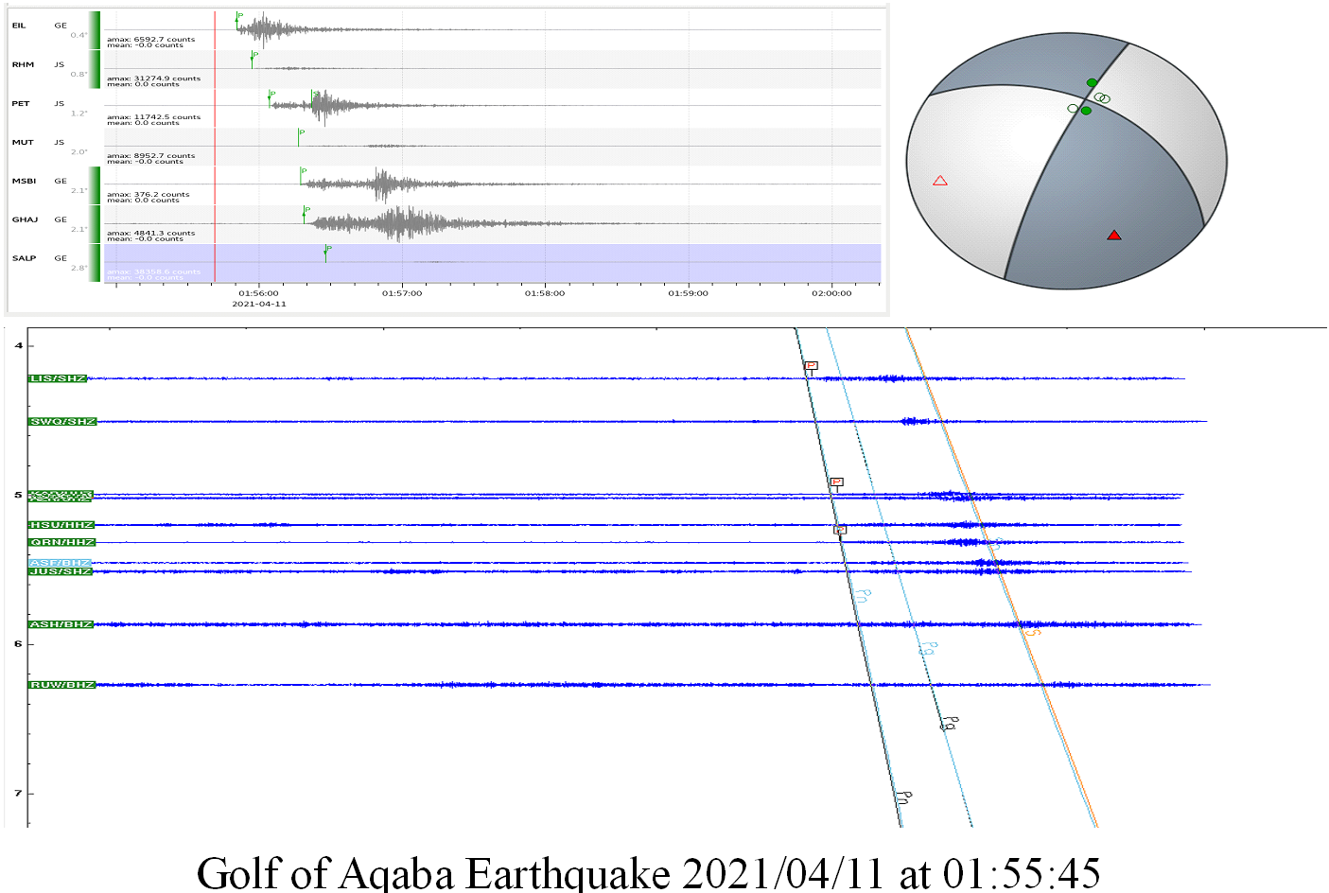
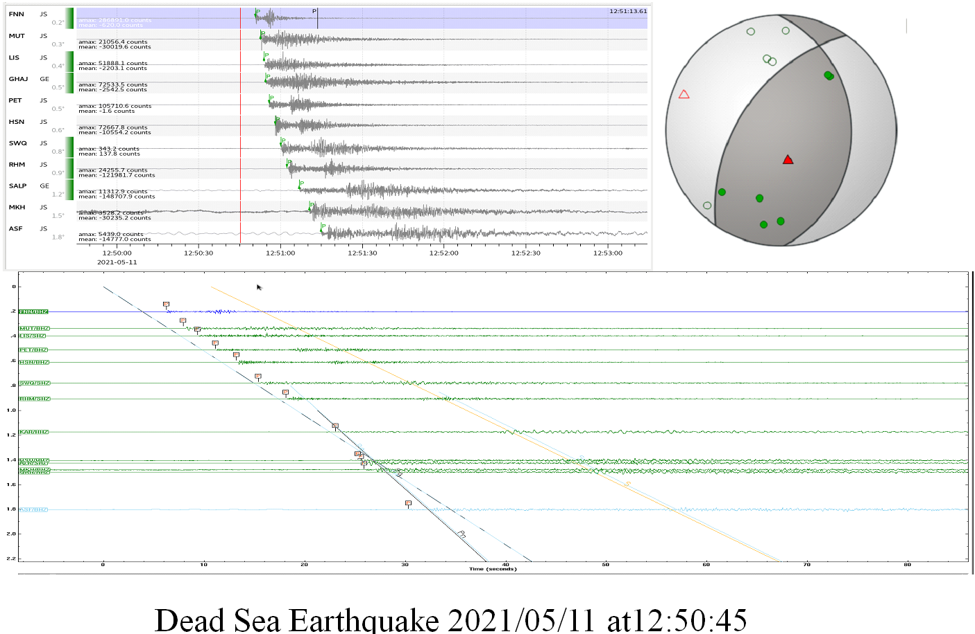
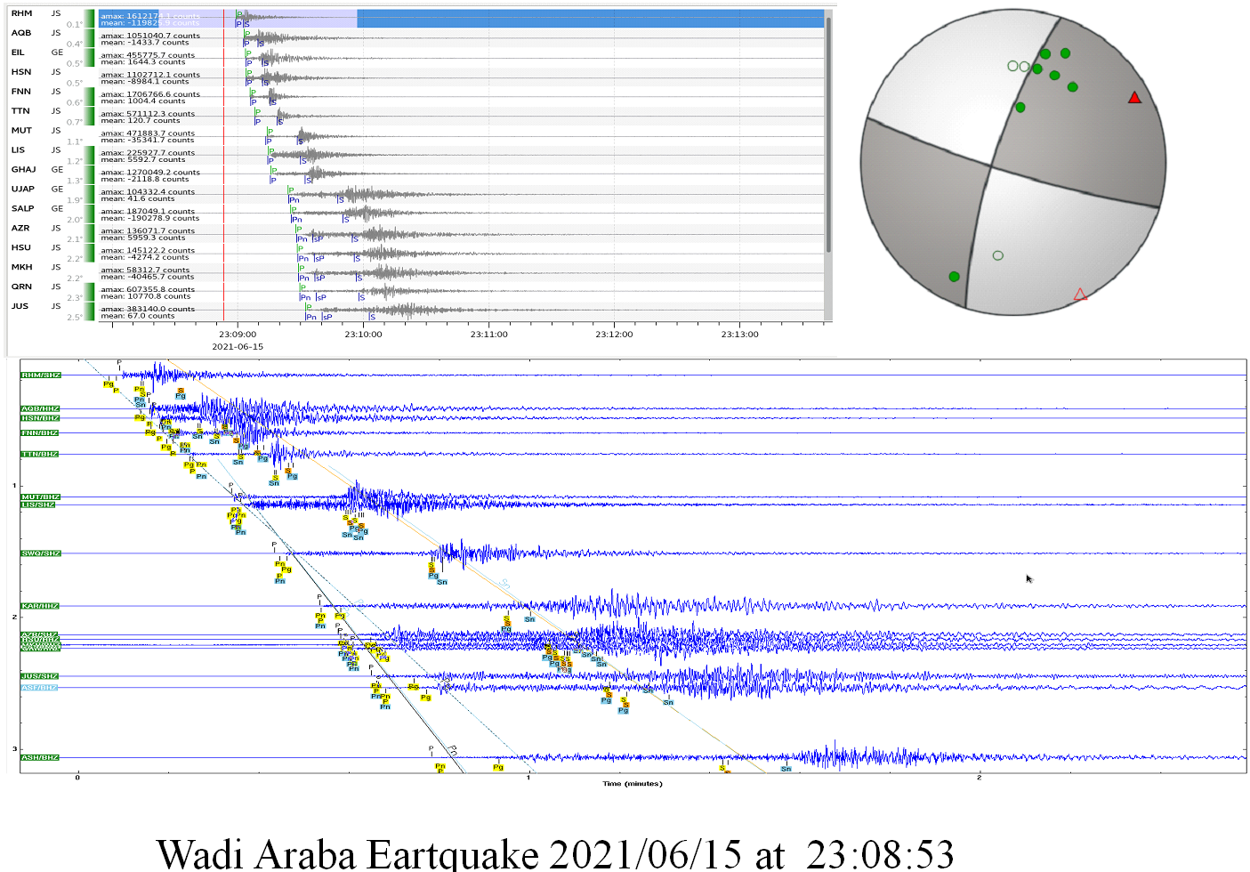
Capacity Building and Technical Assistance Cooperation in Jordan National Data Centre
Results
Please do not use this space, a QR code will be automatically overlayed
P5.3-422

Slide 6
Capacity Building and Technical Assistance Cooperation in Jordan National Data Centre
Results
Building stone quarry explosion detected by Jordan Seismological Observatory, 24-08-2022 at 07:07:46 am
Al- shadiyah phosphate explosion detected by Jordan Seismological Observatory, 17-08-2022 at 10:33:55 am
The establishment of the Jordan National Data Centre (NDC) and utilization of the NDC in a box package software have enhanced event relocation capabilities and strengthened seismic data analysis.
The AS056 Tal-Alasfar Station's continuous monitoring and maintenance of seismic waveform data have made significant contributions to the successful implementation of the Comprehensive Nuclear-Test-Ban Treaty (CTBT).
The NDC's effective utilization of International Monitoring System (IMS) data and International Data Centre (IDC) products has improved access to and analysis of seismic data for comprehensive evaluation.
Please do not use this space, a QR code will be automatically overlayed
P5.3-422

Slide 7
Capacity Building and Technical Assistance Cooperation in Jordan National Data Centre
Conclusion
The Jordan NDC's establishment and development support the implementation of the CTBT, reflecting Jordan's commitment to nuclear non-proliferation.
By utilizaing the NDC in a box package software and continuously monitoring seismic activities, the NDC enhances event relocation capabilities and contributes to the global effort of maintaining peace and security.
By effectively accessing and analyzing seismic data, the Jordan NDC plays a crucial role in regional and global efforts towards nuclear disarmament and non-proliferation. Its contributions to the verification and monitoring of nuclear test ban activities are essential for maintaining global peace and security.
In conclusion, the Jordan NDC, through its capacity-building systems, advanced software utilization, and continuous monitoring efforts, demonstrates Jordan's commitment to the CTBT and its vital role in strengthening the global nuclear non-proliferation regime.
Please do not use this space, a QR code will be automatically overlayed
P5.3-422

