Slide 1
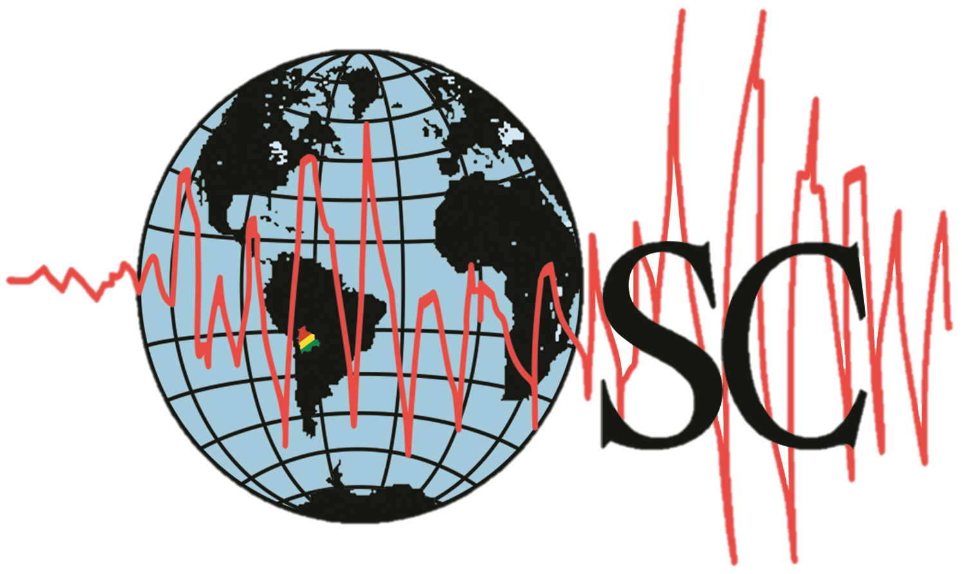
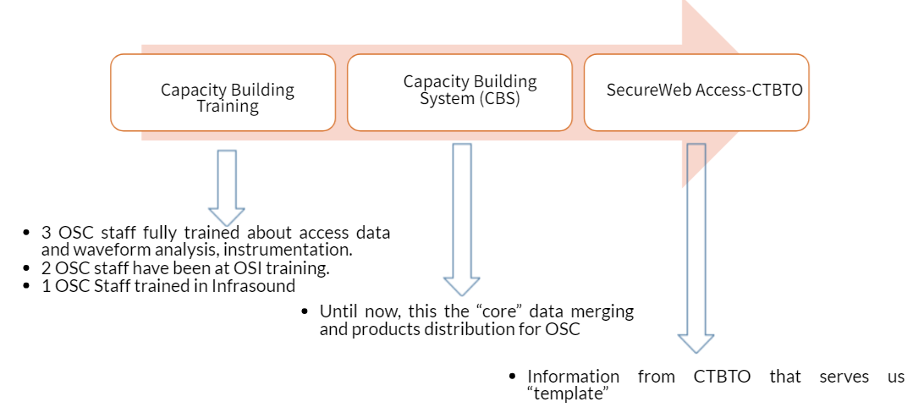
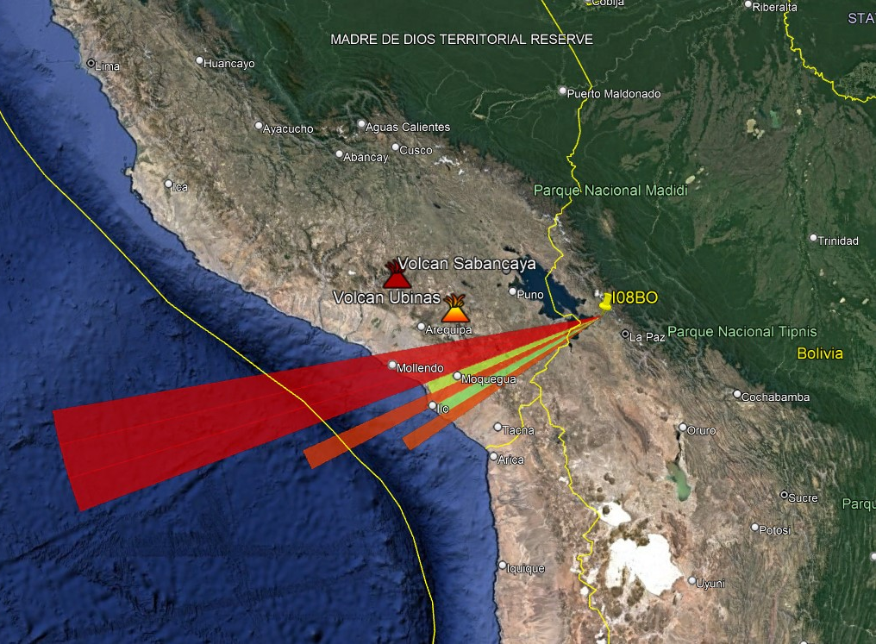
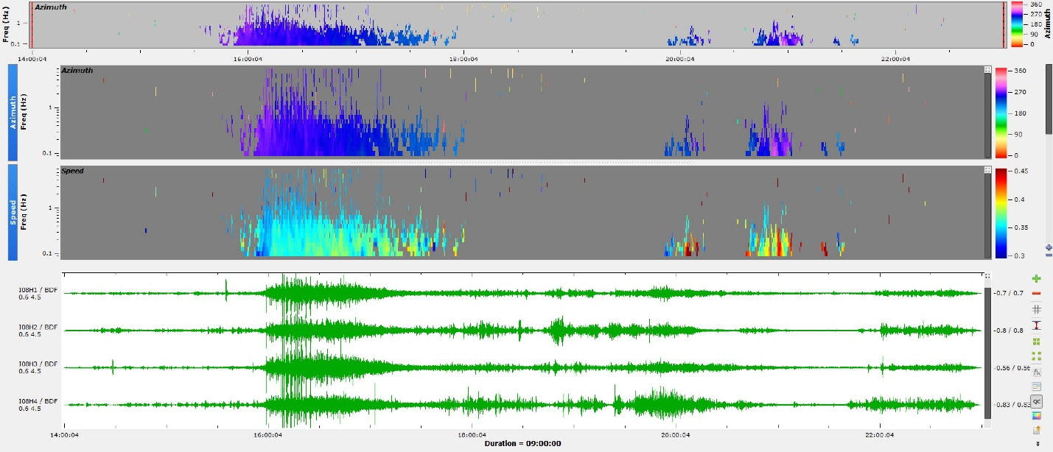
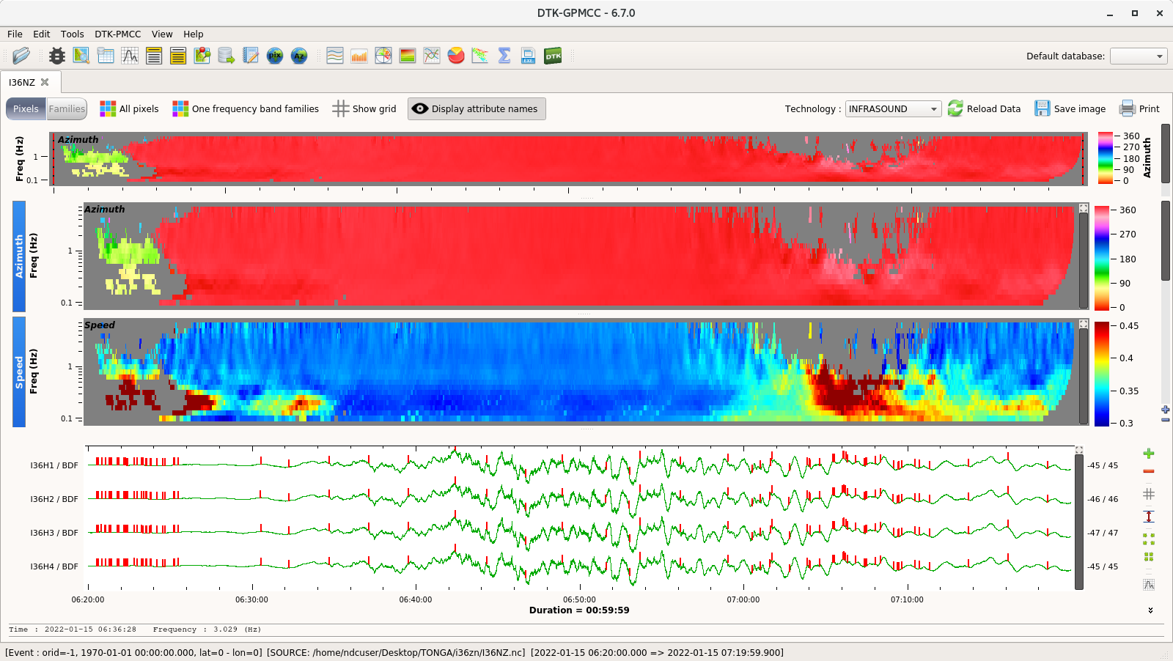
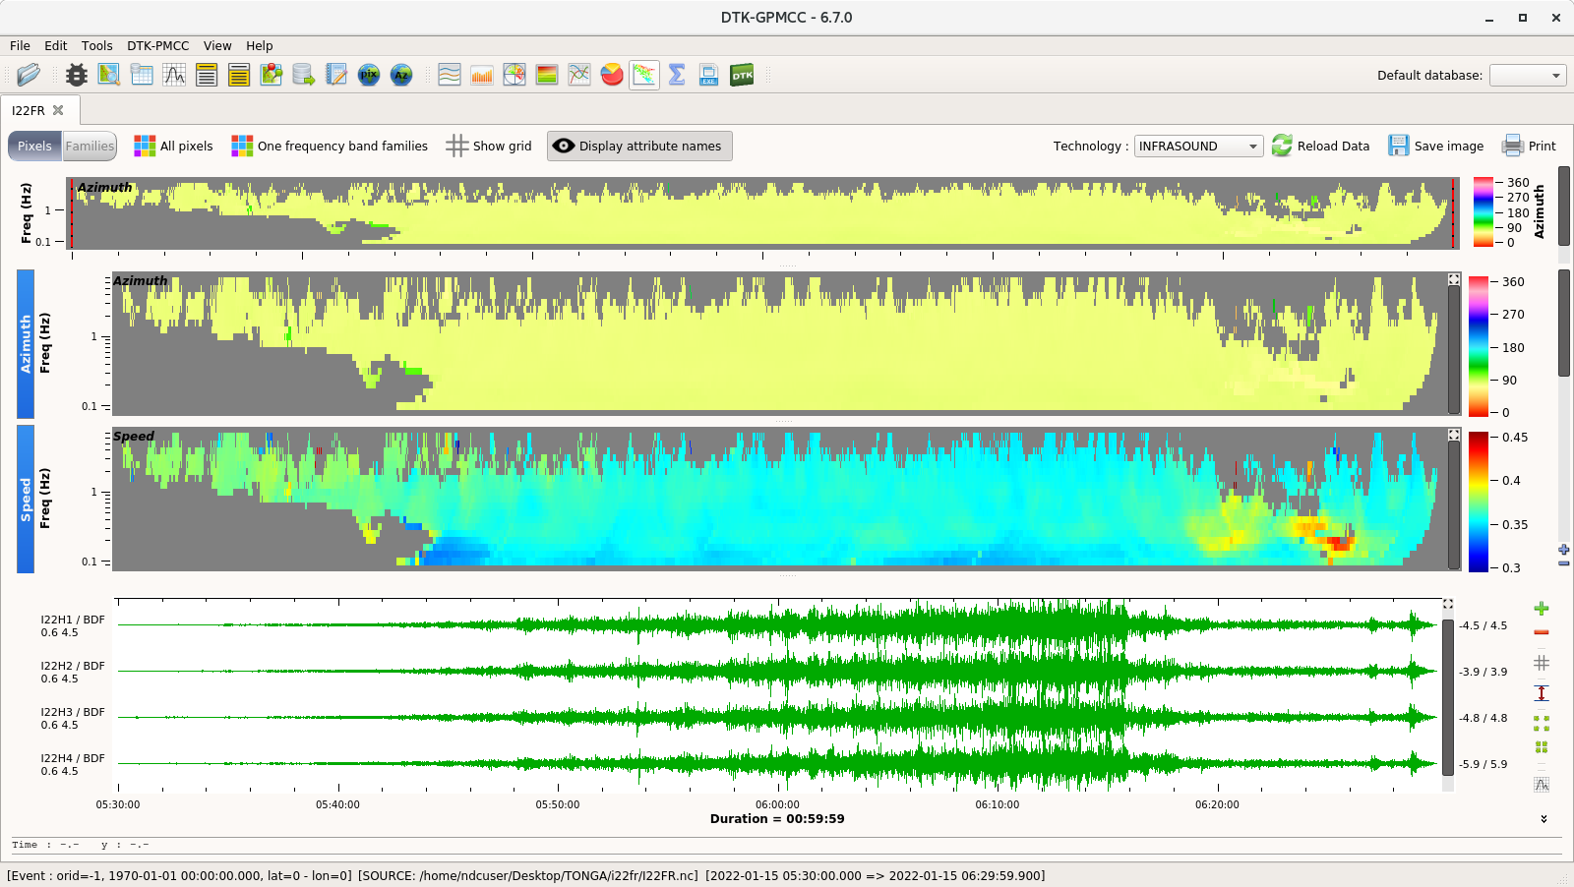
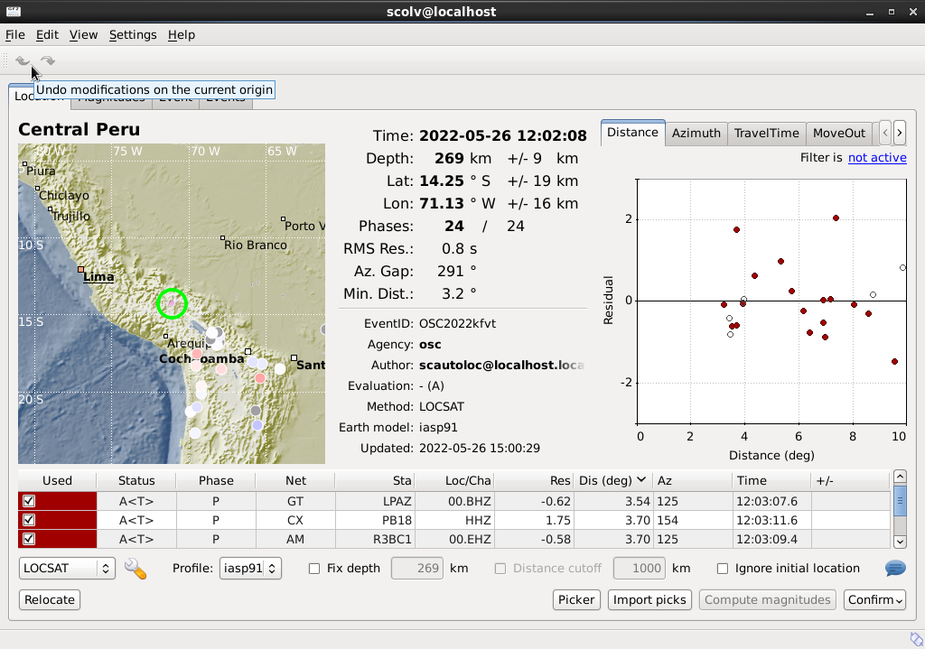
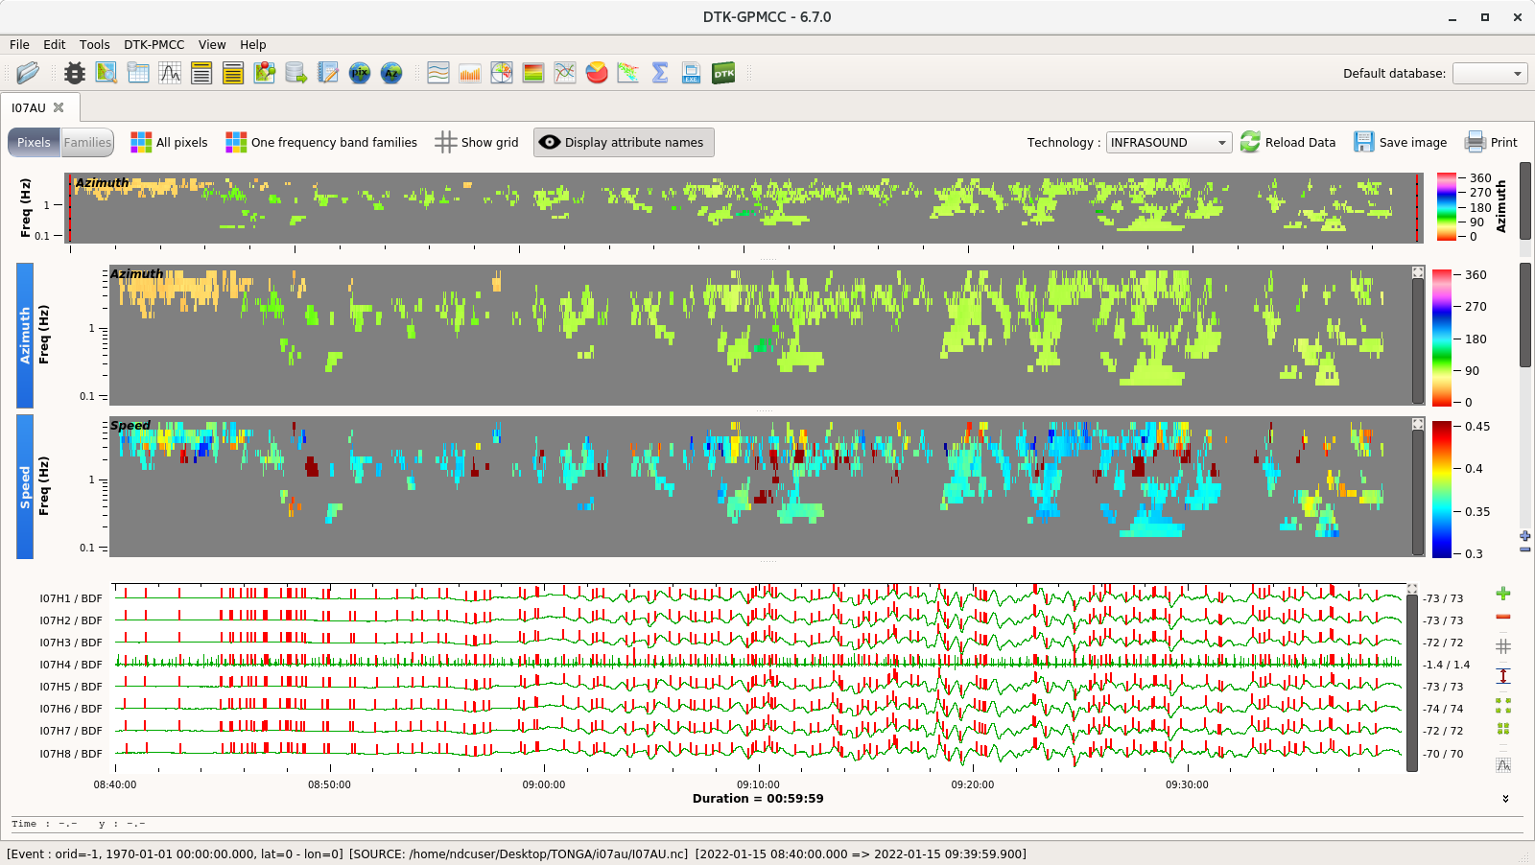
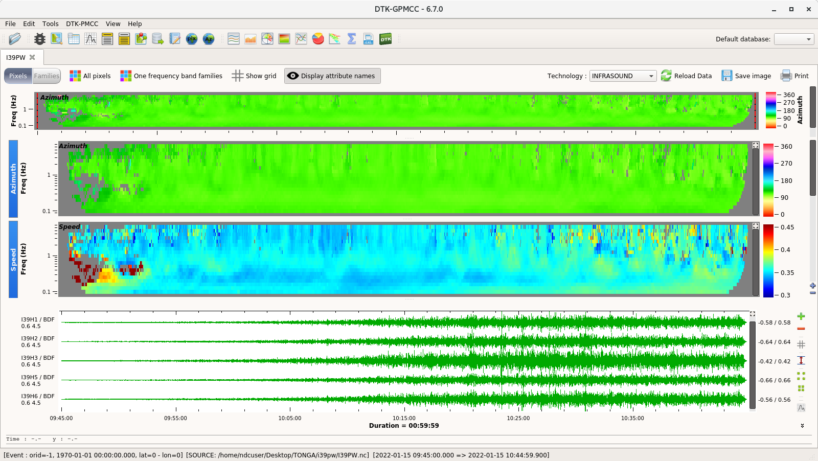
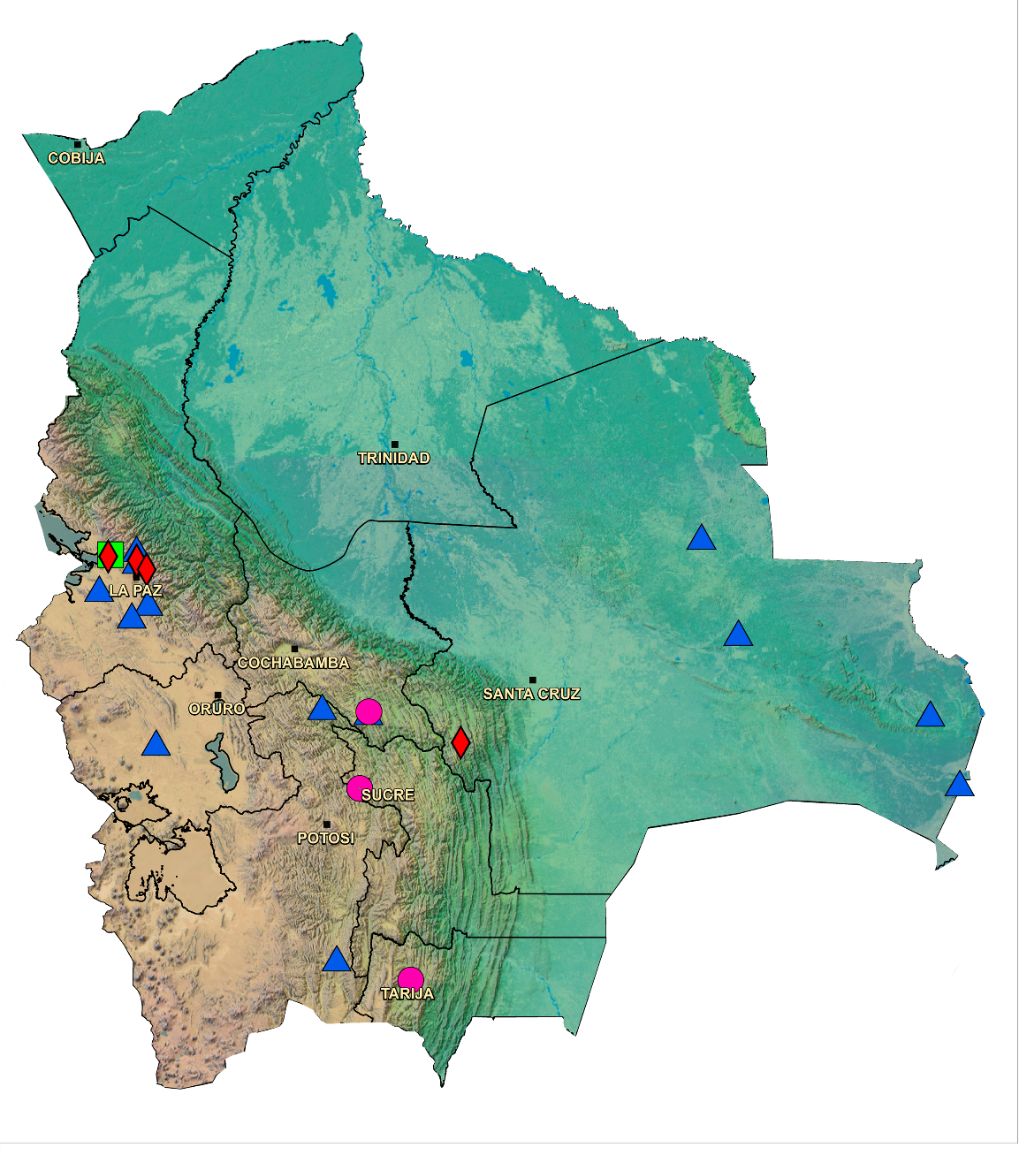
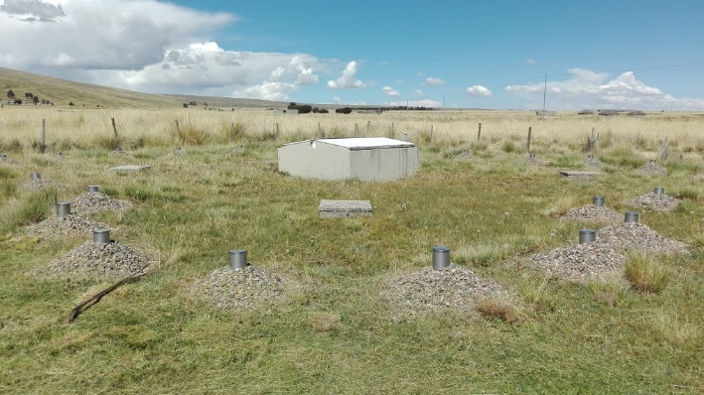
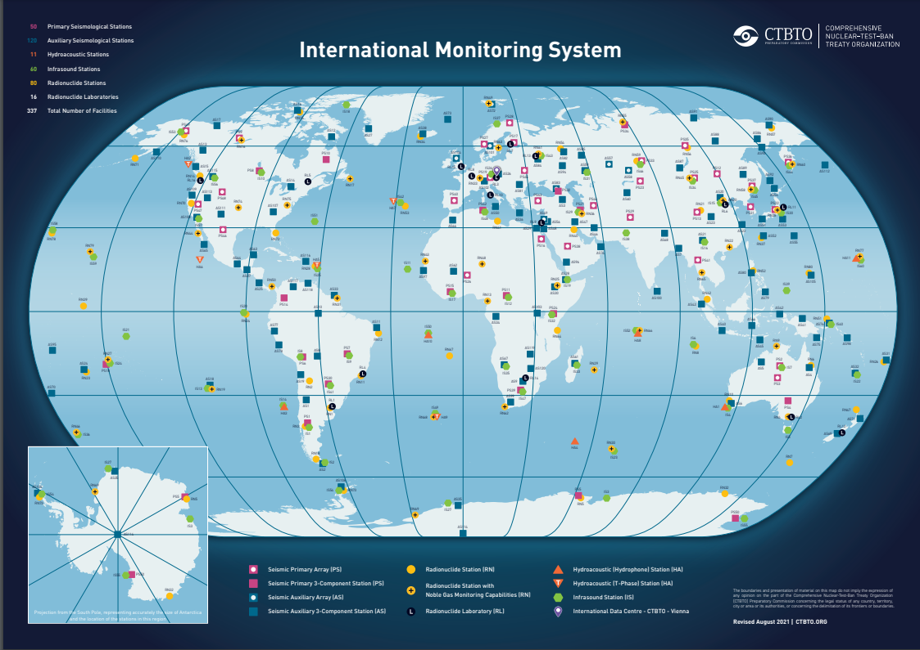
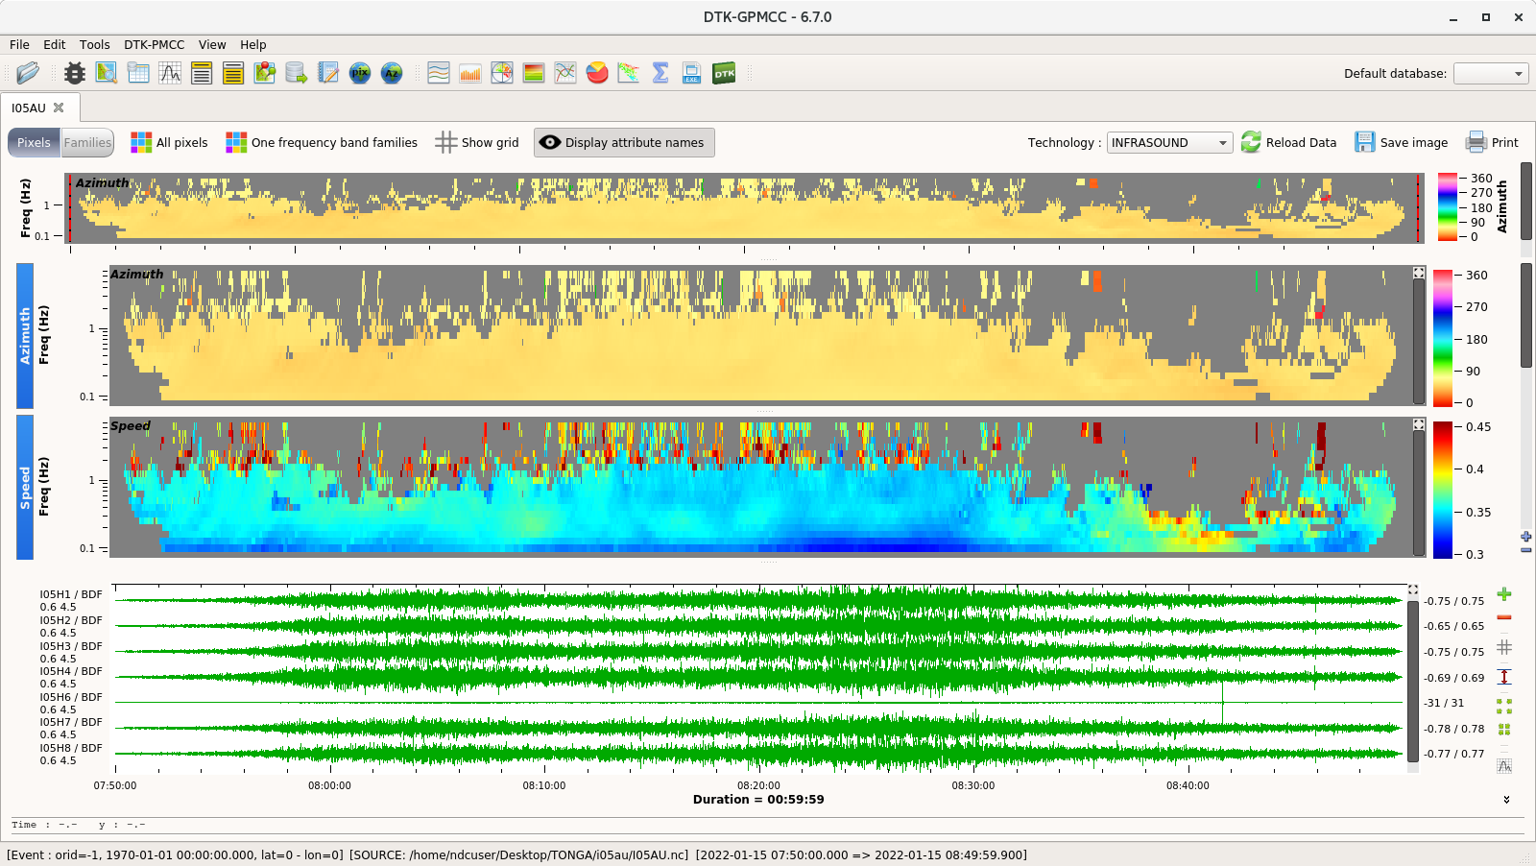
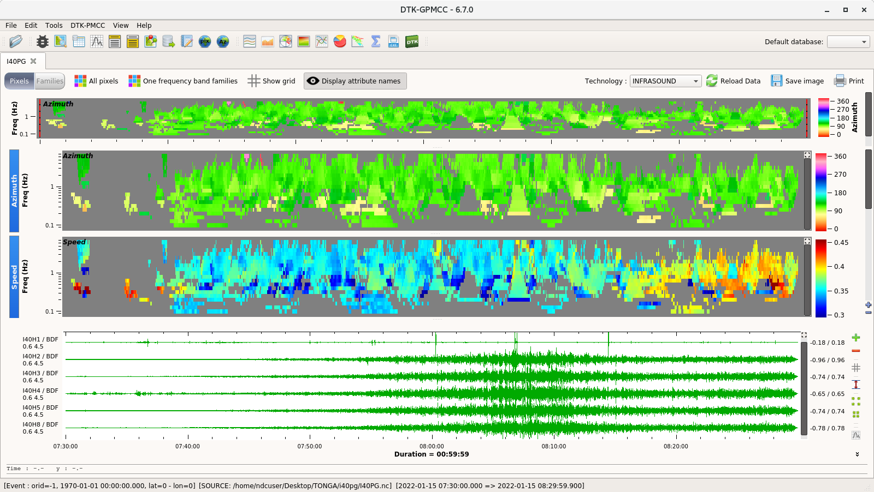
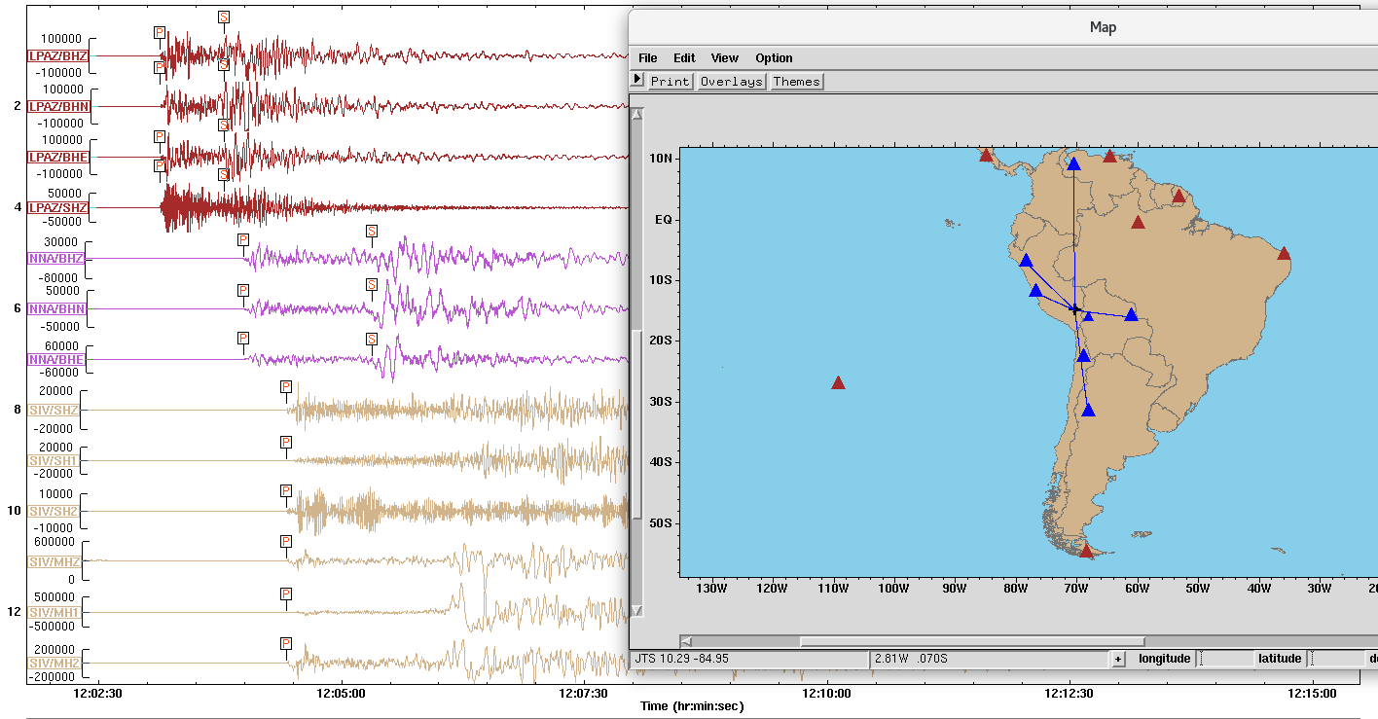
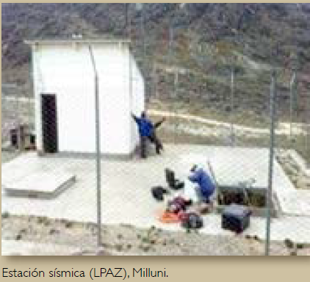
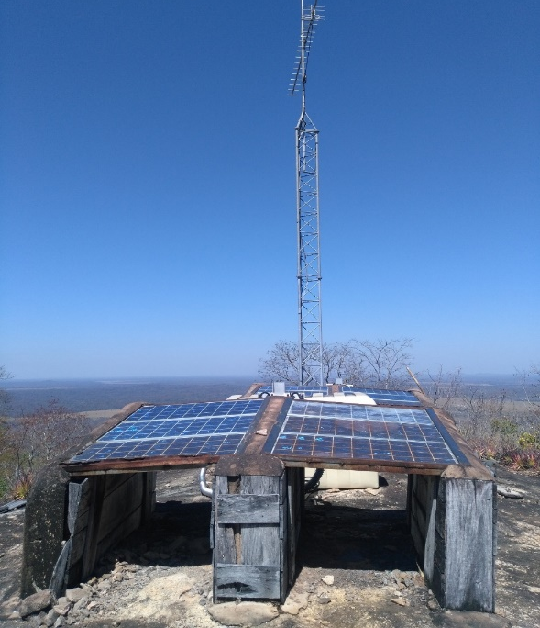
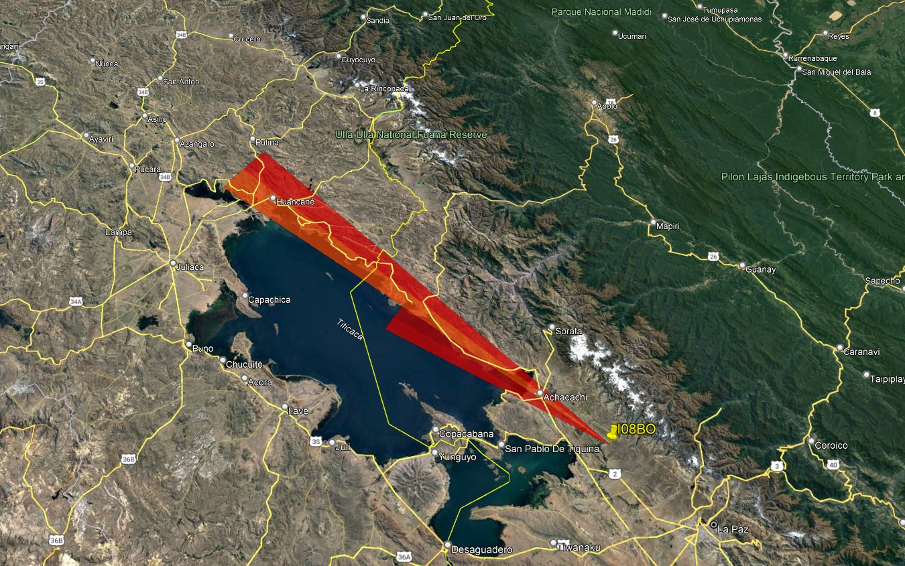
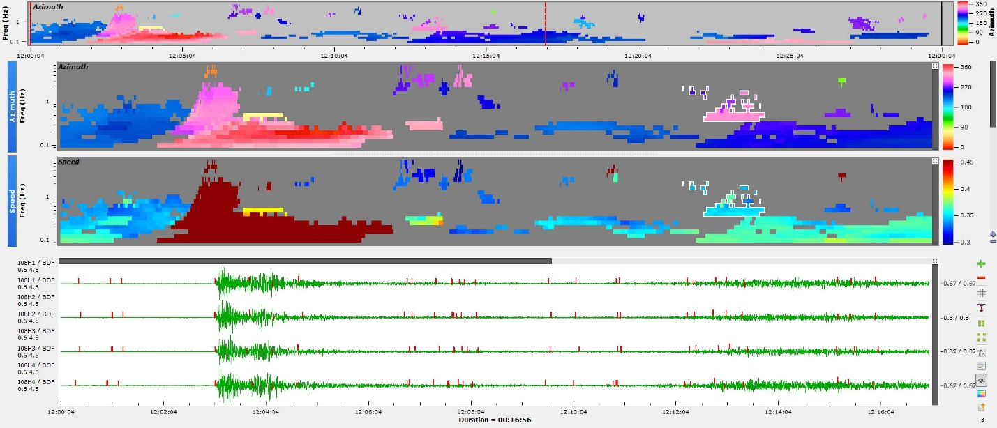
Improvements of Data Analysis by NDC - Bolivia Using IMS Stations and NDC in a Box Programs
Nieto M., Fernandez G., Tintaya R., Condori F.
Observatorio San Calixto
P1.2-462
P5.3-451
ABSTRACT
METHODS
Hunga Tonga-Hunga Ha'apai volcano eruption January 15, 2022
Since 2002, when Bolivian International Monitoring System (IMS) stations (IS08, LPAZ, and SIV) began transmitting data, the Bolivian National Data Centre (NDC) has made an effort to effectively participate in the verification regime of the Treaty using IMS stations and NDC in a box programs for integrating data acquisition, processing and analysis. Thanks to the different trainings of CTBTO, the real time integration of the local seismic stations IMS and Operations Support Centre has been carried out to monitor local, regional and global seismic and infrasonic events through the SeisComP4 acquisition system. All analysis of events data has been carried out, such as: daily routine, analysis of the Peru earthquake of May 26, 2022 using stations IS08, IS41, IS20 (infrasound), PS06, AS008, PS07, AS078, AS019, AS077 (seismic) and Hunga Tonga-Hunga Ha'apai volcano eruption January 15, 2022, through infrasound stations:I05AU, I07AU, I22FR, I36NZ, I39PW, I40PG and IS08. In addition, in recent years, all data analysis programs such as Geotool, DTK-GPMCC, DIVA, SeisComP4 have been updated so that NDC-Bolivia users can analyze data.
On January 14, 2022 a first eruption was recorded, the next day, another eruption that even managed to cover the Sun. The volcanic explosions were audible for tens of kilometers around, being recorded by several infrasound stations (I05AU, I07AU, I22FR, I36NZ, I39PW, I40PG). Also, by the station I08BO located at a distance of approximately 11224 km from the island of Tonga, so the wave took approximately 9 hours to reach the station, this managed to record the event with a frequency of 0.1 to 1 Hz, with a propagation speed between 0.34 and 0.36 km / s, with a duration of approximately 6 hours, the event was recorded from 16:00 to 22:00 hours (GMT).
RESULTS
INTRODUCTION
The operational results of the operability of the International Monitoring System are promising and have opened up the possibility of civil and scientific applications. Some examples of how the IMS CTBTO surveillance technologies contribute not only to the detection of nuclear events but also to the characterization of more phenomena on the planet
Bolivia among the measures of implementation of the Comprehensive Nuclear Test Ban Treaty designates the San Calixto Observatory (OSC) as the National Data Center (NDC) to be part of the International Monitoring System (IMS). Bolivia contributes with 3 certified stations: a primary seismic station (LPAZ-PS06), an auxiliary seismic station (SIV- AS08) and an infrasound station (IS08) to the international monitoring network, which are integrated to the OSC Seismological Network.
Perú Earthquake of May 26, 2022
The Peru earthquake was recorded on May 26, 2022 at 12:02:23 (GMT), magnitude 7.2 M, at a depth of 252 km, which caused alarm in several cities of the country, for the city of La Paz the maximum intensity was IV M.M. This event was analyzed with primary and auxiliary seismic data from the IMS network, using the NDC in a Box programs, such as Seiscomp3 and Geotool, whose hypocentral parameters have a high quality. It was also analyzed with infrasound data from I08BO using Jade-DTK software. The azimuth was 307 and 311 degrees northwest, with an apparent velocity 0.34 km/s and a pressure of 0.015 Pascals (Pa).
Estación de Infrasonido
IS08: 1999 / 2002
CONCLUSION
Bolivia actively participates not only in the processes inherent to the organization, but also in the field of scientific and civilian applications.
IMS surveillance technologies represent a broad and unique technological platform that creates an excellent environment and development opportunities for member states.
Thanks to the different trainings offered by the CTBTO, the real-time integration of stations to monitor local, regional and global seismic and infrasound events has been carried out.
Sísmica Primaria
LPAZ: 1993 / 2003
Sísmica Auxiliar
SIV: 1993 / 2008

