Slide 1
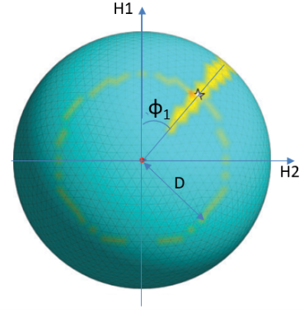
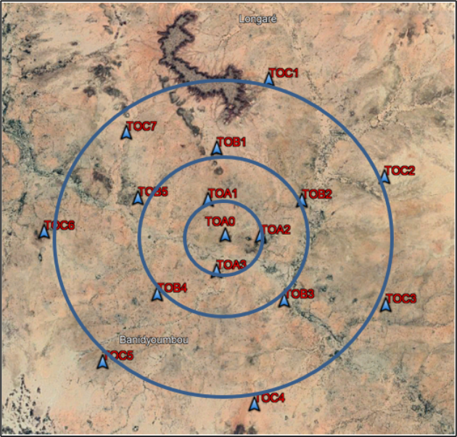
Seimic Data Processing and Beamforming
Idé Alpha Djibrilla
Geophysicist/ HANEA/ NIGER
P5.3-027
The presentation on seismic data processing and beamforming has the mains purposes to show that:
The Array seismic give the high possibility to have phase picking on seismogram , this can let getting the good time difference between P waves and S wavs a parameter to include for distance and epicentre determination;
The possibility to detect the azimuth of body waves (P and S) from a giving event by good analysis of 3 Components recording;
To locate an even ( epicenter determination) from only a single 3-components site from the array;
To confirm the single seismic event localization with far station as the PS26 data used to locate a nuclear test made by DPRK on February 12th , 2013.

