Slide 1

Seismic Data Processing and Beamforming
[Idé Alpha Djibrilla]
Geophysicist / HANEA / NIGER
Given the data quality of the PS26 station, we will show that it is possible to use only the three-component data at a single site among the 16 of the array to locate an event as far away as it is,
The seismic sensor three components itself could let to determine an event localization . By defining a time reference to get the exact correspondents amplitudes from the horizontals components one can calculate the Back Azimuth (AZI) from the P first motion . This can define the direction of the epicenter.
As far station by using the chart of wave propagation and earth model can deduce from TOC2 position:
D ≈ 108° (D ≈ 11.990km)
The backazimut from TOC2 AZI= 38.04º
Using Google earth we were able to locate with distance and azimuth the epicenter of the event that perfectly matches a locality in North Korea. The beam create with all the array data allow to get a good P phase position for the secled TOC2 data, the dates and data can be used by anyone wishing to verify the experiment. this result reassures us that the method works well even for stations s located at a great distance from events, on the other hand this was possible due to the good quality of the data provided by the PS26 station.
Please do not use this space, a QR code will be automatically overlayed
P5.3-027

Slide 2

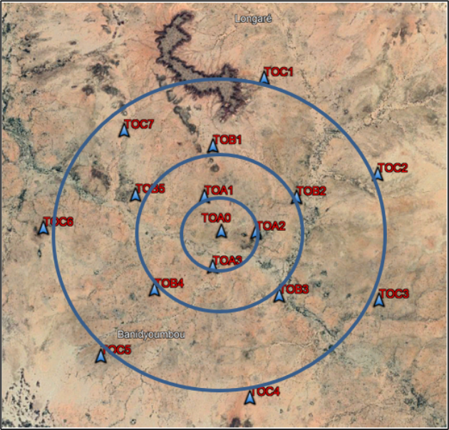
Introduction
Given the data quality of the PS26 station, we will show that it is possible to use only the three-component data at a single site among the 16 of the array to locate an event as far away as it is.
Niger Republic is located in West Africa. The PS26 seismic station is located at 12km west of Torodi and 58 km south-west from Niamey the capital.
The PS26 primary seismic station as an array is composed of 16 sites and a central recording facility (CRF) at the base camp.
Please do not use this space, a QR code will be automatically overlayed
P5.3-027

Slide 3
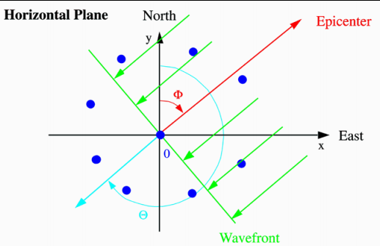
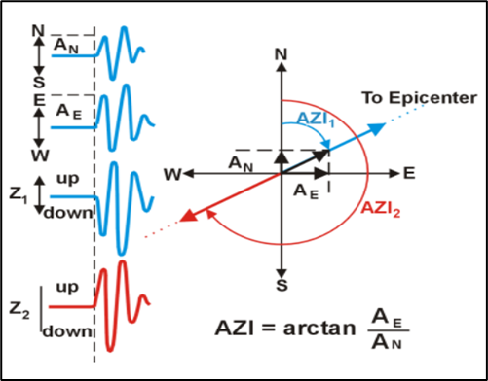
Objectives
Interesting facts with the Seismic Array
Data downloaded from IDC allowed us to make a 3 components data processing for single station event localization. From one site TOC2 of PS26 array data used for this purpose will demonstrate the feasibility of the challenge to locate a nuclear test made by DPRK On February 13th, 2013.
The seismic array system increase the signal-to-noise ratio (SNR) by summing the coherent signals from the single array sites.
The summing create a beam which can help to, more define the coherent signals by highlighting the seismic phases.
The seismic sensor three components itself could let to determine an event localization . By defining a time reference to get the exact correspondents amplitudes from the horizontals components one can calculate the Back Azimuth (AZI) from the P first motion . This can define the direction of the epicenter.
Please do not use this space, a QR code will be automatically overlayed
P5.3-027

Slide 4
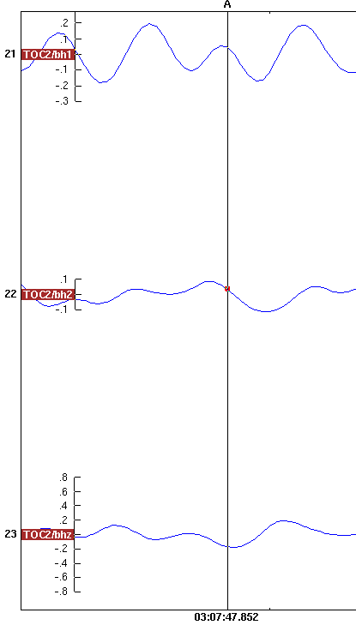

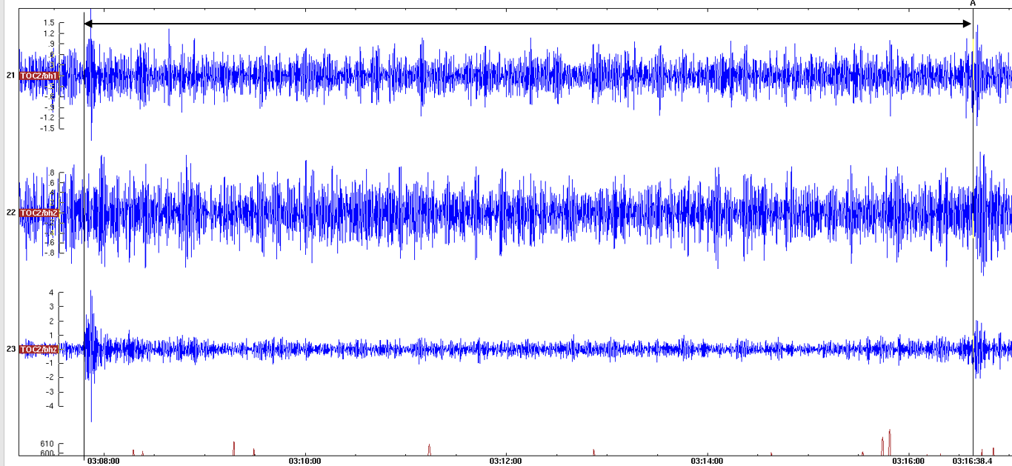

Methods
Interesting facts with the Seismic Array
The estimation of the distance D can be made from the determination of the time difference of arrivals P and S waves on the data. Assuming Vp/Vs = 1.73, the hypocenter distance can be estimated as:
Down
∆_{t}=T_{S}-T_{P}=9min
Tp: Time of first P arrivals
Ts: Time of second S arrivals
D: Distance from the epicenter
Vp: Velocity of Pwaves
Vs: Velocity of S waves
∆t : Difference of time between
Pwaves and S waves.
Please do not use this space, a QR code will be automatically overlayed
P5.3-027

Slide 5

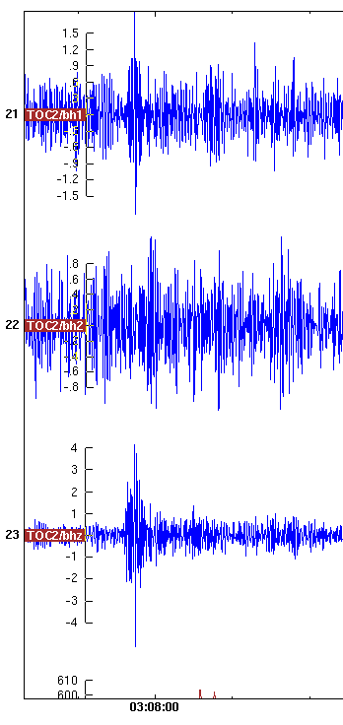
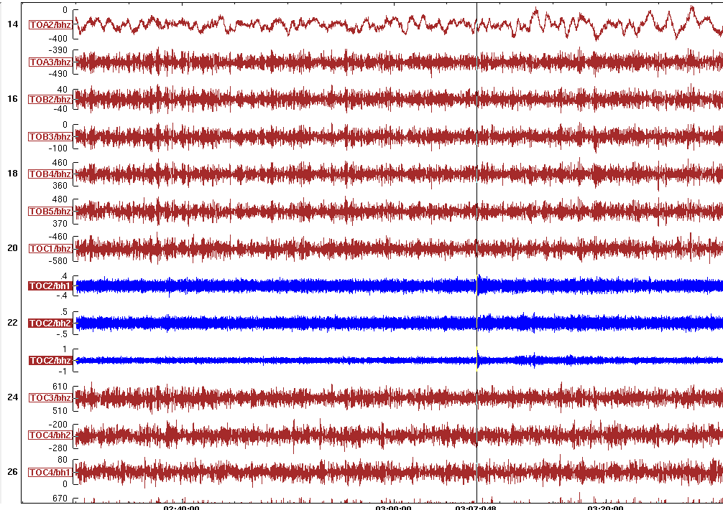
Results
DPRK Nuclear test data of PS26 station on Feb. 12 2013.
AN=0.046
AE=0.036
Z down
As far station by using the chart of wave propagation and earth model, we can deduce from TOC2 position:
D ≈ 108° (D ≈ 11.990km).
AZI= arctan(0.036/0.046)
The backazimut from TOC2 AZI= 38.04°
∆t=TS-TP=9min
Please do not use this space, a QR code will be automatically overlayed
Z Down
P5.3-027

Slide 6
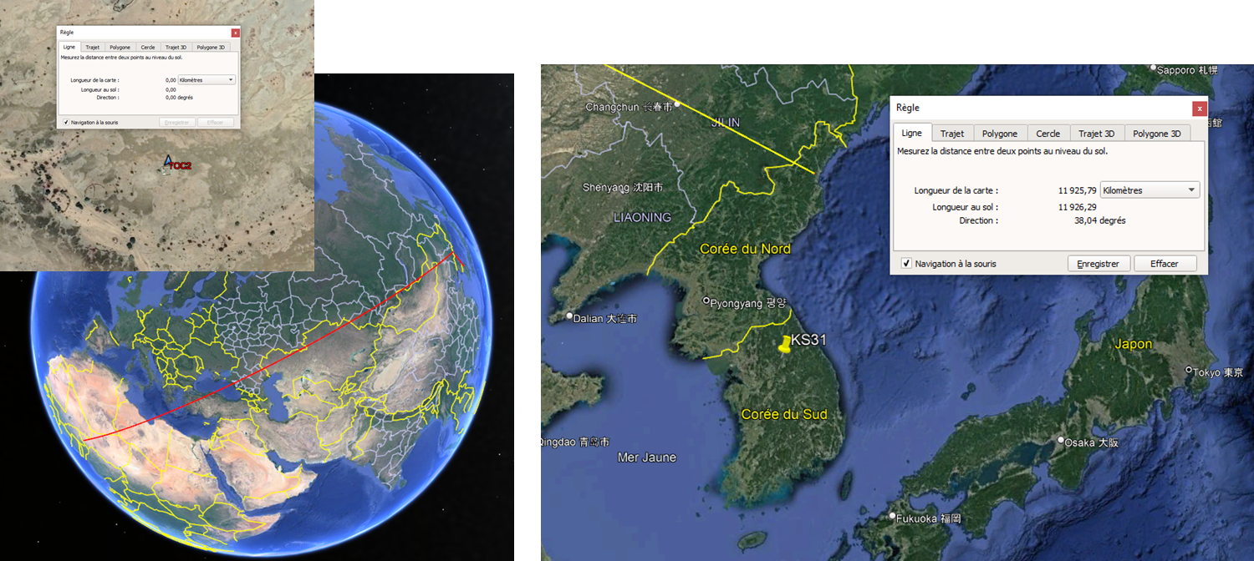
Conclusion
Using Google earth we were able to locate with distance and azimuth the epicenter of the event that perfectly matches a locality in North Korea. The beam create with all the array data allow to get a good P phase position for the secled TOC2 data, the dates and data can be used by anyone wishing to verify the experiment. this result reassures us that the method works well even for stations s located at a great distance from events, on the other hand this was possible due to the good quality of the data provided by the PS26 station.
AZI= 38.04
D ≈ 108° (D ≈ 11.990km)
Please do not use this space, a QR code will be automatically overlayed
P5.3-027

Slide 7
References
Eisermann , Hillel W. Bloch, Alon Ziv. Real-Time Back Azimuth for Earthquake Early Warning,Bulletin of the Seismological Society of America , June 2015.
Martin Knapmeyer. Location of seismic events using inaccurate data from very sparse
networks, , May 2008.
Peter Bormann. IASPEI, New Manual of Seismological Observatory Practice (NMSOP) Volume 1, (GeoForschungsZentrum Potsdam 2002)
Sebastian Rost and Christine Thomas. Array Seimology : Methods and applications, December 2002.
Jan Fyen and Svein Mykkeltveit. Seismic arrays, January 2002
B. L. N. Kennett and E. R. Engdah. Traveltimes for global earthquake location and phase identification, October 1990.
J.R. Kayal . Seismic waves and earthquake , Geological Survey of India,1986.
Please do not use this space, a QR code will be automatically overlayed
P5.3-027

