Slide 1
The Seismic Hazard Distribution of Solomon Islands
Belinda. Waokahi
IMS AS098-HNR/ Seismology Section/ Geology Division/ MMERE/ Solomon Islands
Place your institution logo here
(remove this text box)
Solomon Islands is a double chain of island arc where it’s seismicity was influenced by the interaction of the Pacific Plate and the Indo-Australian Plate. Thus, this case study investigates the
Distribution of potential risky earthquakes with Mag7.0 in the Solomon Islands
The interpretation of general aspects of seismic occurrence with seismic activities of Mag6.0≥
From the Collaboration with USGS for their GSN network of HNR Seismic Station makes it possible to retrieve the
Seismic data of 90 years from 1932 – 2022.
The Seismic data were then divided from the 90 years total time into 3 sets of maps of 30 years . Each 30years time period which differentiated by general seismic aspects of the seismic occurrence for Mag6.0≤ and compared into potential risky earthquakes for Mag7.0≤ with the other 30years interval.
1st 30years : seismicity had low risk.
2nd: 30years : seismic activities had medium risks.
3rd 30years : High risks of seismic hazard activities.
Solomon Islands is a double chained of island arc that had an interaction between the Pacific Plate and Indo-Australian plate which had influences on the high seismicity and potential risks of the Solomon Arc. The 90 years time period shows that the first 30 years had less stress of low risk, and then in the next 60 years, the stress was then accumulated with time so risk was in a medium state and then in the last period of the 90 years shows higher accumulation of stress which releases into high risk.
Please do not use this space, a QR code will be automatically overlayed
P5.3-851

Slide 2
The tectonic map of Solomon Islands displayed with the Solomon Arc/block. Shown the Ontong Java Plateau to be situated on the north of the Vitiaz trench and the San Cristobal and New Hebrides Trench on the southern trench.
Introduction
Solomon Islands is an island arc with double chain islands that situated in one of the complex and seismic active zone in the Pacific Region.
It’s tectonic and geological settings influences the seismicity by the interaction of the Pacific Plate and Indo-Australian Plate
North Solomon Trench is the initial trench that had formed the Solomon Arc with the double chain of islands.
About 12-8Ma the Ontong Java Plateau collided with the Solomon Arc on the Pacific Plate and initiated the San Cristobal Trench and the New Hebrides Trench which is now the seismic active zone.
The study report’s intention and objective was to analyze and interpretation of the seismicity of Solomon Islands, seismic occurrence and determined the distribution of the potential risky earthquakes for the past 90 years.
Please do not use this space, a QR code will be automatically overlayed
P5.3-851

Slide 3
OBJECTIVE and METHOD
OBJECTIVE
METHOD
This report study case is;
To analyze and investigate the seismic activities changes in Solomon Islands seismicity
To understand the seismic occurrence of Solomon Islands in each period of 30 years for the past 90years.
To study the distribution of the potential risky earthquakes in the Solomon Islands
Solomon Islands collaboration with USGS had hosted the Global Seismological Network – HNR Station and transmitted the seismic events to USGS and updated on the USGS webpage.
Seismic data and maps of the 90 years was retrieved from the USGS catalog.
The overall 90 year period was divided into 3 sets of 30years to analyze and investigate the seismic activities and changes.
Each 30years period of time was then interpreted into Mag7.0≥ and Mag6.0≤ to study the risky earthquakes and the seismic occurrence
Please do not use this space, a QR code will be automatically overlayed
P5.3-851

Slide 4
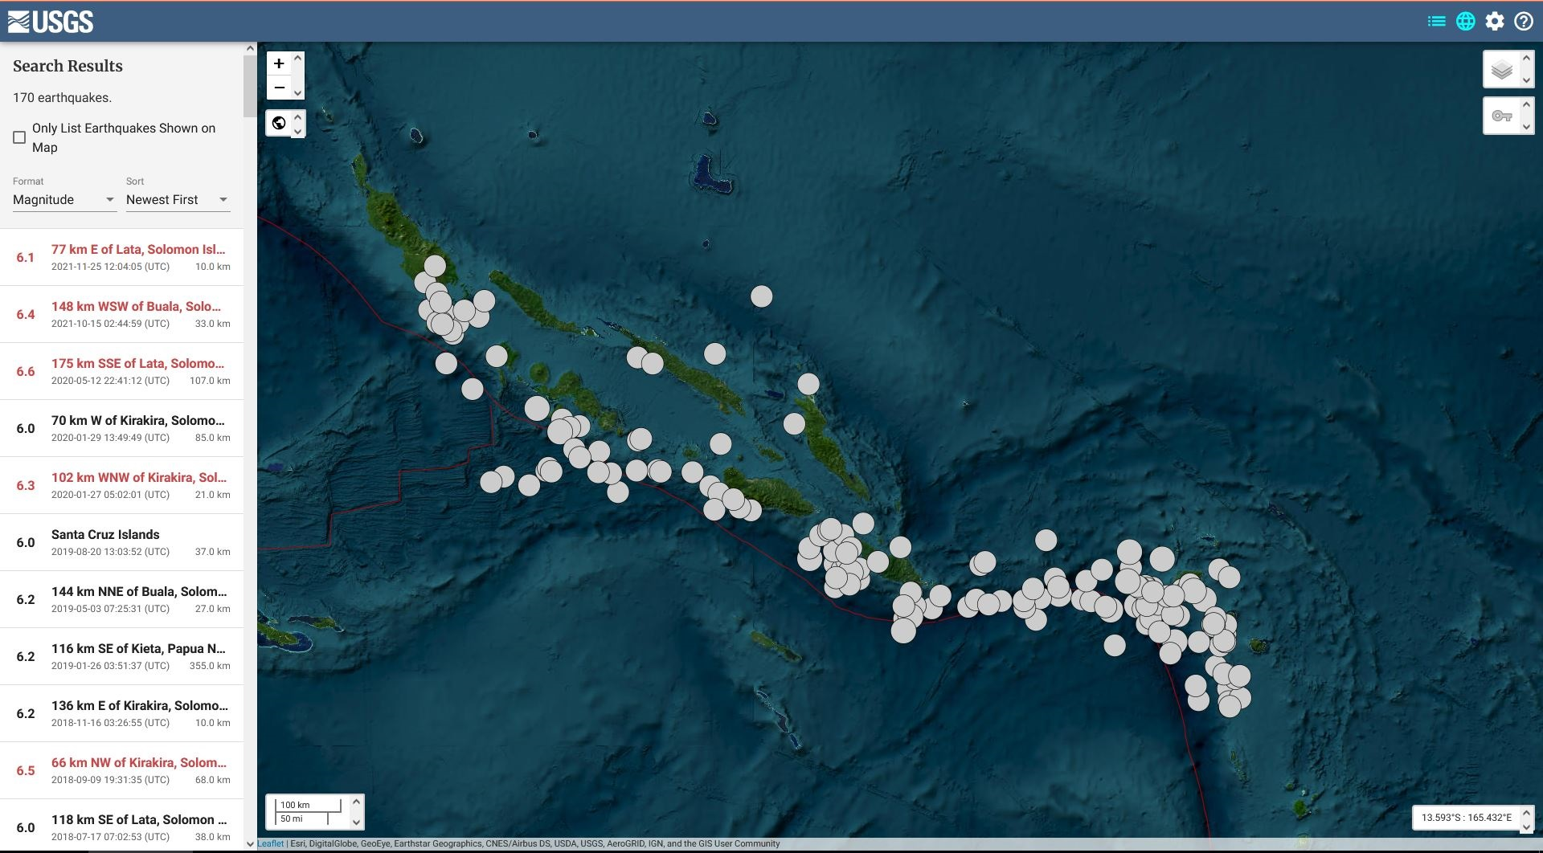
RESULTS
Fig1 below: Seismicity of Solomon Islands from 1932 – 1962 the 1st 30 years period:
The general occurrence displayed seismic activities were concentrated along the San Cristobal Trench and New Hebrides Trench which is the current seismic active zone.
Clusters of earthquakes shows release of stress on the Santa Cruz, in-between SW Makira & SE Guadalcanal, SW of Guadalcanal and shortland islands.
There were 10 seismic risky earthquakes with magnitudes of 7.0≥ had occurred in this period of time and a total of 73 earthquakes with the magnitude of 6.0≥ in total. Thus, indicates low risks when compared to the other period of time.
Fig2 below: 1962 – 1992 seismicity of the 2nd 30 period of time:
The general occurrence of this time period shows most of the seismic activities were concentrated along San Cristobal Trench and New Hebrides Trench. Few earthquakes were detected at Isabel and Malaita which is in the Solomon Arc maybe due to faults system in this area.
The clusters of stress was released in between NW of Makira & SE of Guadalcanal, Santa Cruz, SE Makira and Shortland Islands.
This period of time had 20 potential risky earthquakes of 7.0≥ magnitudes. Had a total of 109 seismic events detected with magnitude 6.0≥ with few damages for the1966, 1977, 1984 and 1991 events at location of epicenters. The seismic activities occurred in this period of time releases a medium of risk of occurrence when compared with the other two period of 30 years.
Fig3 above: The 3rd Period of 30 years of seismicity from 1992 – 2022.
The general occurrence for his period of time had high seismic activities displayed along the San Cristobal and New Hebrides to indicate the subduction of Pacific Plate beneath Indo-Australian Plate.
Clusters of seismic events shows stress released at Santa Cruz at New Hebrides Trench, the islands on the Western Solomons, at NW Makira, NW Guadalcanal, SE Makira, Shortland islands and few at the North Solomon Trench and near Isabel and Malaita.
The distribution of potential risky earthquakes had a total of 19 events with magnitude 7.0≥ and two 8.0 & 8.1 events .two Tsunami events were generated at the Western Solomons by the 8.1Mag earthquake in 2007 and an 8.0Mag in Santa Cruz Islands in 2013 which both had taken lives and done destructions. A total of 153 seismic events also had been detected for the events of 6.0≥Magnitude and 19 earthquakes of magnitude 7.0≥ had occurred in this period. There were some 7.0≥ & 6.0≥ magnitudes of earthquakes that occurred and had causes damage as well thus indicated a high risk of seismic activities taken place during this time period .
Please do not use this space, a QR code will be automatically overlayed
P5.3-851

Slide 5
Fig4 above: shows the total number of seismic events with magnitude 6.0 and greater than from the time period of 1932 – 2022 for the past 90 years.
CONCLUSION
Solomon Islands is located on one of the most seismic active zone in the region and around the world with 374 seismic events of magnitude 6.0≥ for the past 90 years.
It’s seismicity was influenced by the interaction of the subduction of the Pacific Plate and the Indo-Australian Plate which show high concentration of seismic activities along the San Cristobal and New Hebrides Trench.
The first 30 years of this study had low potential risk and seismic activities occurred during 1932-1962 when compared to the other two periods of time because of low number of damages done by the seismic activities that occurred during this time.
The second set of 30 years of time periods is in 1962 - 1992 which is the 60 years time interval. The distribution of potential risky earthquake was at medium risk because of few damages it causes in 1966, 1977, 1984 & 1991 for local tsunamis and landslides.
The third set of 30 years was from 1992 – 2022 and it was the last set of the overall 90 years of the total time interval of the study of the seismic data for Magnitude 7.0≥. This period of time had a high risk of seismic events because it causes destruction to properties, the environment and taken lives like the 8.1mag earthquake in 2007 and the 8.0 mag earthquake 2013. There were some other seismic events of 7.0≥ magnitude earthquake and 6.0≥ magnitude that had also causes landslides and damage of properties.
The new changes that took place was there were earthquakes with 6.0 magnitudes that had occurred in the North Solomon trench for this last 30 years of time period which was suggested to focus on thus it would be of great interest to make further study on and to investigates it’s occurrence.
Please do not use this space, a QR code will be automatically overlayed
P5.3-851

Slide 6
Reference
Anon., n.d. General Aspect of Seismicity, Volcanicity and their related Disaster in the Solomons, s.l.: s.n.
B Kelly and C Qopoto, n.d. Earthquakes, Volcanoes and Tsunamis in the Solomon Islands, Honiara, Solomon Islands: Water & Mineral Resources Division.
D.Tuni, n.d. The Guadalcanal Earthquake 1984, Honiara, Solomon Islands: Solomon Islands Geology Division.
D.Tuni, n.d. Tsunamis in the Solomon Islands 1926 – 1982, Honiara: Solomon Islands Geology Division.
Dauana, B.K, n.d. A Comparison to Volcano Alignment along the Islands, University of Tokyo: JICA Individual Training Programme, Earthquake Research Institute.
Dauana, B. K., Country Report on the General Aspect of Seismological Observation in the Solomon Islands, Honiara, Solomon Islands: Seismological Section, Geology Division, Ministry of Energy Mines and Mineral Resources..
J. W Arthurs B.A, M., 1979. Mineral Occurrences in the Solomon Islands, Honiara: Government Printer.
Masanao, S., Kiyoshi, S., & Takayuki, M. (2003). Microearthquake Seismicity in the Relation to Double Convergence around the Solomon Islands. Geophysical Journal International, 53(8), 691-698. DOI:10.1046/j.1365-246X.2003.01940.x
Porahoa, K., n.d. Inception Report on Seismicity in Solomon Islands, Honiara, Solomon Islands: Seismological Station.
Sylvain Todman & David Nakedau, n.d. Installation Report, Geohazards Vanuatu: s.n.
Thompson, R, n.d. Guadalcanal Earthquakes 1977, s.l.: s.n.
T, T., 2002. Seismic Observation in the Solomon Islands Technical Report, Honiara, Solomon Islands: Ministry of Mines and Energy.
Waokahi, B., 2014. Inception Report on the Seismicity of Solomon Islands, Honiara, Solomon Islands: Seismology Section, Geology Division, Ministry of Mines, Energy and Rural Electrification.
Please do not use this space, a QR code will be automatically overlayed
P5.3-851

Slide 7
Acknowledgement
First of all, I would like to acknowledge the SnT2023 team to accept my abstract and trusted me to attend this Scientific conference in person. It is an honour for me to be present in person and represent my country.
Secondly, sincere appreciation to the Heads of my Section and Division to allow me to represent my Ministry and country to showcase our country’s seismic activities occurrence which is one of the seismic active zone in the Pacific region and the world in this huge conference .
And thirdly, to my family for your understanding, support and allow me time to spend on putting these poster and presentation together.
Lastly to Papa God for the blessings, guidance and protection and all the wisdom knowledge and understanding to produced and have done all of these simple insights to make it possible to attend SnT2023 Conference.
Thank you Thank you so much
And tagio tagio tumas
From Solomon Islands Participant
Please do not use this space, a QR code will be automatically overlayed
P5.3-851

