Slide 1
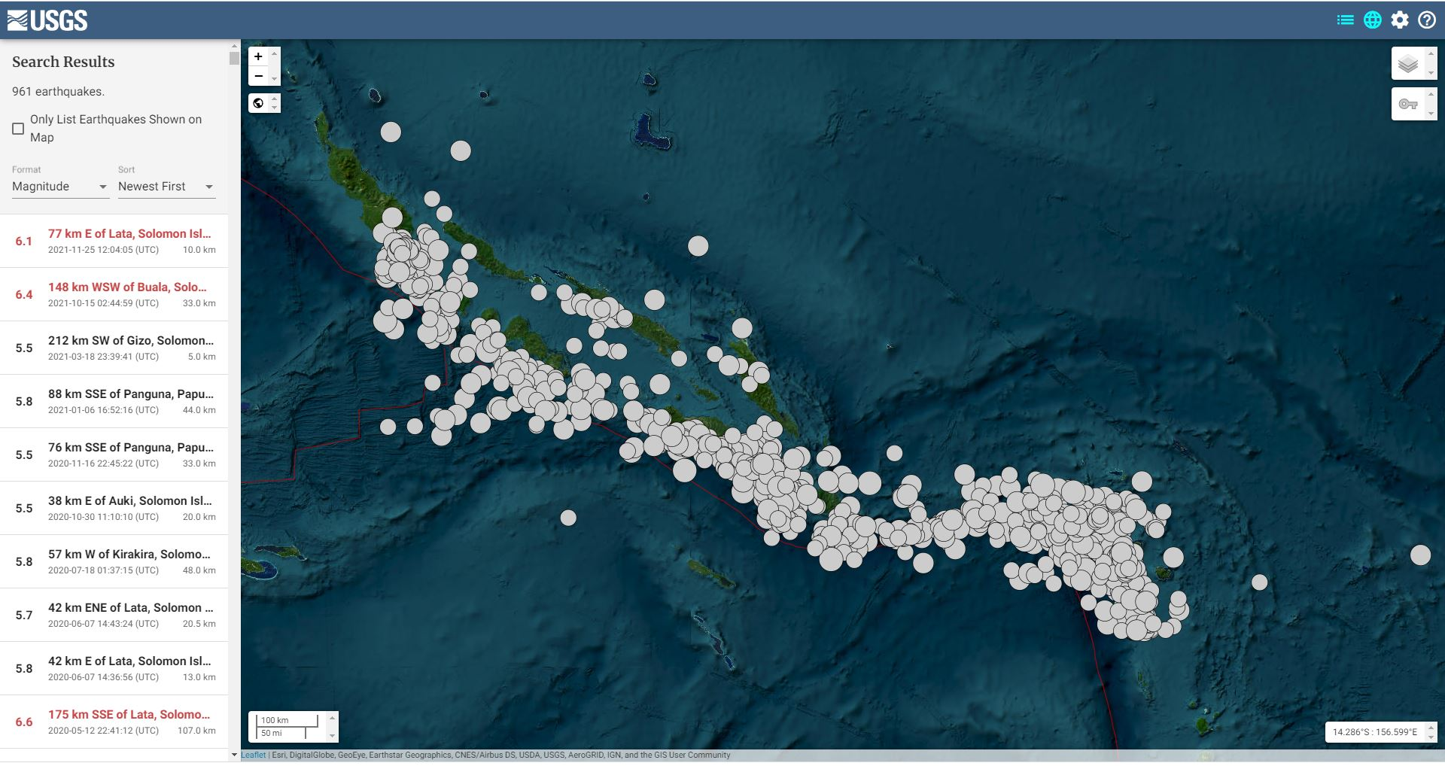
If you want to learn more about the seismic occurrence and distribution of risky earthquakes in the Solomon Islands then you’re welcome to see our e-poster session for T5.3 Regional Empowerment
The Seismic Hazard Distribution of Solomon Islands
Belinda.Waokahi
IMS AS098-HNR/ Seismology Section/ Geology Division/ MMERE/ Solomon Islands
P5.3-851
Solomon Islands is an island country that was located in the South West Pacific region. It’s geological and geographical location and tectonic settings had influenced the formation of it to be one of the most seismic active zone in the region and the world.
This poster presents the distribution of the potential risky earthquakes that occurred in the Solomon Islands from the past 90 years from 1932-2022 with Magnitude 7.0≥.
This poster also gives interpretations of the general aspects of the seismic occurrence with the seismic activities of Magnitude 6.0 ≥ in the Solomon Islands.

