Slide 1
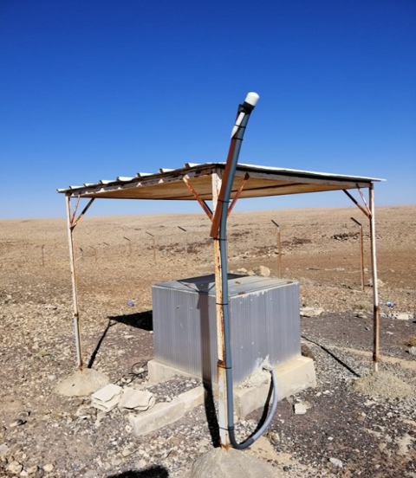
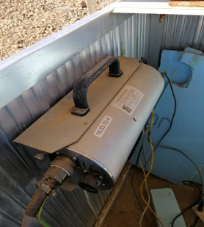
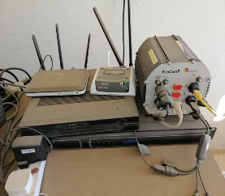
18:30 - 19:30
Jordan and CTBTO Relation and the Development of JSO
Ghassan Sweidan
Jordanian Seismological Observatory/Jordan National Data Center
P5.3-156
Introduction:
Jordan's commitment to international engagement and cooperation in nuclear non-proliferation
Signatory State of the Comprehensive Nuclear-Test-Ban Treaty (CTBT)
Collaboration with the CTBTO for enhancing global monitoring capabilities
Main Points:
Tel-ALASFAR Auxiliary Seismic Station (AS056):
hosted by Jordan to contribute to the International Monitoring System (IMS)
Strategically located for detecting seismic waves from nuclear explosions
Workshop Collaboration:
Hosted workshops to advance interaction between the CTBTO and National Authorities
Focus on establishing a robust verification system
Key Message:
Jordan's active role in global nuclear non-proliferation efforts
Enhancing seismic monitoring capabilities for a safer and more secure world
1996 Signature Treaty
1998 Ratification Treaty
1999 Signed the Facility Agreement
2010 Jordan NDC
If you want to learn more join the e-poster virtual session 3 on Tue 22/06/2023 at 19:00 or access it online on the SnT2023 Conference platform!

