Slide 1
Jordan and CTBTO Relation and the Development of JSO
Ghassan Sweidan
Jordanian Seismological Observatory/Jordan National Data Center
Jordan's commitment to engaging with the international community and fostering cooperation across various fields is reflected in its foreign policy.
JORDAN PROFILE
TAL ALASFER STATION AS056
THE CTBTO EVENTS IN JORDAN
The collaboration between Jordan (CTBTO)
The contribution of the Tel-ALASFAR auxiliary seismic station (AS056)
Jordan's commitment to nuclear non-proliferation is demonstrated through its active participation in the CTBT and collaboration with the CTBTO, leading to enhanced global monitoring capabilities. By fulfilling its obligations and engaging in cooperative efforts, Jordan contributes to regional and international security, ensuring a safer world.
Please do not use this space, a QR code will be automatically overlayed
P5.3-156

Slide 2
Jordan and CTBTO Relation and the Development of JSO
Introduction
Jordan's commitment to engaging with the international community and fostering cooperation across various fields is reflected in its foreign policy. In line with this approach, Jordan Signed and ratified the Comprehensive Nuclear-Test-Ban Treaty (CTBT) with the Secretary-General of the United Nations on 25 August 1998, thereby becoming the twentieth signatory State to endorse the Treaty. On 11 November 1999, a facility agreement was signed between the Permanent Representative of Jordan and the Executive Secretary of the Preparatory Commission for the Comprehensive Nuclear-Test-Ban Treaty Organization (CTBTO). As part of its obligations under the CTBT, Jordan has host the Tel-ALASFAR auxiliary seismic station (AS056) to contribute to the International Monitoring System (IMS). To advance interaction between the CTBTO's Provisional Technical Secretariat (PTS) and National Authorities and National Data Centres, Jordan has collaborated with the CTBTO by hosting various workshops. These workshops focused on addressing specific topics of interest to States Signatories and the PTS, particularly related to establishing the verification system. The outcomes of these cooperative efforts have brought significant developments to the Jordan Seismological Observatory, both in terms of the expansion of stations and advancements in seismic severity studies.
Please do not use this space, a QR code will be automatically overlayed
P5.3-156

Slide 3
Jordan and CTBTO Relation and the Development of JSO
Objectives
Highlighting Jordan's commitment to international engagement and cooperation across various fields, demonstrating its active role in the global community.
Highlighting facility agreement signed between Jordan and the Preparatory Commission for the CTBTO
Introducing the Tel-ALASFAR auxiliary seismic station (AS056) established by Jordan as a contribution to the International Monitoring System (IMS).
Jordan's collaboration with the CTBTO through hosting workshops, focusing on advancing interaction between the CTBTO's Provisional Technical Secretariat (PTS) and National Authorities and National Data Centres.
Please do not use this space, a QR code will be automatically overlayed
P5.3-156

Slide 4
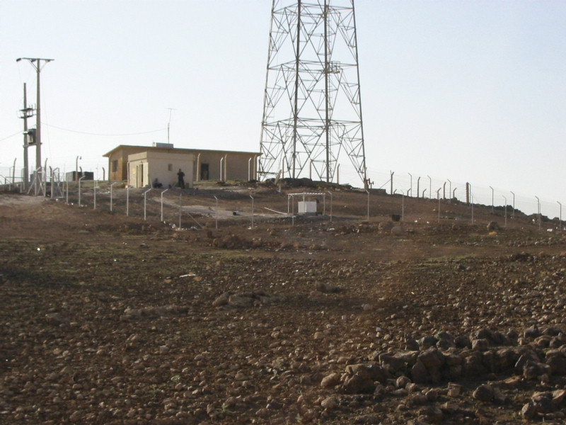
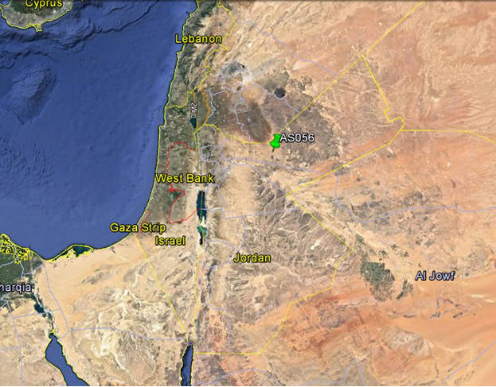
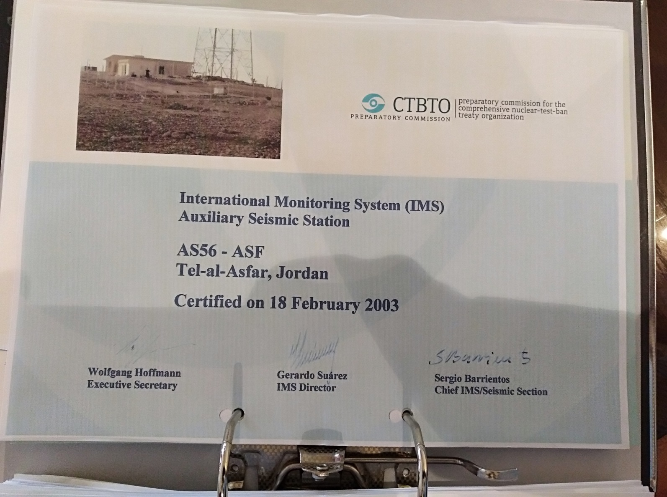
Jordan and CTBTO Relation and the Development of JSO
Jordan's commitment to nuclear non-proliferation is exemplified by its signed and ratified Comprehensive Nuclear-Test-Ban Treaty (CTBT) and the host of the Tel-ALASFAR Auxiliary Seismic Station (AS056). Located approximately 90 km northeast of Amman, the Tel-ALASFAR station represents the first of its kind in Jordan, and it is operated by the Jordan Seismological Observatory.
In addition to the seismic station, Jordan has also made strides in enhancing its capabilities for data analysis and monitoring. In 2014, the CTBTO team installed the capacity building system CBS at the Jordan Seismological Observatory. The NDC-JO plays a crucial role in receiving raw data from three International Monitoring System (IMS) stations. This data provides valuable information for comprehensive analysis and monitoring of seismic activities.
Please do not use this space, a QR code will be automatically overlayed
P5.3-156

Slide 5
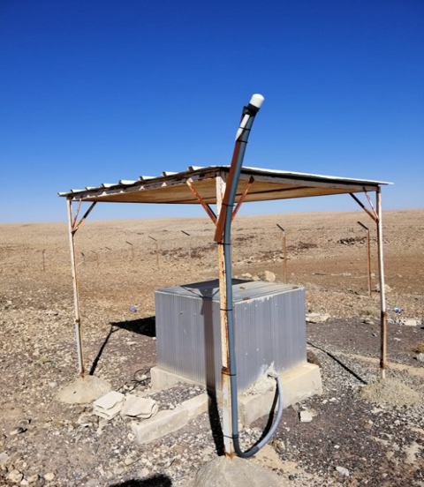
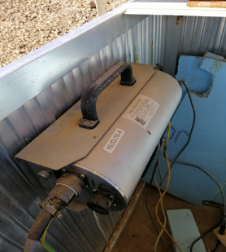
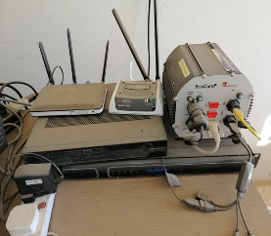
Jordan and CTBTO Relation and the Development of JSO
Place your institution logo here after removing this text box!
Methods and data:
JORDAN PROFILE
TAL ALASFER STATION AS056
Jordan's commitment to nuclear non-proliferation is exemplified by its signed and ratified Comprehensive Nuclear-Test-Ban Treaty (CTBT) and the host of the Tel-ALASFAR Auxiliary Seismic Station (AS056)
THE CTBTO EVENTS IN JORDAN
1996 Signature Treaty
1998 Ratification Treaty
1999 Signed the Facility Agreement
2010 Jordan NDC
1999
The regional workshop on magnitude calibration.
2003
The regional Workshop on evaluation and quality control.
2010
The NDC Development workshop for Middle East and south Asian states was conducted
2010
On-Site Inspection Ground Based Visual Observation and Communications Exercise
2011
Infrasound Technology Workshop(ITW2011)
2014
Integrated Field exercise (IFE14)
2019
The Infrasound Technology(ITW2019)
Please do not use this space, a QR code will be automatically overlayed
P5.3-156

Slide 6
Jordan and CTBTO Relation and the Development of JSO
Results
The collaboration between Jordan and the Comprehensive Nuclear-Test-Ban Treaty Organization (CTBTO) has yielded significant results in terms of the development and advancement of seismic monitoring capabilities.
The establishment of the Tel-ALASFAR auxiliary seismic station (AS056) in Jordan has contributed to the International Monitoring System (IMS), enhancing global monitoring capabilities for detecting seismic activities.
Through the hosting of workshops and the active engagement of National Authorities and National Data Centres, Jordan has played a crucial role in advancing the interaction between the CTBTO's Provisional Technical Secretariat (PTS) and relevant stakeholders. This collaboration has facilitated the establishment of a robust verification system and the sharing of expertise and knowledge among States Signatories and the PTS.
The expansion of the Jordan Seismological Observatory and the advancements in seismic severity studies are notable outcomes of the cooperative efforts between Jordan and the CTBTO. These developments have enhanced Jordan's ability to detect and monitor seismic events, contributing to global efforts in nuclear non-proliferation and promoting regional and international security.
Please do not use this space, a QR code will be automatically overlayed
P5.3-156

Slide 7
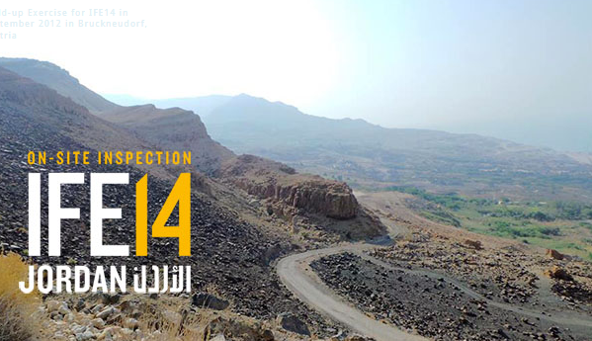
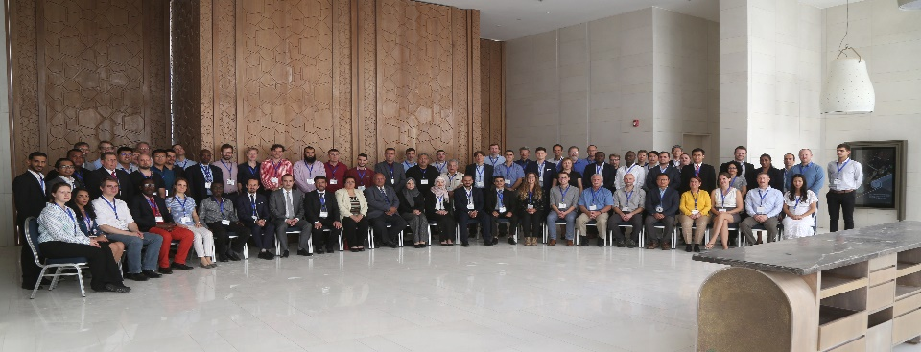
Jordan and CTBTO Relation and the Development of JSO
Conclusion
Jordan's commitment to international engagement and cooperation in the field of nuclear non-proliferation is evident through its active participation in the Comprehensive Nuclear-Test-Ban Treaty (CTBT) and collaboration with the CTBTO. The establishment of the Tel-ALASFAR auxiliary seismic station and the hosting of workshops have contributed to the enhancement of global monitoring capabilities and the advancement of the verification system.
By fulfilling its obligations under the CTBT and actively participating in the international community, Jordan has demonstrated its commitment to promoting regional and international security. The cooperative efforts between Jordan and the CTBTO have not only strengthened Jordan's seismic monitoring capabilities but also contributed to the collective global efforts in ensuring a safer and more secure world.
ITW 2019
Please do not use this space, a QR code will be automatically overlayed
P5.3-156

