Slide 1
The Path Less Traveled: Breaking Barriers For Future Scientists With Disabilities
Paul David Shaver, Jr. M.S.
Duke University & Marshall University Joan C. Edwards School of Medicine
According to the World Health Organization (WHO), over 1 billion people worldwide live with some form of disability. This staggering figure highlights the vast pool of potential talent that remains largely underrepresented in the STEM workforce.
• 12 Question Survey administered to 308 individuals in STEM
• All individuals had bachelors degree or higher
• Data collected and interpreted for trends
As we conclude this introduction, it is crucial to recognize that inclusivity in STEM is not only a moral imperative but also an investment in our collective future. By embracing individuals with disabilities in STEM careers, we unlock potential, foster innovation, and create a more equitable society.
• Significant barriers in education and workplace accommodation
• Large percentage of individuals surveyed reported past discrimination
• Significant percentage reported that they would not enter a STEM career again
Please do not use this space, a QR code will be automatically overlayed
P5.4-136

Slide 2
Current Landscape
STEM fields are vital for driving innovation, economic growth, and societal progress in the modern world. However, a significant disparity exists when it comes to the representation of individuals with disabilities in these various careers.
Despite the progress made in promoting inclusivity and diversity, people with disabilities continue to be underrepresented, leading to a lack of their valuable contributions in these critical areas.
Research has shown that individuals with disabilities face numerous barriers that hinder their participation in STEM fields. These barriers encompass a wide range of factors, including:
Societal attitudes and perceptions;
Inaccessible physical environments;
Lack of accommodations;
Limited educational opportunities
Insufficient role models or mentors.
The intersectionality of disability with other forms of marginalization, such as race, gender, and socioeconomic status, further compounds the disparities experienced by individuals with disabilities in STEM.
#136
Please do not use this space, a QR code will be automatically overlayed
P5.4-136
Notes:
Understanding the extent and nature of the underrepresentation of individuals with disabilities in STEM fields is essential for addressing these disparities and fostering a more inclusive and equitable environment. This research aims to explore the available data on the lack of individuals worldwide with disabilities in STEM fields and shed light on the specific disparities that exist within this population.
By examining existing literature, statistical reports, and relevant studies, this research seeks to identify the key factors contributing to the underrepresentation of individuals with disabilities in STEM and understand the specific challenges they face. Moreover, it aims to investigate the effects of these disparities on both the individuals with disabilities and the broader scientific community, as well as the potential consequences for innovation and progress.
The findings of this research will contribute to a deeper understanding of the barriers faced by individuals with disabilities in STEM fields, highlight the need for targeted interventions and policy changes, and provide insights into potential strategies to promote inclusivity and diversity in these areas. Ultimately, it is hoped that this research will serve as a catalyst for creating a more inclusive STEM ecosystem that harnesses the talents and perspectives of all individuals, irrespective of their abilities.

Slide 3
Objectives
To analyze the available data on the representation of individuals with disabilities in STEM fields worldwide and identify the extent of underrepresentation.
To examine the specific disparities that exist within the population of individuals with disabilities in STEM fields, considering factors such as race, gender, socioeconomic status, and type of disability.
To investigate the barriers and challenges faced by individuals with disabilities in accessing and participating in STEM fields, including societal attitudes, physical and environmental limitations, lack of accommodations, and limited educational opportunities.
To understand the impact of the underrepresentation of individuals with disabilities in STEM fields on the individuals themselves, as well as on the scientific community and innovation.
To explore the intersectionality of disability with other forms of marginalization and its influence on the disparities experienced by individuals with disabilities in STEM fields.
To identify successful initiatives, interventions, and policies that have been implemented to promote inclusivity and diversity for individuals with disabilities in STEM fields and analyze their effectiveness.
To propose strategies and recommendations for creating a more inclusive and equitable STEM ecosystem that encourages the active participation and contribution of individuals with disabilities.
To contribute to the existing body of knowledge on the underrepresentation of individuals with disabilities in STEM fields, providing insights that can inform future research, policy-making, and advocacy efforts in this area.
Please do not use this space, a QR code will be automatically overlayed
P5.4-136

Slide 4
Methods/data
• Using Disability and Employment data from both The National Bureau of Economic Research and The United Nations Department of Economic and Social Affairs commission, we were able to pool information about general labor trends for persons with disabilities.
• Post survey data collected from Stanford University’s Doctors with Disability Conference in 2020 (virtual format); we were able to gather general trends and facts on the current environment for individuals with disabilities navigating careers in STEM fields.
Data collected on 308 total participants (203 identified as having some sort of disability; 105 identified as not having a disability)
All participants had a STEM graduate degree of some sort (MS, MPH, PhD, MD, DO)
All participants were either currently working in a STEM field or had in the past
Each participant was asked 12 questions and either answered yes/no or used a scale to answer:
Strongly Agree
Agree
Neither Agree or Disagree
Disagree
Strongly disagree
Please do not use this space, a QR code will be automatically overlayed
P5.4-136

Slide 5
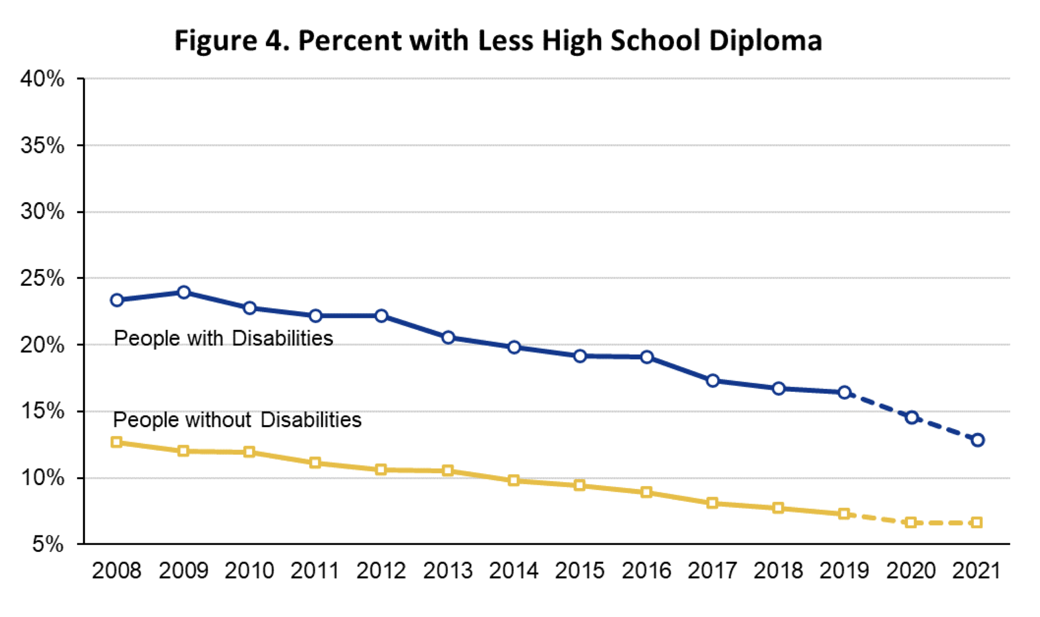
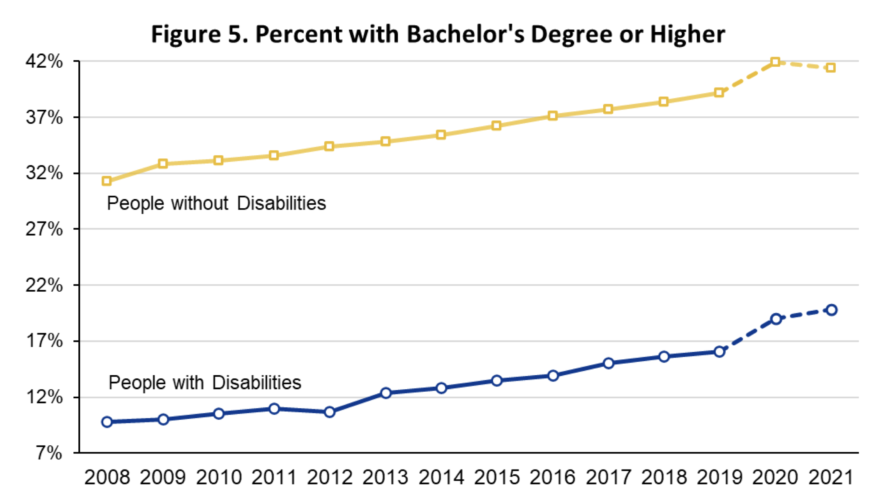
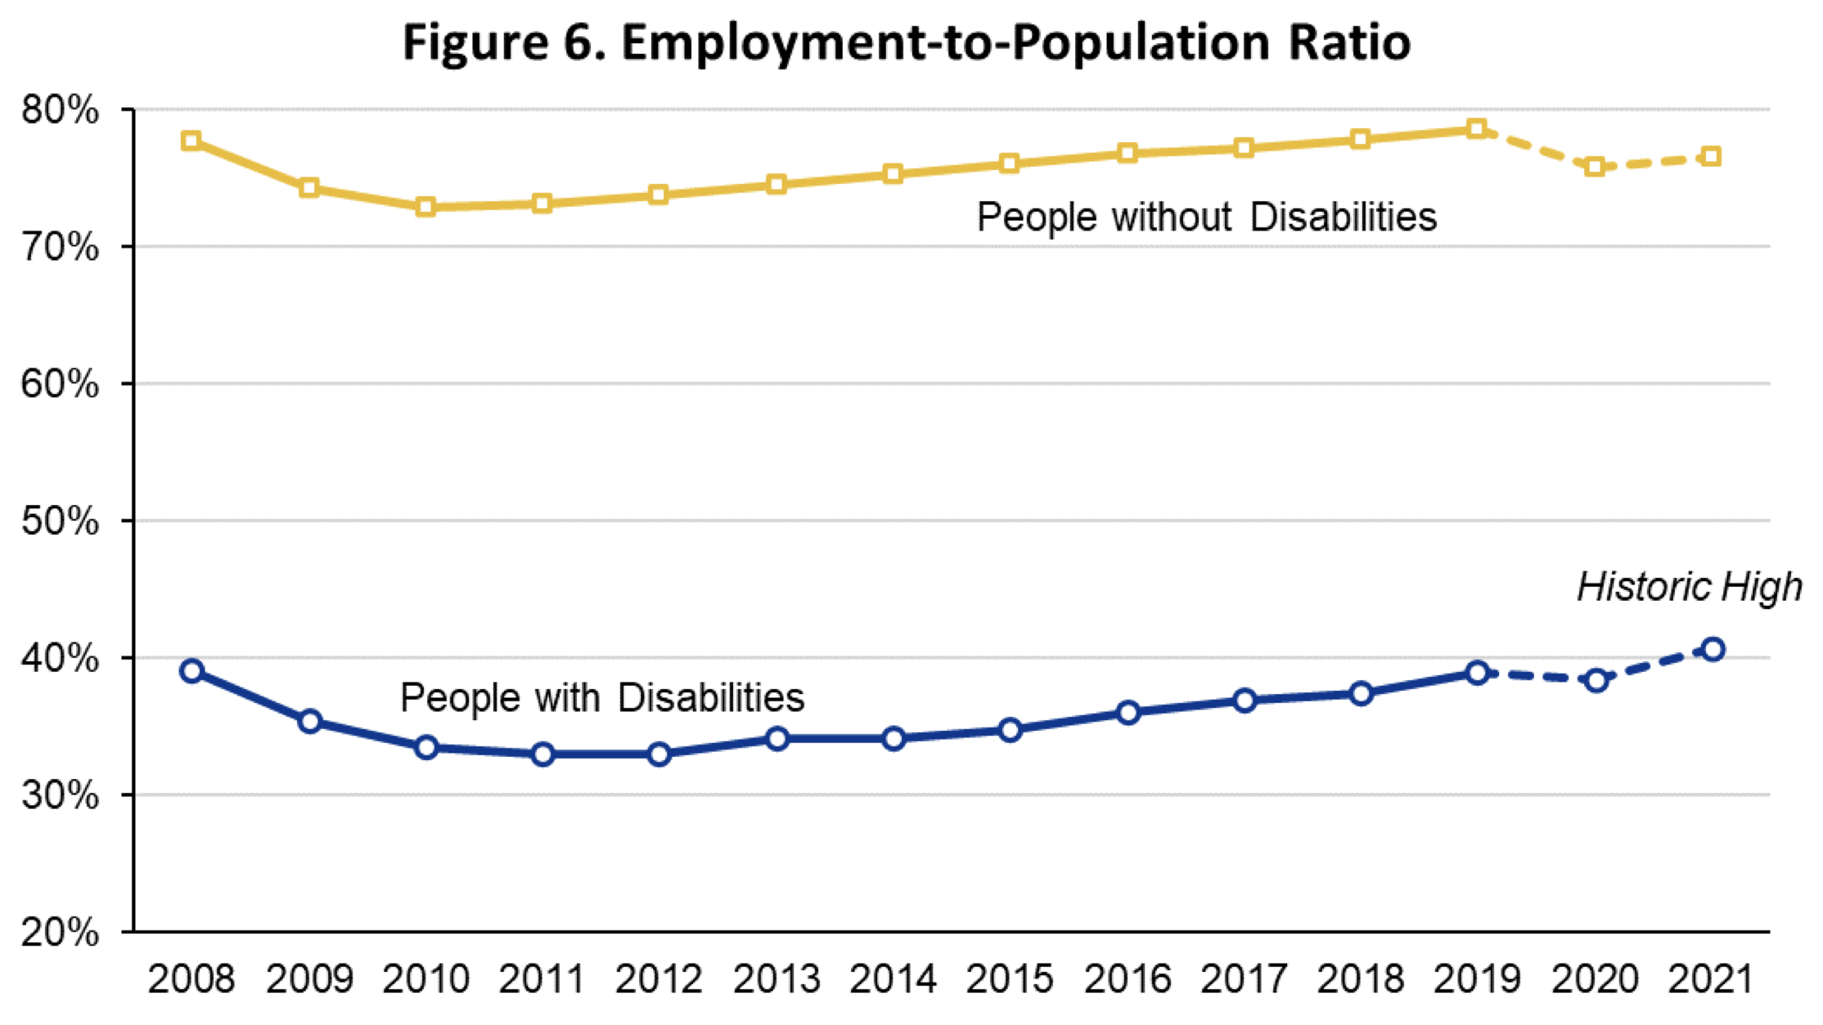
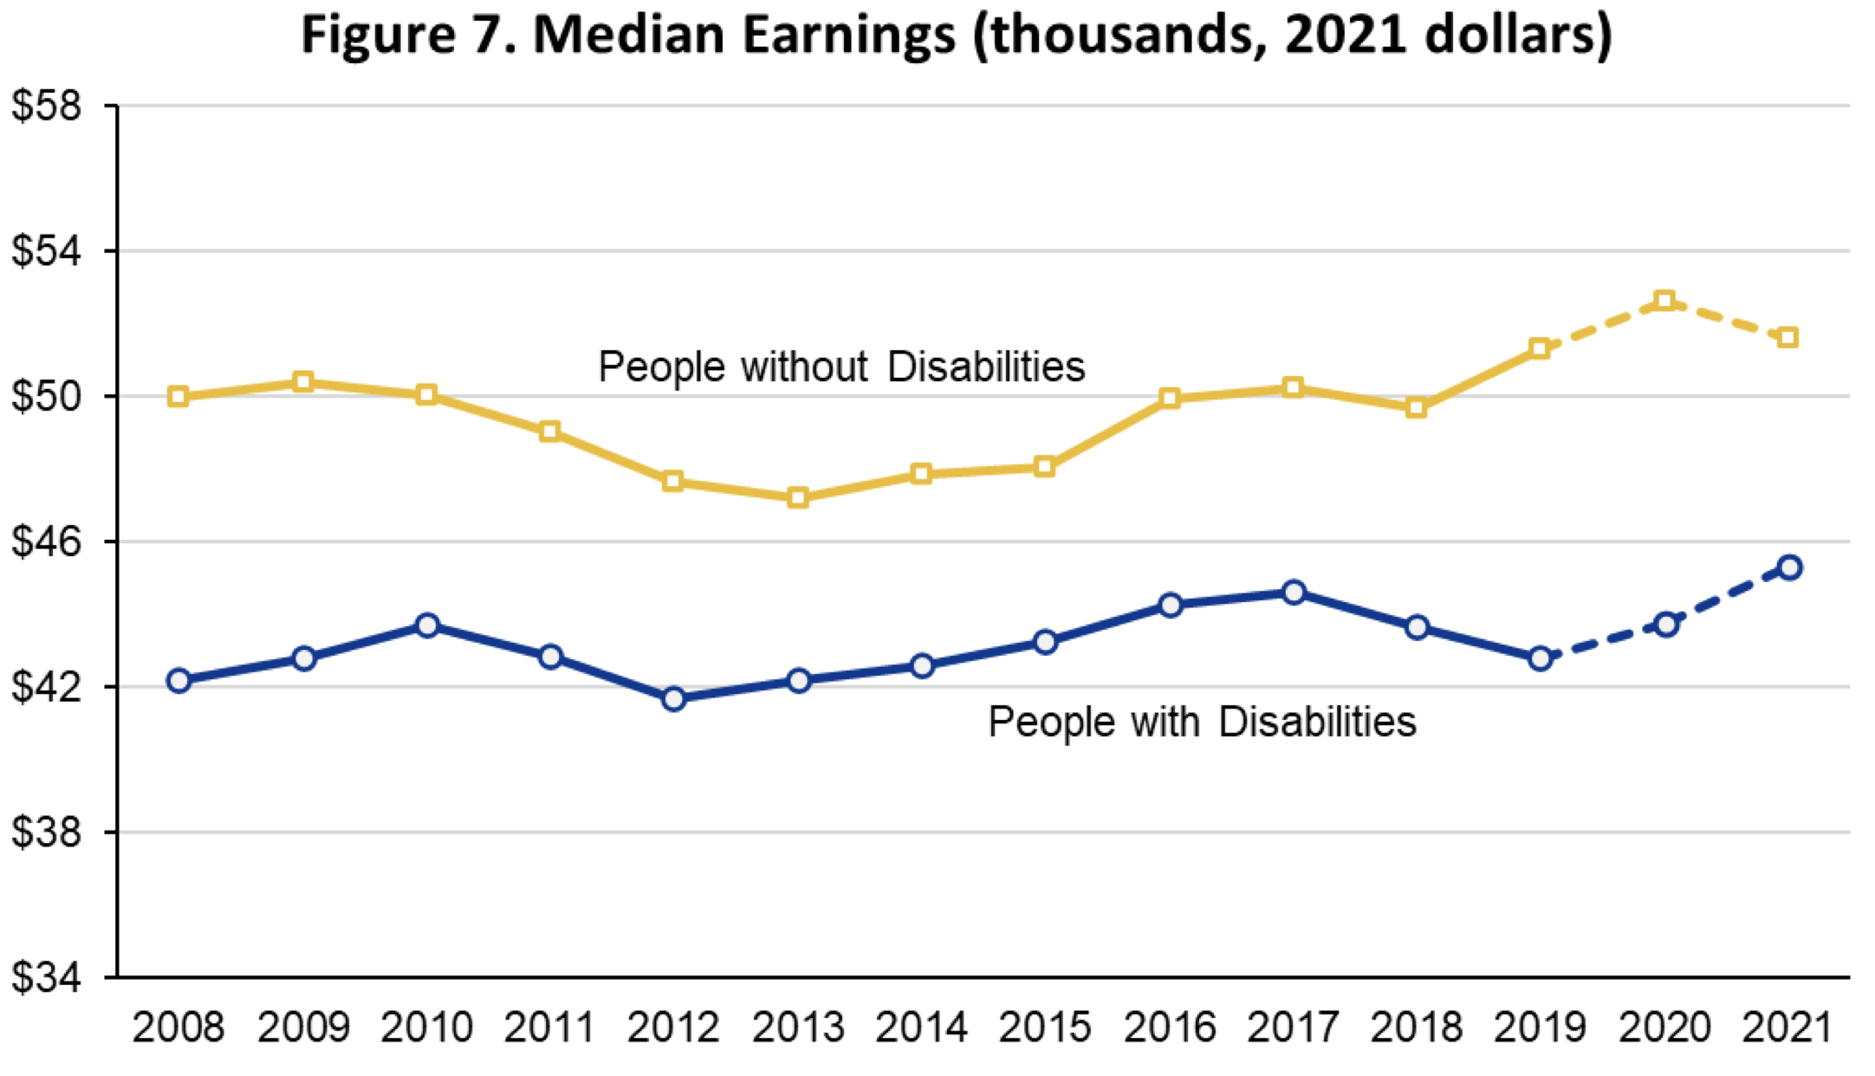
National Bureau of Economic Research (USA) Data Interpretation
#136
Please do not use this space, a QR code will be automatically overlayed
P5.4-136

Slide 6
Survey Results
Job Satisfaction:
Q1: How satisfied are you with your current job in the STEM field?
- Very satisfied: 10%
- Somewhat satisfied: 15%
- Neutral: 45%
- Somewhat dissatisfied: 25%
- Very dissatisfied: 5%
2. Bias:
Q2: Have you ever experienced bias or discrimination in your STEM career due to your disability?
- Yes, frequently: 30%
- Yes, occasionally: 35%
- Rarely: 30%
- No, never: 5%
Q3: If you answered "Yes" to the previous question, please provide a brief description of the bias or discrimination you have faced.
(Note: The following responses were gathered from participants who answered "Yes" to Q2. The responses have been summarized and categorized for brevity.)
Lack of promotion opportunities due to assumptions about capability.
Ignorance or misunderstanding about accommodations needed.
Underestimation of skills and contributions.
Exclusion from important projects or decision-making processes.
Disregard for opinions and ideas in team settings.
Please do not use this space, a QR code will be automatically overlayed
P5.4-136

Slide 7
Survey Results
3. Access to Accommodations:
Q4: How accessible are the accommodations provided
for your disability in your workplace?
- Very accessible: 30%
- Somewhat accessible: 40%
- Neutral: 20%
- Somewhat inaccessible: 7%
- Very inaccessible: 3%
Q5: Did you have to finance your own accommodations?
- Yes: 82%
- No: 18%
Q6: If you answered ”yes” to the question above, estimate your expenses for workplace accommodations:
- < $5,000: 88%
- $5,000 - $10,000: 6%
- $10,000 - $15,000: 3%
- $15,000-$20,000: 2%
- $25,000 +: 1$
4
4. Mentorship:
Q7: Have you had access to mentorship opportunities with individuals who share a similar disability in the STEM field?
- Yes: 45%
- No: 55%
Q8: If you answered "Yes" to the previous question, how valuable was the mentorship in helping you navigate your STEM career?
Invaluable support and guidance in overcoming unique challenges.
Increased confidence and motivation to pursue career goals.
Insightful advice on navigating workplace dynamics as a person with a disability.
Expanded network and connections within the field.
Please do not use this space, a QR code will be automatically overlayed
P5.4-136

Slide 8
Survey Results
5. Equality:
Q9: Do you feel that individuals with disabilities are treated equally in STEM careers compared to their non-disabled peers?
- Yes, definitely: 10%
- Yes, to some extent: 15%
- Neutral: 30%
- No, not really: 40%
- No, not at all: 5%
Q10: If you answered "No" or "No, not at all" to the previous question, what specific areas do you believe need improvement to achieve equality?
Increased representation of individuals with disabilities in leadership roles.
Enhanced accessibility in recruitment and hiring processes.
Awareness and education programs to reduce bias and discrimination.
- Stronger enforcement of disability rights and accommodations.
- Equal access to career development and advancement opportunities.
6. Job Choice:
Q11: Would you choose a career in a STEM field given what you know now and your current experiences?
- Yes: 65%
- No: 35%
7. Salary and Promotion
Q12: Do you feel that your salary and promotion opportunities are similar to your non-disabled peers?
- Yes: 72%
- No: 28%
Please do not use this space, a QR code will be automatically overlayed
P5.4-136

Slide 9
Conclusion
Individuals with disabilities are underrepresented in most career fields, especially STEM careers. Systematic issues and lack of accommodation often create barriers to entering these fields. This lack of representation leaves out a huge global population of bright minds and leaves out a key perspective in modern research.
Increasing representation for individuals with disabilities in STEM careers requires a multi-faceted approach. Institutions and organizations can better address this disparity by:
• Raising Awareness: educating public, students, educators about the capabilities of those with disabilities in STEM; challenge stereotypes and misconceptions by increasing workplace diversity
• Access: Provide an inclusive and accessible educational and workplace environment; offer assistive technologies to allow individuals with disabilities an even playing field.
• Mentorship Programs: partner with/establish mentorship programs that connect individuals with disabilities to others in similar fields of work; Provide guidance, support, career advice at timed intervals
• Accommodation and Workplace Support: establish a disability coordinator to help aid students/workers with disabilities in finding accommodations and brainstorming solutions on how to improve workspace
• Diversity and Inclusion Training: Conduct workshops with colleagues to address importance of welcoming and supporting individuals with disabilities; address unconscious bias, promote awareness of needs, and foster inclusive work culture
• Research and Innovation: invest in research and new technologies/solutions that improve accessibility in STEM fields; encourage funding for disability focused STEM research projects that advance the knowledge in your field or work.
Please do not use this space, a QR code will be automatically overlayed
P5.4-136

Slide 10
References
National Center for College Students with Disabilities (NCCSD): The NCCSD provides resources and support for college students with disabilities pursuing STEM fields. Their website offers information on scholarships, assistive technologies, career guidance, and advocacy. Visit their website at: https://www.nccsdonline.org/
AccessSTEM: AccessSTEM is a project funded by the National Science Foundation (NSF) that aims to increase the participation of individuals with disabilities in STEM careers. Their website offers resources for students, educators, and employers, including success stories, mentoring programs, and accommodation strategies. Explore their resources at: http://www.washington.edu/doit/stem/
DO-IT (Disabilities, Opportunities, Internetworking, and Technology): DO-IT is an organization based at the University of Washington that promotes the inclusion of people with disabilities in academic and professional settings. Their website provides resources on career development, accommodations, mentoring, and inclusive teaching practices. Check out their resources at: http://www.washington.edu/doit/
American Association of People with Disabilities (AAPD): AAPD is the largest disability rights organization in the United States. While not specific to STEM careers, their website offers resources and information on disability advocacy, networking, and employment opportunities. Visit their website at: https://www.aapd.com/
Disabled in Science: Disabled in Science is a community-driven initiative that aims to support individuals with disabilities in STEM fields. They provide resources, networking opportunities, and a supportive community for disabled scientists. Learn more about their work at: https://www.disabledinscience.org/
AccessEngineering: AccessEngineering is an online resource that provides inclusive design guidelines and information on accessible technologies in engineering. It offers resources for engineers, educators, and students with disabilities. Access their website at: https://www.accessengineeringlibrary.com/
STEM-ABLE: STEM-ABLE is a non-profit organization dedicated to empowering individuals with disabilities in STEM. They offer mentorship programs, networking opportunities, and resources for students, educators, and professionals. Explore their resources at: https://www.stem-able.org/
National STEM Education Diversity Initiative: The National STEM Education Diversity Initiative focuses on increasing diversity and inclusion in STEM fields. While not solely focused on disabilities, their resources cover various aspects of diversity, including disability inclusion. Find more information at: https://nsedinitiative.org/
Please do not use this space, a QR code will be automatically overlayed
P5.4-136

