Slide 1
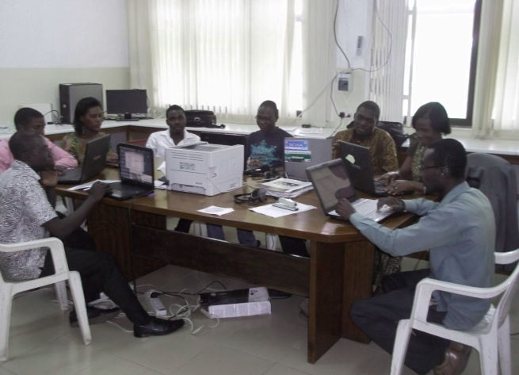
Promoting Activities of CTBTO in the Younger Generation
and Early Career Scientists in Ghana
Prince Amoah
Nuclear Regulatory Authority, Nuclear Installations Directorate, Accra ,Ghana
Affiliation / Organization / Company / Institute [if any / Font: Arial Size: 14]
P5.4-585
Ghana ratified the Comprehensive Nuclear-Test-Ban Treaty on June 14, 2011.
Prior to the ratification, the Ghana National Data Center was established in 2010.
The NDC has a vision of becoming a centre of excellence in the monitoring, verification and application of the Nuclear Test Ban Treaty technologies in the sub-region.
The continuity and sustenance of efforts for any set goal is key in the fulfilment of the goal.
This poster presents analysis of the efforts to involve the younger generation, the extent of involvement and some suggestions in promoting activities of the CTBTO to the younger generation in Ghana.
Some NDC staff and Interns at work

