Slide 1
PROMOTING ACTIVITIES OF CTBTO IN THE YOUNGER GENERATION AND EARLY CAREER SCIENTISTS IN GHANA
Prince Amoah
Nuclear Regulatory Authority, Nuclear Installations Directorate, Accra ,Ghana
The vision of the CTBTO can be sustained when activities of the CTBTO are well promoted to the younger generation and early career scientists globally. This poster presents the case of Ghana.
Research survey was conducted using electronic questionnaire shared through an online data collection platform (Google forms) to individuals studying or working in the Nuclear Sciences.
From the results, Almost 50% of the respondents have no idea of CTBTO and its activities.Other interesting trends were also deduced from the data analysed.
Efforts of the CTBTO in reaching out to the younger generation through fellowships, internships, mentorships etc. is highly commendable and should be replicated locally by the National Centres.
Please do not use this space, a QR code will be automatically overlayed
P5.4-585

Slide 2
INTRODUCTION
The CTBTO has the main goal of building up the verification regime of the Comprehensive Nuclear-Test-Ban Treaty (CTBT) in preparation for the Treaty's entry into force, as well as promoting the Treaty's universality.
Ghana ratified the Comprehensive Nuclear-Test-Ban Treaty on June 14, 2011.
Prior to the ratification, the National Data Center was established in 2010;
to receive and use data for the verification and compliance to the Comprehensive Nuclear Test Ban treaty (CTBT).
The continuity and sustenance of efforts for any set goal is key in the fulfilment of the goal.
Please do not use this space, a QR code will be automatically overlayed
2
P5.4-585

Slide 3
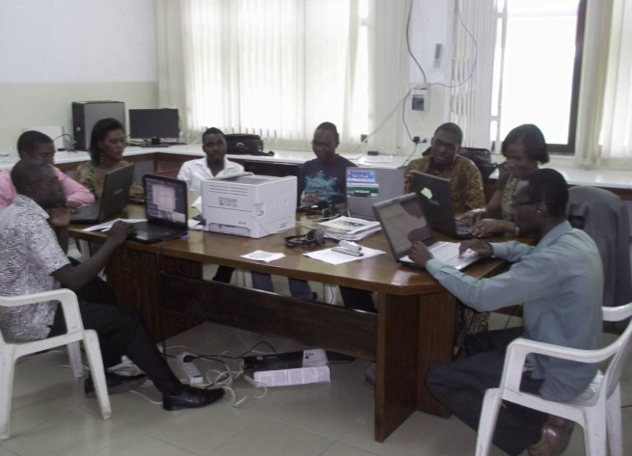
NDC GHANA
The National Data Center (NDC) in Ghana forms part of the global network of the Comprehensive Nuclear-Test-Ban Treaty Organization (CTBTO).
The NDC has a vision of becoming a centre of excellence in the monitoring, verification and application of the Nuclear Test Ban Treaty technologies in the sub-region.
Efforts in accomplishing this vision can be sustained when activities of the CTBTO is well promoted to the younger generation and early career scientists in Ghana.
Please do not use this space, a QR code will be automatically overlayed
Some NDC staff and Interns at work
3
P5.4-585

Slide 4
METHODOLOGY
Research survey was conducted using electronic questionnaire shared through an online data collection platform (Google forms) to 50 individuals.
The targeted sample size were selected staff from the Nuclear Regulatory Authority, Ghana Atomic Energy Commission and students of the School of Nuclear and Allied Sciences.
Design & Electronic Distribution of Questionnaire
Data Aquisition and Sorting
Data Analysis and Discussion
Please do not use this space, a QR code will be automatically overlayed
4
P5.4-585

Slide 5
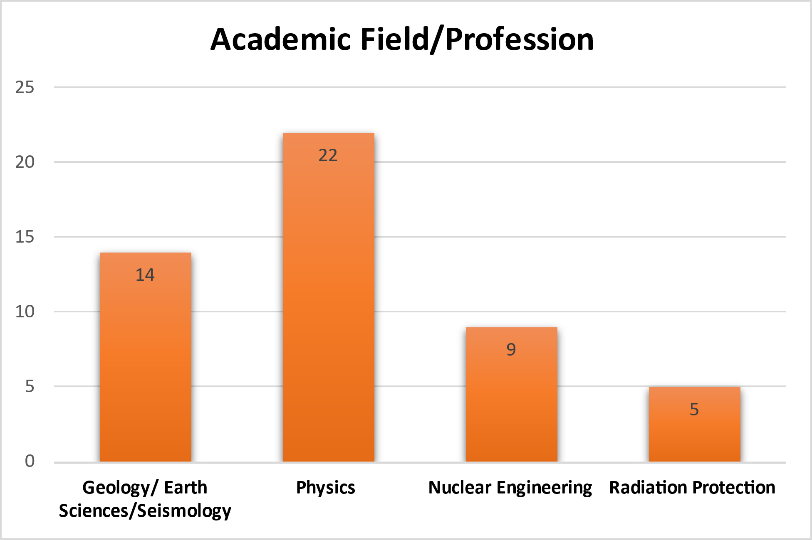
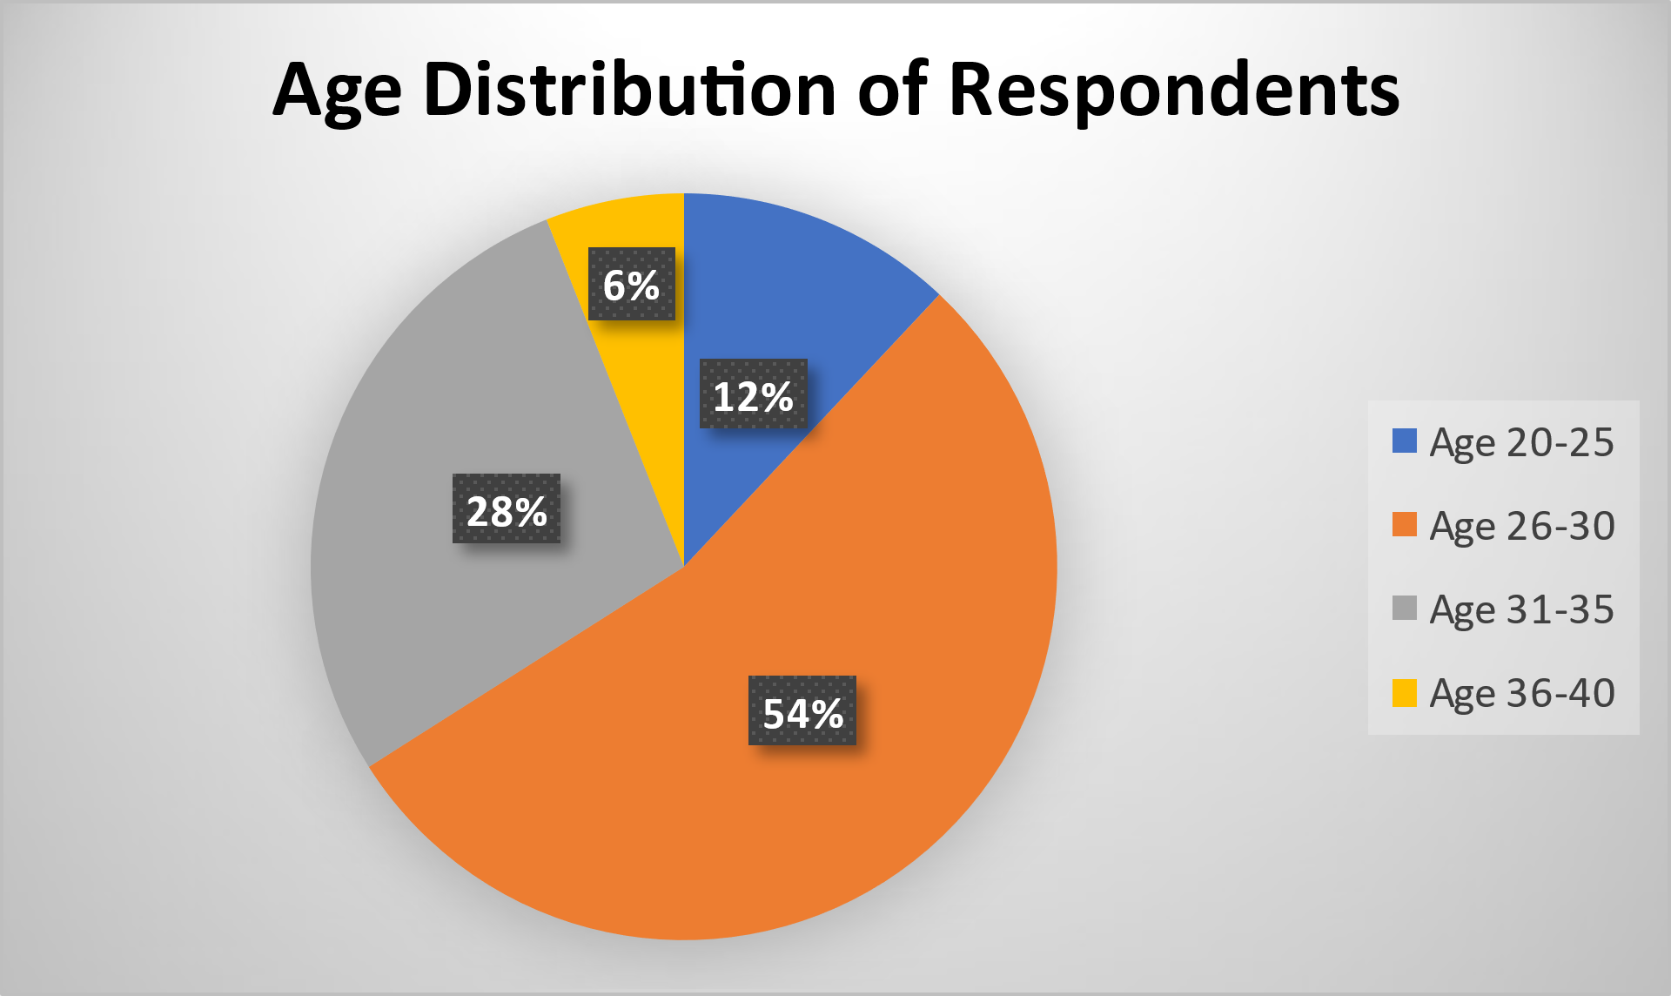
RESULTS & DISCUSSION
From the results, all the respondents are young or early career scientist with more than 90% within the ages of 20-35.
More than 50% of the respondents have fair idea or not aware of CTBTO and its activities.
20% of the respondents (10) have knowledge of CTBTO and at least participated in a CTBTO activity.
Please do not use this space, a QR code will be automatically overlayed
P5.4-585
5

Slide 6
CONCLUSION
Efforts of the CTBTO in reaching out to the younger generation through fellowships, internships, mentorships etc. and the youth group is highly commendable.
Notwithstanding, National Data Centres should replicate these efforts locally, as well as organise seminars and outreaches to further inform, involve and mentor young and early career scientists on the activities of the CTBTO.
In addition, the activities of the CTBTO should be highlighted during national celebrations of International day against Nuclear Tests on 29 August every year to raise awareness.
Please do not use this space, a QR code will be automatically overlayed
6
P5.4-585

Slide 7
REFERENCES
Amponsah, P., & Osae, S. (2014). Potential Benefits of the Comprehensive Nuclear-Test-Ban Treaty Organization to Ghana. Environmental Research, Engineering and Management, 67(1), 65-70.
Amponsah, P & Serfor-Armah, Y. (2012). Ghana’s experience in the establishment of a national data center. Earthquake Science, 25, 347-351.
Please do not use this space, a QR code will be automatically overlayed
P5.4-585

