Slide 1
Seismica: a community-led diamond open access
journal at the service of seismology worldwide
Marino Protti¹, Gareth Funning², Tiegan Hobbs³, Christie Rowe⁴, Catherine Rychert⁵, Danielle Sumy⁶
(1) Observatorio Vulcanológico y Sismológico de Costa Rica, Universidad Nacional (OVSICORI-UNA), Costa Rica, (2) University of California, Riverside, USA, (3) Geological Survey of Canada, Canada, (4) McGill University, Canada, (5) Woods Hole Oceanographic Institution, USA, (6) Incorporated Research Institutions for Seismology (IRIS), USA.
Seismica is a community-driven, diamond open-access journal, meaning articles are free to publish and free to read, without a subscription. Authors retain full copyright. Equity, diversity, and inclusion are central to the goals, policies, and procedures of Seismica.
Our mission is to publish original, novel, peer-reviewed research in the fields of seismology, earthquakes, and related disciplines.
With the first articles published in late October 2022, and more in press, Seismica is becoming a free and open venue for the seismological community to publish results from the entire spectrum of seismological research and applications.
Seismicia is a truly global publication, with authorship and editors from across disciplines and continents.
Please do not use this space, a QR code will be automatically overlayed
P5.4-824

Slide 2
Introduction
Mission & Values
Seismica publishes original, novel peer-reviewed research in the fields of seismology, earthquake science, and related disciplines. Seismica is a community-driven, diamond open-access journal. Articles are free to publish and free to read, without a subscription. And authors retain full copyright.
Publication types
Seismica publishes four types of manuscripts:
Research articles
Fast Reports
Reports,
Null results / failed experiments:
Software Reports:
Data-based Reports
Opinion articles and reviews
Special Issues
Please do not use this space, a QR code will be automatically overlayed
P5.4-824
Notes:
Seismica publishes three types of manuscripts:
Research articles, which present advances in scientific knowledge or understanding. These are typically from 3,000 to 10,000 words in length (excluding references and figure captions), and can address any aspect of seismology and earthquake science within the journal's scope (see above). Authors who have long articles of over 10,000 words that cannot be shortened should contact the Executive Editor for Production ahead of submission to see if this can be accommodated.
Fast Reports: Fast Reports are high quality, time-sensitive manuscripts (typically submitted within several weeks following an event), and short (typically ~3000 words, with 2-3 display items). An earthquake report may include: original observations and ground motion recordings, source inversions, felt reports and impacts on the built environment, or secondary hazard assessments (e.g., tsunami, landslides). However, submissions offering little more than information routinely provided by earthquake monitoring agencies (e.g. USGS, Geoscope, EMSC) will not be considered. To be accepted for Seismica, the Fast Report must be brief, but the research must be neither overstated nor overly summarised; it must include multiple analyses of the event in question, must be scientifically sound, and must provide new information. Fast Reports also welcomes articles that could be perceived critical and urgent for science strategy, policies or standards (e.g., building codes). Fast Reports go through an accelerated review process managed by a dedicated team of editors and one additional expert review, and aim to publish about 30 days after submission. Manuscripts which are too long (without prior permission of editor), out of scope, or for which accelerated review is not adequately justified will be rejected with an invitation to submit in another article type. Fast Reports must conform to Seismica's guidelines for authorship, conflict of interest, and code and data availability. Authors are strongly encouraged to submit in Seismica's LaTeX template to reduce delays in revisions and typesetting. If "major revisions" are required prior to acceptance, the manuscript may be transferred out of "Fast Reports" to another article type. In order to facilitate rapid publication, authors are expected to respond to emails from the Seismica team quickly during the review/revision period and preparation for publication. Supplementary material may be included (<1000 words and <10 display items).
Reports, which contribute peer-reviewed useful information to the public sphere but may not represent a substantive advance in scientific understanding in themselves. Reports include:
Null results / failed experiments: While null results are often ignored in the scientific literature, they can be useful in advancing science, for instance through highlighting difficulties in reproducing published results or by documenting the circumstances in which particular methods or approaches may be unsuccessful. Due to the lack of editorial interest and the difficulty in defining the value of negative results, very few journals offer the possibility for such publications. Seismica is willing to consider publications of null results where they are illuminating or instructive in the context of previous published studies. Null-result manuscripts should include sections on: the background to the study, methods, details of the null results, discussion of the null results in the context of previous work, and scientific and/or technical insights drawn from the null results. This last element is essential for a good null-result report - the insights presented there should serve as a 'take-home message' for other researchers in that field.
Software Reports: The goals of Software Reports in Seismica are to document new codes, to facilitate community use of them, and to ensure reproducibility of their outputs. Software Reports should include a main paper, plus a user manual and source code that should be uploaded to a public domain repository. The main paper should describe the scientific context, the methods employed, and detail aspects such as test case simulations, model verification, evaluation and performance. Including the examples and test cases mentioned in the main paper as tutorials within the repository is strongly recommended. All code repositories must be privately accessible by the editors and reviewers upon submission, publicly accessible upon acceptance, and the codes included are subject to peer review. See Availability of data, materials, and code for more information.
Data-based Reports (e.g., Large Community datasetinitiatives, Instrument Deployments, and Field Campaigns): These submissions allow seismological and other field data collection (e.g., logging a paleoseismic trench or collecting photogrammetric data) to be documented via a citable and peer-reviewed reference that describes the data collected, the experiment design, and relevant collaborators. Ideally these manuscripts should be submitted as soon as possible - i.e., after the instruments and/or data are recovered, and initial data quality assurance (e.g., noise analysis) is completed. Datasets must be publicly available or be made available within two years via a public domain data repository such as the IRIS Data Management Center or Zenodo. If the data are embargoed, then the end date of the embargo and the repository for the data must be stated in the article. Reports are constructed given a specific structure: Scientific background and motivation; Description of the instrument deployment or field experiment (including technical details of the instrumentation, such as instrument response, make and model, etc.); Description of obtained data (including repository details), Preliminary observations and interpretations. For rapid, temporary deployments or experiments, the Editorial process will follow that of Fast Reports.
Opinion articles and reviews, which are invited papers about a scientific idea, controversial topics and/or innovative concepts. Authors may contact the Editorial Board with ideas of subjects for editorial articles.
Special Issues may include specific criteria for inclusion of different article types, consult the main page for any open Special Issue for details.

Slide 3
SCOPE
Seismica's scope includes a wide range of topics in seismological and earthquake sciences.
Fault-slip and earthquake source phenomena
Earthquake records
Theoretical and computational seismology
Beyond Earth-tectonic applications
Techniques and instrumentation
Earthquake engineering and engineering seismology
Community engagement, communication and outreach
Although Seismica recognizes that such a discipline-based classification might not be the best way to represent the full breadth of Seismica's scientific scope, this broad list does provide an initial framework for potential authors to ascertain whether Seismica might be a suitable venue for publishing their work.
Please do not use this space, a QR code will be automatically overlayed
P5.4-824

Slide 4
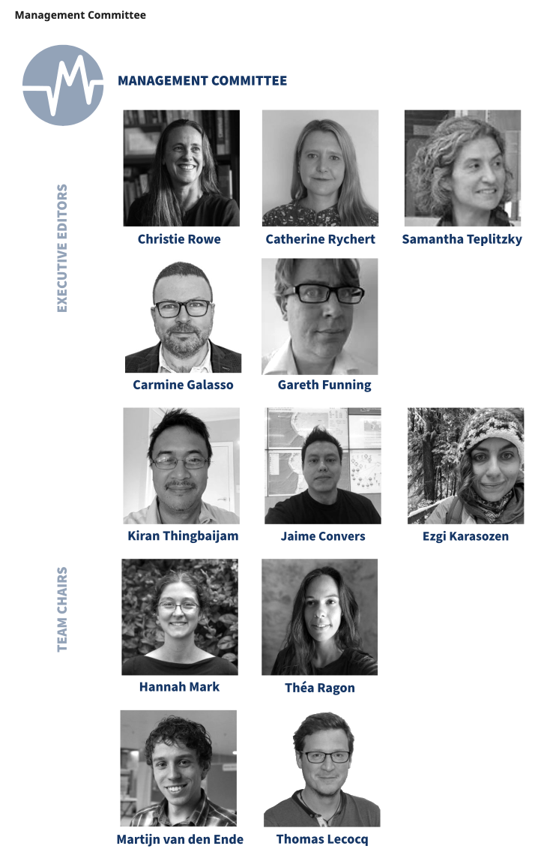
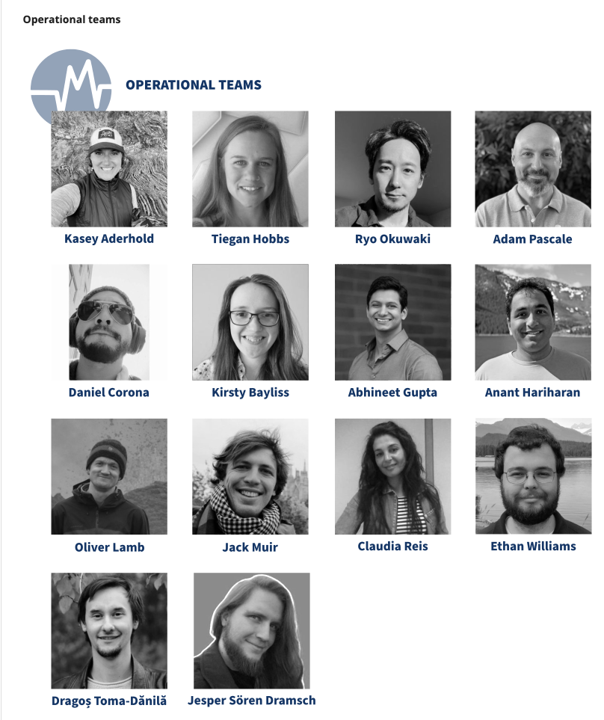
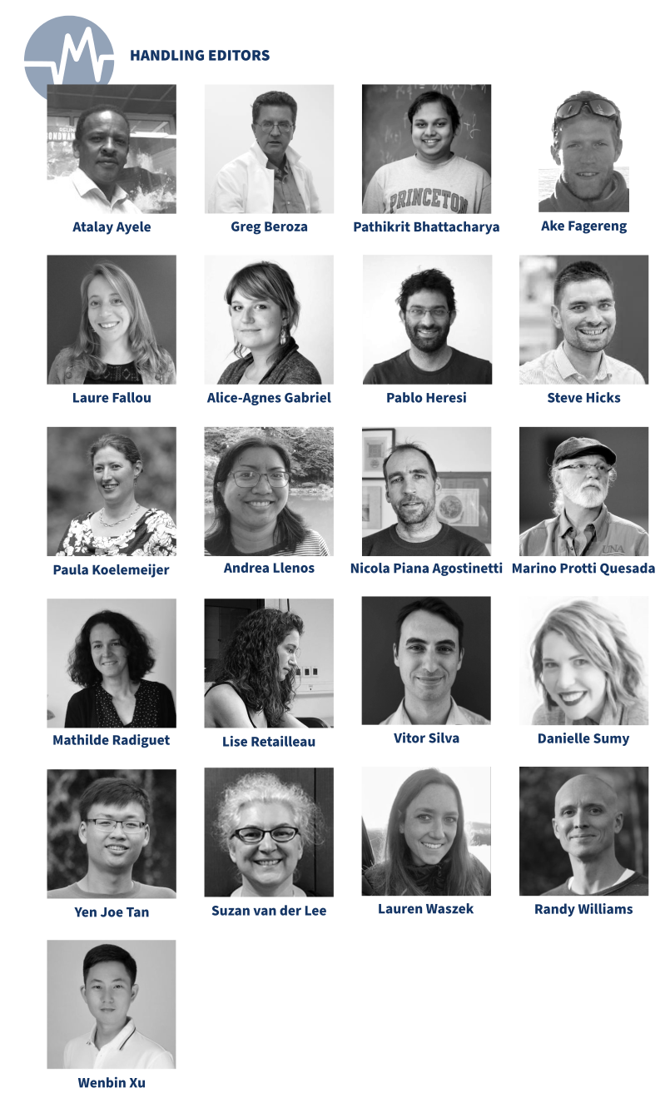
The Team
Please do not use this space, a QR code will be automatically overlayed
P5.4-824

Slide 5
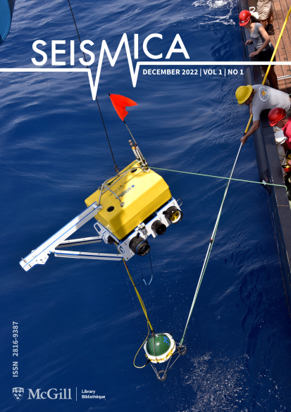
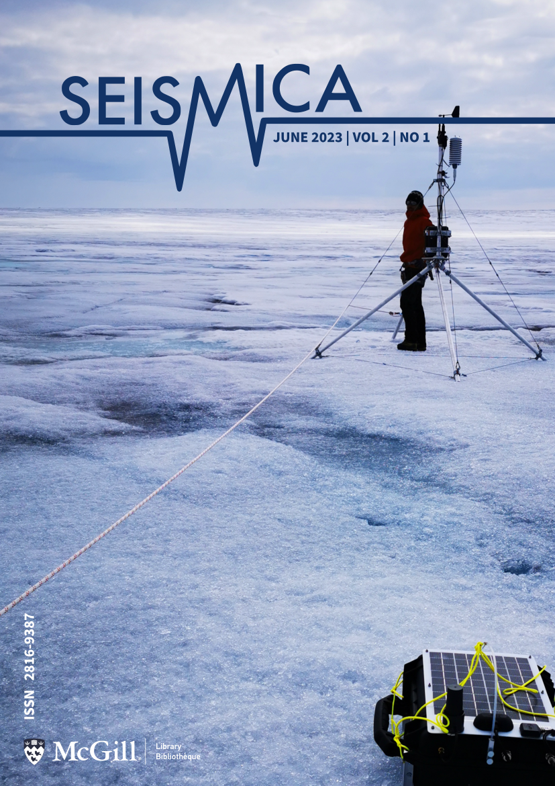
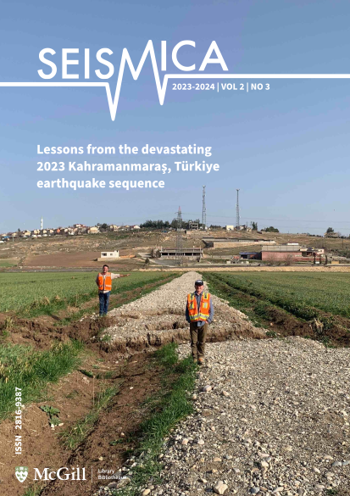
Results
Please do not use this space, a QR code will be automatically overlayed
P5.4-824

Slide 6
Conclusions
Seismica is run by a global community of volunteers.
Seismicia endeavours to become a truly global publication, with authorship from across disciplines and continents.
Seismica also publishes fast reports on recent seismic events, new techniques and algorithms for seismic data processing, among others.
SEISMICA is, therefore, an accessible option to publish seismic results presented at the CTBT Science and Technology Conference 2023.
Visit seismica.org to join our mailing list and reviewer database.
Author Guidelines for step-by-step instructions are available at: https://seismica.library.mcgill.ca/author-guidelines
Please do not use this space, a QR code will be automatically overlayed
P5.4-824

