Slide 1
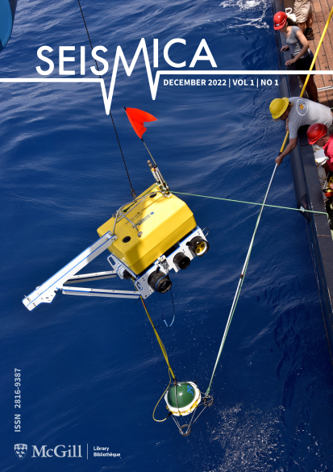
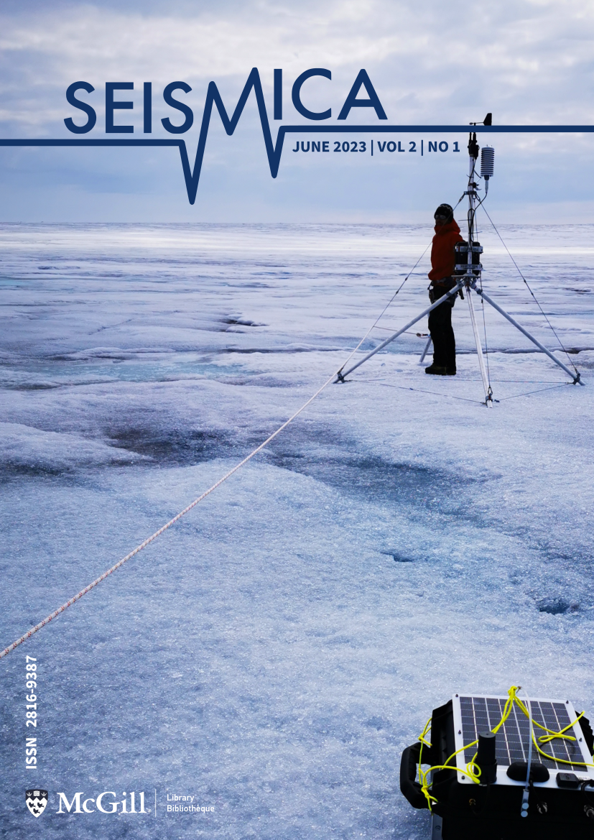
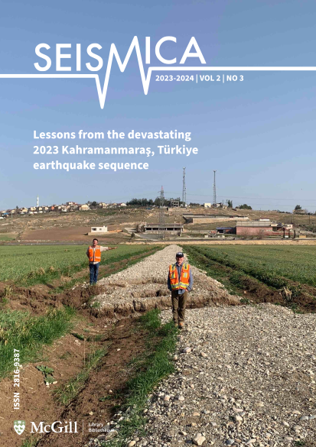
Seismica: a community-led diamond open access
journal at the service of seismology worldwide
Marino Protti, Gareth Funning, Tiegan Hobbs, Christie Rowe, Catherine Rychert, Danielle Sumy
Affiliation / Organization / Company / Institute [if any / Font: Arial Size: 14]
P5.4-824
Seismica is a community-driven, diamond open-access journal, meaning articles are free to publish and free to read, without a subscription. Authors retain full copyright. Equity, diversity, and inclusion are central to the goals, policies, and procedures of Seismica.
Seismica publishes four types of manuscripts:
Research articles
Fast Reports
Reports,
Null results / failed experiments:
Software Reports:
Data-based Reports
Opinion articles and reviews
Special Issues
Seismicia is a truly global publication, with authorship and editors from across disciplines and continents.

